Slide 1
EGI Governance Model
Yannick Legré Director, EGI.eu
yannick.legre@egi.eu

Slide 2
Content
Context
Previous Governance
Process
New Governance
Current council composition
EGI.eu Value proposition

Slide 3
Context
Tensions on previous Governance model between small and big NGIs
Necessity to respond to the erosion of some NGIs
Need for a mechanism to involve more user communities in the governance
Willingness to involve international participation in the governance
Necessity to maintain a steady income from membership fees
Notes:
REC 3. Sustainability planning needs more development, especially in respect of achieving longer-term sustainability

Slide 4
Previous Governance (1/2)
Only eligible (European) NGIs were allowed to be Full Participant and could only be Full Participant
Non-eligible NGIs and EIROs could only be Associated Participant
ESFRIs/ERICs and organisations representing user communities could not join.
Council = Participants + Associated Participants

Slide 5
Previous Governance (2/2)
No proportionality between fees and voting rights
13 Fee levels
3-band option
Associate Participant fees and voting rights “a la carte”
No clear vision on the value of EGI.eu services

Slide 6
Process
Creation of a Task Force in March 2014
Matthew Dovey (Jisc) – Chair; Luciano Gaido (INFN); Jacko Koster (SNIC); Steven Newhouse (EBI); Arjen van Rijn (NIKHEF); Yannick Legré (EGI.eu)
Interviews
Several presentations to the Council
Multiple revision by the Executive Board
Dedicated Council Workshop in September 2014
Adoption by the Council in October 2014

Slide 7
New Governance: main assets
Clear distinction between Full and Associated Participants
Council only composed of Full participants
Possibility for any NGI to be Full or Associated Participant
Possibility for EIROs, ERICs and other International organisations to become Full Participant
Possibility for non-European NGIs to become Full Participant

Slide 8
Membership Fees and Votes (1/2)
Reordering of the participants based on
GDP for Countries (2013 list by International Monetary Fund)
Budget/1000 for EIROs/ERICs/ESFRIs/…
From 13 levels down to 6 buckets
Proportionality between fees and votes

Slide 9
Membership Fees and Votes (2/2)
Introduction of a transitional fee
For 2015 only
For participants with an increase > 1.7 x
Participants opting for the transitional fee in 2015
have to commit to pay the full fee in 2016
get the full voting rights from 2015

Slide 10
Key changes
Previous Governance | New Governance
Eligible NGIs as Full participants | NGIs (both European and non-European), EIROs, ESFRIs, ERICs, … can be either Full or Associated participants
Non-eligible NGIs / EIROs as Associated participants
ESFRIs / ERICs / … couldn’t be participants
No proportionality between votes and fees | Proportionality between votes and fees
Voting weight 1:35 | Voting weight 1:9
13 fee levels | 6 fee levels
No minimal fee | Minimal fee

Slide 11
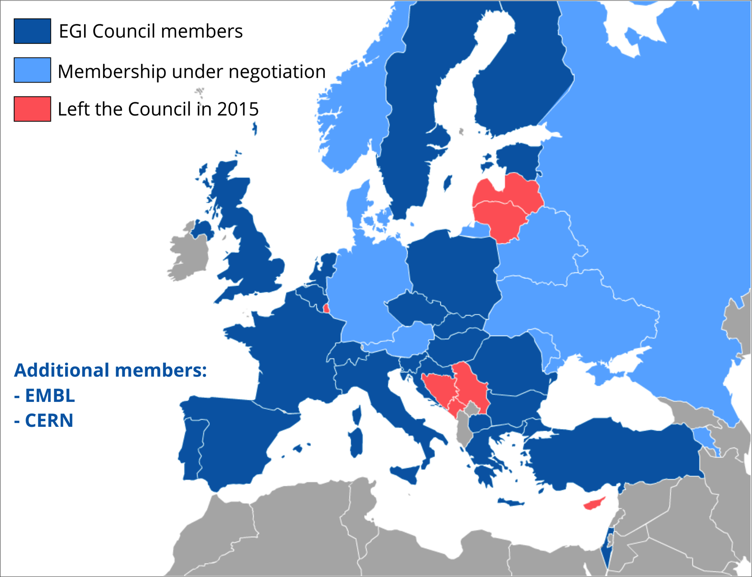
New Council composition
Notes:
Participants: France, United Kingdom, Italy, Spain, Turkey, Netherlands, Switzerland, Sweden, Poland, Belgium, Israel, Finland, Greece, Portugal, Czech Republic, Romania, Hungary, Slovakia, Croatia, Bulgaria, Slovenia, Estonia, Macedonia, CERN, EMBL
Under discussion: Germany, Denmark, Norway, Russia, Austria, Armenia, Moldova, Belarus, Ukraine
Countries who have left: Luxembourg, Lithuania, Serbia, Latvia, Cyprus, Bosnia & Herzegovina and Montenegro

Slide 12
Affiliation programme
On boarding mechanism approved by the Council on February 12th 2015.
Legal entities can apply to the EGI affiliation programme
Discount on the Associated Participant fee
For a limited period of time
Affiliation requests have to be approved by the Council
Work in progress!

Slide 13
EGI Service Portfolios
EGI.eu services
delivered in collaboration with Participants
EGI.eu
portfolio
EGI Federation
Services
EGI
portfolio
Coordination
Consulting and Support
Marketing and Outreach
Software and Services
Project and Programme Management
Operations Coordination
Technology Coordination
Security Coordination
Governance & Project Consultancy
Strategy & Policy Decision Support
Policy Development
Technical Consultancy and Support
Helpdesk Support
Marketing
Outreach
Federated Operations
Applications Database
Training Marketplace
Repository of Validated Software
HTC Platform
Grid Compute
Grid Storage
File Transfer
File Metadata Catalogue
Cloud Platform
Cloud Compute
Cloud Storage
Virtual Appliance Marketplace
http://www.egi.eu/services/

Slide 14
Service to value
EGI.eu services
Delivered together with subcontracting Participants
Coordination
Value
Consulting and Support
Marketing and Outreach
Increased benefits
Decreased barriers
Software and Services

Slide 15
Value for EGI.eu participants
Area | Value | Benefit for EGI.eu participants
Strategy & Policy | Increase your visibility and relevance with funding agencies | Show funding agencies you are committed to cooperation, be highlighted as sector leaders, in European scale research and e-Infrastructures. Higher profile increases likelihood of funding in all proposals.
 | Influence European-level policy on e-Infrastructure | Improve your access to policy makers, ensure your issues are considered, e.g. to H2020 work programmes, with the support of EGI.eu. Increase your policy impact as part of a pan-European collaboration. Ensure your efforts are aligned with other countries, simplify international collaboration and support transnational access.
 | Improve your transfer of innovation to the private sector | Simplify your engagement with the private sector to achieve impact for your research and demonstrate resulting innovations. Be seen as more commercially relevant by funding bodies.
 | Influence EGI service strategy to better support your users | Influence the evolving joint European service portfolio; check that it matches the needs of your local/national research groups.

Slide 16
Value for EGI.eu participants
Area | Value | Benefit for EGI.eu participants
Funding | Improve access to H2020 funding | Take a leading role in H2020 calls, benefit from the shared reputation of the EGI community, get invited to proposals directly or as a third party due to your EGI participation (such as VRE & CoE calls)
 | Get privileged access to EGI-targeted funding | Be invited to specialised proposals only available to EGI.eu participants (e.g. EGI-InSPIRE and EGI-Engage)
 | Access innovative revenue generation models | Benefit from new revenue generating activities, such as acting as an EGI subcontractor or participating in the ‘pay for use’ programme to receive money in return for resource access.
 | See greater impact for your investment in e-Infrastructure | Pay only a small fraction of tasks that benefit you, and for each person month you invest, see major achievements based on all participants acting in a coordinated way to achieve change.
Skills development | Improve the skills of your personnel through accessing community knowledge, expertise and training | Share knowledge with other EGI participants and increase your community skill levels through working with European experts in many areas, e.g. service management and data science.

Slide 17
Value for EGI.eu participants
Area | Value | Benefit for EGI.eu participants
Technical | Access common tools, services and processes to operate a federated infrastructure | Benefit from a suite of technical tools, internal services and management processes that support federated operations in support of High Throughput Computing, Cloud and Data services. Avoid building your own alternatives and facilitate simple cooperation.
 | Promote your services in a shared marketplace supporting smaller and long tail communities | Get access to a common marketplace supporting a wide range of commodity services, supporting independent use by smaller communities and the long tail.
 | Make your services more trustworthy and attractive | Be recognised for the quality and reliability of your services through being certified as EGI sites, and so increase the trust user communities have in your services.
Community building | Improve your access to ESFRIs and emerging user communities | Use EGIs strong connections to user communities and ESFRIs to better serve their users. Recruit new users and maximise your European research profile.
 | Connect your local users with international collaborations | Help your local research communities grow to a European or global scale. Enable their interaction with leading researchers to find collaborators and highlight their successes.

Slide 18
Members of the EGI-InSPIRE collaboration thank the EC for supporting EGI

