Slide 1
EGI Business Models
Sy Holsinger
Senior Strategy and Policy Officer, EGI.eu
sy.holsinger@egi.eu

Slide 2
Purpose
How do business models apply to EGI?
What are the structures by which EGI can deliver value (services)?
What are the revenue models to support them?
Does this offer a sustainable future vision?
Notes:
The aim is to:
Look at how business models apply to EGI
And the way they help us deliver value
The revenue streams that support them
Which combine to support EGI as a sustainable infrastructure for the longer-term

Slide 3
Outline
EGI Business Models
Main Support Activities (PY5 focus)
Future Work, Summary and Conclusions
Notes:
So the presentation is structure to:
Look at the EGI business modes in further detail
Highlight the main activities that support those business models and its development, focusing on project year 5
And concluding with some future plans and final remarks

Slide 4
Outline
EGI Business Models
Main Support Activities (PY5 focus)
Future Work, Summary and Conclusions
Notes:
So starting with the EGI Business Models

Slide 5
What is a Business Model?
Every organisation has a business model,
including non-profits.
To survive, every organisation that creates and delivers value must generate enough revenue to cover its expenses
Definition
  The rationale of how an organisation creates, delivers, and captures value sustainably
    Source: Business Model Generation
    (used also in Wikipedia) http://www.businessmodelgeneration.com/
Notes:
I would like to first to just clarify our understanding or approach to developing business models
As there is a tendency to focus only in on revenue streams, which is a component but not everything
And also that business models only relate to commercial organisations.
However, any organisation needs to understand what is the value that is being delivered, to who and how.
Therefore the EGI business model covers organisational aspects, the services it provides, as well as the delivery models and revenue streams

Slide 6
EGI Organisational Model
Individual Researchers
Research communities
Research Infrastructures
Industry
Researcher-facing Services coordinated by NGIs/EIROs/RC
EGI portfolio
v
EGI.eu
portfolio
NGI 1
EGI.eu
Services coordinated by EGI.eu
And delivered in collaboration with NGIs/EIROs
EIRO 1
NGI 2
The EGI Federation
Notes:
So the organization model of EGI is the foundation for how the services are delivered and the associating business models
There is the EGI federation, made of the NGIs and EIROs, EGI.eu as the coordinating body and the
Communities we serve
Within the Federation, EGI.eu delivers services (in collaboration with the NGIs), that makes up what is called the EGI.eu portfolio
Then as a federation, researcher-facing services that are coordinated by the NGIs/EIROs and provided to the various target communities,
This defines the EGI portfolio.

Slide 7
Service Portfolios
Services coordinated by EGI.eu and
delivered in collaboration with NGIs/EIROs
Services coordinated by
NGIs/EIROs/RCs
Coordination
Consulting and Support
Marketing and Outreach
Software and Services
Project and Programme Management
Operations Coordination
Technology Coordination
Security Coordination
Governance & Project Consultancy
Strategy & Policy Decision Support
Policy Development
Technical Consultancy and Support
Helpdesk Support
Marketing
Outreach
Federated Operations
Applications Database
Training Marketplace
Repository of Validated Software
HTC Platform
Grid Compute
Grid Storage
File Transfer
File Metadata Catalogue
Cloud Platform
Cloud Compute
Cloud Storage
Virtual Appliance Marketplace
http://www.egi.eu/services/
Notes:
The services within these two portfolios split between the services coordinate by EGI.eu (read across)
And
The services coordinated by the NGIs/EIROs and RCs (read both)

Slide 8
EGI Solutions
A combination of products, services, and intellectual property focused on solving a problem (opportunity) that creates and/or drives value (measurable) and can be significantly standardised
Federated Operations
High-Throughput Data Analysis
Federated Cloud
Community Driven Innovation & Support
Ingredients from the EGI community:
Services from EGI.eu
Services from NGI/Resource Centres
Software products from technology providers
Data, knowledge, expertise from the community
Notes:
As you have heard this morning, these services are grouped within 4 solutions
When defining business models, there are a number of delivery patterns that emerge around them.
Therefore, we can look at how each solution is delivered, the access model and the revenue model applied.

Slide 9
Delivery Models:
HTC and FedCloud
EGI Federation
HTC and FedCloud:
Compute, storage, file transfer, VMI Marketplace
Researchers
Value Prop:
Infrastructure to deploy on-demand services
Ability to analyse large datasets or to execute thousands of computational tasks
Target:
Users with not enough resources within their institution.
Users with resources distributed in different centres (need uniform access)
Users with distributed resources and datasets that must facilitate collaboration
Access Mode | Channel | Revenue Stream | Status
Quota-based | Direct grant | Funding Agencies | Now
Quality-based | Scientific Review | Funding Agencies | In progress
Market-based | Direct Negotiation | Direct charge | In progress
Quality-based | Transnational Access | Funding Agencies | Desired
Notes:
Starting with the two technical solutions, where the EGI federation, led by the NGIs/EIROs, provides infrastructure services to researchers,
Whether to deploy on-demand services, to execute batch jobs.
Here, we have defined the access mode according to the categories provided in the ”European Charter for Access to Research Infrastructures” document.
These solutions are currently being provided as quota-based through direct grants,
But we are also working on a scientific review for quality-based access as well as market-based through pay-for-use which I will going into more detail later on.
One new one we potentially see for the future is through transnational access.

Slide 10
Delivery Models:
Community Driven Innovation
EGI Federation
Community Driven Innovation:
Foresight and strategy
Training and consultancy
Co-development and support
Researchers
Value Prop:
Discover the best approach or develop new ways around data or compute-intensive research
Knowledge-as-a-service (e.g. competence centres)
Target:
Researchers that want to run their data- and computing-intensive experiments, but find obstacles or difficulties in accessing and running computing facilities
Access Mode | Channel | Revenue Stream | Status
Quota-based | EGI.eu Membership | Membership Fees | Now
Quality-based | Collaboration Agreements | In-kind | Now
Quality-based | Projects | Funding Agencies | Now
Market-based | Consultancy | Direct charge | In progress
Notes:
Moving to community driven innovation, where the EGI Federation, coordinated by EGI.eu, provides researchers with,
The ability to best utilize the infrastructure providing basically knowledge as a service.
This is mainly supported by the membership fees, but is also complimented by in-kind contributions through collaboration agreements and funded projects.
Couple with the pay-for-use activities, will be an opportunity for paid consultancy as well.

Slide 11
Delivery Models:
Federated Operations
EGI.eu
Core Coordination
operations, projects, security and technology, policy, marketing
Added value services:
training, outsourced event org.
EGI Federation
Value Prop:
A cost-efficient framework to manage operations within a federated environment, while retaining responsibility of local infrastructure
Target:
(Primary) RCs and RIs already within the EGI community or wishing to become
(Secondary) Other providers geographically and/or structurally dispersed, but plan to organise themselves for federated service provision
Access Mode | Channel | Revenue Stream | Status
Quota-based | EGI.eu Membership | Membership Fees | Now
Quality-based | Collaboration Agreements | In-kind | Now
Notes:
Finally, is the federated operations, which are the core EGI.eu services provided internally to the EGI Federation. This solution provides the means for the infrastructure to be federated across Europe and beyond.
So our primary focus is on the resource providers and research infrastructures either already a participant within EGI or those looking to join,
However, we are starting to see a secondary opportunity to provide this as a package to be taken and used out of EGI as a means of organisations
to federated their own distributed environment.
The principle means of this being delivered is through the membership fees, with some strategic partnerships through collaboration agreements.

Slide 12
Delivery and Revenue Models:
Summary
Multiple revenue stream matched with delivery models
  Natural given service and solutions portfolio
  Diversification supporting sustainability
Transnational Access
Paid Consultancy
Pay-for-Use
Funded Projects
Delivery Model
Scientific Review
In-kind Collaboration Agreements
In-kind Collaboration Agreements
Free at point of use
Membership Fees
Membership Fees
HTC/FedCloud
Community Driven Innovation
Federated Operations
Notes:
So to summarize the various delivery and revenue models,
The green shows the ones that are place or stable, with yellow are in progress such as the pay-for-use and
And red future opportunities.
This hybrid model is natural given the various services and solutions delivered, as well as a diversification to support sustainability
By not being completely dependent in one area.

Slide 13
Outline
EGI Business Models
Main Support Activities (PY5 focus)
Future Work, Summary and Conclusions
Notes:
To support these business models, a number of activities need to and have taken place, so focusing on the last year….

Slide 14
PY5 Activities supporting
Business Models
WP5 is composed of two main tasks:
  NA5.1: “Strategy, policy and business development”
    5.3 PMs (EGI.eu)
  NA5.2: “Business models and proof of concepts”
    34 PMs (across 12 partners) + 5 PM unfunded effort
Main Activities over PY5
  This presentation
    Pay-for-Use Proof of Concept
    EGI business engagement program definition
    Business model development (including EGI Marketplace)
  Later presentation (strategy)
    Open Science Commons vision development and promotion
    Definition of a value proposition document for EGI.eu
    New EGI strategy through a consultation process with the stakeholders
Notes:
There was a dedicated workpackage created in the final review of the description of work, which focused on
Strategy, policy and business development, which looks at the strategic topics and concepts,
Complimented with implementation activities such as proof of concepts.
You have heard about the open science commons and will hear in later presentations from Yannick and Sergio about EGI’s value and revised 2020 strategy.
So I will focus on the pay-for-use proof of concept, business engagement programme, and underpinning activities such as the
Agreement framework and the EGI marketplace

Slide 15
Pay-for-Use PoC:
Overview
  2014: Implementation of proof of concept (PoC) based on a policy paper (2013)
  Jan-Apr: Best effort
  May-Dec: Funded in EGI-InSPIRE PY5 (NA5.2)
  Objectives
  Articulate business and responsibility models
  Define prices for services from
  Understand required agreements
  Identify the tools and necessary development
  Analyse the changes to roll out new functionalities into production
  Evaluate legal, policy, and organizational issues
Final Report as concrete input to 2015 activities (see next slides)
  Received an Executive Summary in the reviewer pack
  Full report available at: https://documents.egi.eu/document/2377
Notes:
The pay-for-use proof of concept, which was based on a policy paper, started in early 2014 on a best effort basis, which was the supported with
Dedicated effort within the revised Dow from May to Dec.
The main objectives pick out key words)
The final report was produced, which you will have received the executive summary, with a link to a full report, as a means for self-reflection over what was done and to have a record of activities as a foundation for continued activities in 2015.

Slide 16
Pay-for-Use PoC:
Participants
43 individual participants and observers
  EGI.eu (Lead), Resource Centers, NGIs, Commercial Company
Publishing Pricing Information
  30 Providers across 12 Countries
    20 Grid: Belarus; Bulgaria; Germany; Greece; Italy; Latvia; Poland; Spain; Switzerland; Turkey
    10 Cloud: Finland, Greece; Italy; Poland; Slovakia; Spain; Turkey; UK
    15 Storage sites: Bulgaria; Greece; Italy; Spain
Price Ranges (incl. support)
  Grid (HEPSPEC/hr): €0.01 - €0.15 (Avg. €0.05; Median €0.05)
  Cloud (wallclock/hr): €0.03 - €0.11 (Avg. €0.05; Median €0.05)
  Storage (€/GB/month): €0.01 - €0.14 (Avg. €0.04; Median €0.04)
  +/- VAT 8%-24% (where applicable)
    Taxation report available at: https://documents.egi.eu/document/1391
  Prices to be valid for one year once in production
Notes:
The pay-for-use group had quite diverse participation, with more than 40 coming from EGI.eu as the lead, Resource Centers, NGIs, and even a commercial company
So far, 30 providers are publishing pricing information comprising grid, cloud and storage services.
Here you can see the various prices with the average working out to around 5 cents and hour for both grid and cloud,
Which is quite competitive considering they include support
And the VAT that would need to be applied when applicable

Slide 17





Pay-for-Use PoC:
Initial Business Scenario
2. Searches
1. Publishes Services
Service / Price List
11. Makes payment
3. Selects / Submits Request
4. Agrees SLA
10. Provides Invoice & Reports
8. Adds Users / 9. Uses Services
7. Allocates
Capacity
Customer
Service Provider
5. Informs About New Customer
6. Informs VO
Virtual Organization
Broker
Notes:
In order to optimize the resources, we started by creating a general scenario from providing prices, accounting for them, etc. so we can easily identified what tool we already had that could be used, and what changes or development would be needed.
Currently, the broker plays a support role, but…

Slide 18
Business Scenario:
Potential Broker Role
Publishes Services
Searches
Service / Price List
Selects / Submits Request
Informs About New Customer
Agrees SLA / Handles Payment
Agrees OLA
Broker
Creates VO
Allocates
Capacity
Service Provider
Customer
Adds Users / Uses Services
Virtual Organization
Notes:
Moving forward we can see emerging models and potential value for the broker to take a more central role.
Such as reducing many-to-many relationships.

Slide 19
Broker Business Models
Model | Certification | API | Consultancy | Allocation | Single SLA | Accounting Reports | Invoicing
Invisible Federator | ✔ | ✔
Advisor | ✔ | ✔ | ✔
Matchmaker | ✔ | ✔ | ✔ | ✔ | ✔
Trusted Third Party | ✔ | ✔ | ✔ | ✔ | ✔ | ✔
One Stop Shop | ✔ | ✔ | ✔ | ✔ | ✔ | ✔ | ✔
EGI.eu does/can fulfill most models
  Does legal structure support one-stop shop?
    Governance Task Force in progress
  Need to define pricing scheme and price for service
    % of transaction; Subscription from providers within marketplace
  Can we realistically serve both models (indirect and direct)?
    Clear process needed to define when and where applied (e.g. user location; provider preference)
Notes:
From this a number of broker business models can be identified.
EGI.eu would be in the best position to provide this role, however there number of aspects to be clarified such as
-does the legal structure support a full broker model
-what is the pricing scheme, such as a registration or subscription fee, % of transaction, etc.
Finally, can we realistically support both models.

Slide 20
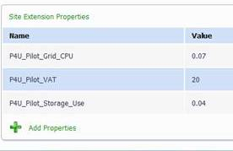
Pay-for-Use PoC:
Current results
Processes in business scenario for phase 1 defined
Tools adaptation
  Registry extensions added to set prices
  Accounting Portal accounting information
  e-GRANT Broker/User Interface
  Providers
  30 providers publishing pricing information (20 Grid, 10 Cloud)
Legal and Policy solutions emerging
  e.g. research-only purpose statements; joint collaborations
Business Cases being explored
  Helix Nebula, ESA, Cloud for Europe, Charity Engine, Arctur, Engineering
Notes:
So where are we now. We have:
adapted the service registry with extensions for providers to be able to insert prices
Accounting portal is able to account for the uses
e-GRANT, which was already handling the federated resource allocation, to serve as the broker and user interface

Slide 21
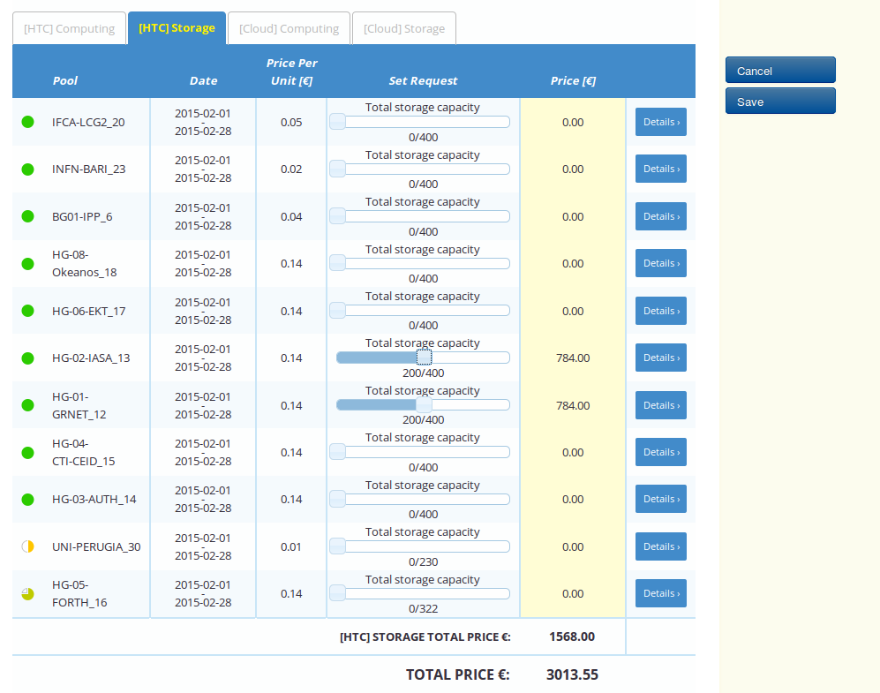
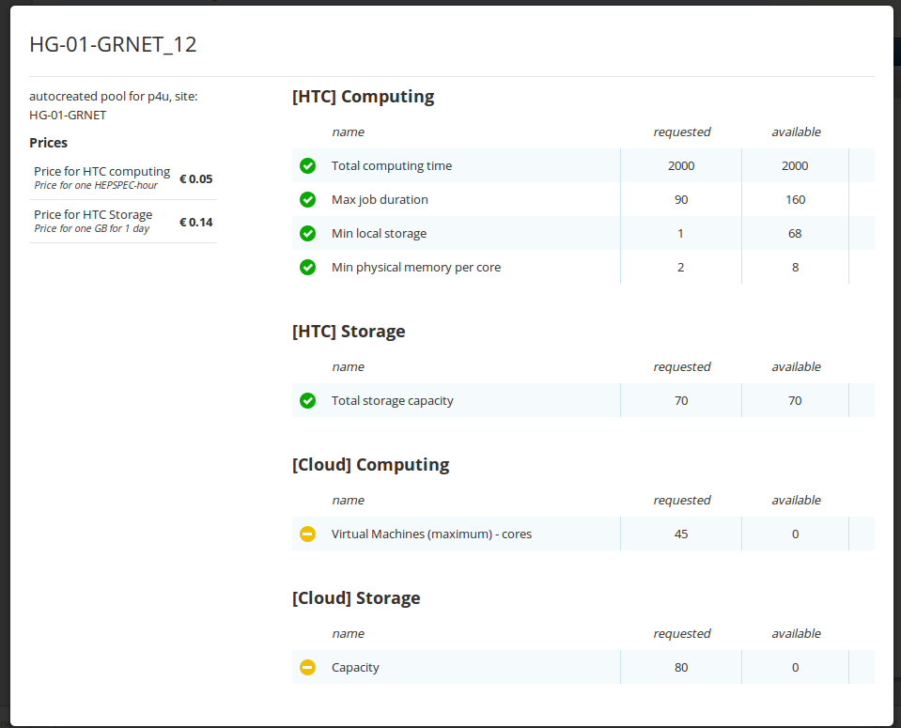
e-GRANT:
Development for Pay-for-Use
Completed
  Special pool type: pay-for-use (w/ price)
  Importing prices from Registry
  User self-allocation: supported matching pools enabled for customers (existing broker functionality)
  Automatic finding and presenting the cheapest allocation that suited requested parameters
  Presenting cost of overall allocation
Planned
  Proper SLA created based on template and negotiated metrics
  Billing according contract/SLA (integration with accounting needed)
Notes:
From the user interface

Slide 22
EGI Pay-for-Use:
Business Models
  Infrastructure-as-a-Service (IaaS)
    Charge for resources consumed to support researchers/research communities with budget to purchase services
      Offer a selection menu: grid, cloud, storage; Support different pricing schemes
      Means to deliver other value-added services
  IaaS + Consultancy
    Exploit community expertise for customers who require dedicated support
      Get applications up and running with optimised usage, training, etc.
  Joint development initiatives/collaborations
    Develop joint work plan to exchange services
      Can allow for time/effort to be charged and resources offered for “free” (value expressed in monetary equivalent)
  Broker
    Avoid many-to-many relationships
      Facilitate customer management (e.g. discovery, allocation, agreement)
Notes:
IFCA (Spain) several use cases #2
5FTE paid, then the number of CPU provided and expressed in terms of monetary value
In addition, this could tool for communities receiving services “free at point of use” for us to demonstrate the value of the services they are consuming on a daily basis thanks to the national and European funding agencies.

Slide 23
Pay-for-Use:
Future Recommendations
User-facing graphical interface
  Bulk technical development is complete and a design mock-up created
  Working on finer grain details (e.g. user functionality, cloud selection)
Increase automation of varying pricing schemes beyond pay-for-use and packaged services (e-GRANT terminology of “pools”).
SLA using EGI templates (based on FitSM)
  Legal liability text and automated .pdf generation
Ensure FedCloud technical integration (e.g. flavours)
Integrate an automated billing function
Mature EGI.eu's role as a full central broker
  Contractually: EGI.eu currently does not have a VAT number and potentially needs a separate business entity
  Pricing model: Define registration fee, % of transaction
Align closely with future ‘Marketplace’ activities, which have a very large crossover with the P4U PoC

Slide 24

Business Engagement:
Programme
Defined Business Engagement Programme
  Purpose and scope
    Focus on SMEs; drive innovation; increase sustainability opportunities
  Areas of collaboration
    e.g. computing capacity, software products, market intelligence, big (open) data and promotion
  Benefits for both participants and EGI Community
    e.g. visibility, resource access, new products /development, value demonstration
  Three-tier level structure
    Member (lightweight), Associate (formal agreement), Partner (long-term)
  Activity plan
    Promotion, network of experts, funding instruments for resourcing effort
Notes:
As tiziana mentioned this morning, we have defined a framework for working with business and industry.
The programme outlines (pick high-level points)
Work is to match and scope activities according to priorities being discussed from our strategy work within the council and to understanding available funding mechanism such as….

Slide 25
Business Engagement:
Business Model
Potential funding instruments
  Series of dedicated activities with SMEs within EGI-Engage
    Open Data, Big Data Value generated in selected fields
  EGI Donor Club
    Obtain tax deductions/exceptions
  H2020 project calls and SME instruments
    €3 billion in funding over the period 2014-2020
  In-kind
    Collaboration agreements and co-development
  National/Local funding
    Active business network requires resources for conducting national/local activities
Expected Outcomes
  Value demonstration of EGI services
  Improved/expanded technical services
  New knowledge and expertise, publications
  Business generated
Notes:
Pick the highlights
-

Slide 26
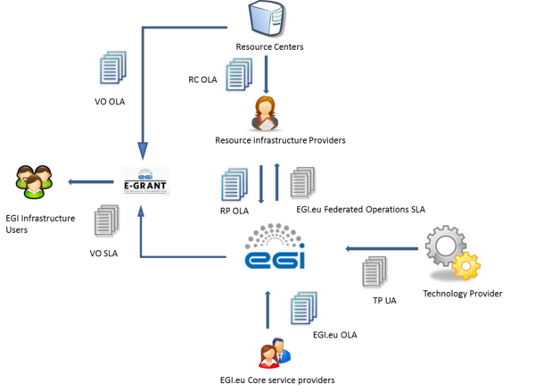

Agreement Framework
OLA: Operational Level Agreement
SLA: Service Level Agreement
UA: Underpinning Agreement
between
EGI.eu
RC/RP: Resource Centers/Providers
TP: Technology Providers
VO: Virtual Organisations
Notes:
Part of our efforts with implementing service management, based on the FitSM standard, was aligning our agreements with the various providers across the federation to underpin the business models presented.
Taken the experience with aligning our OLAs for the core services, led by Malgorzata, we revised the agreements with resource providers.
In addition, being triggered user community demand (namely BioVeL), VO (user) facing SLAs were created (again, based on FitSM) through e-GRANT.
We now see other interested (DRIHMS – hydro-meteorology, Comp Chem)

Slide 27

EGI Marketplace:
Initial Concept
Enable people to share and discover ANY resource they need for science
Authentication (eduGAIN, social, enterprise
Group management (organizational, local)
Attributes (billing information)
user
group
organization
community
Favorites
Ratings
Etc.
attribute providers
user profile
marketplace portal
directory / authentication
Search across all service types
Different catalogs (AppDB, GOCDB, HNX, IRIS)
Catalogs should deliver additional value to providers
Can have multiple of the same type of catalog
Service Catalogs
VM registry
software
instruments
cloud services
API
etc.
Plugin Modules
Different plugins for catalogs (e-GRANT)
Deliver additional value
Not mandatory
Multiples of the same type of plugin
accounting / reporting
billing
persistent identifiers
proposals
etc.
Notes:
We starting working on the conceptual model of an EGI marketplace over the last year as part of our strategy to improve our user oriented focus, where the idea that all users can have a single access point to discover the breadth of services, not only EGI services, but any service such as those within the NGIs/EIROs, research communities, etc that could support researchers in doing there science.
As the marketplace matures, will see how it integrates with user portal style functionality and existing tools such as the FedOps tools, AppDB, e-GRANT
This is the conceptual model that will serve as the foundation for 2015

Slide 28
Outline
EGI Business Models
Main Support Activities (PY5 focus)
Future Work, Summary and Conclusions

Slide 29
Future Opportunities
Business Models
  Clarify ‘free at point of use’ policies within the business model framework
  Finalise additional delivery models (e.g. scientific review, pay-for-use)
    Evolve EGI.eu as a broker
  Prepare for future opportunities (e.g. transnational access)
  Tendering, procurement
    Analysing available tenders and mobilising community (e.g. DIGIT)
  Expand consultancy and training
    e.g. strategy support, service management, application porting
  EGI Donor Club (finalise, approve, promote)
  Support fees through provisioning of ad-hoc community services with EGI partners
Business Engagement Programme
  Publish and promote
  Establish agreements through network of contacts (in preparation for EGI Conf)
EGI Marketplace
  Evolve from conceptual model and start implementation

Slide 30


Summary
2011
EGI Ecosystem and Revenue Stream Options
2014
EGI Business Plan, revised strategy and implementation plan
2012
Organizational, Technological, Financial, Legal aspects
2013
EGI2020 Strategy, Service Portfolio, Market Analysis, Scenario Planning
2012
Evolving the EGI Business Model through established structure (Lean Canvas)
Global Service Provider
All EGI-Inspire Deliverables (D2.7, D2.13, D2.18, D2.20, D2.25)
Also supported by written policy papers and organised workshops
Notes:
Looking back over the last 4 year and where we started and we are

Slide 31
Conclusions
Defined services and solutions
  Each with associated business models
Activities according to strategy implementation
“Out of the box” approaches to supporting sustainability (i.e. pay-for-use)
Programmes and technical development towards expanding target customers
  Long tail of science, business/industry
EGI Community moving forward as one
  Providing clarity of the value offered and the financial means to support them
  Reducing sustainability concerns
    Invited more and more often by user communities to develop their user facing environment based on our solutions
Notes:
In conclusion, it has been quite a demanding year, but has been very interesting.
The value of EGI is being generated and communicated.
We have clearly defined services with associated business models and financial means to support them
We have taken diverse approaches to sustainability such as the pay-for-use
We are expanding our potential user base to include the long-tail of science and industry
And through all of this, the EGI Community is moving forward as one to ensure EGI is a sustainable infrastructure able to support excellent science and research.

Slide 32


Members of the EGI-InSPIRE collaboration thank the EC for supporting EGI

