Slide 1
FedCloud F2F Agenda
David Wallom

Slide 2
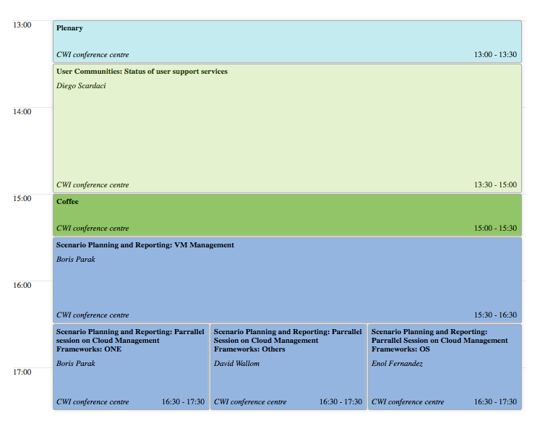
Tuesday

Slide 3
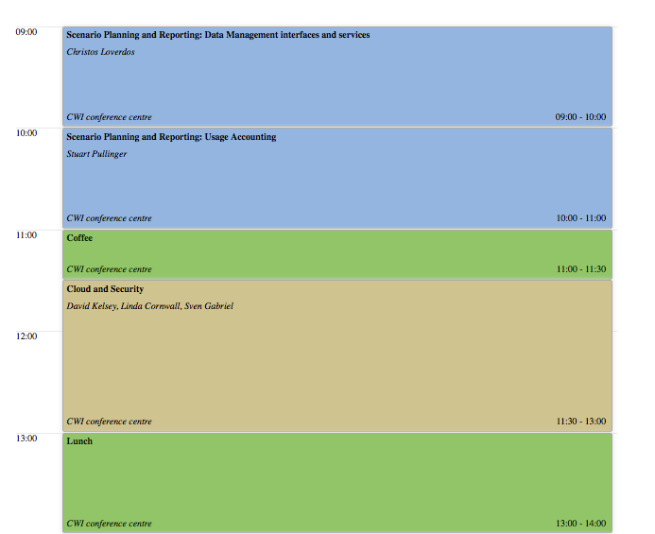
Wednesday AM

Slide 4
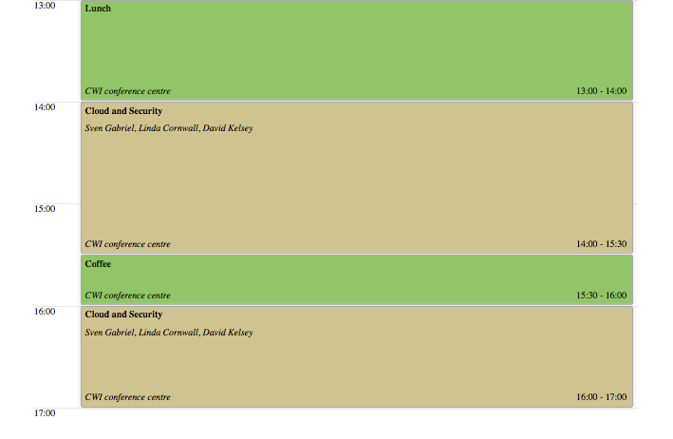
Wednesday PM

Slide 5
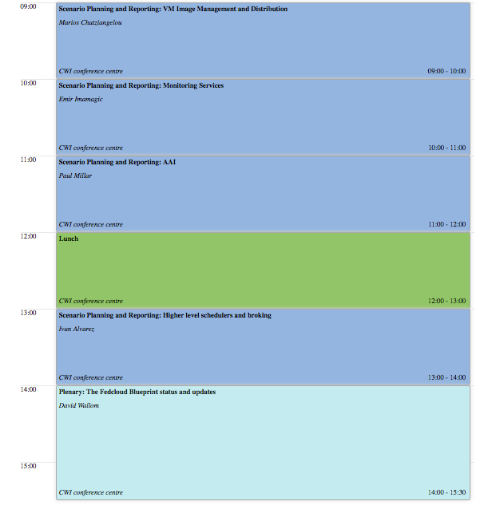
Thursday

