Slide 1
Software provisioning and HTC Solution
Peter Solagna
Senior Operations Manager
peter.solagna@egi.eu

Slide 2
Software provisioning

Slide 3
Achievements of the SW provisioning
Established and maintained agreements with the technology providers
Developed and maintained a quality control process for the software that has to be deployed in the production infrastructure
Quality criteria definition and verification
Staged rollout
Provided a repository infrastructure to distribute the software among the resource centres

Slide 4
UMD Release Team
URT meetings
2 meetings per month
Meeting with the product teams contributing to UMD
Updates on release activities of the PTs and UMD schedule dissemination

Slide 5
UMD releases
During PY5
Total of 7 UMD-3 updates
87product updates (125 including multiple platforms: SL5, SL6, DEBIAN6)
Unified Middleware Distribution | UMD-3 | 0 major release
 |  | 5 minor updates
 |  | 2 revision updates
EGI PKIX trust anchors | 5 releases
SAM | 1 release
Total number of releases:
UMD-1: 16 releases, 142 product updates
UMD-2: 16 releases, 227 product updates
UMD-3: 15 releases, 430 product updates

Slide 6
Quality criteria evolution
7 releases of the quality criteria document
Quality requirements for software in UMD
Coverage of all the UMD products
Disseminated among the technology providers
Reduced to a core set of requirements during PY4 to make possible for external verifiers to contribute to the process
Products verification on dedicated cloud resources
Integration with the Federated cloud processes
Increased automation of the processes to reduce overhead
Average time/verification from 14h/product in PY1 to 2.5h/product in PY5
Notes:
Future plans about cloud services: QC for VMI, process of verification of images(?)
Support for the CoE/CC

Slide 7
Software provisioning evolution
EMI yum/apt
UMD-1
Untested
UMD-1
Tested
UMD-1
Production
IGE yum/apt
EMI
IGE
EPEL
UMD-2
Untested
UMD-2
Tested
UMD-2
Production
UMD-3
Untested
UMD-3
Tested
UMD-3
Production
HTTP
PT specific
Community repositories

Slide 8
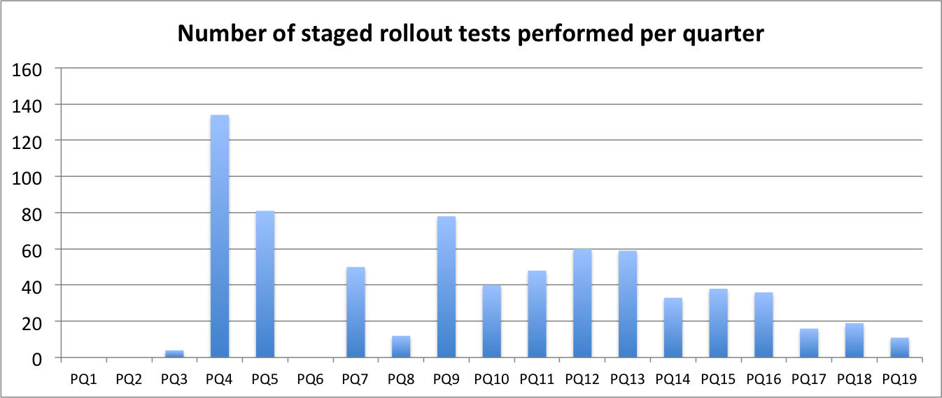
Staged rollout
PY5
Number of early adopter sites | 81
NGIs contributing to SR | 28
Number of SR test performed during PY3 | 46

Slide 9
Future plans
Continue to support the production infrastructure
Distribute Cloud components to support Fedclouds
Quality criteria
Support software release of the EGI communities and the Centres of Excellence
Virtual Machines Images quality control
Repository infrastructure
Extend the platforms supported to fulfill the stakeholders requirements
Replace the EMI repositories as the main target for the product teams to release

Slide 10
HTC Solution

Slide 11
HTC Solution summary
Enable researchers to access large scale data management and computational capacity
To analyse or produce large datasets through the execution computational tasks, which can be either single or parallel processes
Research can be performed in an effective, cost-efficient and collaborative way
Uniform access to distributed and federated resources
Support users communities who need to federate their own resources
Support users communities who do not own resources
Notes:
How the solution was supported by PY5 (additonal slide)

Slide 12
HTC Architecture
HTC architecture compute + storage
Describe the shift towards GUI/community specific solutions
From command line tools and X509 personal certificates
To science gateways and robot certificate
Hide the complexity of the HTC

Slide 13
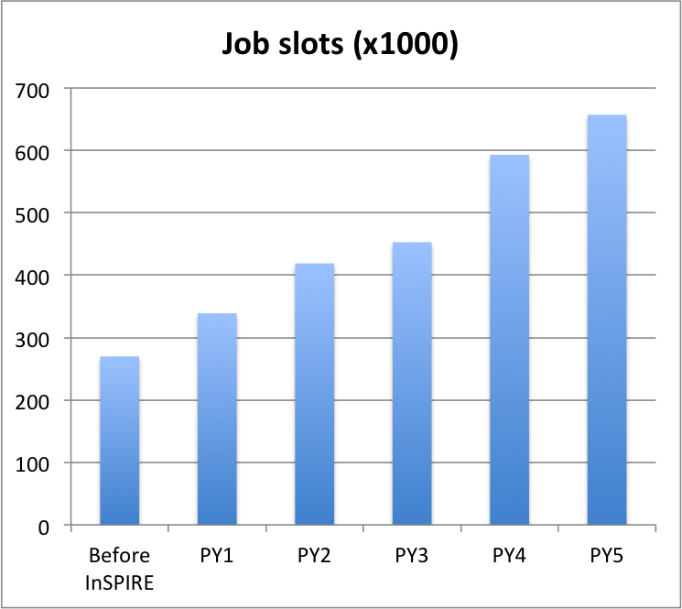
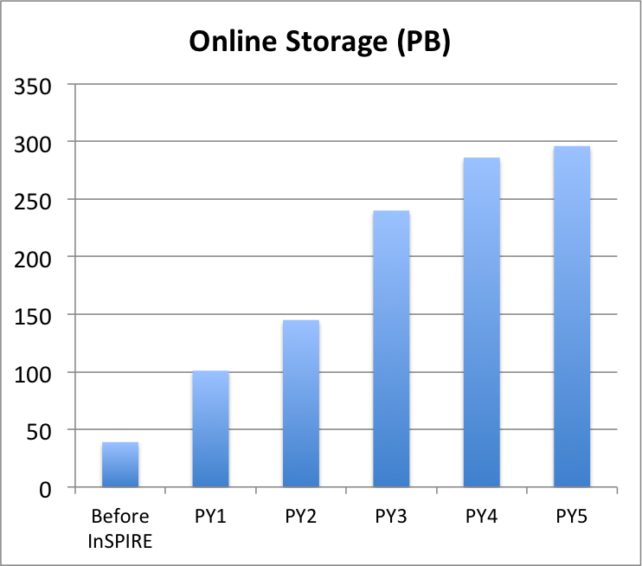
Evolution of the HTC production infrastructure
End of PY5
Job slots council member RPs (Increase from PY4) | 401,200 (+10%)
Job slots including integrated RPs | 531,000
Online storage capacity (Increase from PY4) | 296 PB (+4%)

Slide 14
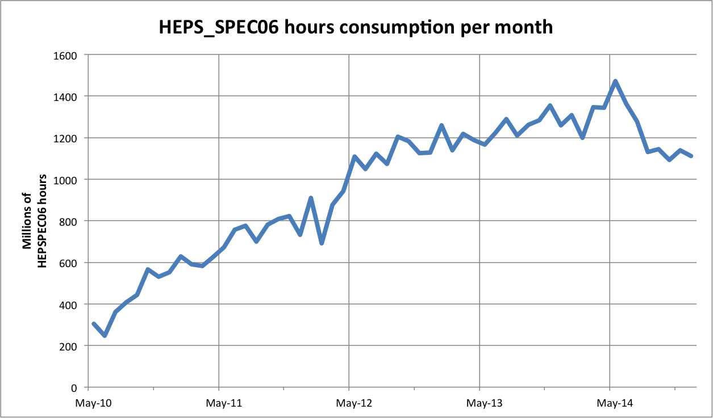
Use of the HTC infrastructure
PY5 (Increase from same period 2013)
Job executed | 372 Mln (+10%)
Wall clock time [HEPSPEC06 hours] | 12.38 Bln (+15%)

Slide 15
HTC integration
EUDAT
EGI/EUDAT interoperability cookbook to support common use cases
XSEDE
Study of collaborative use examples to identify cross e-infrastructure use cases and identify interoperability requirements
IDGF
Desktop resources part of the production infrastructure since PY5

Slide 16
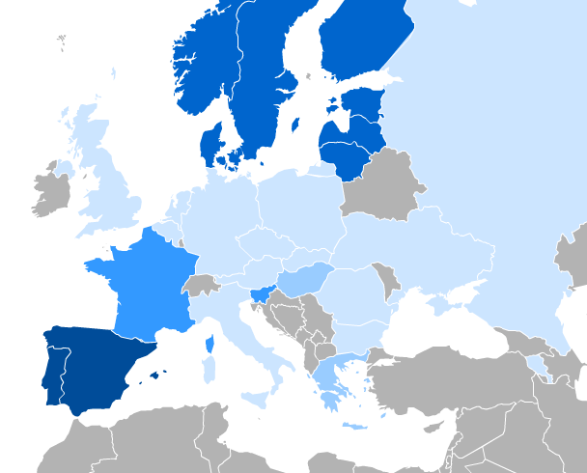
Inter-usage across EGI
TO OSG
More than 6,200 jobs in PY5, excluding HEP
TO IDGF
More than 68,000 jobs in PY5
Notes:
RImettere

Slide 17
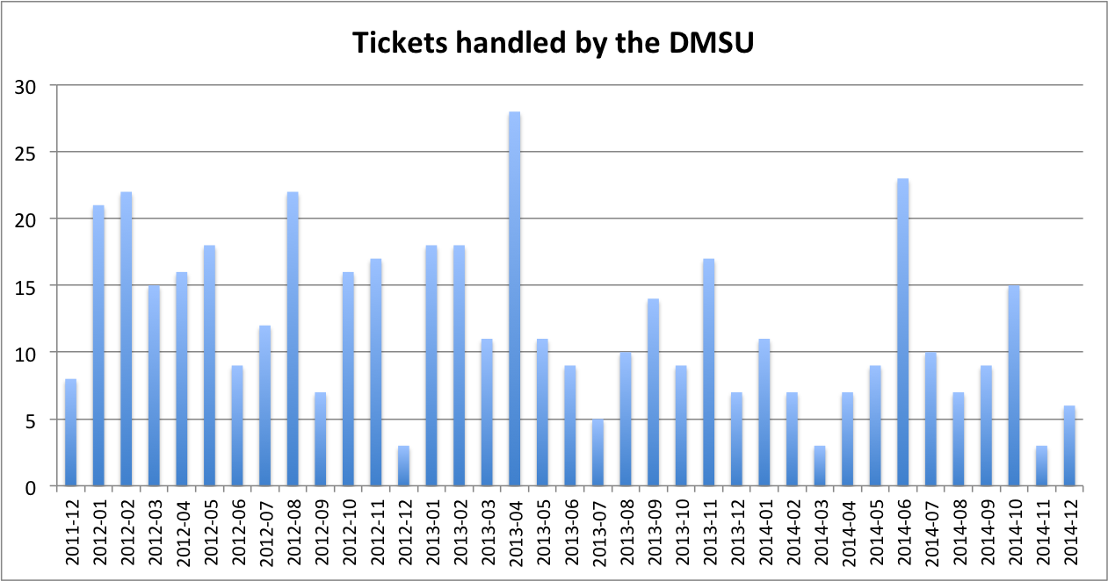
Helpdesk support for the HTC services
PY5 (DMSU Supported as core activity)
Tickets handled by the DMSU | 82
Tickets solved by the DMSU | 78

Slide 18
Conclusions
Software provisioning
Supported as core service by the EGI members fees
Releasing
HTC Middleware: gLite, ARC, Globus
HTC/HPC Middleware: UNICORE, QCG
Storage: dCache, Frontier-Squid, CVMFS
Ready to evolve to support the needs of the EGI stakeholders
Additional business models: provided as a service to centres of excellence and EGI user communities
HTC
Support for the increased requirements of the user communities
Effective sharing of resources among countries and user communities

Slide 19
Questions
Members of the EGI-InSPIRE collaboration thank the EC for supporting EGI

Slide 20
Middleware campaigns in PY5
dCache storage element
Version 2.2.x had a longer support period than the other UMD-2 components
End of support August 2014
End of upgrade campaign November 2014
APEL clients
Migration from UMD-2 to UMD-3 client versions was not transparent
End of upgrade campaign December 2014
VOMS for ops VO (used in monitoring)
Ops VOMS servers must be configured in every user facing monitored service
Campaign started on August with a broadcast and concluded at the end of October
Notes:
Add the whole project

Slide 21
AAI strategy
Cloud
IdP
Attribute Authority
IdP
SAML
IdP/X509
IdP
Attribute Authority
Grid
IdP
OAuth2
Notes:
Explain the fed.idenrtity support in grid middleware. Why not.

Slide 22
AAI Pilot
Started during PY5 the deployment of a pilot on cloud services
Study the feasibility of direct integration of federated identities in EGI services
Implementing: uniform user authentication and distributed community management for authorization
Work to be expanded within AARC and EGI-Engage
Not only for cloud, but for all the EGI services

