Slide 1
The Federated Cloud solution
David Wallom
University of Oxford
SA5 Task Leader

Slide 2
Who, Why & What
Development Activities since July ‘14
Operationalisation
User communities

Slide 3
SA5 EFFORT DETAILS

Slide 4
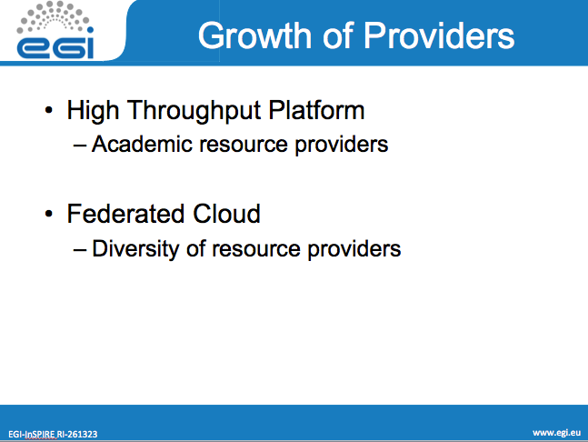
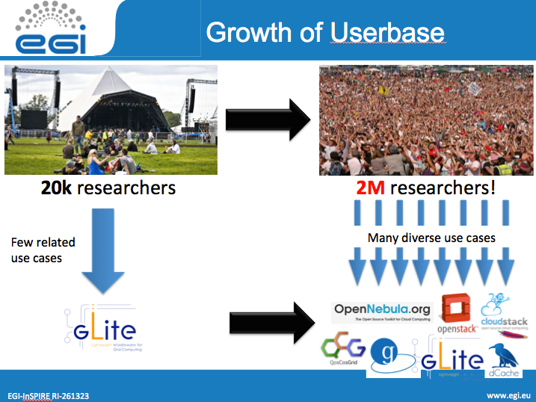
Why?
Notes:
Growth in diversity of userbase whilst maintaining research excellence

Slide 5
Value proposition
The EGI Federated Cloud, a federation of institutional private Clouds, offering Cloud Services to researchers in Europe and worldwide
A single cloud system able to
Scale to user needs
Integrate multiple different providers to give resilience
Prevent vendor lock-in
Enable resource provision targeted towards the research community
Standards based federation of IaaS cloud:
Exposes a set of independent cloud services accessible to users utilising a common standards profile
Allows deployment of services across multiple providers and capacity bursting

Slide 6
Develop and deploy Software Appliances on scalable independent resources
Provide long running services to consumers
Store and Share Data and Software Applicances

Slide 7
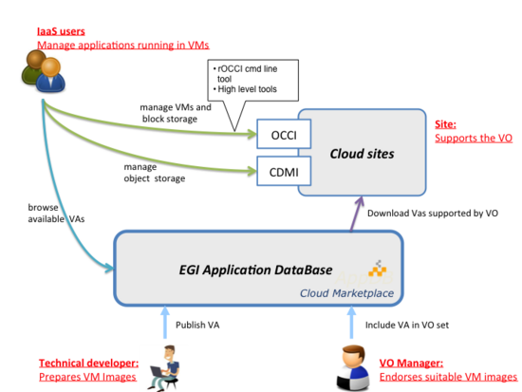

Slide 8
Principles of Federation
Standards and validation: Recommended and common open standards for the interfaces and images – OCCI, CDMI, OVF, GLUE2, AAI
Resource integration: Cloud Computing to be integrated into the existing production infrastructure.
Heterogeneous implementation: no mandate on the cloud technology.
Provider agnosticism: the only condition to federate resources is to expose the chosen interfaces and services.
Notes:
Original Task Force Mandate: 18 months, September 2011 – March 2013
EGI-Inspire Integration: Formalised scope as Task SA2.6 from April 2013

Slide 9
EGI Cloud Infrastructure
User Community
EGI Collaboration Tools
EGI Cloud Infrastructure Platform
Instance Mgmt
Storage Management
Image Repository
EGI Cloud Service Marketplace
Cloud Management Stacks
(OpenStack, OpenNebula, Synnefo, …)
EGI Application DB
EGI Core Platform
Service
Registry
Information Discovery
Federated AAI
Monitoring
Accounting
Help and Support
Security Co-ordination
Training and Outreach
Sustainable Business Models

Slide 10
Task SA5.1
Updates to the Scenarios

Slide 11
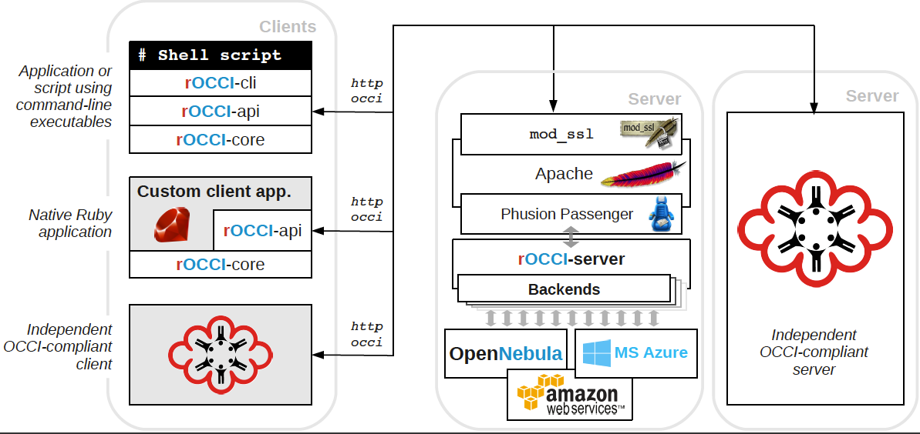
VM Management
Developing support for further Cloud Management Frameworks/Services through rOCCI
Extending OCCI 1.1 through inclusion of contextualisation via Cloudinit
All uploaded Fedcloud images should support Cloudinit
All supported CMF OCCI implementations extended to support

Slide 12
Data Management
Completion of CDMI reference implementation including documentation and support
Further enhancing the implementation through experience from use-cases
  Developing connectors to underlying storage systems(e.g. OpenStack, File System)

Slide 13
Federated AAI
Vital to have a better understanding of user requirements for Federated AAI
  Conducted a survey of currently engaged FedCloud user-communities
    size
    dynamics (how often new members appear, how often do they leave)
    Existing technology use
Investigated per-user sub-proxy as a short-term AAI solution to improve ease of user access and traceability.
Participation of FedCloud members in the EGI AAI Pilot
Provided EGI-FedCloud use-cases to other groups, such as DFN-AAI and LSDMA.

Slide 14
Information Publishing
Currently supporting OGF GLUE 2.0 standard
  Extending standard through inclusion of cloud information
  Incorporating feedback from public comment period
  Maintaining backwards compatibility
Developing methods for addition of cloud storage information in future GLUE standards

Slide 15
Accounting
TO COME B4 FRIDAY

Slide 16
VM Image management
Support for VO-wide image lists following the HEPiX format
Integration with the EGI Information system
Extend the AppDB authentication system by supporting federated AAI through eduGAIN
Large catalogue of available Software Appliances (SaaS)
Integration with external metadata repositories to provide broader support to communities and engage with other activities

Slide 17
Indicative usage statistics
Registered Virtual Appliances: 30, ref
Sites supporting the AppDB Cloud Marketplace: 21, ref
Supported Virtual Organizations: 9, ref
    atlas,
    biomed,
    cms,
    demo.fedcloud.egi.eu,
    drihm.eu,
    fedcloud.egi.eu,
    highthroughputseq.egi.eu,
    lhcb,
    vo.chain-project.eu
[Operation of the AppDB Cloud MP, officially started on June/2014]

Slide 18
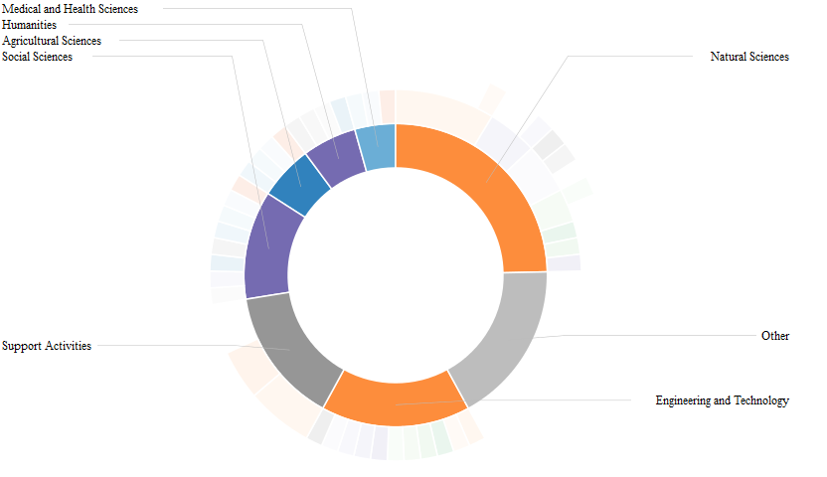
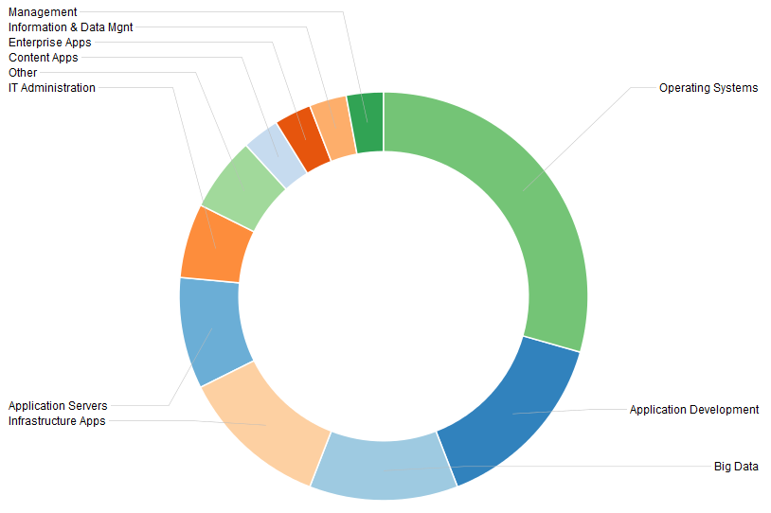
Virtual Appliances distribution
From a scientific point of view
For engineers

Slide 19
Resource Broking
Extend the IaaS capabilities of the EGI cloud
  ‘Alternatives’ to the OCCI client and API
  More than OCCI
Infrastructure brokers and Application brokers
  SlipStream* – PaaS for automating deployments; Helix Nebula
  Catania Science Gateway Framework – SaaS with ID federations
  COMPSs – programming framework for auto-parallelisation
  VMDIRAC – abstraction on top of various HPC/HTC/cloud
  WS-PGRADE – workflow development and enactment
  Vcycle - a VM lifecycle manager that implements the vacuum model on IaaS Cloud services

Slide 20
Connecting new Resource Providers
Share background information
  Name*
  Institute*
  Email address*
  One paragraph long description of your organization
  Envisaged timeline (is there a deadline to finish the setup? for how long do you wish to contribute to the EGI Federated project?)
  Estimated number and size of machines that you may provide to EGI
  Type of Cloud Management Framework (if already installed)
  Link to webpage, document or other online resource for further information
Where none available support installation of compatible Cloud Management Framework including Fedcloud service connectors
Proceed through certification procedure to test installed services and ensure quality of services provided
  Temporary EGI procedure created to provide instructions on registration and certification of resources. [PROC18]
  Main resource centre joining procedure [PROC09] updated to reflect cloud services

Slide 21
Partnership
Resources
  12 NGIs provide 19 certified resources
    Czech Republic(1), Germany(2), Greece(1), Hungary(1), Italy(3), Macedonia(1), Poland(1), Slovakia(1), Spain(5), Sweden(1), Turkey(1), United Kingdom(1)
  5 NGIs currently integrating resources
    France(2), Finland(1), Portugal(1), South Korea(1)*, United Kingdom(1)
  5 NGIs with interested resource providers
    Bulgaria(1), Denmark(1), Israel*(1), The Netherlands(1), Spain(3), Switzerland(CH), United Kingdom(2)
  Worldwide interest & integration
    South Africa* (SAGrid)
    United States* (NIST, NSF A.C. Centres)
    Australia* (NeCTAR)
* Not shown on map
Notes:
Stability of production resources, increasing number drawn to federated cloud with largish backlog of integrating sites

Slide 23
User Model
The offer to our users;
  Total control over deployed applications
  Elastic resource consumption based on real needs
  Immediately processed workloads – no more waiting time
  An extended e-Infrastructure across resource providers in Europe
  Service performance scaled with elastic resource consumption
  Single sign-on at multiple, independent providers

Slide 24










EGI FedCloud Communities @ Launch
Ecology – BioVeL: Biodiversity Virtual e-Laboratory
Structural biology – WeNMR: a worldwide e-Infrastructure for NMR and structural biology
Linguistics – CLARIN: ‘British National Corpus’ service (BNCWeb)
Earth Observation – SSEP: European Space Agency’s Supersites Exploitation Platform for volcano and earthquakes monitoring (Collaboration with Helix Nebula)
Software Engineering – SCI-BUS: simulated environments for portal testing
Software Engineering – DIRAC: deploying ready-to-use distributed computing systems
Software Engineering – Catania Science Gateway Framework
Musicology – Peachnote: dynamic analysis of musical scores
Earth Observation – ENVRI: Common Operations of Environmental Research infrastructures (collaboration with EISCAT3D)
Geology – VERCE: Virtual Earthquake and seismology Research
Ecology – LifeWatch: E-Science European Infrastructure for Biodiversity and Ecosystem Research
High Energy Physics – CERN ATLAS: ATLAS processing cluster via HelixNebula
More info: https://wiki.egi.eu/wiki/Fedcloud-tf:Users

Slide 25
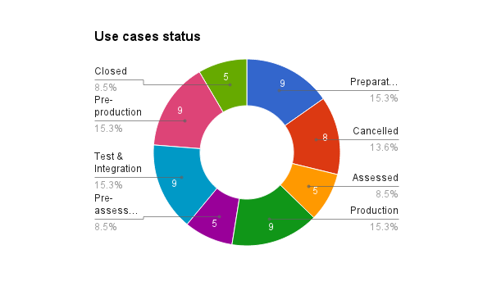
Use cases status
59 Use cases in total

Slide 26
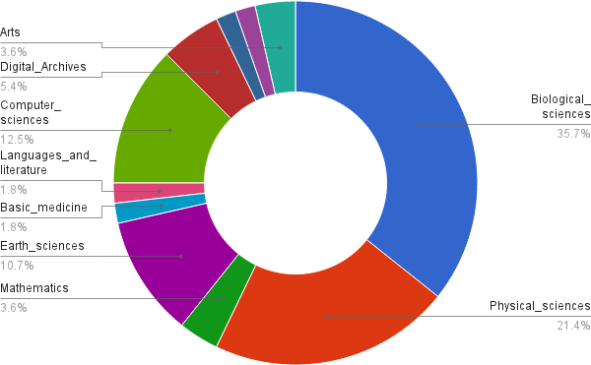
EGI FedCloud Use Cases Discipline Classification (2° tier)

Slide 27
User Support Workflow
F2F / teleconference
  Initial requirements
  Allocation of technical experts
  Milestones
Continuous tracking with appropriate support
  Technical integration support from EGI/NGI team
    On the incubator VO or setup of new VO
  Service development support from EGI FedCloud Task Force
  Community support through Virtual Team projects
Migration into production
  Resource provider commitments [SLA and MoUs]

Slide 28
Continuing a Technology Evolution
Broader support for open standards in Cloud management frameworks
  Utilisation of rOCCI for interfaces to commercial cloud frameworks
  Completion of high quality reference implementation for CDMI
New feature additions to foundational tools depending on requests
  Accounting, monitoring, service discovery, Image Management
Value added services for User Communities
Strengthening the underpinning platform

Slide 29
Federated Cloud Services
Tier 4:
Zero ICT
Infrastructures
PaaS
PaaS
VRE
Virtual
eLaboratory
Secure storage
Tier 3:
Platform as a Service
Tier 2:
General-purpose platform services
DB aaS
Hadoop
aaS
Key Mgmt
Encryption
ACL mgmt
Tier 1:
Reliable
Infrastructure Cloud
Federated IaaS and STaaS Cloud

Slide 30
Investigate the possibility of EGI running an online-CA.
Further information system development must be use case-driven, including integration to higher level services such as brokers to provide real added value for the cloud users.

Slide 31
Conclusions
EGI Federated Cloud is attracting new communities belonging to various scientific domains
  26 communities and 50 use cases currently supported, 4 from commercial organisations
Paving the way for a global federated cloud marketplace led through European Innovation
  Established best practice
  Illustrating leadership
  Open standards, open technology
  Open membership, open processes
  Open competition

Slide 32
Growth of Providers
High Throughput Platform
  Academic resource providers
Federated Cloud
  Diversity of resource providers

Slide 33
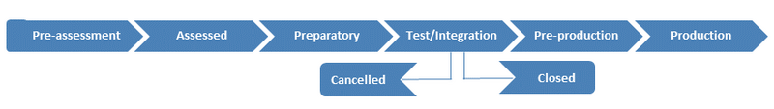
Usecase Integration Workflow
Status | Description
Pre-assessment | FCUS members identified a potential use case that can profit from the EGI Federated Cloud services
Assessed | The use case requirements are assessed with relevant information added to a dedicated wiki page, to manage the full porting & integration process
Preparatory | The user & FCUS team setup the environment to execute tests on the FedCloud (configuration of client environment, identify resource providers, upload VM images, ...)
Test & Integration | Users are accessing the FedCloud through the fedcloud.egi.eu VO to execute tests while integrate their applications to the infrastructure
Pre-production | Test & integration phases were successfully completed. Create a production Virtual Organization (VO) or join an already existing VO
Production | Use case is being used in production. The use case completed all tests and is regularly making use of the Federated Cloud using a production level VO
Closed | Test & integration successfully completed. Use case either does not foresee moving into production.
Cancelled | Test & integration did not successfully completed. User cancelled the use case.

Slide 34
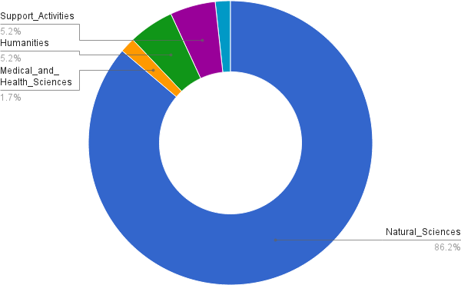
EGI FedCloud Use Cases Discipline Classification (1° tier)
Engineering and technology 1.7%

