Slide 1
UPV-IBM’s Big data observatory & hadoop infrastructure management
Damian Segrelles, Germán Moltó & Ignacio Blanquer,

Slide 2
IBM-UPV Big Data Observatory
A joint action by the School of Informatics of the UPV and IBM to promote BigData practicals in post-graduate courses.
IBM has offered a free Enterprise license to IBM InfoSphere BigInsights (An IBM’s version of Hadoop and other analytic tools for visualization, “R”, text analysis and tables).
Usage restricted to academic and research activities in the UPV – not production.
Main common interest is to educate students on BigData technologies
Currently a post-graduate course and a Master Degree.
http://bigdata.inf.upv.es

Slide 3
Resources
InfoSphere BigInsights is installed on our cloud on-premises
UPV’s site is for application development and prototyping.
IBM offered the possibility of using IBM Bluemix IaaS for production.
Currently two projects under development
Suitability of university degrees according to employment demand.
Extraction of trending topics from live streamed content in radio and tv.

Slide 4
Plans and opportunities
The work of the observatory aims at:
Supporting the research part of the academic activity of forthcoming post-degree students (40-60 per year).
Create success stories and new use cases.
Potential links with EGI (To be proposed to IBM)
Support BigInsights from UPV’s FedCloud site.
Scale-up the concept of Observatory to other centres in EGI.

Slide 5
Iaas Management framework of GRYCAP

Slide 6
Iaas managing services
IM
COMPaaS
A SLA management framework for IaaS.
www.grycap.upv.es/compaas
Automatic configuration and recontextualization service.
www.grycap.upv.es/im
EC3
VMCA
Creation of elastic virtual clusters on top of both public and on-premise IaaS providers
www.grycap.upv.es/ec3
A Virtual Machine Consolidation Agent
www.grycap.upv.es/clues/eng/addons.php
VMRC
CLUES
A rich metadata repository of Virtual Machine Images.
www.grycap.upv.es/vmrc
An energy management system for Clusters and Cloud infrastructures.
www.grycap.upv.es/clues

Slide 7
Infrastructure Manager
General platform to deploy on demand customizable virtual computing infrastructures.
Multiple VMs with multiple configurations.
No need of pre-packaged VMIs.
Enable re-using of VMIs.
Infrastructure-Agnostic
Currently supports: OpenNebula, OpenStack, EC2, GCE, OCCI (FedCloud), FogBow, Docker, LibVirt.
Service with two APIs: XML-RPC and REST.
Working Scheme:
Receives a document (RADL)
Resource and Application Description Language
High level Language to define virtual infrastructures
Specify VM requirements
Contact the catalog to get a list with the most suitable VMI.
Obtain the list of IaaS providers available to the user.
Selects the best combination.
Contact the IaaS provider selected to deploy the infrastructure and finally configure it.

Slide 8
Infrastructure Manager (II)
network privada
network publica (outbound = 'yes')
system front (
cpu.arch='x86_64' and cpu.count>=2 and
memory.size>=2048m and
net_interface.0.connection = 'publica' and
net_interface.1.connection = 'privada' and
net_interface.1.dns_name = 'hadoopmaster' and
disk.0.os.name='linux' and
disk.0.os.flavour='ubuntu' and
disk.0.os.version='12.04' and
disk.0.applications contains
(name='ansible.modules.micafer.hadoop')
)
system wn (
cpu.arch='x86_64' and
memory.size>=2048m and
net_interface.0.connection='privada' and
disk.0.os.name='linux' and
disk.0.os.flavour='ubuntu')
configure front (
@begin
- roles:
- { role: 'micafer.hadoop', hadoop_master: 'hadoopmaster', hadoop_type_of_node: 'master' }
@end
)
configure wn (
@begin
- roles:
- { role: 'micafer.hadoop', hadoop_master: 'hadoopmaster' }
@end
)
deploy front 1
deploy wn 5

Slide 9
Hadoop cluster
Creation Times
Deploys a hadoop cluster (1 head node and 5 WNs)
Uses a special application requirement (ansible.modules.micafer.hadoop)
It downloads roles from Ansible Galaxy (http://galaxy.ansible.com)
The configure section uses the galaxy roles.
 | 11 nodes (EC2) | 51 nodes (EC2) | 6 nodes (ONE) | 11 nodes (ONE)
Creation | 9:29 | 14:26 | 12:05 | 22:13
Node Addition | 5:46 | 11:23 | 5:13 | 5:33
Node Removal | 3:17 | 6:36 | 1:18 | 1:32
EC2:
Master: c1.medium
1.5 GB de RAM and 2 cores
WNs: m1.small.
1.5 GB de RAM and 1 cores
ONE:
Tailored requirements (1 core and 2 GB RAM).
Overhead with many MVs due to bottleneck in network accesses

Slide 10
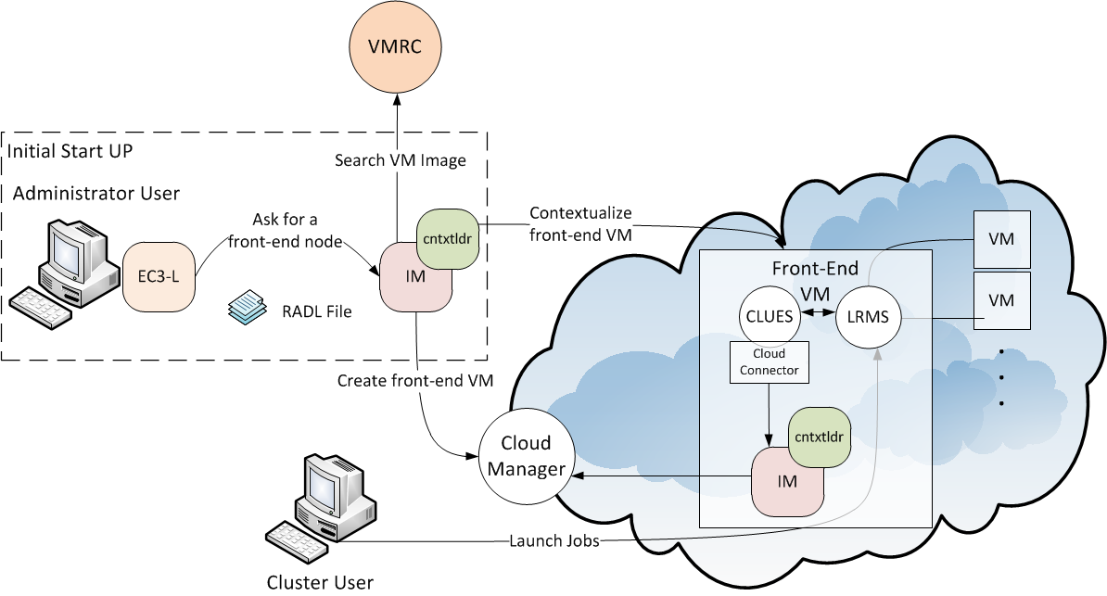
EC3
Elastic Cloud Computing Cluster
EC3 = IM + CLUES
IM is used in conjunction with a energy management software for clusters called CLUES to enable the deployment of elastic virtual clusters on cloud platforms.

Slide 11
EC3
Elastic Cloud Computing Cluster
CLUES and the IM interact at two levels:
EC3 launcher deploys a front-end node configuring CLUES and other instance of the IM service.
CLUES uses internally IM to deploy the VMs that will be used as working nodes for the cluster.
For that, it uses a RADL document defined by the sysadmin, where the features of the working nodes are specified.
Once these nodes are available, they are automatically integrated in the cluster as new available nodes for the LRMS.

Slide 12
Contacts
IBM-UPV Big Data Observatory
Damià Segrelles: dquilis@dsic.upv.es
GRyCAP IaaS management ecosystem
Germán Moltó: gmolto@dsic.upv.es
GRyCAP head
Ignacio Blanquer: iblanque@i3m.upv.es

