Slide 1
Big data: research and development at IISAS
Viet Tran
Institute of Informatics, SAS
Slovakia

Slide 2
Research activities in Big Data
Information Retrieval, Big Data
Semantics, Graphs and Networks, Semantic Search
Multi-language Text Analysis
Knowledge Modeling, Ontologies

Slide 3
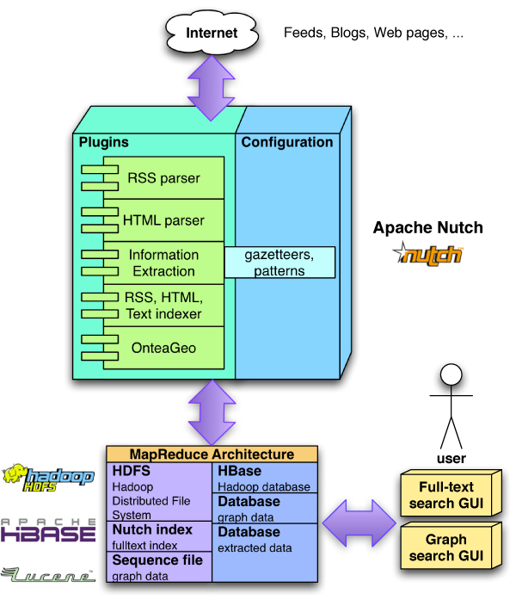
Products
RDB2Onto: Tool for Relational Data to Ontology Individuals Mapping
ACoMA: Acoma process email communication on server side and attach relevant knowledge to email messages.
EMBET: Experience Management based on Text Notes - Active and Context sensitive Recommendation System
RIDAR: Relevant Internet Data Resource Identification
WEBCRAWLER: WebCrawler downloads recursively web pages.

Slide 4
Selected projects related to Big Data
EU projects
REDIRNET: Emergency Responder Data Interoperability Network (1.3.2014-31.8.2016)
VENIS: Virtual Enterprises by Networked Interoperability Services (2011-2014)
EUSAS: European Urban Simulation for Asymmetric Scenarios (2010-2012)
COMMIUS: Community-based Interoperability Utility for SMEs (2008-2011)
ADMIRE: Advanced Data Mining and Integration Research for Europe (2008-2011)
And many Grid-related projects (EGI-Inspire, EGEE- 1,2,3; DEGREE, Int.Eu.Grid, Kwf-Grid, MediGrid, CrossGrid)

Slide 5
Selected projects related to Big Data
National projects
CLAN: Cloud Computing for Big Data Analytics (1.7.2012-31.12.2015)
SMART-II: Center of Excellence for SMART technologies(2010-2014)
SIVVP: Slovak Infrastructure for High Performance Computing (2010-2015)
VEGA: Selected methods, approaches and tools for distributed computing (2012-2015)
VEGA: New methods and approaches on information processing and knowledge bases (2013-2015)

Slide 6
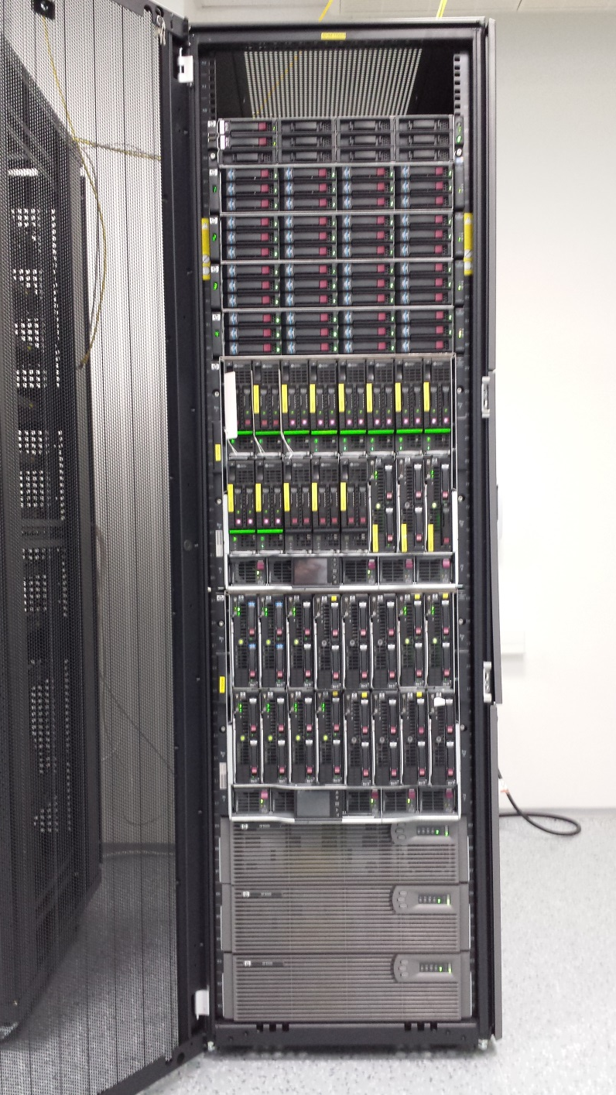
HADOOP Production cluster
16 nodes of
24 Intel Xeon cores (384 cores in total)
48 GB RAM
1 TB
Software
Hadoop
Spark

Slide 7
HADOOP Development cluster
10 nodes of
12 Intel Xeon cores
48 GB RAM
512 GB storage
Software
Hadoop
Spark
Hive
Pig

Slide 8
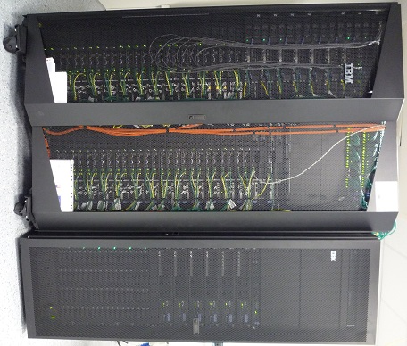
Ongoing infrastructure
52 computing nodes of IBM dx360 M3 (2x 6–core Intel E5645, 48GB RAM, 2x500 GB scratch disk) + service nodes and storages
To be shared between cloud and Hadoop/Spark

