Slide 1


A Competence Center to Serve Translational Research from Molecule to Brain
Alexandre M.J.J. Bonvin
MoBrain CC coordinator
Bijvoet Center for Biomolecular Research
Faculty of Science, Utrecht University
the Netherlands
a.m.j.j.bonvin@uu.nl

Slide 2
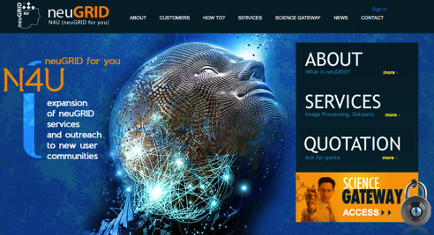
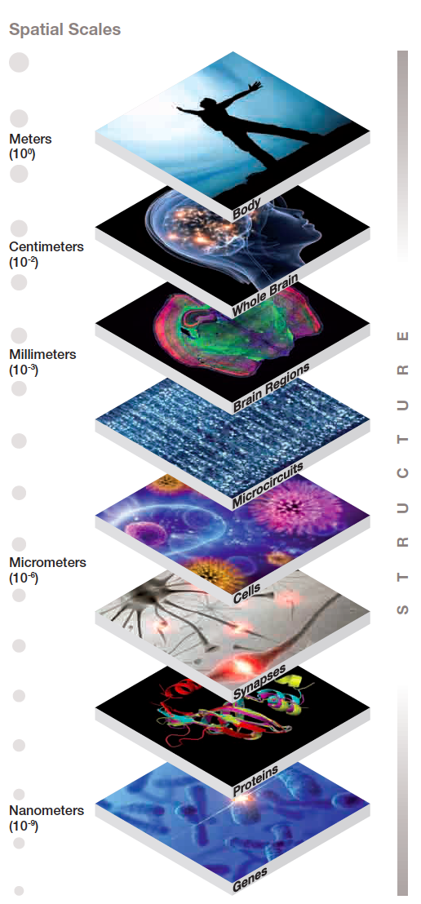
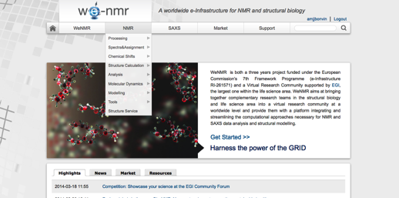
Main objectives
Bring the micro (WeNMR) and macro (N4U) worlds together into one competence center under future EGI activities:
With activities toward:
  Integrating the communities
  Making best use of cloud resources
  Bringing data to the cloud (cryo-EM)
  Exploiting GPGPU resources
While maintaining the quality of our current services!

Slide 3
Partners involved
Utrecht University, Bijvoet Center for Biomolecular Research (BCBR)
Consorzio Interuniversitario Risonanze Magnetiche Di Metalloproteine Paramagnetiche (CIRMMP)
Consejo Superior de Investigaciones Cientificas (CSIC) (and Spanish NGI)
Science and Technology Facility Council (STFC)
Provincia Lombardo Veneta Ordine Ospedaliero di San Giovanni di Dio - Fatebenefratelli (IRCCS FBF)
GNUBILA France
Istituto Nazionale Di Fisica Nucleare (INFN)
SURFsara (Dutch NGI)
CESNET (Czech NGI)
Open Science Grid (US)

Slide 4
Main activities
Task 1: User support and training 9 PM
Task 2: Cryo-EM in the cloud: bringing clouds to the data 23.4 PM
Task 3: GPU portals for biomolecular simuations 14 PM
Task 6: Integrating the micro (WeNMR/INSTRUCT) and
macroscopic (NeuGRID4you) VRCs 11 PM
TOTAL funded effort 57.4 PM

Slide 5
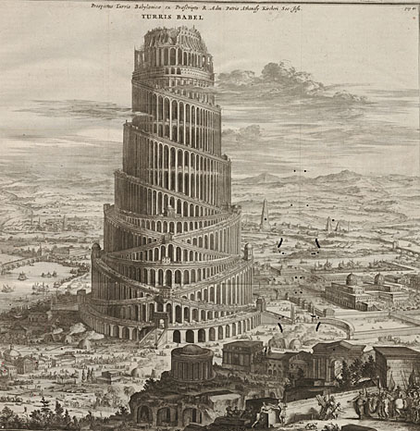



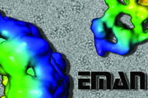
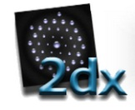



Task2: Integrated Image Processing Workflows for Electron Microscopy
Using different EM software packages is now like the tower of Babel, for that we (CSIC) are developing the Scipion Workflow integrator
Notes:
Why we are working in Scipion? Simply put, the EM field needs software integration.
Currently processing with different software packages is like a Babel Tower.
User needs to deals with files convertion between packages, which wastes time
and is error prone.

Slide 6
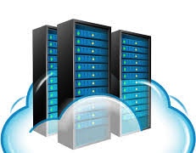

Task 2: Virtualize the execution hosts
Execution hosts
Internet
Scipion client
Cloud computing
Big data transfers
Scipion server
Data storage
Notes:
By Virtualizing the Execution Hosts, we will be able use computing resources more efficiently.
First, we can computing nodes will be allocated when needed, which avoid having them when
There are not computing jobs. And second, the number of nodes can be adapted for each
Job requirements (ie. Maybe some jobs requires more RAM memory while other make use of more CPU power)

Slide 7

Task 2: Virtualize server and storage
Execution hosts
Internet
Scipion client
Cloud computing
Big data transfers
Scipion server
Data storage
Notes:
By Virtualizing the Execution Hosts, we will be able use computing resources more efficiently.
First, we can computing nodes will be allocated when needed, which avoid having them when
There are not computing jobs. And second, the number of nodes can be adapted for each
Job requirements (ie. Maybe some jobs requires more RAM memory while other make use of more CPU power)

Slide 8
Task 2 requirements
Cloud resources (FedCloud)
AAI tools
In the long run:
  Federated Cloud storage
  Links between experimental facilities and data storage / cloud resources (e.g. within the iNext H2020 infrastructure project)

Slide 9
Task 3: GPU portals for biomolecular simulations
Two main goals:
Deploy the AMBER and/or GROMACS packages on GPGPU test beds, develop standardized protocols optimized for GPGPUs, and build web portals for their use
Develop GPGPU-enabled web portals for exhaustive search in cryo-EM density. This result links to the cryoEM task 2 of MoBrain
Both goals should be achieved by month 16 of the EGI-Engage project

Slide 10
Task 3 requirements
GPGPU resources for development and testing (CIRMMP, Cesnet, BCBR)
Discoverable GPGPU resources for grid (or Cloud) submission (for the putting portals into production
GPGPU Cloud solution, if used, should allow for transparent and automated submission
Software and compiler support on sites providing GPGPU resources (CUDA, openCL)

Slide 11



Task 4: Integration
Analyse the WeNMR and N4U ecosystems to define and collect the scientific requirements for the new entry portal
Build an entry portal that will integrate and/or gather information from the various web portals relevant to WeNMR and N4U
Identify and cross-reference the main applications and pipelines
Map, exchange and optimize in a synergistic manner the various EGI services, e-Science and e-Infrastructure solutions
Integrate in the new entry portal the specific support centers

