Slide 1
TSA1.6 for OMB
Torsten Antoni, KIT

Slide 2
Middleware specific Workflows
Various different workflows
DMSU workflow (prototype in January release)
DMSU 2nd level support
Tech Provider 3rd level support
Release announcement workflow (prototype in February release)
Tech Provider to SA2 and back
Bugs found in operations (prototype in February release)
From SA2 to Tech Provider and back
All workflows in one seperate instance

Slide 3
Report Generator
report generator remodeling (March release) New requirements
e.g. from Middleware groups
Focus on variability of the tool
Output only in further processable formats, e.g. xml (no graphics)

Slide 4
NGI Integration
Continuous integration of NGIs (ongoing)
Currently 28 NGIs in GGUS
20 as support unit (human interface)
8 with automatic interface
3 xGUS instances (DE, CH, AEGIS)
5 with local ticket system
Plan to have all NGIs connected by TF’11
Increase the rate of automatic interfaces
xGUS or local ticket system
Maybe decdicated meeting for this at TF?

Slide 5
Application / community support
Improve collaboration with NA3 and SA3
Help them to benefittingly make use of GGUS
Start a UF‘11

Slide 6
New interface functionalities
Extend Ticket System interfaces to include ticket relations (parent/child – master/slave)
„Nice to have“-feature

Slide 7
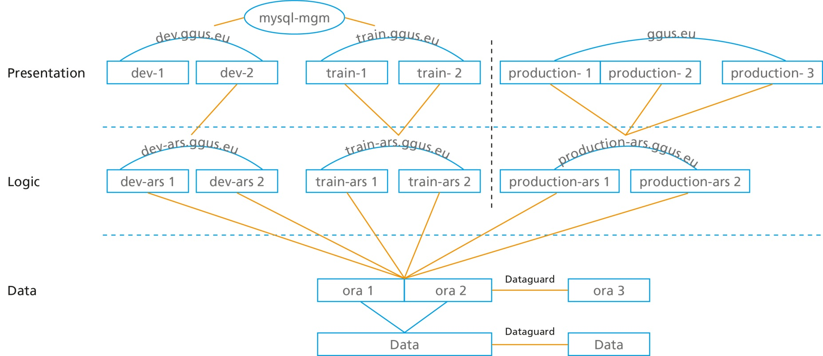
High Availability for GGUS
Active – active high availablility concept
Data layer done
Logic and presentation layer ready by the end of the first half of 2011

Slide 8
Review of support units
After removal of middleware support units
Consolidate list of support units
Get rid of unused legacy support units
Start in April release

Slide 9
Review of documentation
Make sure that all GGUS related documentation is up to date
Start with documentation of new Middleware related problems workflows and xGUS documentation

Slide 10
MS417: EGI Helpdesk and the NGI Support Units
Due PM14 (End of June)
Internal review should start beginning of Mai
We need to start soon
Could be announced at OMB

Slide 11
Possible extension of GGUS use
Middleware workflow for non-EGI users or components
xGUS for extra-EGI projects regions
If funded or benefitting EGI

Slide 12
Clarification of requirements gathering workflows
„Too many cooks…“
OTAG discusses GGUS
USAG discusses GGUS
Tech Providers need to have a forum
Seperate xGUS requirements workflow?

