Slide 1
agINFRA: The European hub for agri-food research and how EGI can support
Nikolaos Marianos
Agro-Know, Project Management Director
Notes:
Good morning, my name is Sy Holsinger, I am a senior strategy and policy officer at EGI.eu. Some of the things I do at EGI is support the development and evolution of the EGI strategy, create sustainability and business models, lead outreach to industry as well as providing consultancy around implementing service management best practices. I was the business programme manager in the predecessor project to EGI.
Today, I am pleased to kick off the first of a series of business tracks at EGI events and talk a little about EGI’s business engagement programme.

Slide 2
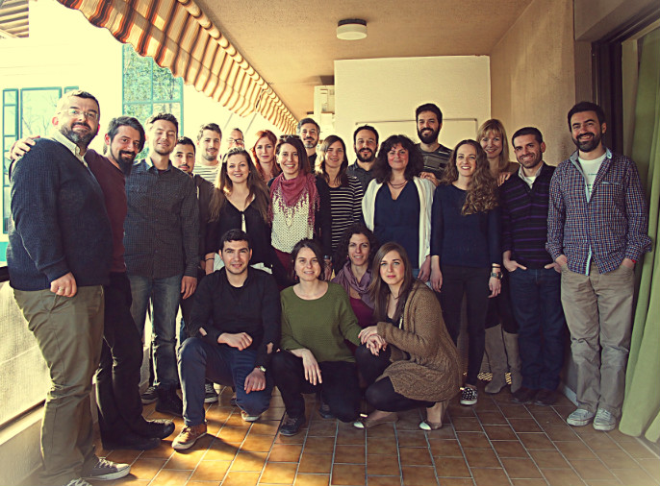
http://www.agroknow.gr
An extraordinary company that captures, organizes and adds value to the rich information available in agricultural and biodiversity sciences, in order to make it universally accessible, useful and meaningful.

Slide 3
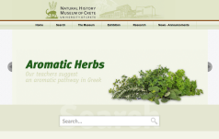
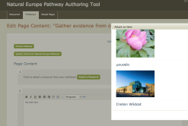
Data aggregation & sharing solutions
Cultivation
Harvesting
Blossom
Data Discovery Services
Unorganized Content in local and remote sites
Ingestion
Enrichment
Translation
Publication
Educational
Data Platform
Bibliographic
Widgets
Organized and structured Content in local and remote DBs
Educational
Aggregate data from diverse sources
Works with different type of data
Prepare data for meaningful services
Authoring services
Bibliographic
Other
Analytics services

Slide 4
Indicative partners & clients
Food and Agriculture Organization (FAO)
Global Forum on Agricultural Research (GFAR)
International Fund for Agricultural Development (IFAD)
World Bank Group
UK’s Dept for International Development (DFID)
Michigan State University (MSU)
Wageningen University & Research (WUR)
French Institute of Agricultural Research (INRA)
International Centre for Research in Organic Food Systems (ICROFS)

Slide 5
Advocates of Open
CIARD.net: a global movement dedicated to open agricultural knowledge
Global Open Data for Agriculture and Nutrition (GODAN): make agricultural and nutritionally relevant data available, accessible, and usable for unrestricted use worldwide

Slide 6
Making different systems work together
Agricultural Interoperability Interest Group (IG), Research Data Alliance (RDA)
Knowledge & Learning Systems WG, Global Food Safety Partnership (GFSP)

Slide 7
Large scale data-related projects
agINFRA: a data infrastructure to support agricultural scientific communities (2011 - 2015)
12 partners (incl. FAO); tech coordinator, evaluation, sustainability
in G8 Open Data in Agriculture Action Plan for Europe
SemaGrow: Data intensive techniques to boost the real-time performance of global agricultural data infrastructures (2012 - 2015)
8 partners (incl. FAO, WUR); tech, evaluation, sustainability
in G8 Open Data in Agriculture Action Plan for Europe
OpenMinTeD: Open Mining Infrastructure for Text and Data (2015- 2018)
15 partners (incl. UoA, EBI, INRA); tech+data, requirements & evaluation
Big Data Europe: Integrating Big Data, Software and Communities for Addressing Europe’s Societal Challenges (2015-2018)
12 partners (incl. FAO); agri-food community & use cases

Slide 8
Our Mandate
“We will promote research for food and agriculture, including research to adapt to, and mitigate climate change, and access to research results and technologies at national, regional and international levels.
We will reinvigorate national research systems and will share information and best practices.
We will improve access to knowledge”
Heads of State and Government, World Summit on Food Security, Rome, November 2009

Slide 9
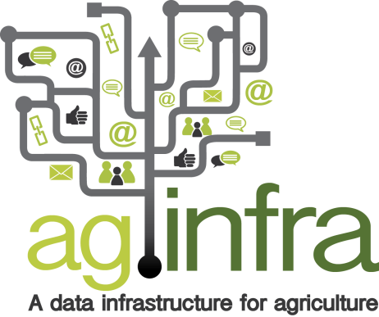
aginfra.eu
The European hub for data-powered research on agriculture, food and the environment
a research data sharing help desk & service point for H2020 projects in our thematic areas
the agri-food node of OpenAIRE
a big (research) data machine & stack of technologies
an ecosystem for research data scientists, developers, startups

Slide 10
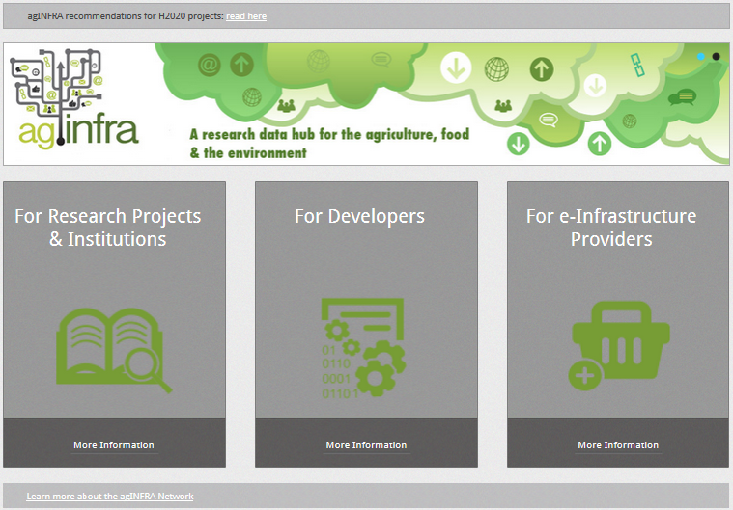

Slide 11
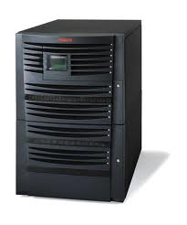
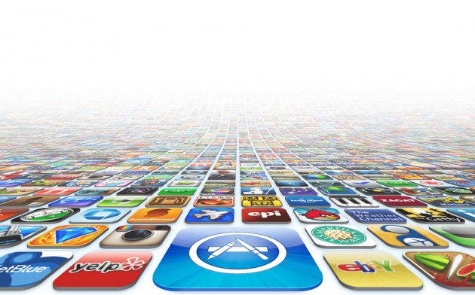
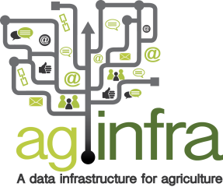
New aginfra.eu e-infrastructure
A legion of software apps/tools/services that researchers use
Grid & cloud infrastructure
Data Repositories
All the researchers of the world waiting eagerly to use research-oriented software apps/tools/services

Slide 12
A data-powered ecosystem
Aiming to provide a hub for to support the European communities of data scientists, software companies, tech startups working with clients in the agri-food sector
global public, private & societal stakeholders presenting their data-related problems
EU technology developers present & demonstrate their apps & systems to the global stakeholders

Slide 13
An ecosystem that could look like this
Tech/IT industry & start ups
Agricultural data scientists
Agricultural data aggregators
Agro data providers (FAO, CAAS, DEFRA, DFID, etc)
Data science community
Agricultural software app/tool/service companies
Agro/food industry
Agro/food research & academia

Slide 14
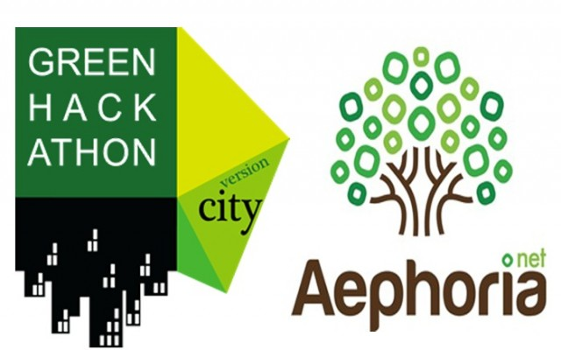
Engagement, awareness, support

Slide 15
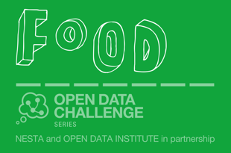
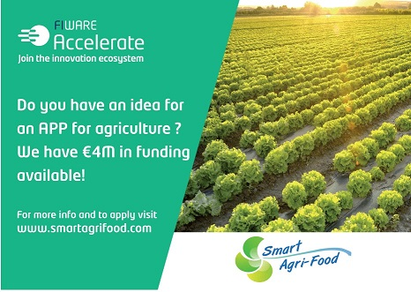
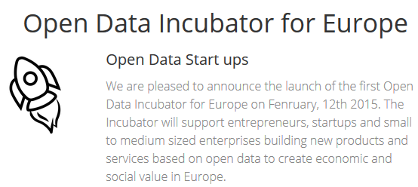
Connect to & facilitate business initiatives

Slide 16
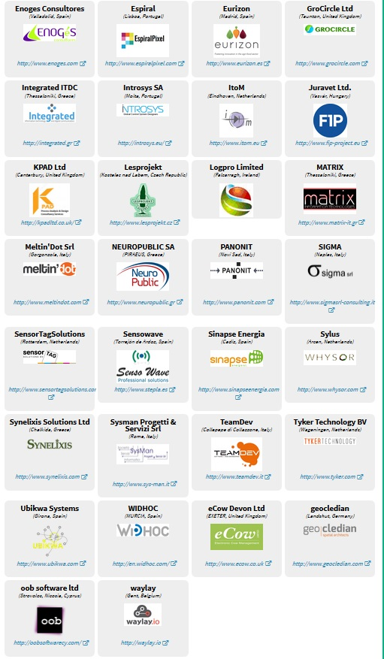
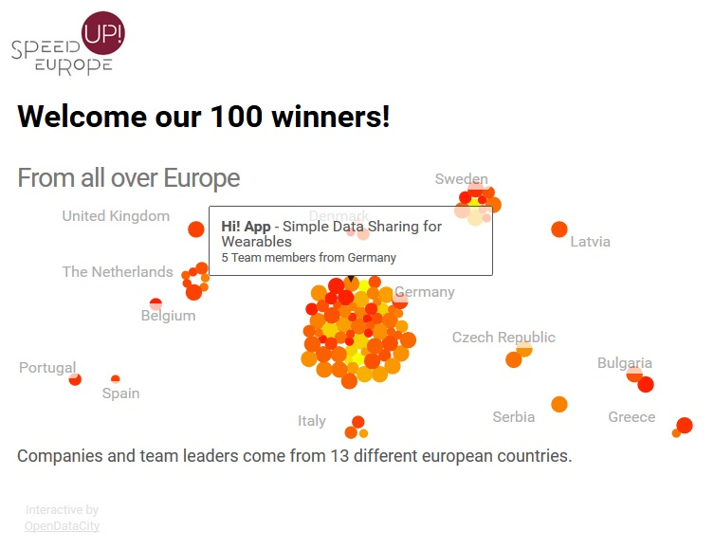
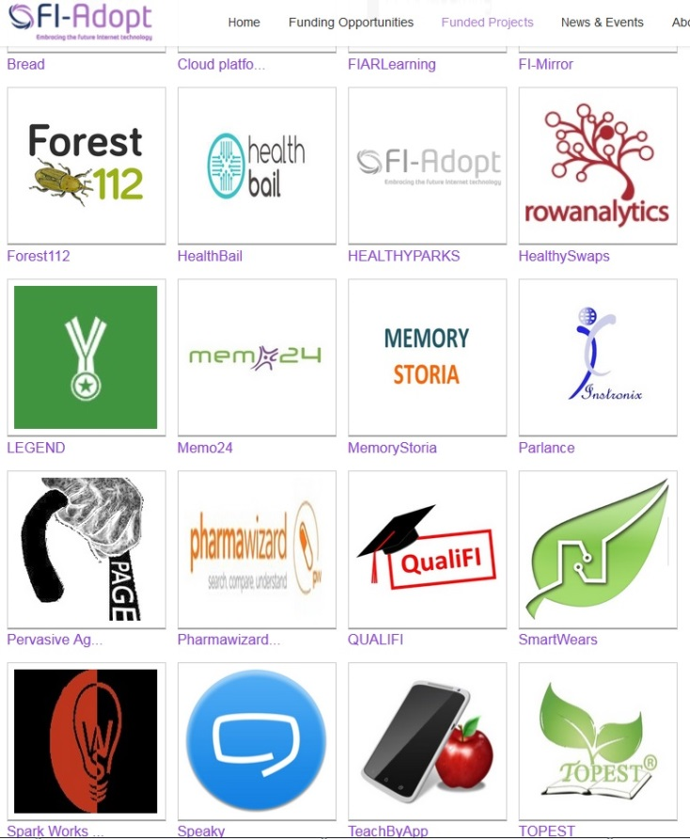
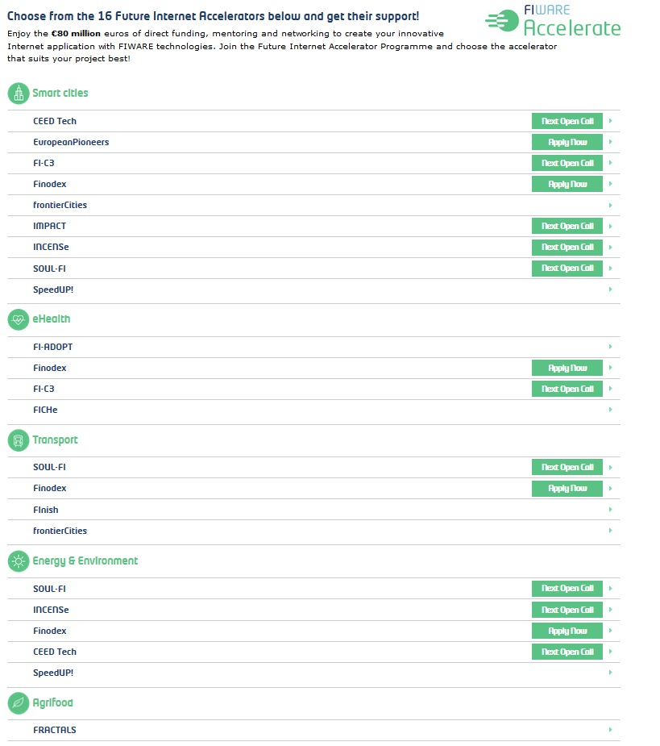
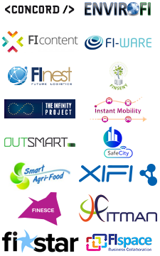
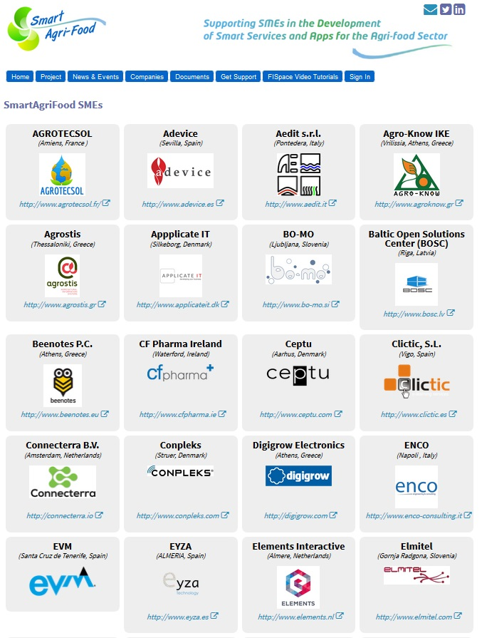
SME accelerators

Slide 17
Important questions
Who are they?
How many?
What cloud resources do they use now?
Other EGI related services?
Would they use cloud provided by EGI and why?

Slide 18
Proposed actions to get answers
Analysis of the agri-food research sector in EU and North and South America (and global?)
Segment: SMEs/Industry and Academia
Definition of personas and scenarios
Link with FI-PPP (and more) accelerator projects
Collect requirements to identify opportunities
Conduct interviews and online survey

Slide 19
Offer services through agINFRA

Slide 20
Offer services through agINFRA

Slide 21
Notes:
Happy to take any questions.

