Slide 1
Cloud PaaS - all user communities meeting
Gergely Sipos
Technical Outreach Manager (EGI.eu / MTA SZTAKI)

Slide 2
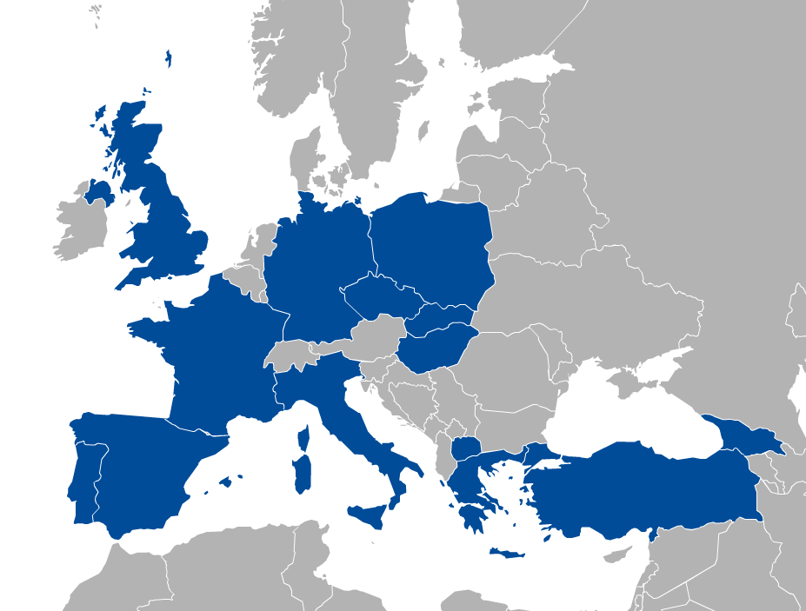
EGI Federated Cloud Infrastructure
Resources
21 providers from 14 countries
17 interested in joining from 7 countries
IaaS interfaces
APIs, Command line (OCCI)
Online guides, videos, etc.
User support teams in 11 countries
Notes:
15 RPs and 12 NGIs on May last year

Slide 3
High Level Tools (PaaS)
Extend the IaaS capabilities of the EGI cloud
Simplify application/service development on cloud
External contributions in the EGI Federated Cloud
Systems currently offered:
Catania Science Gateway
PaaS, SaaS
Slipstream
PaaS for automating deployments
COMPSs
Programming framework for auto-parallelisation
Identity Federation
Helix Nebula
VMDIRAC
Abstraction on top of various HPC/HTC/cloud
WS-PGRADE
Workflow development and enactment
Vcycle
VM lifecycle manager

Slide 4
Goals of the PaaS sessions
Existing PaaS solutions?
Planned platforms?
Bringing in and offering plaforms in EGI?

Slide 5
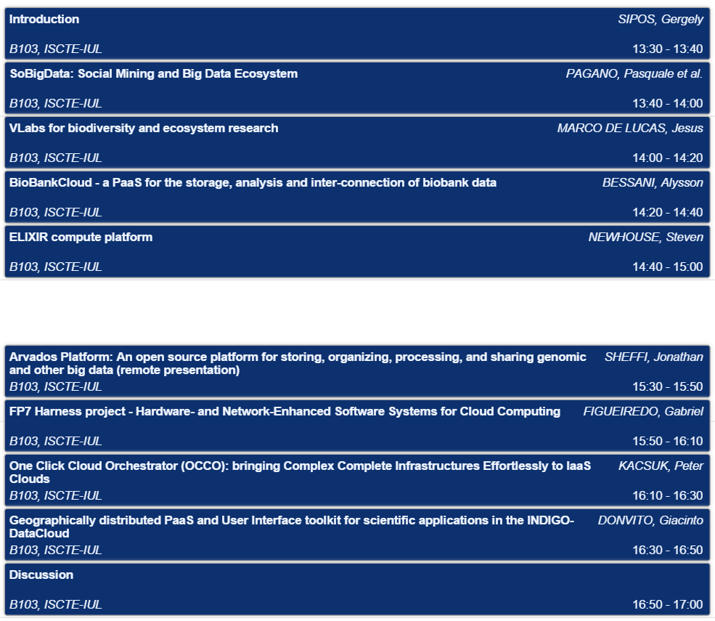
Notes, Q&A: http://go.egi.eu/paas

