Slide 1
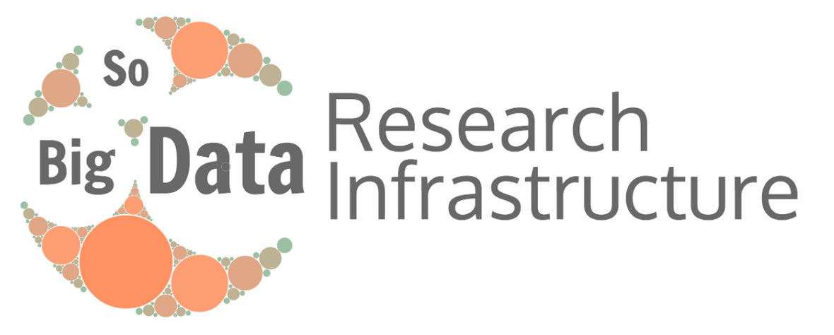
SoBigData: Social Mining and Big Data Ecosystem
Pasquale Pagano and Fosca Giannotti
CNR - ISTI, Pisa (Italy)

Slide 2
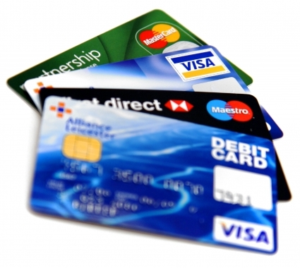
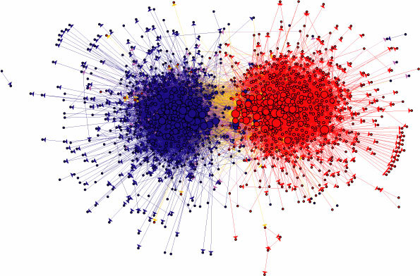
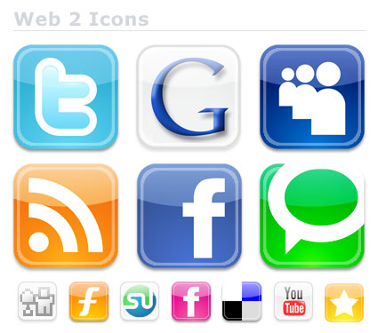
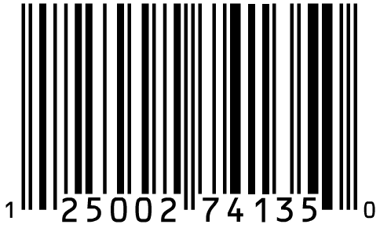
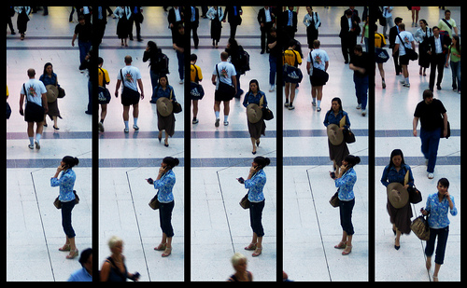
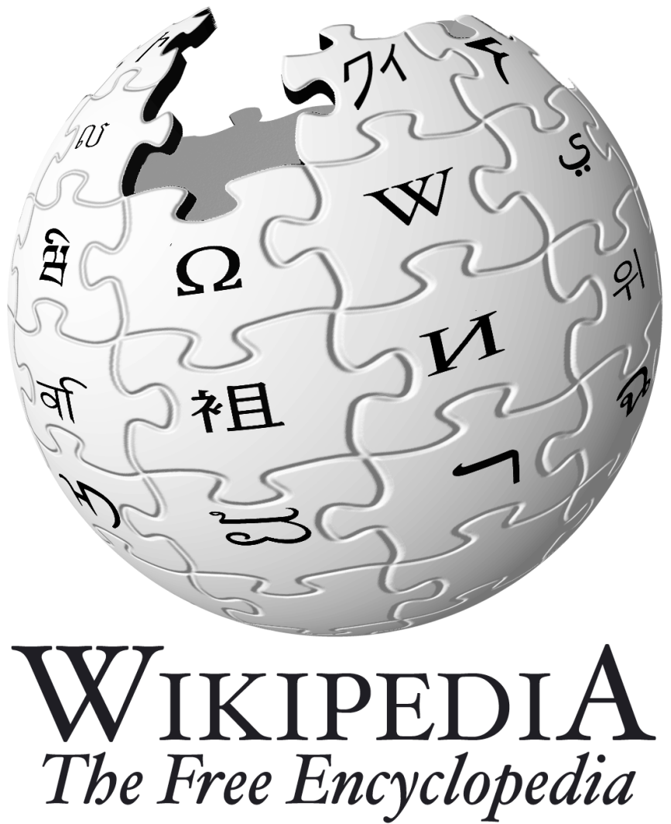
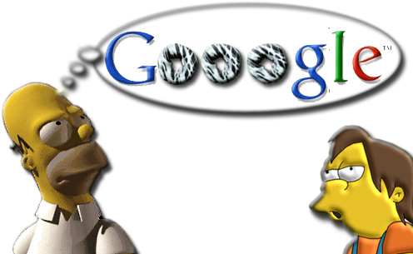
Big data “proxies” of social life
Shopping patterns
Relationships & social ties
Desires, opinions, sentiments
Movements
Notes:
We live in a time with unprecedented opportunities of sensing, storing, analyzing (micro)-data, at mass level, recording human activities at extreme detail

Slide 3
Challenges of Social Mining
Using user-generated content for
discovering and analyzing emergent social behaviors,
by combining sensing of personal micro-data (tweets, web logs, mobile phones traces) and participatory sensing (via crowdsourcing,…)

Slide 4
Answer to :
Which are the indicators of social well-being (beyond GDP) and how can they be computed and monitored?
How is the aging population effectively helped by the social participation to digital community services?
Is an infective disease emerging? How is its diffusion model?

Slide 5
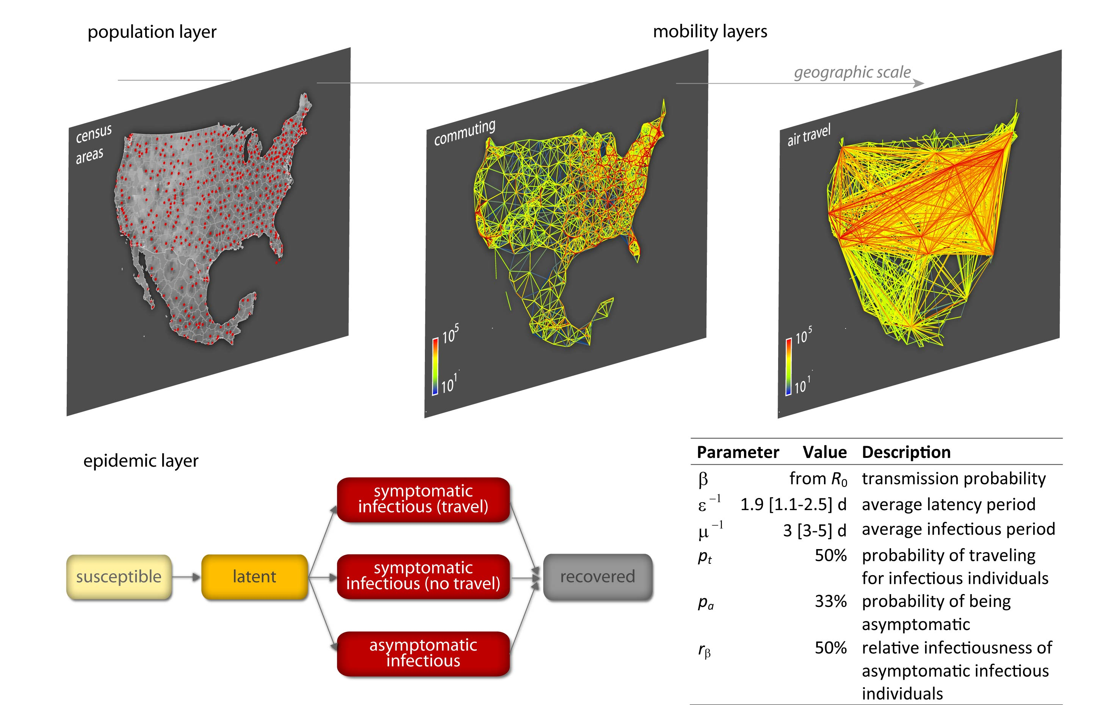
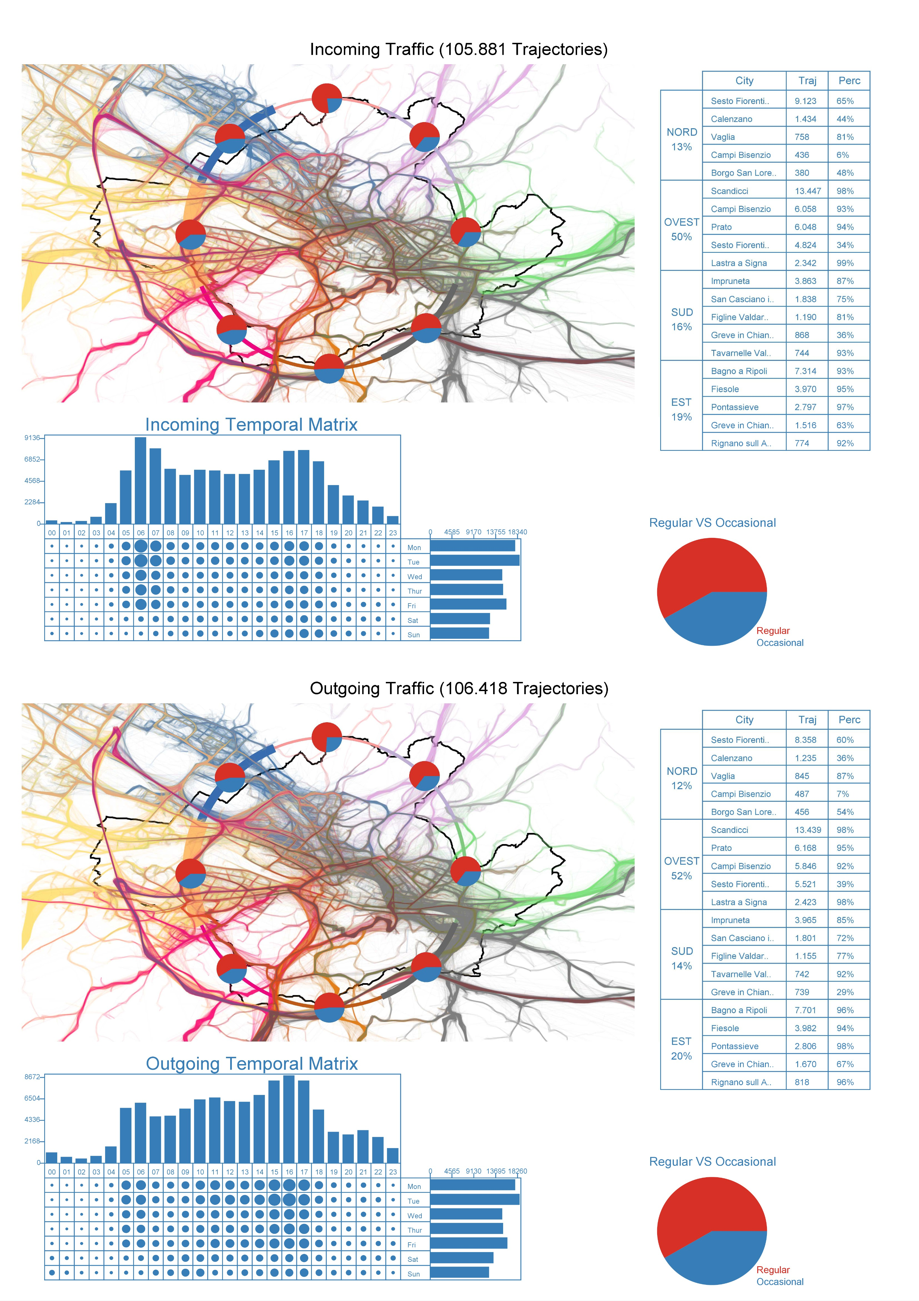
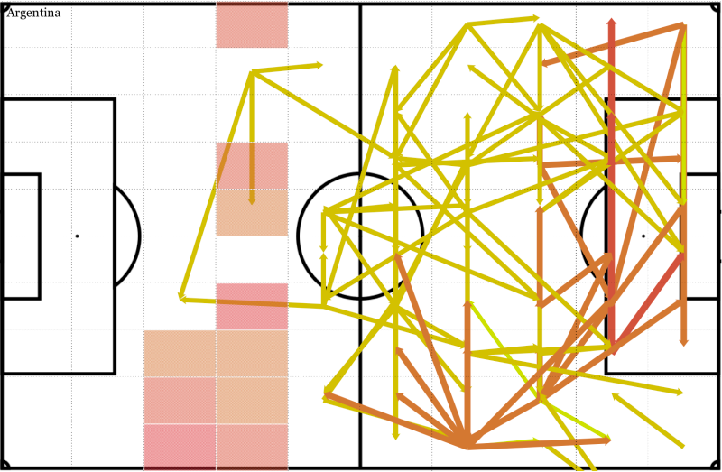
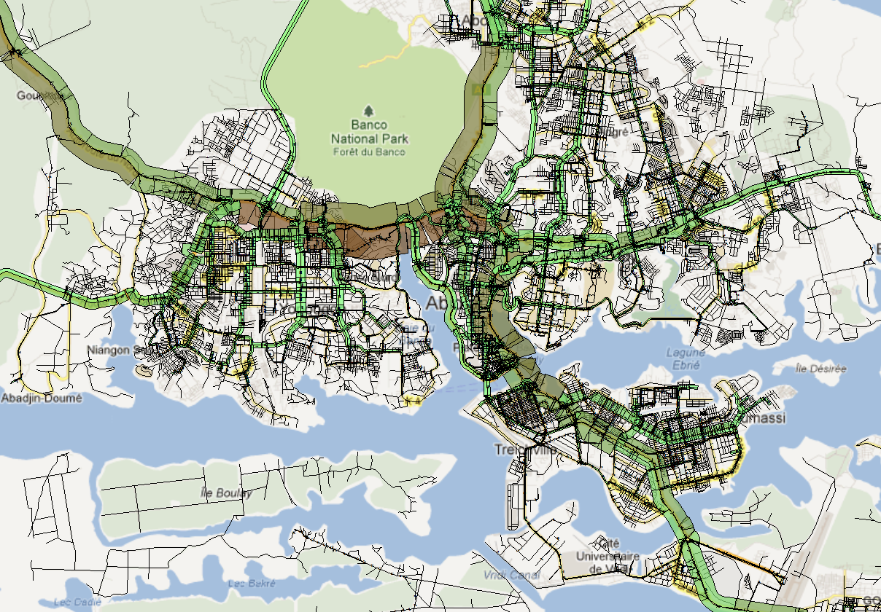
Some Real Examples
Big Data for Epidemic Forecasting
Big Data for Urban Mobility Atlas
The patterns of success in football
Big Data for Developing Countries

Slide 6
All the scenarios require… MODELS
MODEL
Representation of the problem space in the ICT vocabulary (data, processes, systems).
Models can be:
Based upon analytical/statistical laws
Based upon simulations
extracting general behaviors from many observations of the behavior of individuals
Based upon inductive methods applied to data
Notes:
Mathematical model: uses mathematical concepts and language.
Analytical Model: mathematical models that have a closed form solution
Numerical Model: mathematical models that are solved by numerical approximation
Statistical model: uses statistical concepts and language, e.g. probability distribution functions.
Data mining model: extracts patterns from large data sets.
Simulation model: predicts the expected behavior of a system.
Agent-based model: simulates the actions and interactions of autonomous agents (representing individuals, groups or organizations)

Slide 7
Social Mining Vision
a framework combining different models to
measure, understand, and possibly predict
human behavior

Slide 8
What is needed
Data
Platform
Community
distributed data ecosystem for procurement, access and curation of big social data
distributed platform of interoperable, social data mining methods
A starting community of scientific, industrial, and policy makers

Slide 9
www.sobigdata.eu
1 - CNR Consiglio Nazionale delle Ricerche Italy
2 - USFD The University of Sheffield UK
3 - UNIPI Università di Pisa Italy
4 - FRH Fraunhofer IAIS and IGD Germany
5 - UT Tartu Ulikool Estonia
6 - IMT Scuola IMT Lucca Italy
7 - LUH Gottfried Wilhelm Leibniz Universitaet Hannover
8 - KCL King’s College London UK
9 - SNS Scuola Normale Superiore di Pisa Italy
10 - AALTO Aalto University Finland
11 - ETHZ ETH Zurich Switzerland
12 - TUDelft Technische Universiteit Delft Netherlands

Slide 10
Existing national RIs to be integrated
SoBigData.it CNR & University of Pisa & SNS & IMT www.sobigdata.it
GATE USFD, Sheffield UK http://gate.ac.uk
IVAS Fraunhofer IGD, Darmstadt, DE https://www.igd.fraunhofer.
Alexandria LUH, Hannover, DE http://www.L3S.de
Aalto Helsinki, Finland
E-GovData Tartu, Estonia http://www.cs.ut.ee
Living Archive, Zurich, Switzerland

Slide 11
Data&Knowledge&People infrastructure for Big Data
ETHICAL VALUES: privacy, trust, transparency
EDUCATION: data literacy – data scientists

Slide 13
SoBigData.eu thematic clusters
There are six thematic clusters of competences and services
[TSMM] Text and Social Media Mining
[SNA] Social Network Analysis
[HMA] Human Mobility Analytics
[WA] Web Analytics
[VA] Visual Analytics
[SD] Social Data
TSMM
GATE@USFD
SNA
KDD@SoBigData.it
HMA
KDD@SoBigData.it
WA
HPC@SoBigData.it
HPC@SoBiigData.it
WAFI@SoBigData.it
VA
IVAS@IGD
Aalto
SD
LivingArchive@ETH
E-GovData@Tartu
Alexandria@LUH

Slide 14
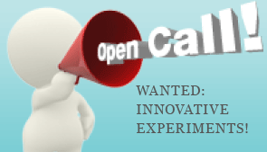
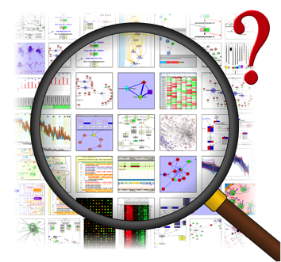
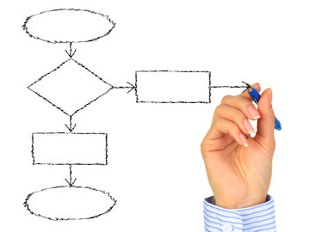
SoBigData.eu Access
There are two access modalities to data and methods:
Transnational Access
Exploratory Projects
Blue-sky projects
Virtual Access
Data and Methods Catalogue(s)
Modular virtual research environment

Slide 15
SoBigData.eu Virtual Access [1]
A Platform to support
Data
Methods
Publication and validation
Policy definition
Anonymization
Encryption
Embargo definition
Accounting monitoring
Publication and validation
Policy definition
Linking to data
Contextualization
Provisioning
Accounting monitoring

Slide 16
SoBigData.eu Virtual Access [2]
Empowered by gCube then Data and Methods entities will become infrastructure resources
Entity
As a resource
As a service
Publication
Methods
Failure mgmt.
Lifecycle mgmt.
Authorization
Access
Orchestrate
Reference
Data
Accounting
Data
Methods
Publication and validation
Policy definition
Anonymization
Encryption
Embargo definition
Accounting monitoring
Publication and validation
Policy definition
Linking to data
Contextualization
Provisioning
Accounting monitoring

Slide 17
SoBigData.eu Virtual Access [3]
Data and Methods defined through the Platform will then
be registered in the Catalogue(s) that will be operated by D4Science as service
be made exploitable via VREs
created dynamically
to include subset of resources (data, methods)
according to the defined policies
to serve the needs of subset of users for a defined timeframe

Slide 18
Thank you for your attention Questions?

