Slide 1
Collaboration in Research with Dropbox for Business
EGI Conference
May 21, 2015 | Mark Reich| markreich@dropbox.com

Slide 2
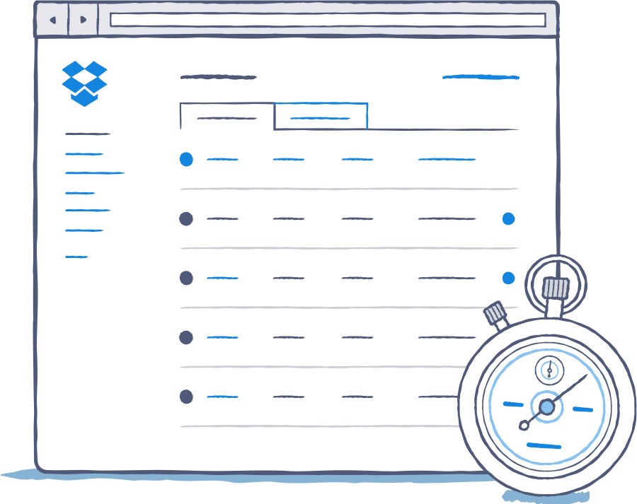
About Dropbox and our customers
Dropbox Security & Compliance
Our Vision
Dropbox for Business in practice
EGI & Dropbox

Slide 3
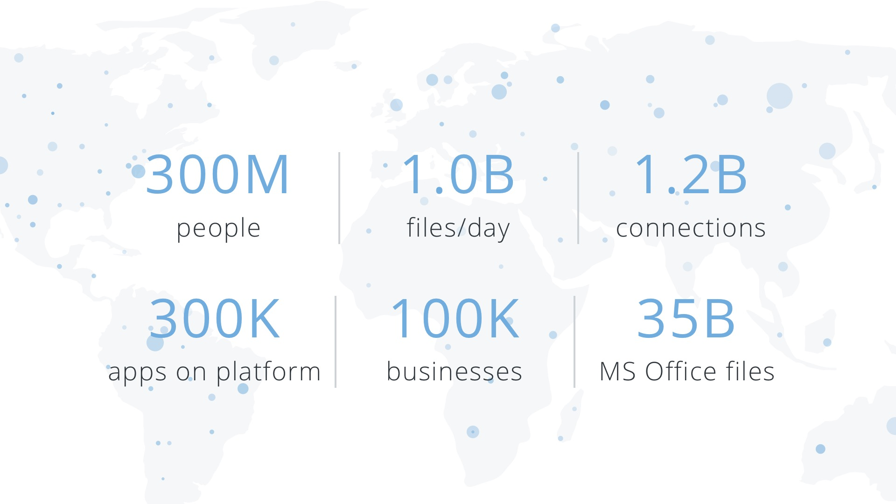
The most scalable collaboration platform with 1.2B live connections
Notes:
Story:
You already know Dropbox as a file sync & share solution for consumers. But we are more than that. We are a collaboration network of global scale. 1 Bn files a day are uploaded, 35 bn office files on our servers, 100k businesses

Slide 4
Global Research institutions trust us
Notes:
Among these organisations are a number of renowned research institutes. SP (Statens Provningsanstalt) in Sweden recently signed up over 600 members. The same is true for CRG (Centro de Regulacion Genomica) in Spain. We even recently have found our first partner in the EGI council, the X project led among others by FMI out of Switzerland. All these projects share characteristics were researchers need to cooperate to obtain their research objectives, regardless of location or institute they are affiliated with

Slide 5
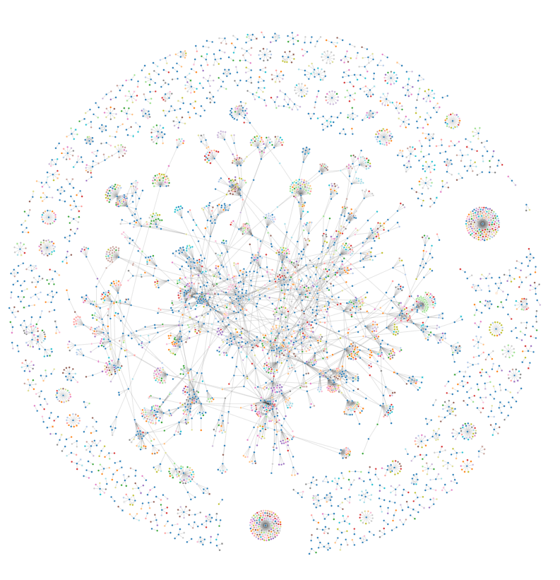
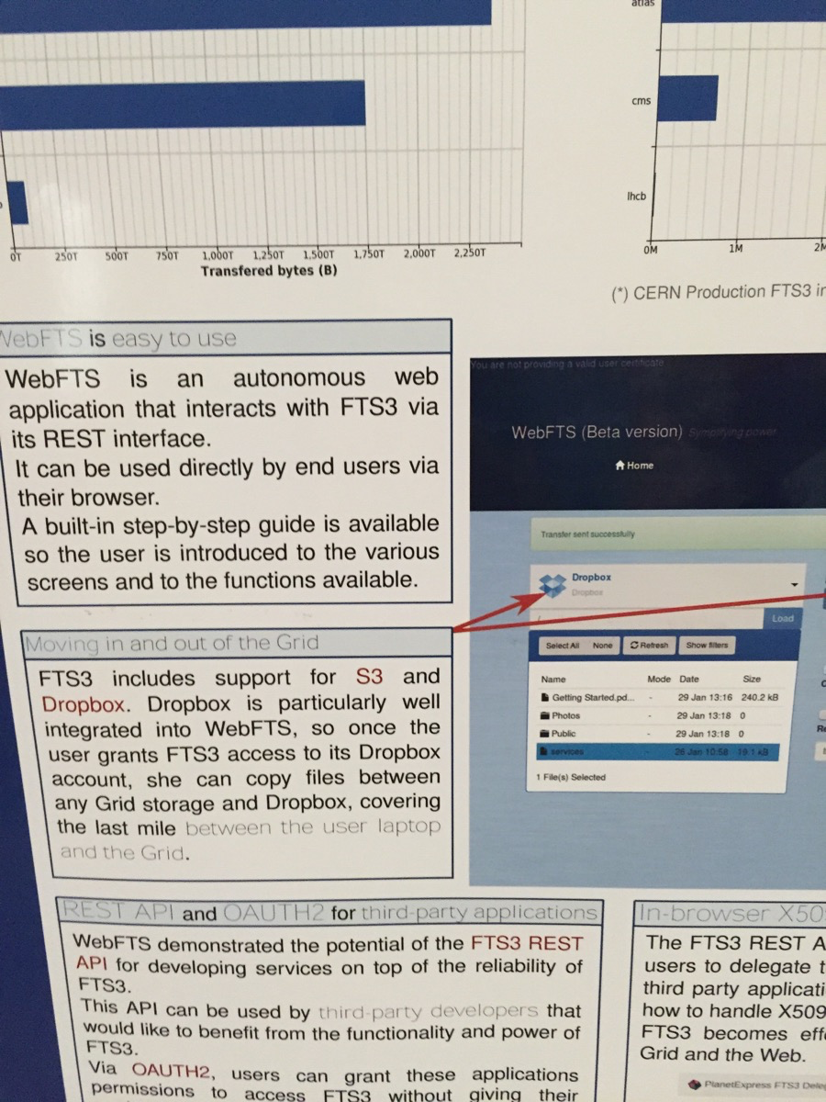
Your researchers trust us
17,000 users
Notes:
I think most of you would be aware that many of your colleagues are working with Dropbox, but I just wanted to share some examples here today to show you our solution already helps many of your peers do their work in a better way:
17,000 users among the 61 members of the EGI council. These are only signups using the respective domains of the institutes
This is what we call a collaboration web. It depicts the users of a domain of one of the council members (blue dots). The lines mean connections via shared folders or links, colored dots are users with other domains
An anecdote from the conference: CERN FTS 3 Data Movement Service integrates with Dropbox (in particular)

Slide 6
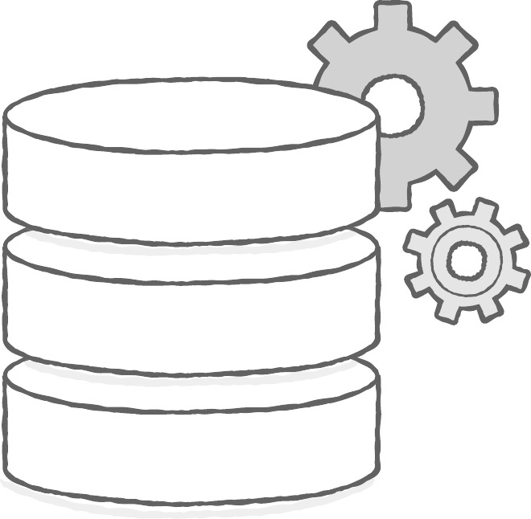
We are worthy of your trust
Secure Infrastructure
Supervision
Adoption
Notes:
The extend of usage might have been new to you, but you all know people use us, this is not why I am here. I want to show you that not only your colleagues should trust Dropbox, but that we offer you a solution worthy of your trust in IT
First, I would like to share with you our understanding of a secure solution when it comes to your data:
The basis is a secure infrastructure, we do this for you but also for 300 million dropbox users globally. If we did not have the highest security standards for our backbone, we would have been dead a long time ago
Here’s is the key difference between Dropbox for Business and the basic version: Supervision → Dropbox naturally gives users the power to do things on their own: Create and eliminate permissions, open new project folders, share links externally. Security in this context also means that the organisation has a way to track what is going on in order to be able to enforce certain policies. Dropbox for Business offers you such supervision
Lastly, and here Dropbox is different from other companies, we make adoption a key aspect of our security strategy. What good is a 100% bulletproof solution if only 40 % of your colleagues use it, leaving the rest to other services. Dropbox already has widespread adoption in institutions across the world. It has the potential to be the only solution, eliminating the risk to data security imposed by unsupervised systems

Slide 7
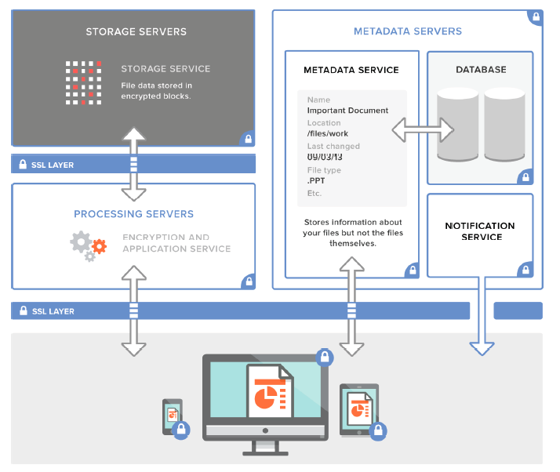
We are built on highly secure infrastructure
Distributed and decentralized infrastructure for security, performance and reliability
Data in transit: SSL/TLS (AES 128-bit or higher)
Data at rest: Files are stored as 4MB blocks, and each block is hashed and encrypted (AES 256-bit)
Notes:
Let me give you some more detail:
- Focus of our infrastructure is security, performance and reliability
We encrypt both in transit & at rest on our servers, with some of the highest available standards respectively
The 4 mb blocks, by the way, are what enables delta sync, the technology that makes dropbox sync so fast

Slide 8
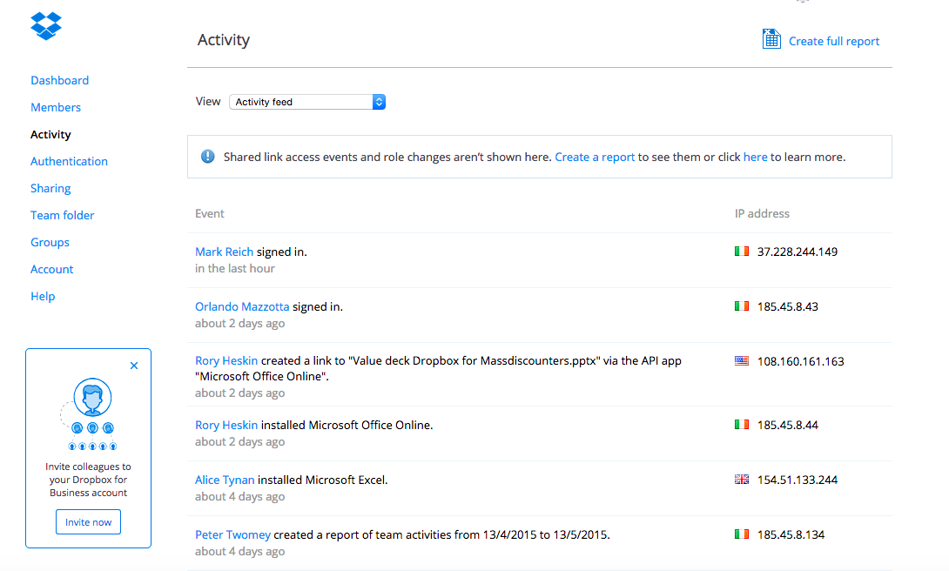
We offer you supervision
SSO & Active Directory integration, SAML
Sharing & file controls (view-only permissions)
Comprehensive audit logs
Remote Wipe & Account Transfer
Notes:
Under supervision, we offer you admin functionalities ranging from integration with Active Directory to special permissions and audit logs.
A specific feature of DfB is Remote Wipe and Account transfer, which lets you remotely delete data from devices and transfer entire accounts with data and permissions between users
→ its about letting users continue in their own right, but giving you final control over the acocunt

Slide 9
And we hold ourselves to high standards
ISO 27001 Information Security Standard
ISO 27018 Data Protection Standard
SOC 3 for Security, Confidentiality and Integrity
CSA Security, Trust & Assurance Registry
U.S.-E.U. & U.S. – Swiss Safe Harbor for collection of personal data
Notes:
I am telling you all this now, but we are making strong efforts to prove this as well
Just this week, we became one of the first companies in our space to receive the ISO 27018 certificate around Data Protection
These auditors certify our technical standards and safety processes. Under NDA, you can request to review the reports

Slide 10
Where is Dropbox going?
We want to be the home for your organization’s data and bring it to life!
Notes:
We are not going to stop here, we have a vision and will develop further to make it come true
- This vision is around collaboration

Slide 11
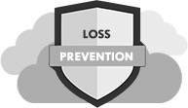
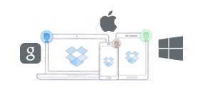
Our vision is based on three pillars
Bringing your data to life
Integrating with your tools
Bridging silos
Notes:
Message:
1) We are ubiquitous, platform-agnostic and connect the silos our competitors build
2) We do not wish to replace your tools, but integrate them
3) We are more than just cloud storage → Our vision centers around collaboration

Slide 12
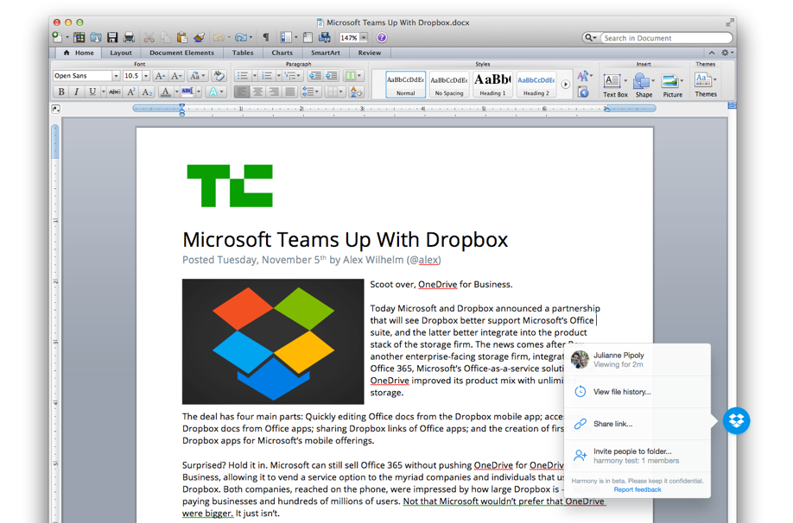
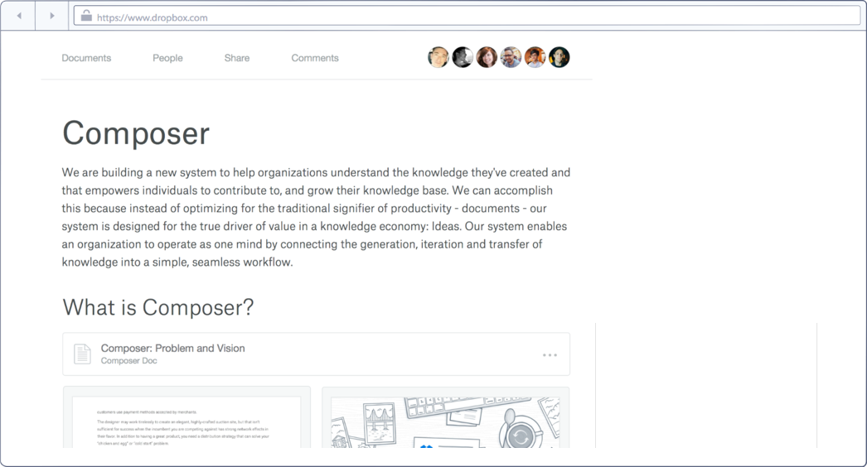
Example: Creating a new collaborative experience
Dropbox Notes
MS Office Integration
Notes:
In collaboration, we are continuosly enhancing our partnership with Microsoft:
Two notable examples: Open files directly out of Dropbox into the mobile Office Apps; Dropbox Badge lets you know who else is working on your file and tells you if there are any unsaved changes to avoid conflicted copies

Slide 13
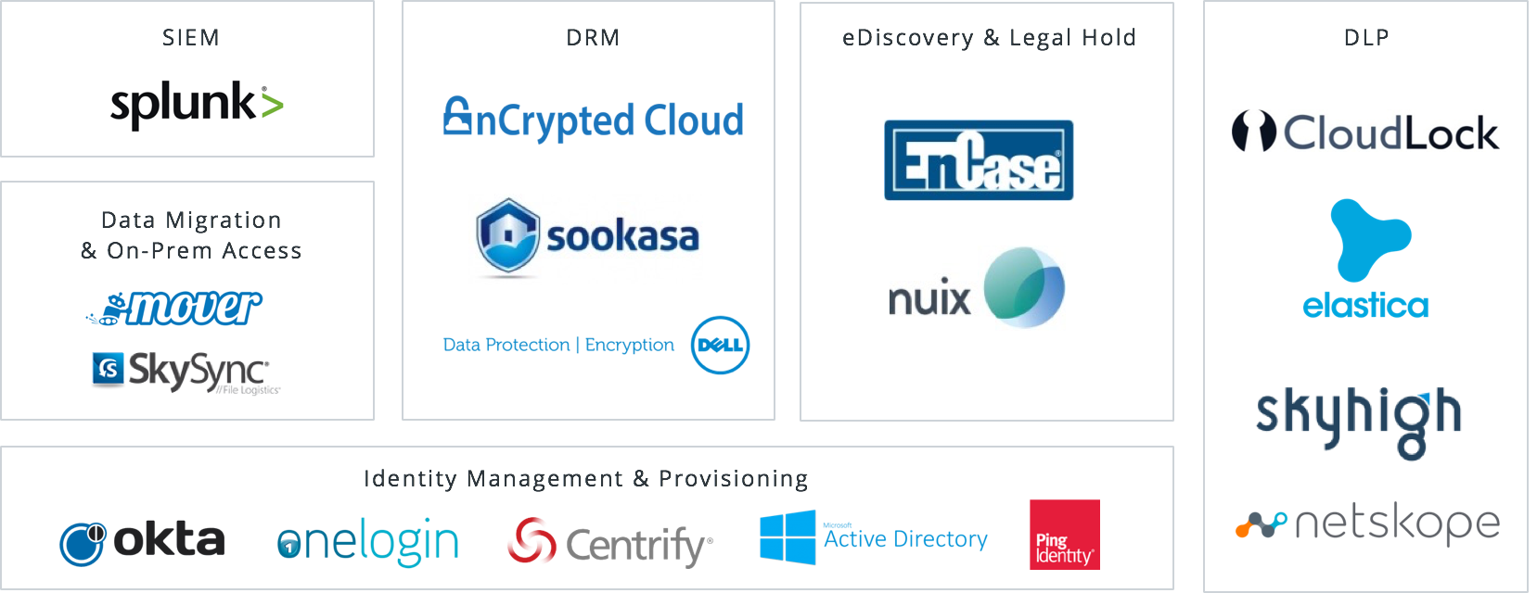
Example: A platform for enhanced security
Notes:
We are aiming at recreating the strong ecosystem of the private version in the professional space
Partners here are centered around enterprise & organization requirements such as Identity management, DLP and encryption

Slide 14
How institutions work with Dropbox for Business
Notes:
Now to share with you some examples

Slide 15
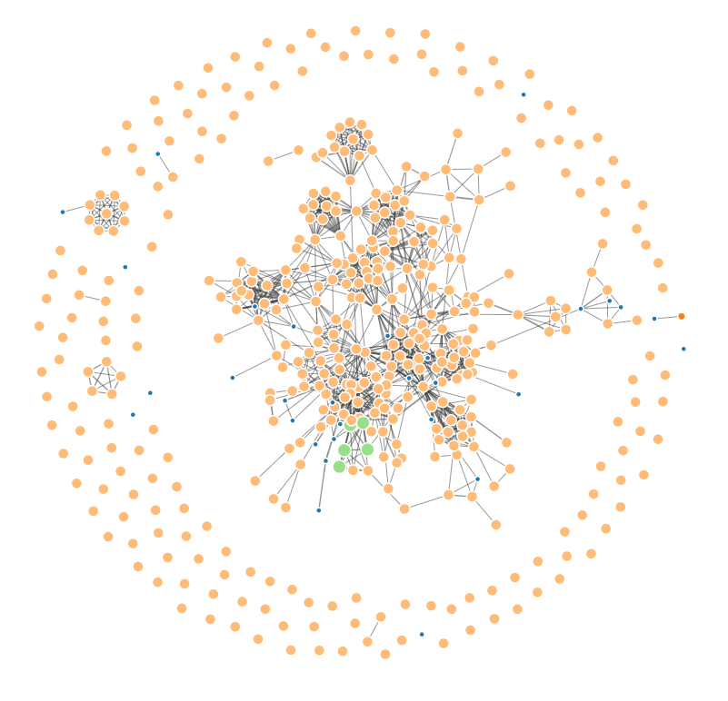
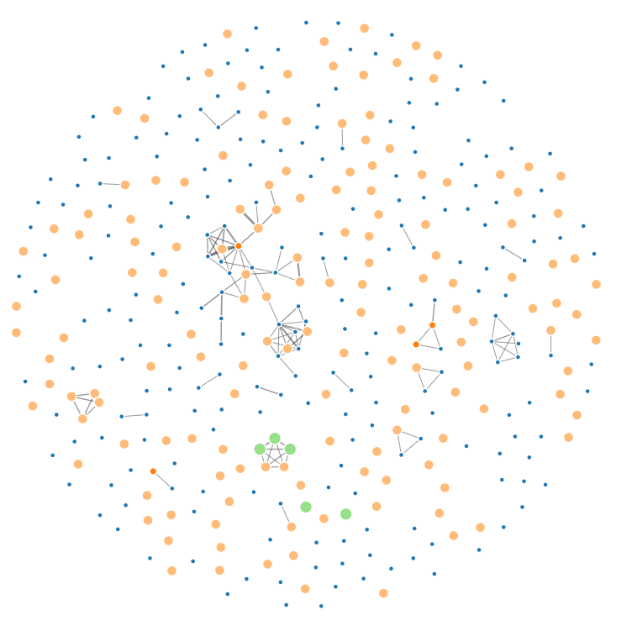
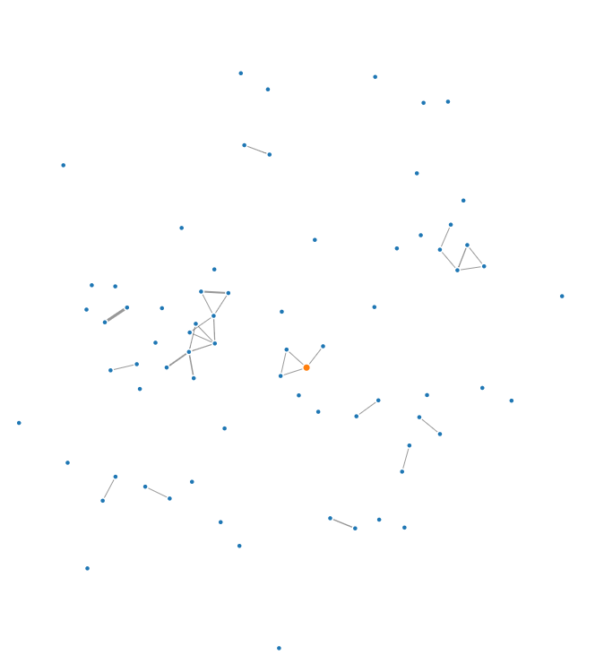
Connecting researchers
2013
2014
2015
Notes:
One of our main strengths remains adoption.
This is one of our biggest customers and their connections on Dropbox before rolling out Dropbox for business (2013), then within the 8 months that have passed between their signing up and now
The dots are users, the lines connections via links and shared folders. You can see how barrier-free information sharing has enabled them to create much stronger connections between the members

Slide 16
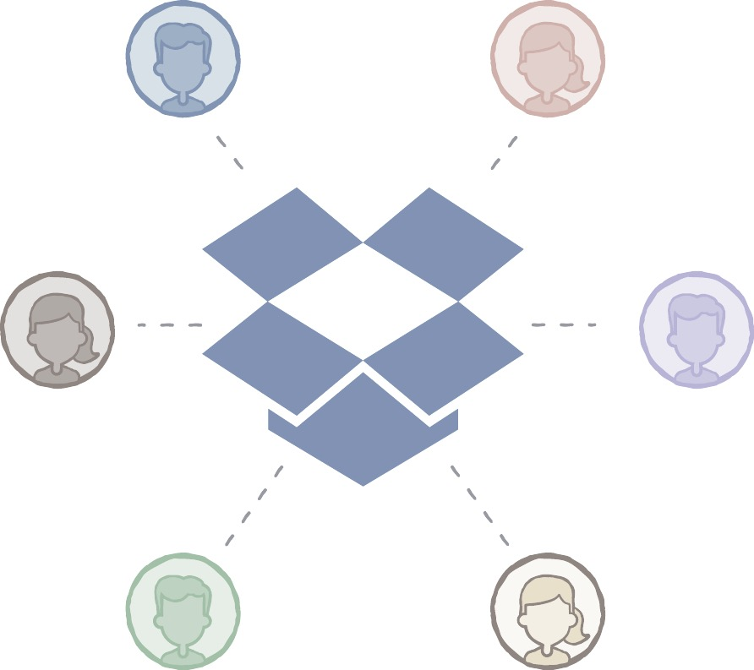
Following established best practices
Fast adoption lead by core users
Dropbox as single source of truth in workflows
Additional Encryption for PII
User-driven: Adoption first, policy second
David Carmargo, Head of ICT@CRT
Notes:
I just spoke with David from CRG yesterday, one of our biggest customers in the research space in Europe. They have seen incredibly adoption of Dropbox for Business in a short time and here is what they did
Usage:
Assigned Lead users that would invite others in their teams. More importantly they made Dropbox the single source of truth. Now, certain data is meant to be stored there and note on individual workstations where it can get lost
On Security:
PII: Sookasa as encryption → researchers have it available and responsibility to use once they feel PII is involved, helps especially when working in the different legal contexts in europe and adds another layer to encryption to sensitive files without limiting the overall user experience
Its responsibility of users. Clear rules will be developed with knowledge of what is feasible

Slide 17
How will Dropbox & EGI work together?
Special EGI Pricing
Designated point of contact
Joint Communication
Individual billing & implementation
Direct support from Dropbox as DfB customers
Members of EGI
Notes:
Our Partnership:
We look to work together to make collaboration within EGI and the individual institutions easier
We will start by offering members a special discount and a point of contact at Dropbox
After an initial pilot our objective is to aim at becoming a full-fledged member of the market place working on joint communication and further integrations

Slide 18
Q&A
Notes:
Our founder, Drew, thought of Dropbox while on a bus from NYC to Boston, when he realized that he had left his USB stick at his apartment. Dropbox began as a simple way to connect people to their devices, and we spent the first first five years perfecting this experience for consumers. Since then, Dropbox has evolved into a network fit for enterprises that connects people to their most important information, apps, and colleagues. This has resulted in 1.2B shared folders and links.

Slide 19
Mark Reich
Core Account Executive DACH
markreich@dropbox.com
+353 87 053 6834

