Slide 1
EGI SLAs and Pay-for-Use in e-GRANT
Sy Holsinger
EGI.eu Senior Strategy and Policy Officer

Slide 2
Outline
Service Orientation
Why SLAs
Establishing agreements through e-GRANT
e-GRANT development to support pay-for-use
Future work

Slide 3
EGI Service Orientation
Individual Researchers
Research communities
Research Infrastructures
Industry
Researcher-facing Services coordinated by NGIs/EIROs/RC
EGI portfolio
v
EGI.eu
portfolio
NGI 1
EGI.eu
Services coordinated by EGI.eu
And delivered in collaboration with NGIs/EIROs
EIRO 1
NGI 2
The EGI Federation

Slide 4
Service Portfolios
Services coordinated by EGI.eu and
delivered in collaboration with NGIs/EIROs
Services coordinated by
NGIs/EIROs/RCs
Coordination
Consulting and Support
Marketing and Outreach
Software and Services
Project and Programme Management
Operations Coordination
Technology Coordination
Security Coordination
Governance & Project Consultancy
Strategy & Policy Decision Support
Policy Development
Technical Consultancy and Support
Helpdesk Support
Marketing
Outreach
Federated Operations
Applications Database
Training Marketplace
Repository of Validated Software
HTC Platform
Grid Compute
Grid Storage
File Transfer
File Metadata Catalogue
Cloud Platform
Cloud Compute
Cloud Storage
Virtual Appliance Marketplace
Notes:
The pay-for-use proof of concept, which was based on a policy paper, started in early 2014 on a best effort basis, which was the supported with
Dedicated effort within the revised Dow from May to Dec.
The main objectives pick out key words)
The final report was produced, which you will have received the executive summary, with a link to a full report, as a means for self-reflection over what was done and to have a record of activities as a foundation for continued activities in 2015.

Slide 5
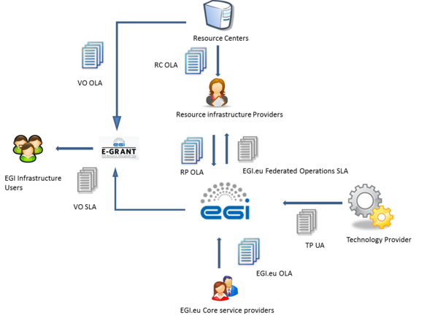
Agreement Framework
OLA: Operational Level Agreement
SLA: Service Level Agreement
UA: Underpinning Agreement
between
EGI.eu
RC/RP: Resource Centers/Providers
TP: Technology Providers
VO: Virtual Organisations

Slide 6
Why are agreements needed?
We know how to do our job

Slide 7
EGI VO SLA: Advantages
It is all about expectations clarity!
Written down for both sides
Monitoring and reporting of Service Level Targets
Practical implementation of collaboration
Negotiation process supported by EGI.eu
Tool facilitating negotiation and reaching agreement
Not a legal contract, No penalties
It should be part of legal contract if in place
Agreement between EGI.eu and VO
Supported by VO OLA between EGI and Providers

Slide 8
EGI VO SLA
Having clearly defined service levels and responsibilities ensuring mutually agreement expectations, comprising:
Scope and description of service
Service hours and exceptions
Service components and dependencies
Support (e.g. priorities and response times)
Service level targets
Limitations and constraints
Communication, reporting and escalation
Information Security
Responsibilities (both provider and customer)
Review

Slide 9
Establishing Agreements

Slide 10
What is e-GRANT?
Dedicated tool supporting EGI Resource Allocation Process
Allows researchers and research communities to request an amount of compute and storage resources, for a given amount of time
Provider A
SLAs
OLAs
Customer
Broker
Provider B
Request submission
Matchmaking
Propose & Sign OLAs
Creating SLA
Propose & Sign SLA

Slide 11
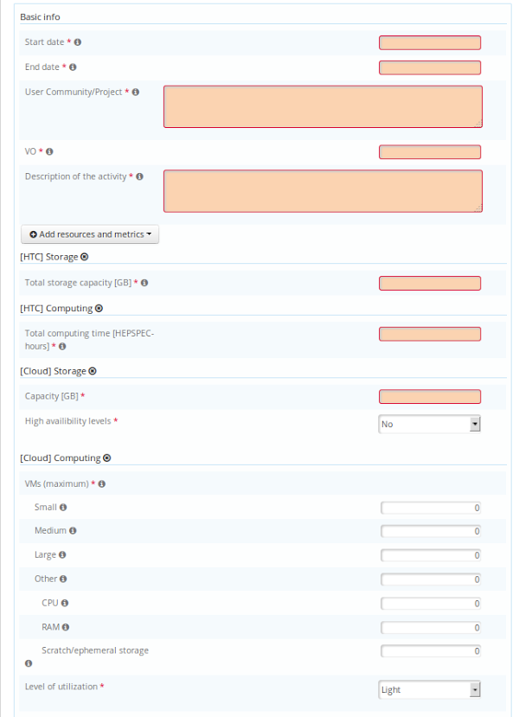
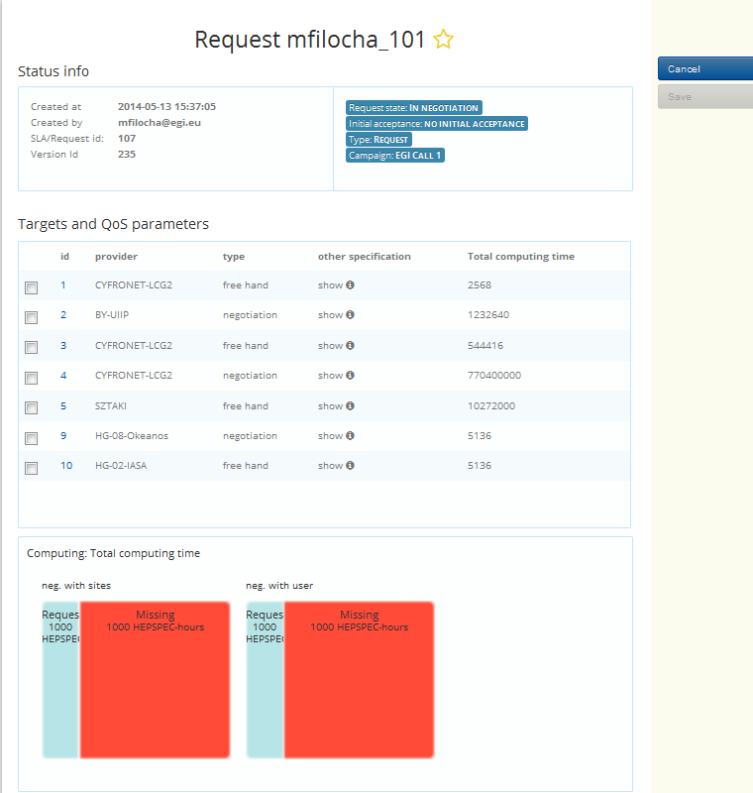
e-GRANT: Main Functionalities
Pool Matching:
Submit request
Find pools with parameters adequate to Request’s metrics
Choose most suitable pools
Create SLAs in which technical parameters are calculated based on customer choice
Defined Quality of Service:
Level C1: Opportunistic
Resources are not guaranteed and are subject to availability
Level C2: Time allocation
Resources are available in fair share-like mode for a fixed time period
Level C3: Reserved allocation

Slide 12
e-GRANT: New Resources
Resource provisioning
The VO provides the resource requirements for a long-term period (e.g. 2-3 years)
The requests are discussed at EGI council level
In case there will be pledged resources, they will be recorded in e-grant, reported in the SLA and monitored

Slide 13
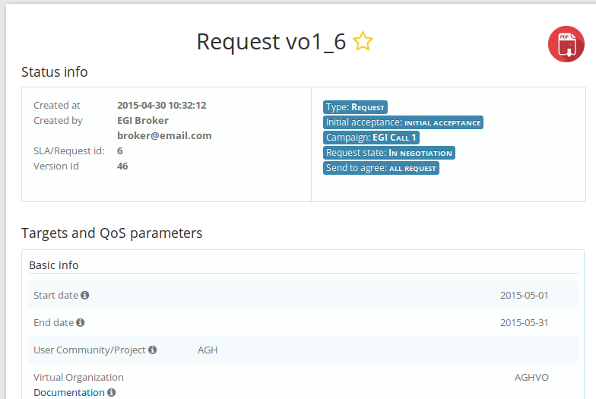
e-GRANT: Workflow
VO Managers submit the request for resources to e-GRANT
RC or NGIs submit an offer (pool) of resources
Negotiation and Agreement process
e-GRANT generates SLA between VO and EGI (1 document for request), based on the template and result of negotiation
Including the additional requirements agreed between VO and RC
Generates the underpinning OLAs between EGI and RC
Notes:
At any stage of the process, you can download the SLA that has automatically generated information – level a detail will depend on what stage of the process you are in

Slide 14
e-GRANT development to support pay-for-use

Slide 15
Pay-for-Use PoC: Initial Business Scenario
2. Searches
1. Publishes Services
Service / Price List
11. Makes payment
3. Selects / Submits Request
4. Agrees SLA
10. Provides Invoice & Reports
8. Adds Users / 9. Uses Services
7. Allocates
Capacity
Customer
Service Provider
5. Informs About New Customer
6. Informs VO
Virtual Organization
Broker
Notes:
In order to optimize the resources, we started by creating a general scenario from providing prices, accounting for them, etc. so we can easily identified what tool we already had that could be used, and what changes or development would be needed.
Currently, the broker plays a support role, but…

Slide 16
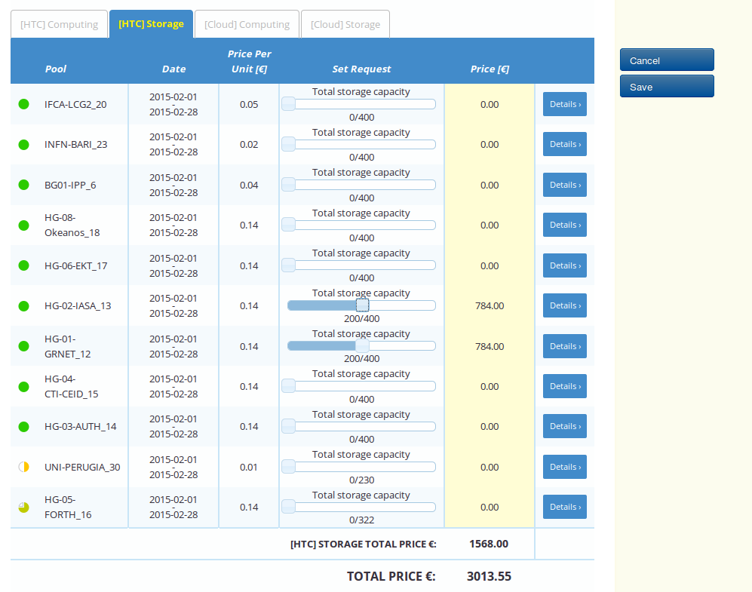
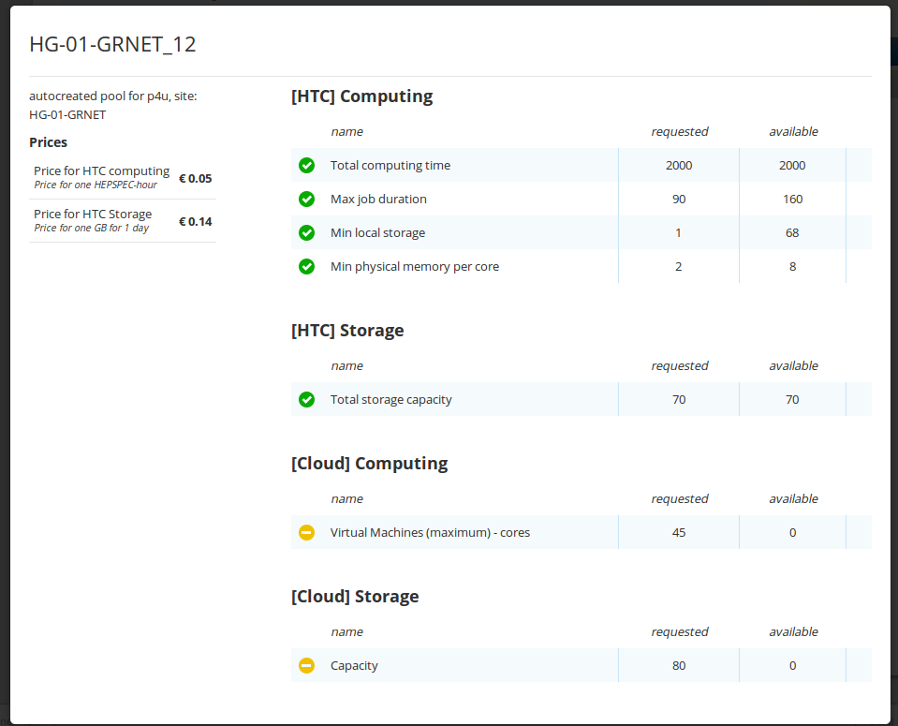
Pay-for-Use PoC: e-GRANT Graphical User Interface
Completed
Special pool type: pay-for-use (w/ price)
Importing prices from Registry
User self-allocation: supported matching pools enabled for customers (existing broker functionality)
Automatic finding and presenting the cheapest allocation that suited requested parameters
Presenting cost of overall allocation
Planned
Proper SLA created based on template and negotiated metrics
Billing according contract/SLA (integration with accounting needed)
Notes:
From the user interface

Slide 17
What Now?

Slide 18
Future Work
Monitoring of resources delivery and QoS according to an SLA
Integration with accounting views (SLA-specific views)
Availability information
Create an interface between e-Grant and ARGO
SLA reporting functionalities
Integration with EGI Marketplace activities
Self-allocation: matching pools enabled for Customers
Support for special types of allocation for “special offers” like LTOS (seed- resources), demostrators, call-for-applications, hacathons, etc.
Pay-for-Use
Advance e-GRANT user-facing graphical interface
Integrate an automated billing function
Increase automation of varying pricing schemes beyond pay-for-use and packaged services (e-GRANT terminology of “pools”).
Ensure FedCloud technical integration (e.g. flavours)
Add legal liability text within SLAs

