Slide 1
EGI strategy to support individual users or small research groups
Peter Solagna – EGI.eu
Operations Manager

Slide 2
What is long tail of science for EGI?
Several interpretation/definitions of the term LTOS
Very often the members of this category do not see themselves as part of the LTOS
EGI defines the long tail of science as individual users or non distributed small research groups
From 1 to less than 10 people who do not need to share processes or data among themselves on the EGI infrastructure

Slide 3
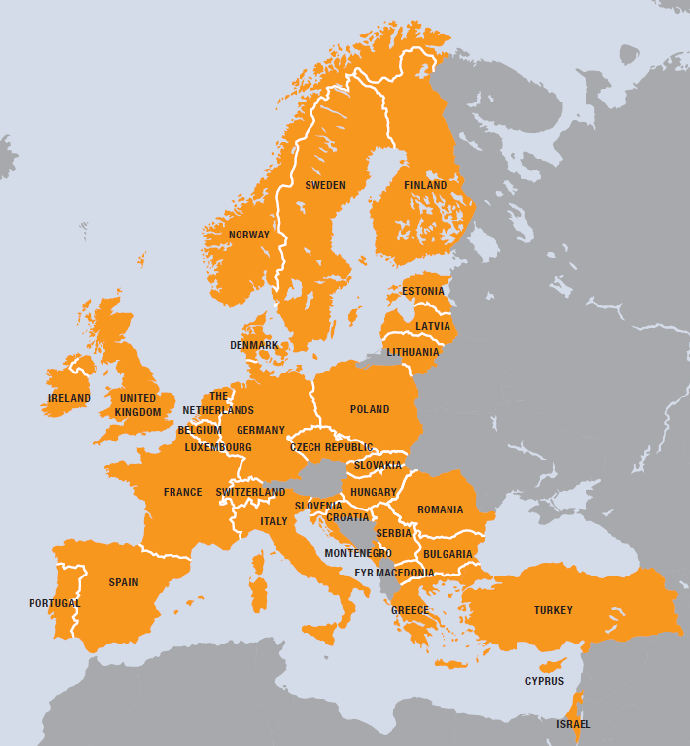
EGI community ecosystem
VO
European
Over 35 countries
Grid
HTC services
Cloud services
Storage services
Infrastructure
350 resource centres
400,000 cpu cores
190 PB storage
SLA AUP
VO
SLA AUP
To support the long tail of science researchers EGI is developing a dedicated platform to address users’ requirements
?
?
For European researchers and their international collaborators
Notes:
EGI have recognised the need for simpler and more harmonised access for individual researchers and small research groups, to remove the barriers that discourage the new users of EGI, and so the EGI community started to design and prototype a new platform in October 2014 to support this "long tail" of science.

Slide 4
Users requirements for a LToS platform
Availability of resources HTC, cloud and storage
Short-medium term access
Quick access, avoid unnecessary bureaucracy
Long-term, dedicated resource access, dedicated SLAs, will still require separate community Vos
Zero-barrier access: any user who carries out relevant research can get a start-up resource allocation
We can decide what relevant means (e.g. any non-for profit)
No need for specialised relationship with an NREN, a CA
No need to establish an Registration Authority at user’s institute
User support
Available through the NGIs/NILs/EGI.eu

Slide 5
Long tail support in the NGIs
EGI designed a platform to address the needs of small research groups This platform is meant to be a central workflow that EGI can offer to the users and to the NGIs
It is a technical support tool that can be reused by NGIs where needed and integrated with their existing processes where needed
Many NGIs already have processes to address the individual users requirements
And we do not want of course to interfere with their processes
On the contrary we will try to integrate as much as possible the platform with existing processes

Slide 6
EGI requirements for a LToS platform
Realistic: reuse existing technology building blocks as much as possible
Secure: provide acceptable level of tracking of users and user activities
Scalable: can scale up to support large number resource providers, technology providers, use cases and users

Slide 7
The high level architecture of the platform
Zero-barrier
IdP
User Management Portal
User DB
EGI SSO
X509
Approves
Security Policy VO AUP
Realistic
Science Gateway
Science Gateway
X509 credentials factory
Resources
Requests

Slide 8
Who is approved?
Users need to:
Be able to demonstrate affiliation with a research institution within Europe, or to have contacts with a research institution in Europe (e.g. a referee in an institution)
Be able to describe the purpose of his/her research
Possibly with medium term goals
Be willing to acknowledge the EGI/NGI support in their publications

Slide 9
Who approves?
There is need for a manual check of the information provided by the user, who is going to test it?
EGI User support/Operations team
Resource allocation team
In the near future, NGI NILs and user support contacts
Having the NILs in the loop will help NGIs not to miss any potential new use case or developing community
Again, this is also a service to the NGIs

Slide 10
Future work: eduGAIN integration
eduGAIN credentials already provide information about the user affiliation:
Research / Education environment
Widespread, already a lot of institutional idp federated
Again, we want to avoid to ask users to create new credentials unless it’s strictly needed
But not mandatory: we will not remove a barrier (x509) adding a new one (mandatory edugain)

