Slide 1



Marine/Maritime Market Analysis - Initial Findings for the iMarine Case
21 MAY 2015
A N D R E A M A N I E R I
Notes:
Good Afternoon everybody.
Thanks Sy to inviting me to give this presentation about the initial findings of iMarine and (now it’s on-the-air) the follow-up project BlueBridge.
The scientific data collected and knowledge generated by the marine/maritime research represent an important value for a number of industries and policy-makers.
In this presentation, I’ll introduce the work done (on-going in this field) by our team as part of the iMarine (formerly), now Egi-Engage and then in BlueBridge about the market sector analysis.

Slide 2

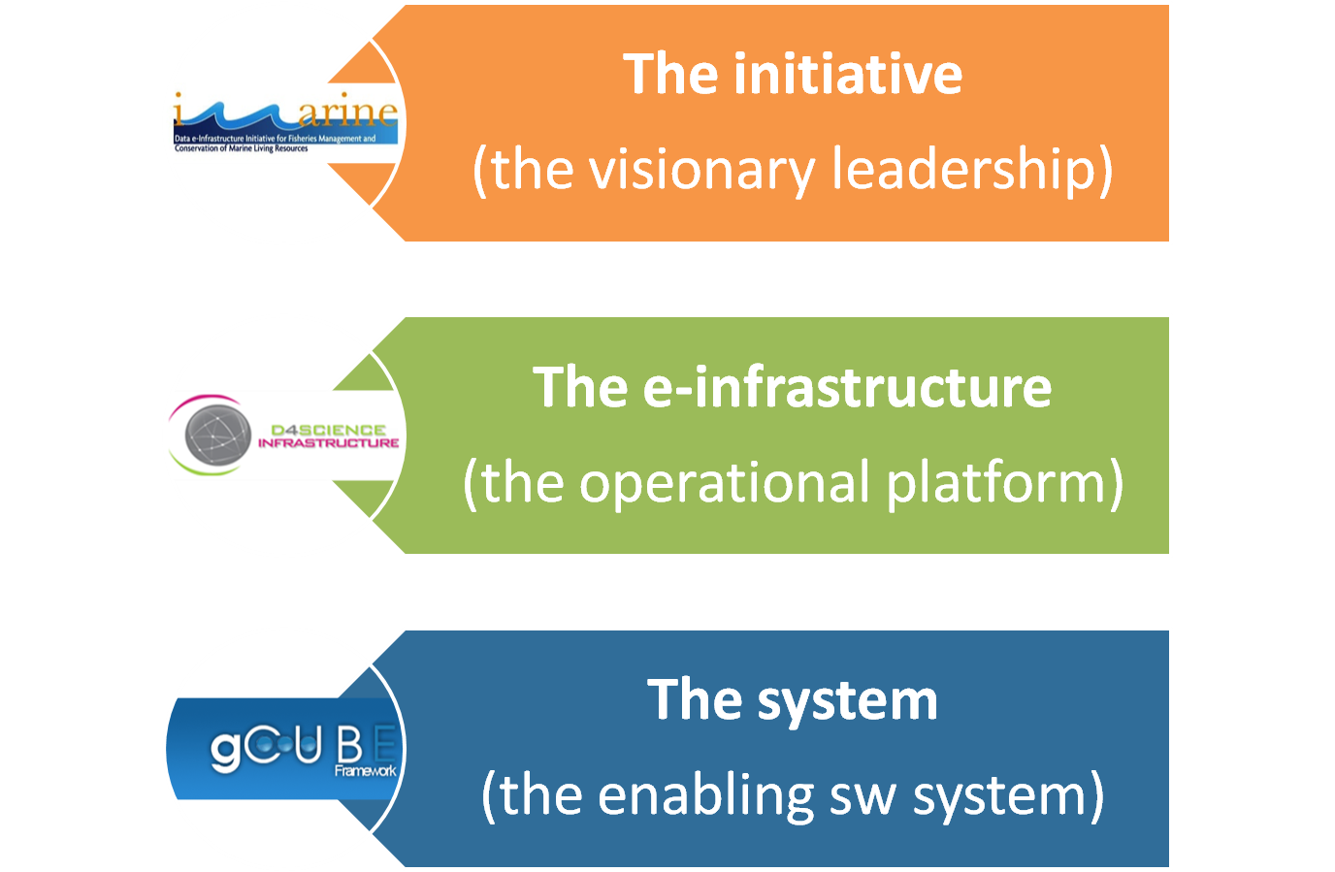

MANAGING DATA / Ten Years of experience
2
Courtesy Pasquale Pagano – CNR-ISTI, iMarine Technical Manager
Notes:
The story of iMarine sit back in 2004, when, as part of the DILIGENT project and in cooperation with CERN, ESA, CNR-ISTI, NTUA et.al we’ve developed a system called gCUBE for the storage, access and curation of heterogeneous data, including satellite and Earth Observation Data and used, in D4Science I and II, to create the data infrastructure.
iMarine is the initiative that uses the services of D4Science to support the fishery and marine research communities.

Slide 3
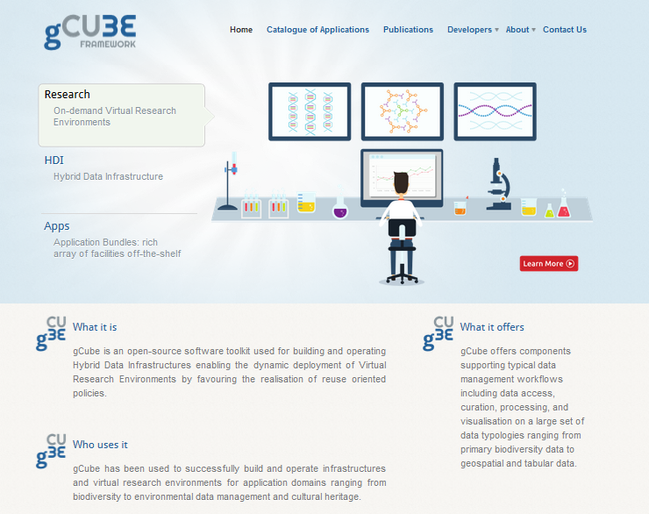
gCUBE / enabling D4SCIENCE
Flexible
abstract over differences in location, protocols, and models by
Feature-rich
resources and technologies into a utility
offering a single registration, monitoring, and access facilities
Automatic scaling of resources,
keeping failures partial and temporary by reacting to and recovering from potential issues.
Storage, Discovery, Indexing, Search, Execution, …
3
Courtesy Pasquale Pagano – CNR-ISTI, iMarine Technical Manager
Notes:
The interesting aspects of gCUBE is the flexible and scalable nature, the ability to deal with any type of data, self-healing features to isolate failures and restore from partial unavailability and other potential issues.
It’s in production since 2008, it’s supported by a dynamic community of scientific programmers, quite stable and fully documented.

Slide 4
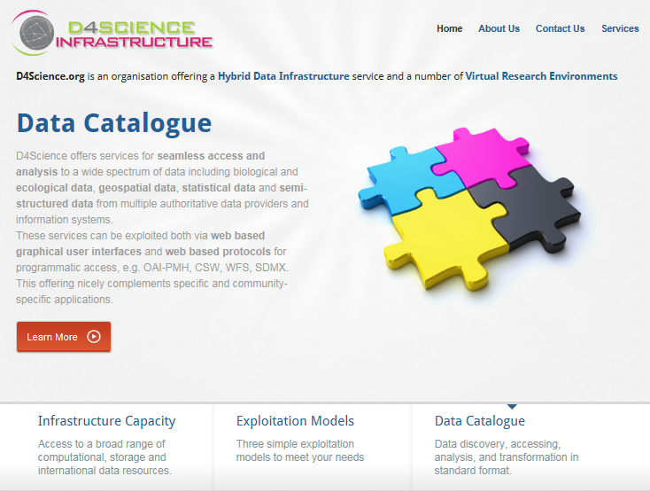
D4SCIENCE / an eInfrastructure per-se
4

Slide 5
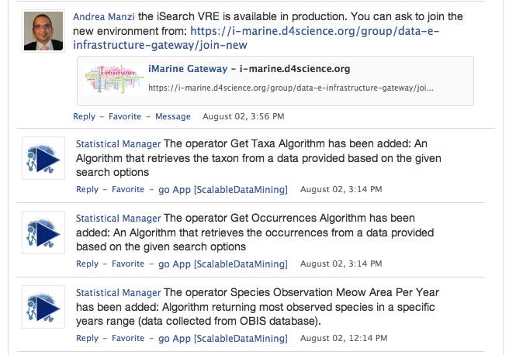
D4SCIENCE / A Social Experience
A single place to
  Get status and updates from applications and other users they are interested in;
  Get notifications about messages, jobs completion, new generated products, etc.
5
Courtesy Pasquale Pagano – CNR-ISTI, iMarine Technical Manager

Slide 6
D4SCIENCE / All-you-need Environment
A single place to
  Manage all the portal extension.
Messages
Workspace
Notifications Page
Search in your Workspace
Home Social
6
Courtesy Pasquale Pagano – CNR-ISTI, iMarine Technical Manager
Notes:
A top-bar menu is used to support the navigation among various features and, from a programming perspective to add extra functions as needed

Slide 7
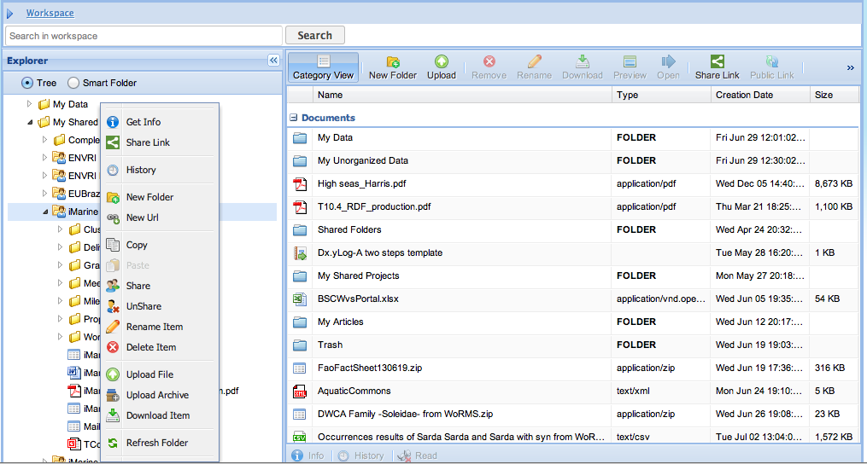
D4SCIENCE / A single-stop-shop to your (research) data
A single place to
  Manage data, store and preserve them
  Share data
7
Courtesy Pasquale Pagano – CNR-ISTI, iMarine Technical Manager
Notes:
Finally, it has been introduce the concept of Virtual workspace where you can store, manage and preserve,, any type of data privately or shared with other users.

Slide 8
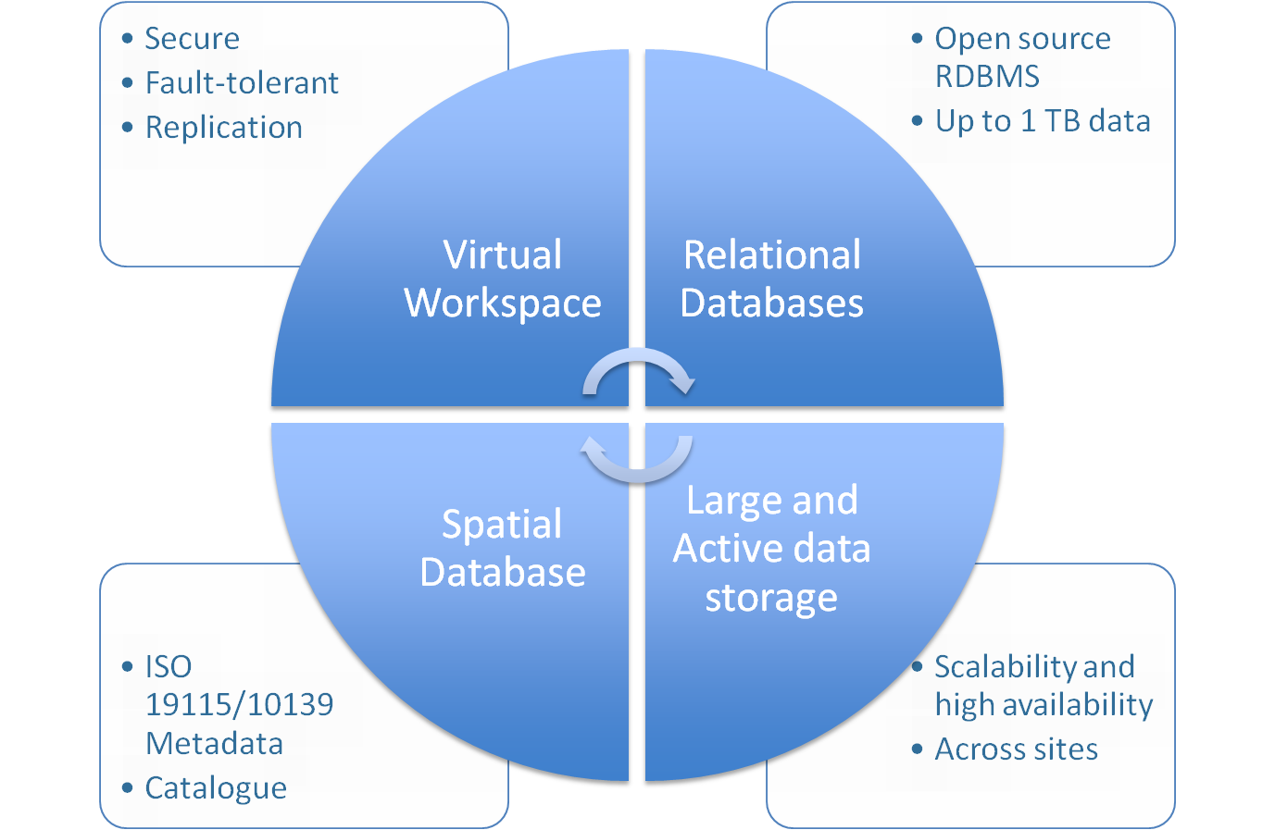
D4SCIENCE / Storage-as-a-Service
8
Courtesy Pasquale Pagano – CNR-ISTI, iMarine Technical Manager
Notes:
gCube allows to store, manage and access every type of data in a transparent way.
It has been designed to allow the dynamic deployment of web-services in the same location where data are to reduce the needs of moving data.

Slide 9
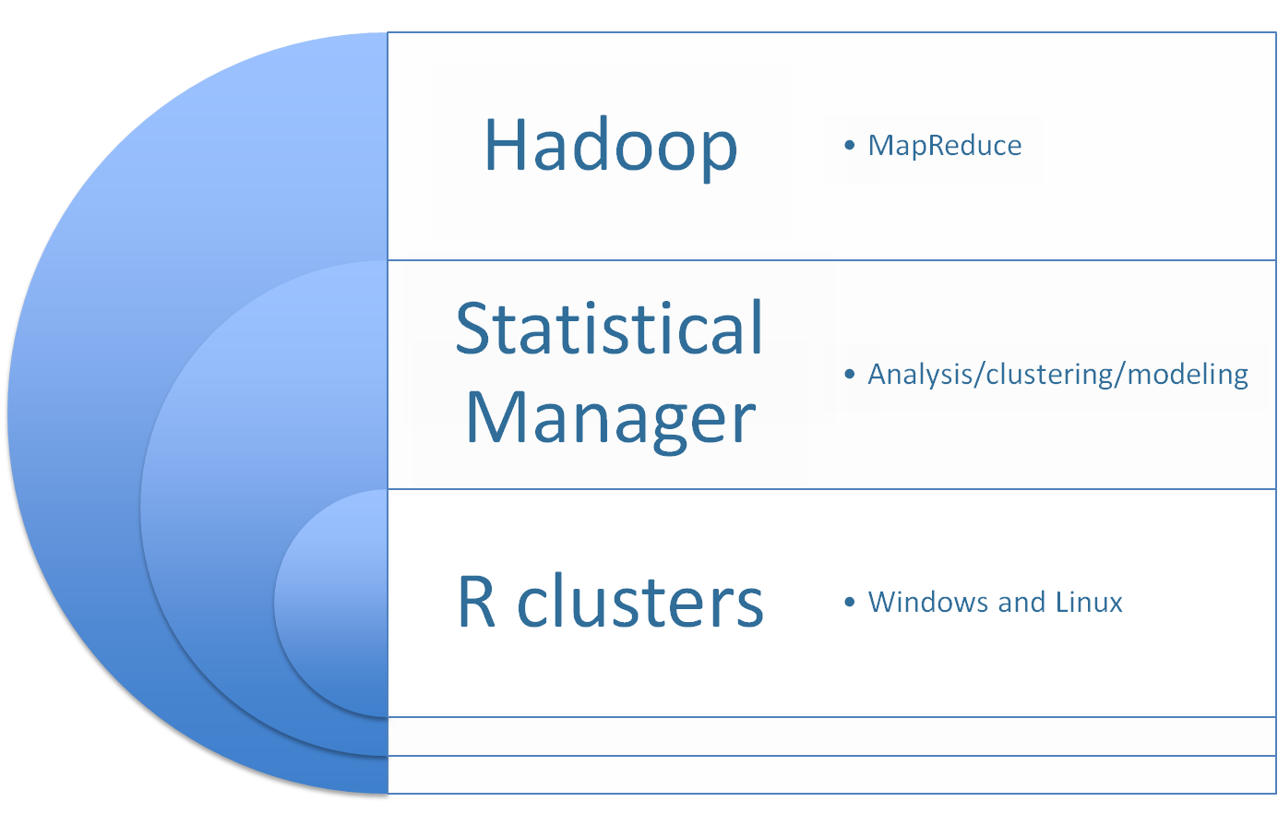
D4SCIENCE / Computing-as-a-Service
9
Courtesy Pasquale Pagano – CNR-ISTI, iMarine Technical Manager
Notes:
Similarly in the Computing area it allow high-level computing paradigms to crunch data, such as NoSql (i.e.map-reduce), Statistical processing (similar to those in Mathlab) and Scientific Computations (i.e. R) to be accessed as a service.

Slide 10
D4SCIENCE / Who don’t count, don’t count (what to count?
Service | Data hosting | Infrastructure
Unlimited users, Infrastructure support, helpdesk, back-up, security
Validation (records) | Workspace | Hardware
Default Processing (<1MB) | Social Tool | Community Management
 | Storage 1TB | Cloud Resources
 | Validation (Datasets) | Custom Data Resources
 | Custom Processing (> 1MB) | Spatial Data integration
 | User Management | Large and Active Storage
 | Unlimited VRE’s
Hour/Day | Month | Year
10
Courtesy Pasquale Pagano – CNR-ISTI, iMarine Technical Manager
Notes:
The built-in accounting framework, developed by Engineering, is used to enable several pay-per-use model, depending on the type of resources and customers needs.

Slide 11
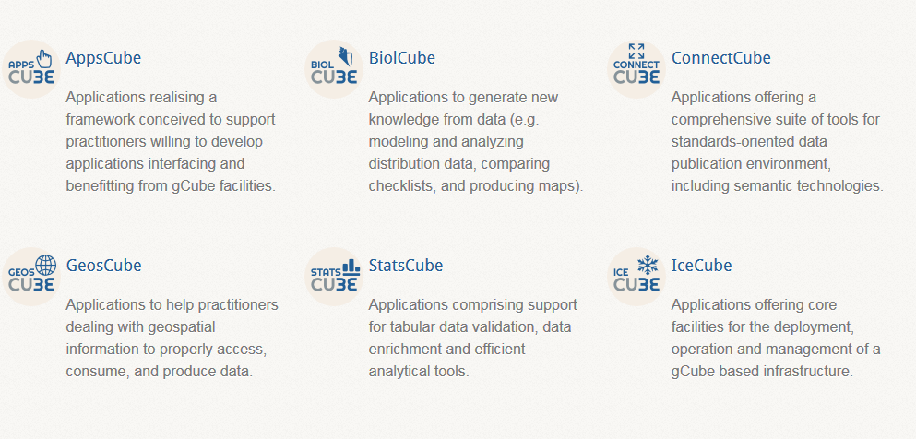
D4SCIENCE / Customised-bundle (ako Data-as-a-Service)
A BUNDLE is a set of services and technologies grouped according to a family of related tasks for achieving a common objective
11
Courtesy Pasquale Pagano – CNR-ISTI, iMarine Technical Manager
Notes:
BIOLCUBE, for the integration and management of biological and ecological data
STATSCUBE, for the management of statistical analysis over any type of data
GEOSCUBE, for the storage and interpretation of geospatial information
CONNECTCUBE, for aggregation, search, access and sharing of any type of resource

Slide 12
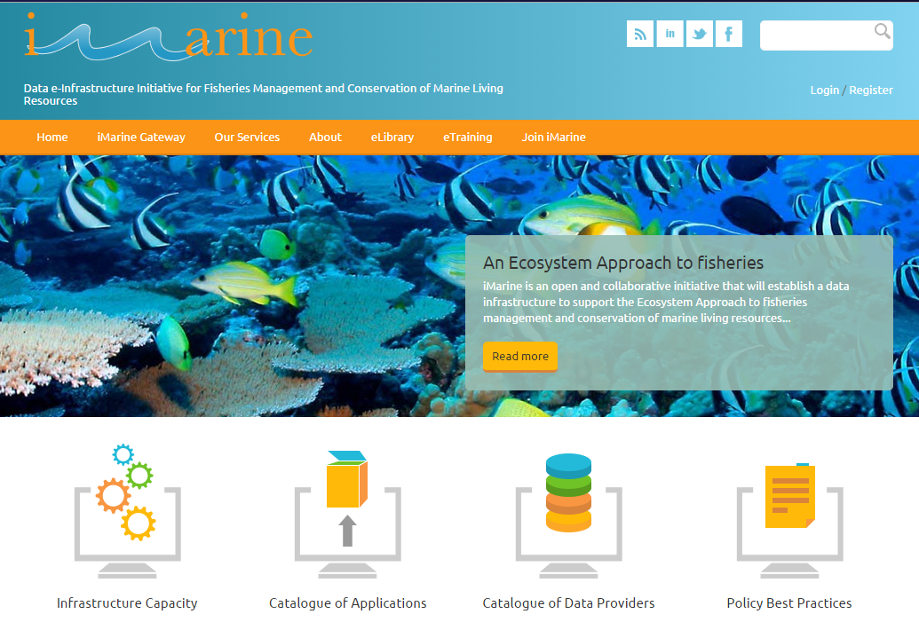
iMARINE BOARDS/ serving the Marine and Maritime community and entities
iMarine Board
Marc Taconet, FAO, Board Chair
Nicolas Bailly, Fishbase Information & Research Group Inc. (FIN), Board Deputy Chair
Anton Ellenbroek, FAO, Board Secretary
Ward Appeltans, UNESCO & Ocean Biogeographic Information System (OBIS)
Julien Barde, Institut de Recherche pour le Developpement (IRD)
Ingrid Bergeret, MEDDE
Hervé Caumont, Terradue
Francky Callewaert, European Commission, DG MARE
Vanderlei Perez Canhos, Centro de Referencia em Informacao Ambiental (CRIA)
Yde de Jong, PESI
Matthew Elliott, UK Marine Management Organisation
Tjess Hernandez, VLIZ
Neil Holdsworth, International Council for the Exploration of the Sea (ICES)
Joao Neves, NEAFC
Friderike Oehler, European Commission, ESTAT
Peter Pissiersens, International Oceanographic Data and Information Exchange (IODE)
Miguel-Angel Sicilia, University of Alcalá
iMarine Council
Stephan Asmundsson, NEAFC
Patricio Bernal, IUCN High Seas Initiatives
Johanne Fisher, FAO
Serge Michel Garcia
Martin Pastoors, Centre for Marine Policy, Wageningen University
12
Notes:
iMarine used all the D4Science services to offer specific research environments (VREs) to the marine/maritime community

Slide 13
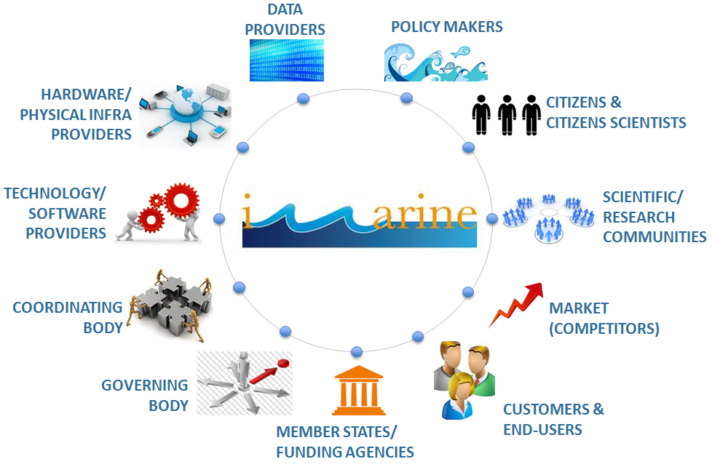
iMARINE SERVICES / serving the Marine and Maritime community and entities
13
Notes:
As for any initiative, to be sustainable, either you marry a billionair or engage with a billion of user (or so).

Slide 14
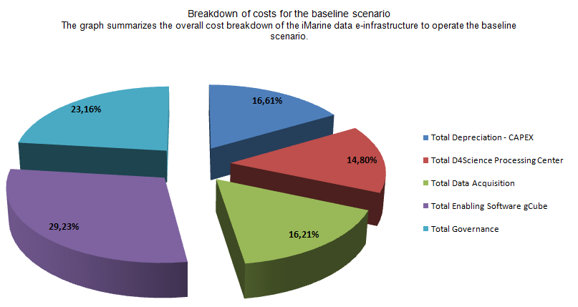
iMARINE SERVICES / serving the Marine and Maritime community and entities
14
Notes:
As for any initiative, to be sustainable, either you marry a billionair or engage with a billion of user (or so).

Slide 15
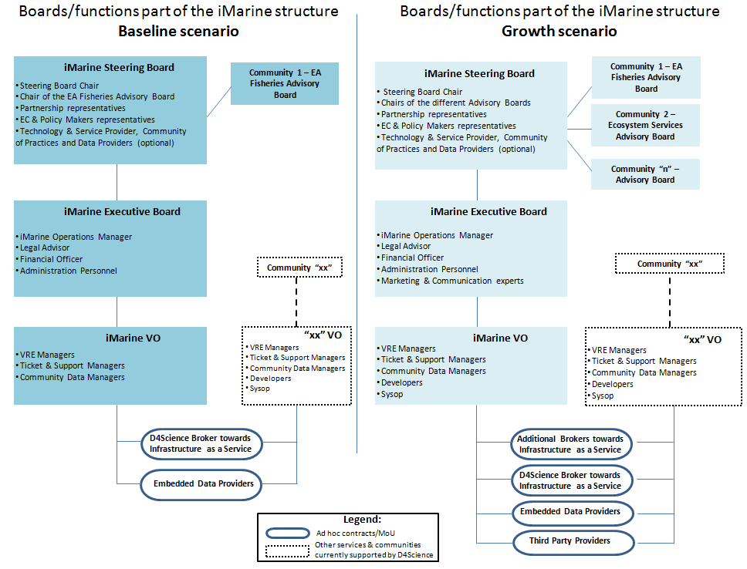
iMARINE SERVICES / serving the Marine and Maritime community and entities
15

Slide 16








MANAGING SCIENTIFIC DATA / a win-win Business Model (?)
Pay for accessing/using
High-Level Services
Data Mgr
Pay-by Projects
(eligible cost for
R&D project)
Data Stewardship
Enabling Platform
(Courtesy David Rosenthal)
Data Access
Data Ingestion
Preservation
Data Processing
Resource
Mgr
Platform
Mgr
Service
Developers
Processor Developers
16
Notes:
Very shortly, in iMarine we captured the complexity of the marine research system through this picture.
In this slide we have several stages in which the data transit. For each there’s a different business model. The challenge is to put all together in a win-win business model.
The ingestion phase is supported by Public funded projects that generate some data. This are kept (i.e. preserved or processed) for the benefit of other users (in the near or far future). This phase should be supported by long-term investments by public initiatives like Eudat or EGI.eu. The Developers of Processors (algorithms that analyse raw data and feed back new data or knowledge) are also supported by grants or (thanks to the citizen science movement) also self-sustained.
The data Stewardship is a bit more complex. Even if some scientist curate their own data for their interest or as part of grants/projects most of the data are parentless.
Then we have the entities and the platforms that enable and easy access to such data (open and free by nature) but adding some value that enable a pay-per-use for accessing such resources. Such money, other than covering the costs (in a no-for-profit basis) of maintaining and running the enabling platform may also cover some costs of processing (processors improvement), preservation or data stewardship.

Slide 17
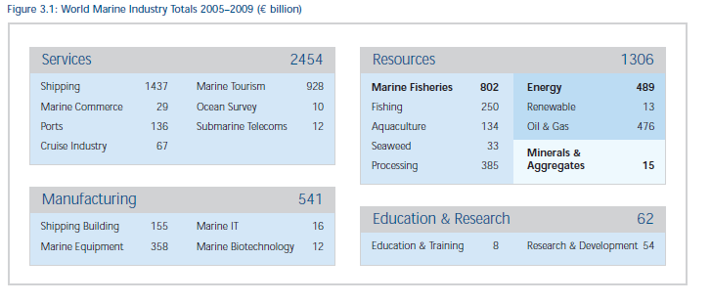
MARINE MARKET(S)/ Qualification of Primary and Secondary Markets
17
Notes:
As for any initiative, to be sustainable, either you marry a billionair or engage with a billion of user (or so).
In order to qualify the sustainable strategy we need to consider if any service and data may be useful to other sectors in the market, other than the Education and Research.
Usually Education and Research have less to pay and more to contribute in kind (for data stewardship and new data)… but the operation of the platform has a continuous cost that cannot be based on competitive calls for funding.
We need to move into commercial environment to ensure the paying users will get value from the researchers work and data.

Slide 18
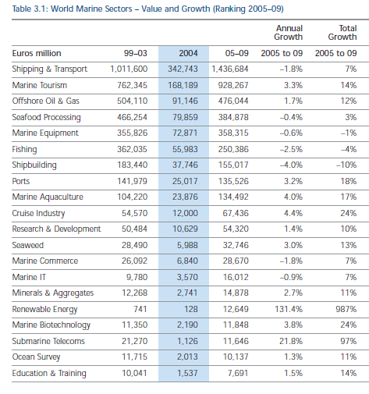
iMARINE SERVICES / Quantification (update) of the market size
18
Notes:
In fact, other the direct market represented by the Education and Research context, already addressed by iMarine, we would like to explore – and quantify – the opportunities in other markets.
The primary targets (in green) are represented by those markets that may have a direct interest in knowledge based on the fishery data available – eg. Marine tourism could use the info about the presence of species in specific routes to get there or to avoid that routes, depending on legal constraints (reserves) or visiting opportunities, or fishing industry and fisheries that may exploit data to get fishing in the right zones with the right means to maintain the species and not destroy the reserves…

Slide 19
EGI-ENGAGE Actions/ Tasks and activities
Broad Market Analysis of Marine/Maritime market (NA2.3)
Sample Cases to be studied from Economic and Legal Point of view (NA2.3)
Regional Database (including DG-MARE)
dissemination gates through web & mobile
Crowdsourcing data Collection
Integrating D4Science and
EGI Fed Cloud (JRA2)
Operating D4Science VREs (SA2)
19

Slide 20
EGI-ENGAGE Actions/ Bringing value to EGI.eu
iMarine (and the follow-up BlueBridge) will
enable the IT resources and data available from D4Science and other EGI sites to be exploited by
  Fishery and marine researchers;
  Fishery and marine industries;
  Other maritime actors.
Demonstrate the feasibility of the business model proposed;
Identify, qualify and quantify a niche in such 5000 Billion Euro market to ensure sustainabilty of D4Science and the iMarine partnership.
20

Slide 21

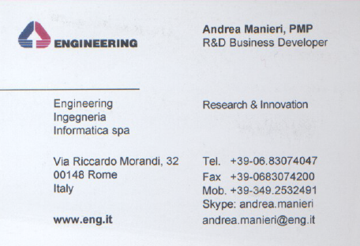

Thanks!
(source: http://valuesdrivenleadership.blogspot.it/2013/06/new-website-shares-findings-status-of.html

Slide 22
Exploitation models
Infrastructure-as-a-Service
  Communities can outsource installation and management of software and databases to D4Science.org
  costs:
    Dedicated VRE providing access to facilities and data: free of charge
    New community providing access to custom facilities and data: to be negotiated according to QoS and SLA, low in average thanks to economies of scale
  benefits: rely on expert operators, established services and procedures, monitoring and alerts

Slide 23
Exploitation models
Software-as-a-Service
  RIs can exploit existing services by accessing to D4Science.org
  costs:
    Dedicated VREs can be created to access either new or already existing facilities and data: free of charge
    New community providing access to custom facilities and data: to be negotiated according to QoS and SLA, low in average thanks to economies of scale
  benefits: rely on expert operators and established services and procedures, elastic resources acquisition and allocation

Slide 24
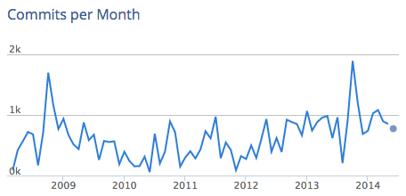

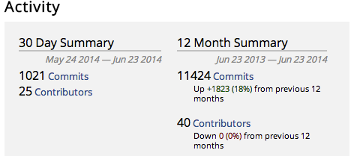

Exploitation models
Open Source
  Licensed under the EUPL
  RIs can install gCube technology (part of it) on their own premises
  costs: HW + expertise + deployment + maintenance
    challenging learning curve
  benefits: retain the control on the entire solution stack

Slide 25
Exploiting existing VREs
Description | You need a workspace where you can store, access, and optionally share files and datasets. You wish to follow the activities performed by the other users of a large community and to join one of the existing applications
Reserved Resources | Zero. Storage and computational jobs queues are shared with other users.
Resources Highlights | Your data is kept private until you share it. However, the computational resources are shared with other users and assigned to you only when needed.
How | Register on the iMarine Gateway and join one of the existing public gCubeApps.
Type of engagement | You are a single user requiring immediate access to biodiversity and fishery data and tailored applications.
Cost | Free to use according to the Terms of Use.

Slide 26
Managing own VREs
Description | You need to create a dedicated environment with specific applications and manage the users by authorizing them to join. Only authorized users will have access to the data used and generated by the newly created applications. You may exploit any of the capabilities and you may add your specific applications and data.
Reserved Resources | From Zero to the resources assigned to manage your private applications.
Resources Highlights | Your data is kept private until you share it with other user of the newly created application. However, the computational resources are shared with other users and assigned to you only when needed.
How | Register on the iMarine Gateway, join the gCubeApps community and ask the gCubeApps VO Manager to become a VRE Designer. Then, design your specific new VRE that will be subject to approval by the VO Manager. On average, a new application is created in less than 24 hours.
Type of engagement | You manage a small set (up to hundreds) of users focusing on a specific scientific topic requiring a common infrastructure to store, maintain, and process data.
Cost | Free to use according to the Terms of Use and without installing any custom and private service.

Slide 27
Managing a new Community
Description | You need to manage a community for a medium/long period and you want to offer members an integrated storage and computational platform for the execution of daily tasks. You may exploit any of the capabilities and you may add your specific applications and data. Data and applications are kept private to your community and confidentiality and security are guaranteed.
Reserved Resources | A minimum equivalent Amazon m3.xlarge – 15 GiB of memory, 13 EC2 Compute Units (4 virtual cores with 3.25 EC2 Compute Units each), EBS storage only, 64-bit platform - is assigned to the community. According to the applications selected in the Application Bundles that have to be offered to the community, the minimum configuration can grow up to 2 m3.2xlarge – 30 GiB of memory, 26 EC2 Compute Units (8 virtual cores with 3.25 EC2 Compute Units each), EBS storage only, 64-bit platform – resources that are reserved to the community. Additional resources can be assigned on-demand to scale up distributed computations and up to the negotiated quota as established in the negotiated phase between the Community Manager and the iMarine Infrastructure Manager.

Slide 28
Managing a new Community [cont.]
Description | You need to manage a community for a medium/long period and you want to offer members an integrated storage and computational platform for the execution of daily tasks. You may exploit any of the capabilities and you may add your specific applications and data. Data and applications are kept private to your community and confidentiality and security are guaranteed.
Resources Highlights | Your data is kept private until you or any other authorized user shares it with either other users of the newly created applications or with the wider community. Only the members of the community use the computational resources assigned to it and the data is moved and stored according to an encryption key that is specific to the community.
How | Contact iMarine through the contact-point mailing list and report the description of the community, the average number of users, the scientific applications you wish to host in iMarine, and any additional information useful for a proper analysis of your request.

Slide 29
Managing a new Community [cont.]
Description | You need to manage a community for a medium/long period and you want to offer members an integrated storage and computational platform for the execution of daily tasks. You may exploit any of the capabilities and you may add your specific applications and data. Data and applications are kept private to your community and confidentiality and security are guaranteed.
Type of engagement | You manage a medium/large set of users focusing on many scientific topics ranging from the analysis of statistical and biodiversity data to the management of geo-referenced data. The community needs a common infrastructure to store, maintain, and process data through the creation of focused applications (VREs), each of which is focusing on a specific scientific goal.
Cost | Negotiated. It depends on the QoS and the number of users of the community.

