Slide 1
ELIXIR Cloud Roadmap
Chairs: Steven Newhouse, EMBL-EBI & Mirek Ruda, CESNET

Slide 2
Initial Mandate
Recognise the cloud will be important for ELIXIR research community
Short-term Activities:
Identifying available cloud resources
Including training, documentation and consultancy needed to fully exploit them
Stimulating demand by raising the visibility and availability of resources
Identifying gaps in both supply and demand
Propose mechanisms to fill them these gaps
Medium-term Activities:
Develop a cloud strategy for ELIXIR for Heads of Nodes (HoN) discussion

Slide 3
Cloud Resources
Site Resources: 15
EMBL-EBI, IPB, KTH, SNIC, INFN, CSC, SurfSARA, CESNET, BSC
Countries
EMBL-EBI, FI, NL, CG, CZ, FR, ES, IT, SE, Nordics
Technologies:
OpenStack, OpenNebula, StratusLab, VMware
Part of EGI Federated Cloud
3 resources (2 sites)

Slide 4
Use Case Scenarios
Infrastructure as a Service (IaaS)
Establishing virtual clusters for expanding local resources
Running data analysis pipelines near pre-existing large data sets
Secure environment for analysis of sensitive data
Platform as a Service (PaaS)
Scalable web service hosting frameworks
Managed analysis environments (external administrators)
Shared development environments (all can access)
Providing standard VMs to run on IaaS
To deliver a software environment
To deliver a software product
For training
For testing software in different environments

Slide 5
Liaison Activities
Internal with other ELIXIR TFs
AAI: Used to control access to cloud resources
Service Registry: Cloud instances must appear and be searchable [Not in scope]
Storage: Needs to be accessed from cloud resources
Training: Cloud infrastructure to support training
Metrics Monitoring & Quality Control: Must include cloud instances [May not be in scope]
External with e-Infrastructures
With EGI discussions over the last 12 months… activity in EGI-Engage ELXIR CC
With EUDAT through pilot projects… activity in EUDAT2020
With GEANT through Enlighten Your Research initiatives

Slide 6
ELIXIR Excelerate
Administrative
4 year EC funded project
Start date 1/9/15 (TBC)
EC contribution EUR18M
38 beneficiaries (inc. JRUs)
Goal: Accelerate implementation of ELIXIR
Implementation of the ELIXIR Scientific Programme
Engagement with user communities
Integration of national ELIXIR Nodes
Coordination of a distributed infrastructure

Slide 8
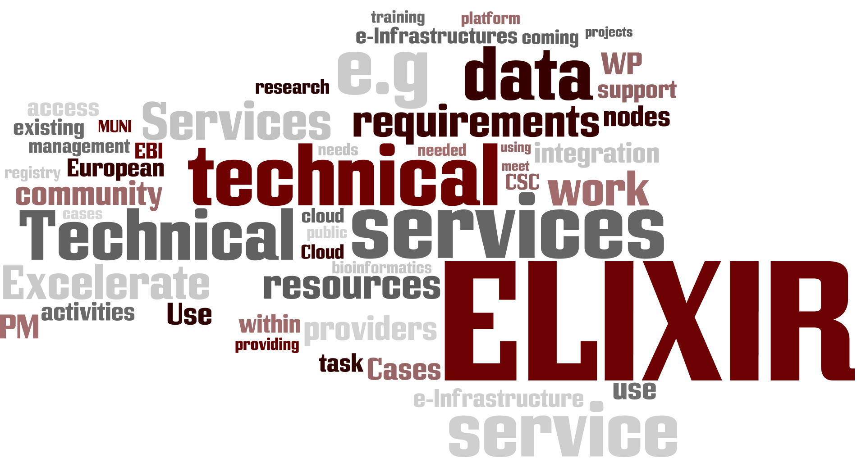
Excelerate Technical services WP4 (€2.060.000)
ELIXIR cloud offerings and services; Secure data access and exchange; Resource management and exchange policies; Technology watch and e-infrastructure synergies.
WP3 builds on active task forces that have emerged from the ELIXIR community: Cloud, AAI and Storage & data transfers
Challenge: positioning. W.r.t. European e-Infrastructure and ELIXIR nodes

Slide 9
Tasks and PMs (206PMs)
Task 3.1: Leadership and community building with ELIXIR TeC
Including interaction with e-Infrastructures
Task 3.2: User-facing support
Requirements and operational support to the 4 main use cases
Task 3.3: Compute Platform integration
Researcher authentication and authorization services for ELIXIR
Cloud and compute service access enabling use of large processing capacity/capability
Storage environment and data transfers for compute-level access to large data
Registry of ELIXIR infrastructure services
Notes:
The picture at slide 5 is not consistent – the Integration to use cases includes there also tasks 3.2.
I propose to call the Task 3.3 Platform integration and to use the same wording in the scheme on Slide 5

Slide 10
Research Platform 4 Life Science (RP4LS)
ELIXIR
Activities, Projects, & Training
Excelerate
Scientific Use Cases
User Integration (T4.2)
Technical Integration (T4.3)
PIDs
ORCID
Workflow
engines
ELIXIR Compute Platform
Authentication & Authorisation
Resource Accounting
File Access & Movement
Service Directory
Service Registry
Management (T4.1)
External Funds
Cloud IaaS
(ELIXIR & beyond)
Data Archive
Data Source
Meta-data & file location Catalogue
Excelerate Funded
Network

Slide 11
Activities related to the ELIXIR Compute Platform
EGI-Engage CC
Running a non-human analysis on the EGI Federated Cloud
EUDAT 2020
Explore using EUDAT for data set replication and discovery
Issues:
Want to minimise additional software deployed at a site (e.g. iRODS, UMD)
Neither users or administrators use certificates
When will these not be required to manage an EGI Federated Cloud site
Impact
Need EGI to facilitate the adoption of EGI Federated Cloud within ELIXIR
ELIXIR needs a stable platform (EGI Federated Cloud?) to deploy onto

Slide 12
Infrastructure Developments
Virtual Machine Library
EGI’s App DB is closely integrated with EGI’s Federated Cloud work
Provide means to upload VMI and distribute these to sites
Use PERUN (from CESNET) to manage VO of allowed cloud uploaders
PERUN and EGI AppDB support federated identity tokens
Collaboration with Bull
Provide a portal for launching and managing VMs
Bull provides resources to build and integrate the portal

Slide 13
Future activities with this infrastructure…
Populating the VMI Library
Galaxy Workflows
Collaboration with NeCTAR (Australia)
Training Virtual Machines
Contribution from all authorised parties (through FedID and PERUN)
Services
Put VMs of EMBL-EBI services in library for download and remote operation
Cloud Usage
ELIXIR researchers allowed to run one VM on a federated cloud?
Allocate resources across sites for large scale analysis (e.g. PanCancer)

Slide 14
Summary
ELIXIR willing to look to EGI for its Federated Cloud capability
This model needs to be seen (and have value) for the ELIXIR community
Needs to be certificate free for administrators (as well as users)
Needs to be a quick and easy solution (minimal local deployment)
Strong OpenStack base
But interest in commercial software (VMware) and commercial services (AWS, MSA GCE )
ELIXIR Compute Platform
Building on e-Infrastructures (see B103 Wednesday @ 14:40)
Employment
EMBL-EBI is hiring to support this work (steven.Newhouse@ebi.ac.uk)

