Slide 1
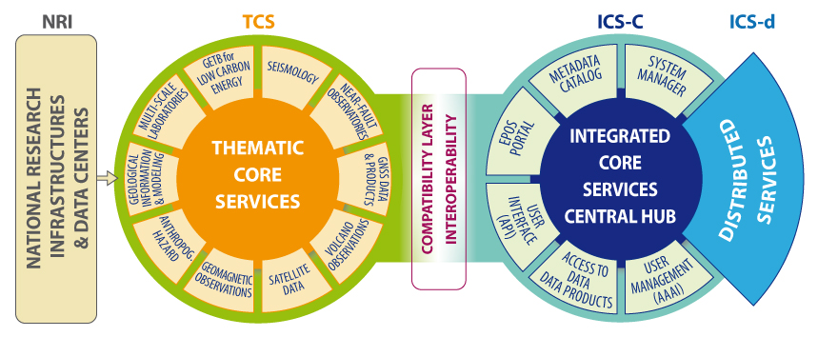
1 -overview of the Research Infrastructure
Integration, interoperability computation
community-specific integration
novel e-infrastructure
Interoperability
Brokerage
Data generation
Data collection
Responsible
of sustainability
and operation
IPR
Data curation
Metadata
Registration
Community Services
Standardization
Data pocilies
Metadata registry
Processing
Aggregation
Integrated analyses
Visualization
Procurement
Sustainability

Slide 2
2 - the foreseen computing model
EPOS IP will implement TCS, build the ICS-C and define requirements to design ICS-d (24 months)
TCS & ICS-C implementation priorities:
Interoperability through a new metadata catalogue (RDA, VRE4EIC)
Data Management Plan (ENVRI+)
Data & repository registries, PIDs, Preservation (EUDAT, RDA)
User management and accessibility: AAI, FMI, scientific gateway (VERCE,EGI)
ICS-d design goals:
Processing & visualization
Modeling & Data Intensive Applications
ICS-d requirements:
Define computational requirements for a few selected communities
Receive technical specification to use distributed computational resources

Slide 3
4 - how are the computing resources to be acquired
Procurement policy for EPOS computational resources:
European initiatives, organizations & projects
Federating national technological providers
Relying on private technological providers or PPP providers
Implementation must be harmonized with national priorities and strategies
Is a fully competitive environment the most suitable approach for developing of a federated approach to HPC/HTC resources in Europe ?
How to move from projects to sustainable federated organizations?

Slide 4
5 - Issues and outstanding questions about resource provisioning
Data must be promptly discovered, made accessible and downloadable, curated, minable and transferrable together with appropriate processing software and e-infrastructure resources → EPOS Priorities: Metadata, AAAI, User Mgmt
There are a number of overlapping issues that regard data organization and their access, data transfer from (and to) super computing centres (HPC) and among the platforms of the federated communities → Scientific Gateway & Software
The capacity of RIs to provide a robust sustainability plan in the framework of a well-defined governmental structure is therefore connected to the procurement policies toward national and/or European scale initiatives → Financial, Legal and Governance issues

