Slide 1
The Catania Science Gateway for the EGI Long Tail of Science Pilot
Roberto Barbera
Univ. of Catania and INFN
EGI Conference 2015
20 May 2015, Lisbon

Slide 2
Outline
The Catania Science Gateway Framework (CSGF)
The SG for the Long Tail of Science Pilot
Summary and outlook

Slide 3
The CSGF in a nutshell
http://www.catania-science-gateways.it
Born in 2010 to hide Grid complexity (especially security-wise)
Designed to be:
Sustainable (Fully based on standards)
Scalable (through Glassfish)
Secure (AAI/Traceability)
Interoperable (one system → many infrastructures)
Accessible anytime from anywhere (including mobile devices)

Slide 4
CSGF Architecture
Applications
SGW x
Infrastructures
App 1
Grid
App 2
VO a
SGW y
…
App 2
VO b
App i
…
App k
App j
API Frontend
HPC
App k
App x
Cloud
…
Tenant a
App x
Tenant b
SGW z
…
App n
API Services

Slide 5
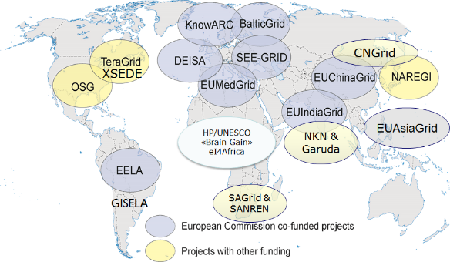
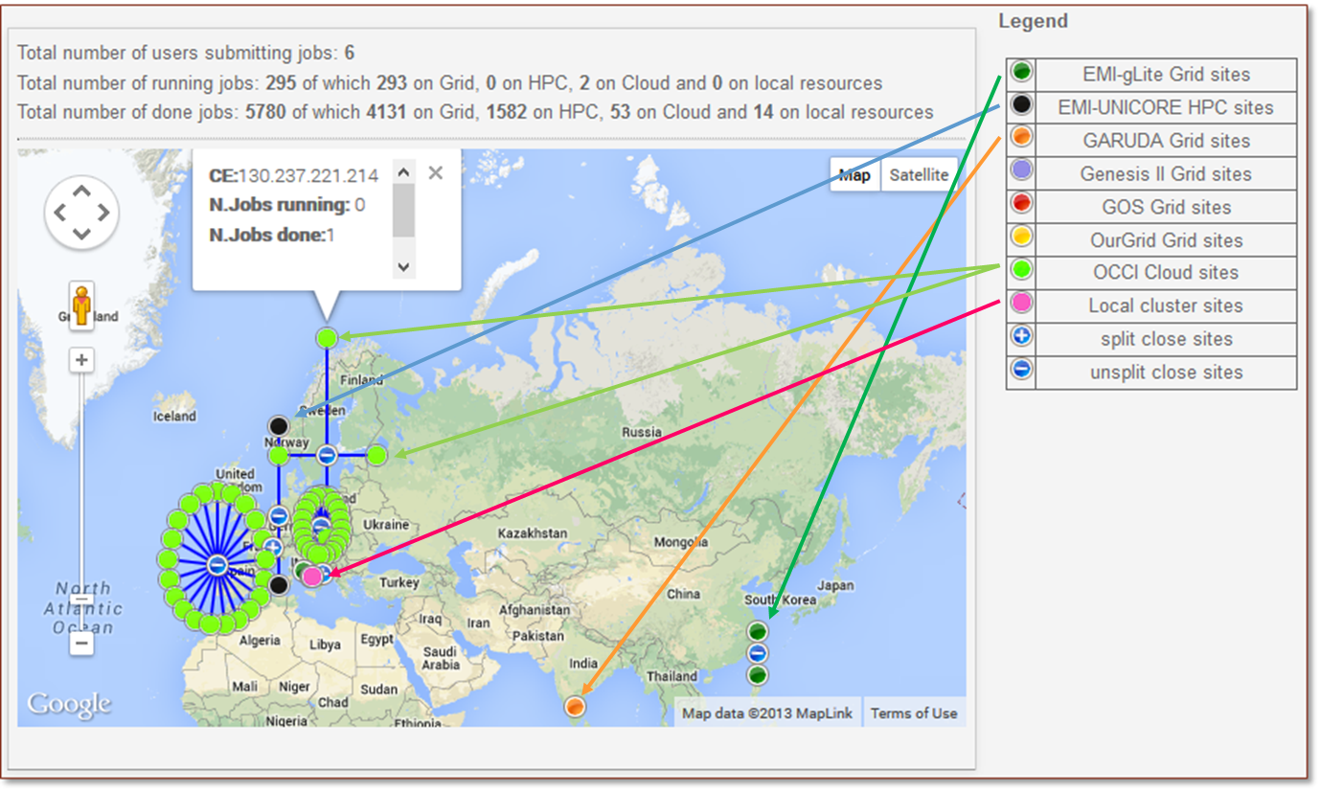
CSGF Components
Users having different roles and privileges
Portlets
AAI
Administrators
Power users
Basic users
VRC members
etc,
Grid&Cloud Engine
Thanks to the CSGF, the interoperability of different distributed e-Infrastructures has been successfully demonstrated
Grid
Cloud
HPC
20/05/2015

Slide 6
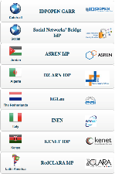
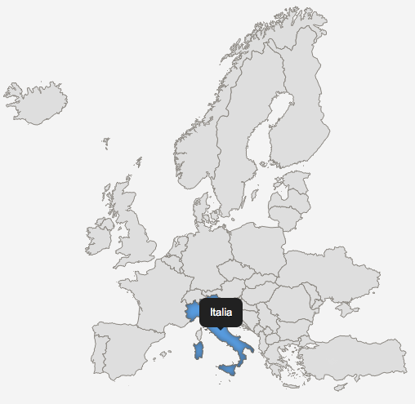
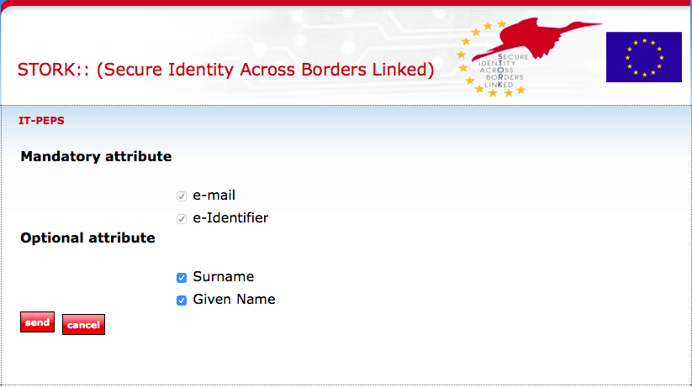
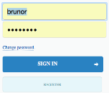
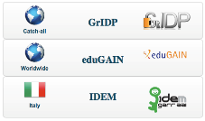
AAI in the CSGF
access.egi.eu
EGI
UMP
OpenID
Identity Federations
AuthN/AuthZ
handled separately
Authentication
SAML 2.0
IdP 1
IdP 2
…
Authorization
IdP n
1. Sign In
2. Select eID or Your institute IdFs
3. Select your IdF and IdP
eid-stork.eu
4. Use IdP to get authorized by IdP

Slide 7
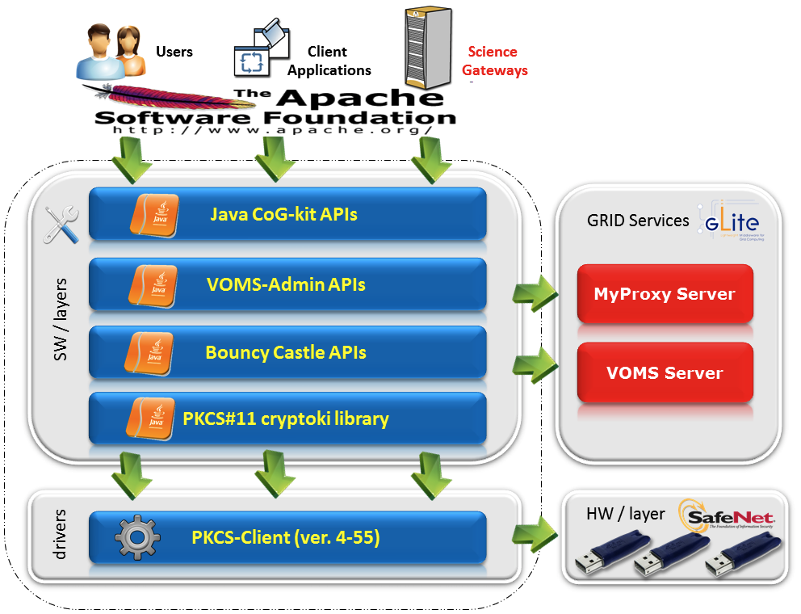
The CSGF Grid & Cloud Engine
eToken Server (GSI Access)
Science Gateway Interface
Data Engine
Job Engine
Robot certificate proxies
→ user DN extension
UserTracking
Compliant with the EGI Portal and User Traceability policies
Accounting
Auditing
SAGA-compliant API
Grid/Cloud/HPC

Slide 8
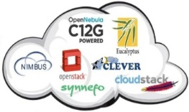
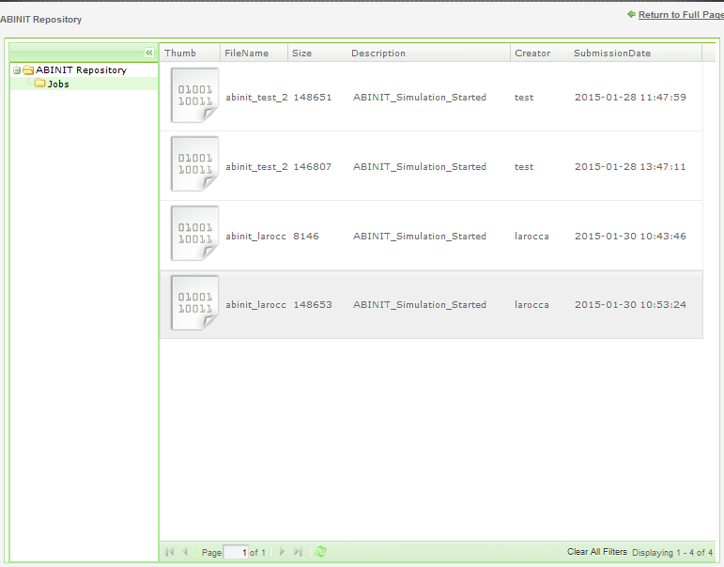
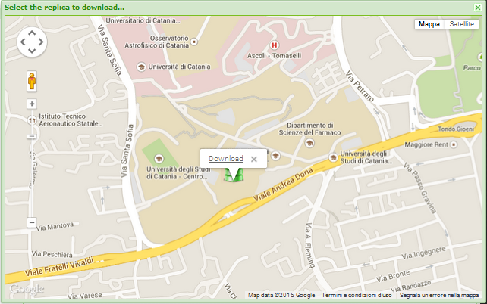
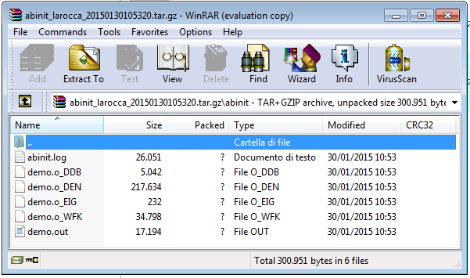
Data Management with the CSGF (save job output)
run jobs
Register DOI/PID
Science Gateway
Metadata Service
Local storage
HPC
Clusters
Register analytics on repository
REST API
Browse/download digital assets
glibrary.ct.infn.it
Grid storage
User Tracking DB
eToken
service
Cloud Storage

Slide 9
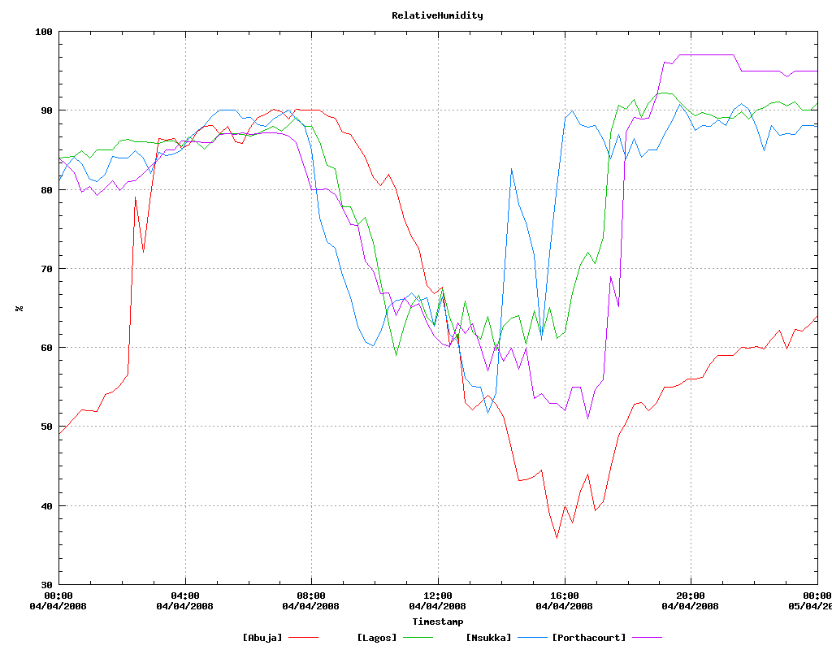
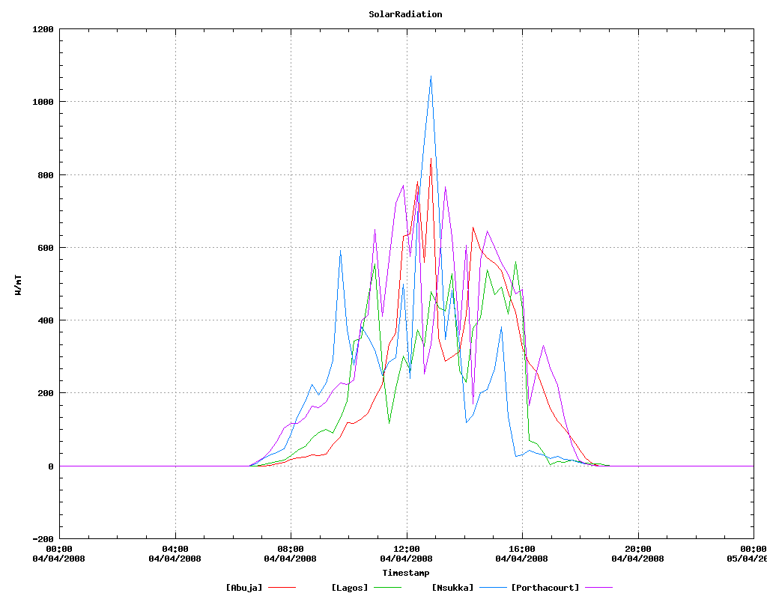
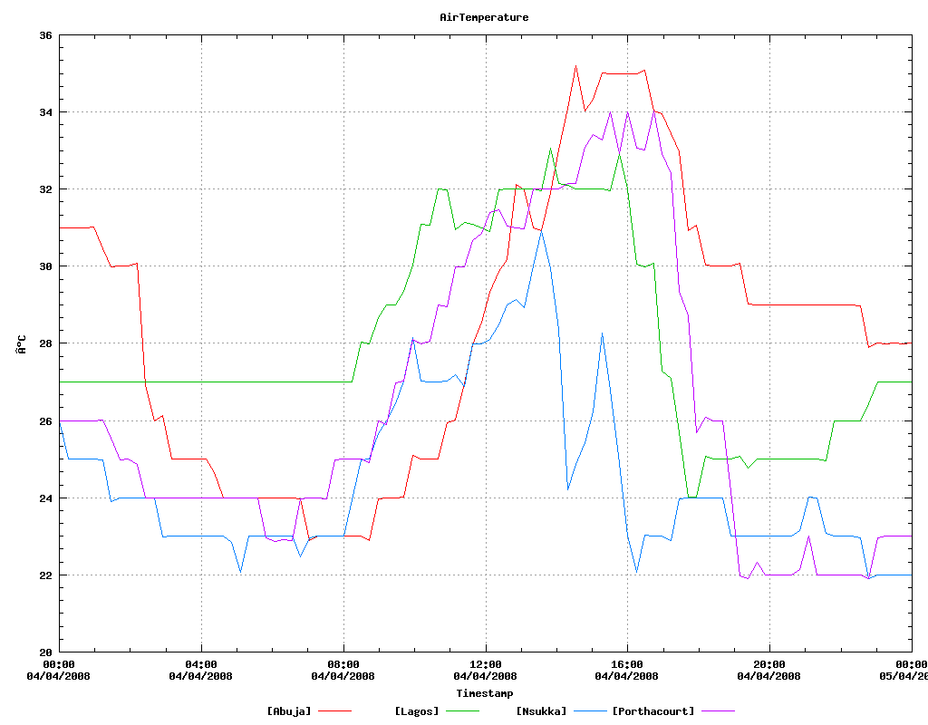
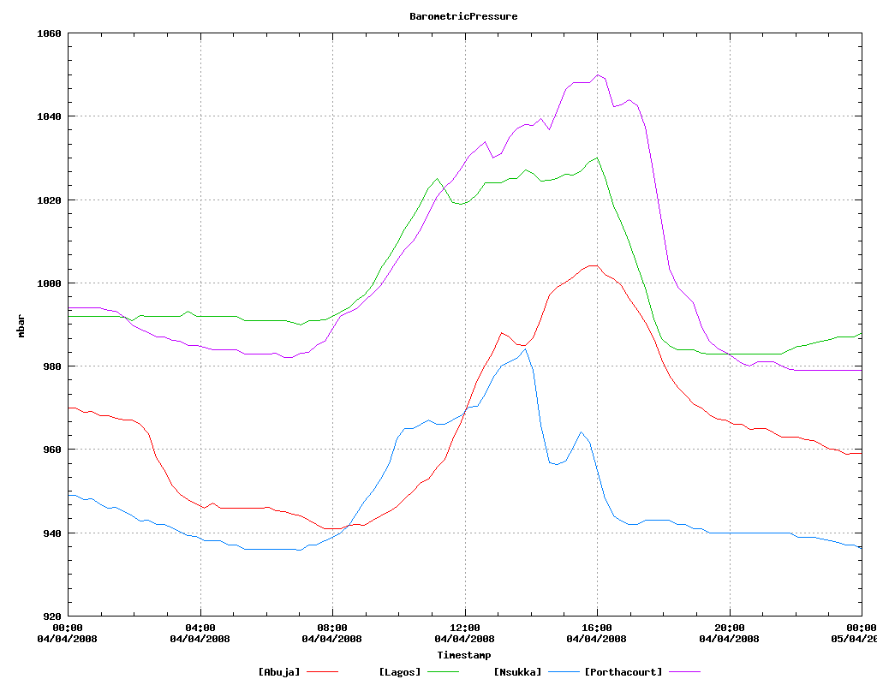
Data Management with the CSGF (read job input)
Retrieve DOI/PID
run jobs
Science Gateway
HPC
Clusters
Metadata Service
Local storage
Visualise output
REST API
Get digital assets
Grid storage
User Tracking DB
eToken
service
Cloud Storage

Slide 10
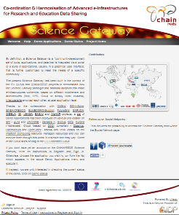
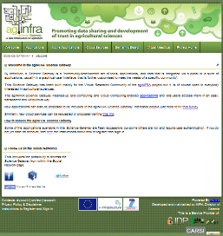
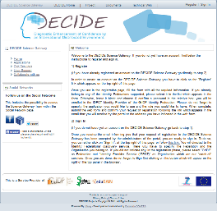
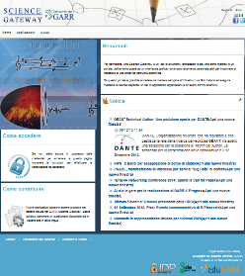
CSGF Implementations

Slide 11
The SG for the EGI LToS Pilot (http://csgf.egi.eu)

Slide 12
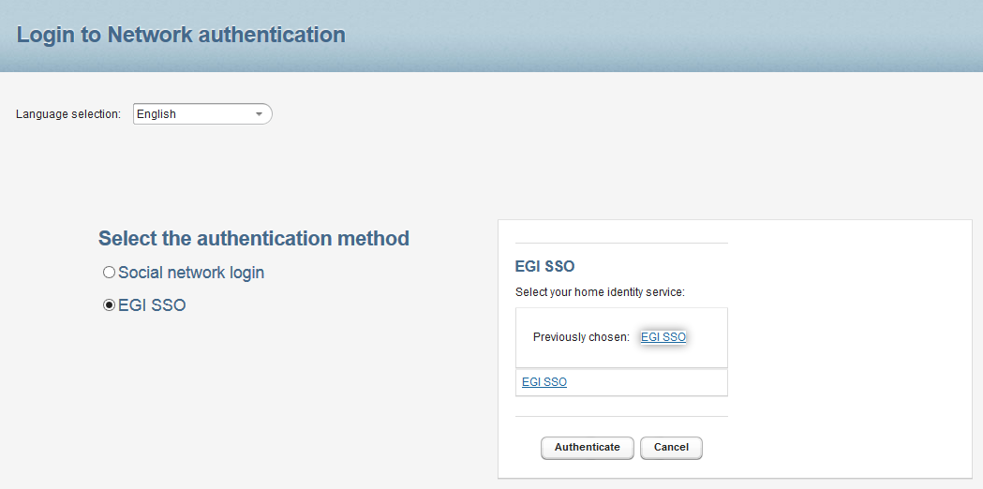
AuthN/AuthZ with the UMP

Slide 13
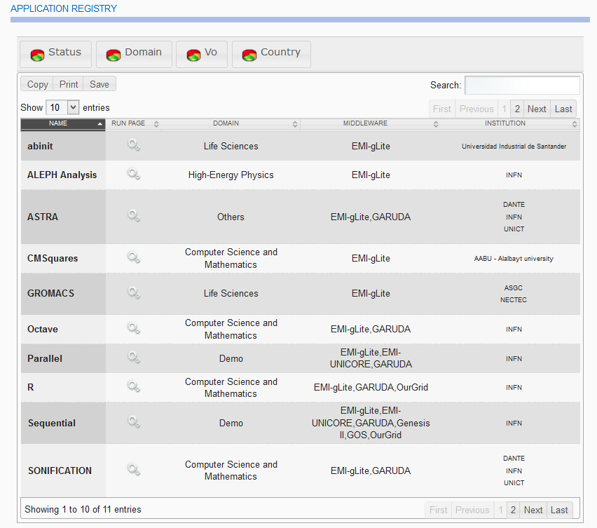
Several Applications Available (full list)

Slide 14
Several Applications Available (browse & point & click & run)

Slide 15
Summary and outlook
The first prototype of the Catania SG for the EGI LToS Pilot is available
What’s missing before going in production
Tune the AuthN/AuthZ workflow up
Gather resources pledged to the LToS VO
Prune applications
Implement a mechanism to let users propose new applications to be integrated in the SG
Define who will do the integration (special training ?)

