Slide 1
Federated Monitoring Solution - ARGO by GRNET, SRCE and CNRS
Emir Imamagic, SRCE

Slide 2
Overview
Introduction
ARGO
Architecture
Status
Future Work

Slide 3
Introduction
What should be there?
What is the status?
network availability
services availability
How is it used?
You can’t manage what you don’t measure...

Slide 4
ARGO
Flexible and scalable monitoring framework
Status, availability and reliability of services
Advanced A/R computation engine
custom complex A/R algorithms
Flexible deployment models
distributed, centralized
Modular design enables integration with external systems
Based on open source components

Slide 5
ARGO - Monitoring Engine
Nagios based framework
service endpoints monitoring
Automatic Nagios configuration
using external information sources
Flexible metric configuration
integration of all Nagios-compatible probes
Credential management
MyProxy or robot based X509 proxy certificates
Integration with messaging infrastructure

Slide 6
ARGO - Messaging Infrastructure
Apache ActiveMQ Broker
configured as broker network
Transport layer between monitoring engine and central A/R components

Slide 7
ARGO - A/R Engine
Heart of the ARGO system
status and A/R calculation
report generation
web and API interface
Modular integration with external information sources
e.g. GOCDB, BDII, GSTAT, POEM
Multi-tenant support
tenant defines topology, metric and A/R algorithms
Open source components
Hadoop, MongoDB, GO, Lavoisier

Slide 8
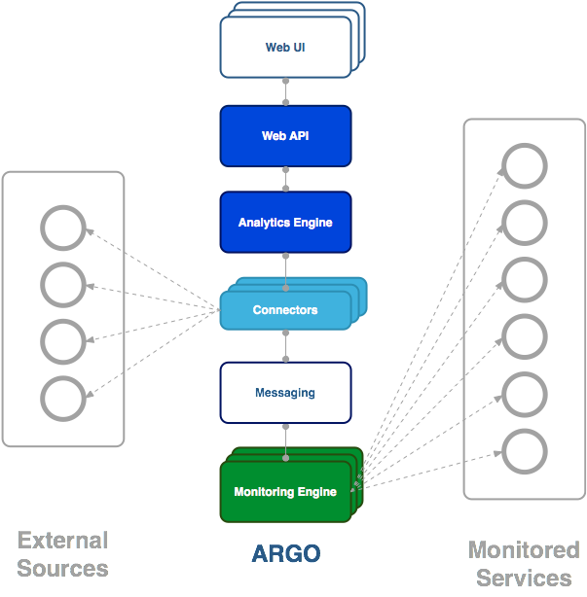
ARGO - Architecture

Slide 9
ARGO - Status
Central ARGO A/R Engine
deployed on Okeanos cloud infrastructure
Message broker network
redundant instances at GRNET and SRCE
Distributed monitoring instances
over 50 NGI-level instances
monitoring 3500 services with more than 10.000 service checks
Central monitoring instances
operational tools, fedcloud sites, security tests

Slide 10
Future Work
Modularise the Core Monitoring Engine
Refactor messaging infrastructure
Improve support for SLA monitoring
Monitoring availability & reliability as a Cloud Service
Clean interfaces for end-users, operations and developers

