Slide 1
EGI Federated Cloud
Enol Fernández
Cloud Technologist (EGI.eu/CSIC)

Slide 2
EGI Federated Cloud
EGI Federated Cloud is a hybrid federated cloud for research user communities, which comprises cloud providers to support data- and computing-intensive workloads
Public Cloud
Community Cloud
Open to any research community
Open Standards: use of common open standards for the interfaces and images (OCCI, CDMI, OVF, GLUE2, …)
Resource integration: Cloud Computing integrated into the existing production infrastructure.
Accessible to one or more selected VOs
API choice, but must assure interoperability within the community. Standards are fostered.
Looser Federation profile: based on a subset of components (accounting, monitoring, …)
Notes:
EGI Federated Cloud:
integrates a set of independent cloud services presented coherently as a single system using common interfaces.
allows the user to choose freely among a broader range of service providers
allows to use own applications already developed by people within their own community whom they trust, and from other communities who have an independent badge of quality.

Slide 3
EGI Cloud Infrastructure
User Communities
EGI Collaboration Tools
EGI Cloud Infrastructure Platform
Uniform interfaces to Cloud Compute and Storage
Image Repository
VM Management
Storage Management
Cloud Management Stacks
(OpenStack, OpenNebula, Synnefo, …)
Resource Provider Infrastructure
Cloud Management Stacks
(OpenStack, OpenNebula, Synnefo, …)
EGI Cloud Service Marketplace
Resource Provider Infrastructure
Secure endorsed Application and Service Deployment
EGI Application DB
EGI Core Platform
Service
Registry
Information Discovery
Federated AAI
Monitoring
Accounting
Monitoring and control of utilisation
Help and Support
Technical Consultancy and Support
Security Co-ordination
Training and Outreach
Sustainable Business Models

Slide 4
VM Management
On demand compute to run any kind of workloads on virtual machines
Site A
OCCI as standard interface
FedCloud contextualization extension
FedCloud profile extension
Clients
ruby and java clients
OCCI connectors in brokers
Servers
rOCCI-server
OCCI-OS
snf-occi
VM
VM
Site B
VM
VM

Slide 5
VM Image Management
Automatic and secure distribution of endorsed VM images for Virtual Organisations
EGI AppDB
Web based front-end in AppDB
OVF for packaging images
HEPiX lists for distribution
Endorsed by VO managers
Signed metadata
RP subscribe and download
EGI endorses basic OS images
VM
Image
VM
Image
VM
Image
Site C
Site A
VM
Image
Site B

Slide 6
Storage Management
Block Storage
Object Storage
Persistent Block Level Storage to attach to VMs
Manage with OCCI
use as any other block device from VMs
Data storage accessible fro anywhere at any time
Sharing/Serve data
CDMI as standard API
No POSIX access!
VM

Slide 7
Integration with EGI core services: Federated AAI
Users access the resources with their X.509 certificates
(+ VOMS integration with PERUN for OpenNebula)
Developments ready for per-user sub-proxy support
AAI solution to improve ease of user access and traceability from robots
FedCloud members participate in AAI pilot activities
Support for other AuthN/AuthZ methods development

Slide 8
Integration with EGI core services: Information System/Service Registry
Single point of information for all EGI resources (both HTC and cloud)
Cloud information published with OGF Glue 2.0 standard
Extensions proposed to better define the services, now on public comment period
Service endpoints, available images, VM templates
AppDB is the main client for the information
Service types in GOCDB:
OCCI, CDMI, VMCatcher, AppDB

Slide 9
Integration with EGI core services: Accounting
Collects VM usage metrics in the central accounting repository
New reporters developed to ensure consistency of generated information
VO manager view with VO specific info

Slide 10
Integration with EGI core services: Monitoring
Ensure service availability and reliability
Current probes:
OCCI, APEL, Perun
On development:
CDMI, vmcatcher
A/R reports

Slide 11
Integration Status
Capability | OpenStack | OpenNebula | Synnefo
OCCI VM Management | Yes | Yes | Yes
Integration with VM image management | Yes | Yes | Yes
Contextualization | Yes | Yes | Yes
OCCI Block Storage | Yes | Yes | In Progress
CDMI Object Storage | In Progress | N/A | Yes
EGI AAI Integration | Yes | Yes | Yes
Monitoring | Yes | Yes | Yes
Accounting records | Yes | Yes | Yes
Information System | Yes | Yes | Yes

Slide 12
Security
Resource Provider questionnaire
Checklist in form of survey concerning management of Resource Providers related to security
Mandatory to join the infrastructure
Security Workgroup:
Security monitoring to intercept flaws runtime
Deal with security issues appearing in the infrastructure
Run security challenges
Assistance and guidelines to create secure VM images (especially EGI endorsed ones)

Slide 13
Usage Models (I)
FedCloud extends EGI computing beyond HTC with new usage models:
Service Hosting
Long-running services (e.g. web, database or application servers)
Compute and data intensive workloads
Batch and interactive (e.g. IPython, R, matlab) with scalable and customized environments not limited to the traditional job model
Datasets repository
Store and manage large datasets for your applications
Disposable and testing environments
Host training events, test new developments and applications without overhead

Slide 14
Usage Models (II)
Combine usage models in a single application
Scalable Service hosting
Block Storage RAID
Web
Server
Data
Server
attach
End User
spawns as needed
mount
WN
WN
WN
analyse
data
Scalable Compute and data processing
Object Storage

Slide 15
High Level Tools (PaaS & SaaS)
Extend the IaaS capabilities of the EGI cloud
‘Alternatives’ of the OCCI client and API
More than OCCI
External contributions (→ support many other clouds too)
New developments expected (e.g. INDIGO-Datacloud)
Catania Science Gateway
SaaS
Slipstream
PaaS for automating deployments
COMPSs
Programming framework for auto-parallelisation
Identity Federation
Helix Nebula
VMDIRAC
Abstraction on top of various HPC/HTC/cloud
WS-PGRADE
Workflow development and enactment
Vcycle
VM lifecycle manager

Slide 16
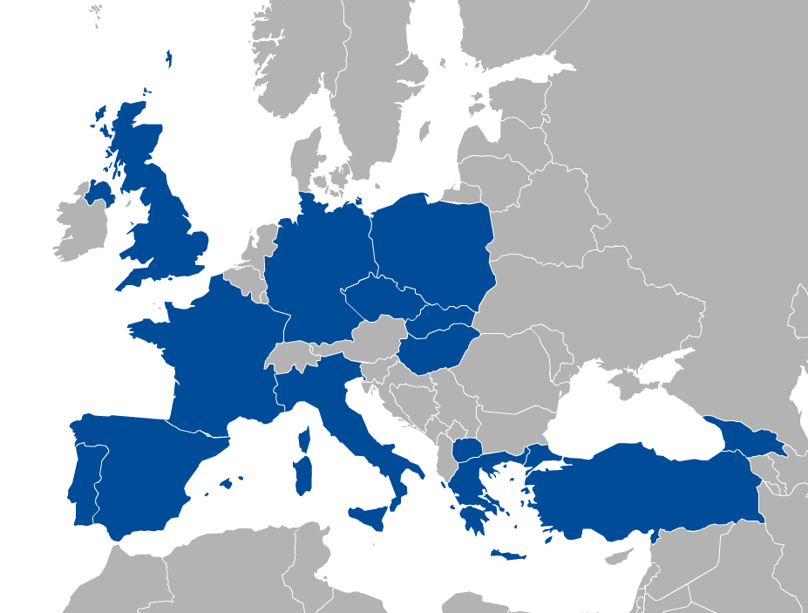
FedCloud Infrastructure
One year of production
Resources
21 providers from 14 NGIs
17 interested in joining from 7 new NGIs
Average A/R 82%/83%
Usage
~700K VMs
~9M CPU hours wall time
Notes:
15 RPs and 12 NGIs on May last year

Slide 17
Joining Federated Cloud
Resource Providers
Follow the EGI Certification Procedure https://wiki.egi.eu/wiki/PROC09, common for HTC and Cloud Resources
Use the installation manuals https://wiki.egi.eu/wiki/MAN10 for your CMF
Technology Providers
Contact the TF mailing list fedcloud-tf@mailman.egi.eu
Users
Contact support@egi.eu, see next talk by Diego

Slide 18
Evolution
The EGI Federated Cloud Task Force continue to work to evolve and improve the Cloud Infrastructure
Feature additions to foundational tools depending on requests
systematic tracking of requests with EGI RT
New scenarios/working groups
Intra-cloud networking
Security
VM Image Endorsement

Slide 19
New developments on the roadmap
VM Management
OCCI v1.2 now in public comment phase, introduces JSON rendering
Vertical scalability
Snapshots and migration of VMs between sites
Data Management
CDMI for OpenStack based on Synnefo implementation
Integration of new stacks (OneData)
AppDB as a broker
Simple manage operations on VMs from web interface
Support for native interfaces
Integration of CANFAR and D4Science

Slide 20
Conclusions
EGI Federated Cloud extends EGI infrastructure
Fully integrating IaaS into EGI production infrastructure
Attracting new communities belonging to various scientific domains (76 use cases, 40 communities)
Paving the way for a global federated cloud marketplace led through European Innovation
Established best practice
Illustrating leadership
Open standards, open technology
Open membership, open processes
Open competition

Slide 21
Thanks!
Alison Packer, Álvaro López García, Binh Minh Nguyen, Björn Hagemeier, Boris Parak, Boro Jakimovski, Cal Loomis, Carlos Gimeno, Christos Loverdos, Daniele Cesini, Daniele Lezzi, David Blundell, Diego Scardaci, David Wallom, Elisabetta Ronchieri, Emir Imamagic, Esteban Freire, Feyza Eryol, Florian Feldhaus, Gergely Sipos, Ignacio Blanquer, Iván Díaz, Jan Meizner, Jerome Pansanel, John Gordon, Kostas Koumantaros, Linda Cornwall, Luis Alves, Malgorzata Krakowian, Marios Chatziangelou, Marco Verlato, Marica Antonacci , Mattieu Puel, Matteo Turilli, Michel Jouvin, Michel Drescher, Miguel A. Díaz, Miroslav Ruda, Mischa Salle, Nuno L. Ferreira, Owen Synge, Paul Millar, Peter Solagna, Piotr Kasprzak , Roberto Barbera, Ruben Valles, Sándor Ács, Salvatore Pinto, Silvio Spardi, Soonwook Hwang, Steven Newhouse, Stuart Pullinger, Sven Gabriel, Thijs Metsch, Tomasz Szepieniec, Víctor Mendez, Viet Tran, Vincenzo Spinozo, Zeeshan Ali Shah, Zdenek Sustr

