Slide 1
Towards a European Open Science Cloud for research
W. Lusoli
S Luber, R Von Schomberg, JC Burgelman
European Commission
DG Research & Innovation
EGI 2015 Conference, Lisbon
19 May 2015

Slide 2
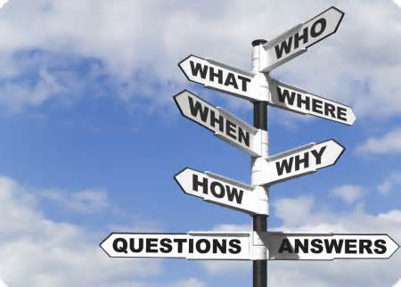
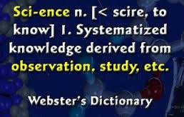
Open Science / Science 2.0
A systemic change in the modus operandi of science and research
Affecting the whole research cycle and its stakeholders

Slide 3
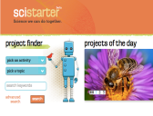







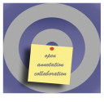




Sci-starter.com
Figshare.com
Data-intensive
Citizens science
Open code
Runmycode.org
Myexperiment.org
Open workflows
Pre-print
ArXiv
Analysis
Publication
Review
Conceptualisation
Data gathering
Open data
Roar.eprints.org
Open access
Datadryad.org
Open annotation
Impact Story
Alternative Reputation systems
Openannotation.org
Scientific blogs
Altmetric.com
Collaborative bibliographies
Researchgate.com
Academia.edu
Mendeley.com

Slide 4
    Public consultation
    Science 2.0: Science in Transition
Assess the degree of awareness amongst the stakeholders of the changing modus operandi
Assess the perception of the opportunities and challenges
Identify possible policy implications and actions to strengthen the competitiveness of the European science and research system
Numbers…
From 03.07.2014 to 30.09.2014
498 submitted responses of which 164 Organisations and 38 Public Authorities
28 position papers voluntary submitted in addition to questionnaire

Slide 6
Rank : the lowest need (1) to the highest need (11)

Slide 7
    Objectives of possible future policy initiative (results from validation workshops)
Support big data infrastructure needs (also governance)
Improving Framework Conditions (Removing barriers, creating incentives) for fostering Open Science
Making science more efficient (better use of and sharing of resources), reliable (replicability/re-use of data) and more responsive to societal challenges
Stakeholders share these expectations of 'Open Science' with large majority, on "condition":
bottom-up
stakeholder-driven
Notes:
Here you could emphasize the role of young researchers and of groups like YEAR - any initiative has to be bottom-up and stakeholder-driven !
As good example:
Welcome the initiative of YEAR to award two outstanding projects of its members including as evaluation criteria the use and promotion of Open Science / Open Research Data tools

Slide 8
    Short-term Roadmap for Policy on Open Science
  Open Science as an action under the Digital Single Market initiative of the European Commission (adopted 6 May 2015), e.g. establishment of a 'European Open Science Cloud'
  Policy Debate on Open Science at May Competitiveness Council
  Council Conclusions 28/29 May
  Launch of a European Open Science Agenda
  22/23 June 2015 Conference: "A new start for Europe: Opening up to an ERA of Innovation"
Notes:
Give also reference to: the second edition of the OpenCon that will be held in Brussels in November 2015. It is “the student and early career academic professional conference on Open Access, Open Education, and Open Data”

Slide 9
European
Open Science Agenda
  Possible actions
  Mandate the development of common interfaces and data standards
  Coordinate at European Level the funding/ maintenance and interoperability of research infrastructures
  Support the development of a European Open Science Cloud for research

Slide 10
European
Open Science Cloud
The European Open Science Cloud is part of Europe´s ambition to support the transition to Open Science and make the most of data-driven science.
The cloud aims to provides all EU researchers a virtual environment with free, open and seamless services for data storage, management, analysis and re-use, across disciplines.
The cloud aims to federate existing and emerging horizontal and thematic data infrastructures, effectively bridging todays fragmentation and ad-hoc solutions.
The cloud would adds value - scale, data-driven science, inter-disciplinarity, data to knowledge to innovation - and leverages current and past infrastructure investment (10BE per year by MS, two decades EU investment).

Slide 11








European
Open Science Cloud
Scale of scientific activity (data-driven science)
Physics
Life sciences
Earth sciences
Applied - engineering
Economics
… …
Social
sciences
Humanities
Citizen science
Lead users… Scientific communities …long tail

Slide 12










European
Open Science Cloud
Scale of scientific activity (data-driven science)
Governance
layer
Bottom-up governance
Federation
Legacy and sustainability
Leverage of MS investment
Physics
Trust
Service
layer
Life sciences
IPR protection
Privacy and personal data protection
Big data analytics
Earth sciences
Data fusion across disciplines
High performance computing
Applied - engineering
Data storage
Data
layer
Economics
Data access and re-use
… …
Data manipulation and export
Social
sciences
Data discovery and catalogue
… …
Humanities
Citizen science
Lead users… Scientific communities …long tail

Slide 13
European
Open Science Cloud
Current activities
DSM follow up
  EP plenary debate
Council Conclusions, Open Science debate
High level expert group
WP 2016-2017
ERA of Innovation Conference

Slide 14
This is a common endeavor:
We want to hear your views!

Slide 15
Thank you!
http://ec.europa.eu/research/conferences/2015/era-of-innovation

