Slide 1
Engagement strategies: bringing together Competence Centres, NILs, UCB and Champions
Gergely Sipos
Technical Outreach Manager (EGI.eu / MTA SZTAKI)

Slide 2
Agenda
15’:
EGI Engagement Strategy - Overview and recent updates – Gergely
3’:
Updated EGI Champion programme – Sara
30’:
Community presentations (by VTs, NILs, Champions, UCB members, CC representatives) – 3 minutes each
See next slide
~40’:
Discussion
Support for the Competence Centres
Application of the EGI Long Tail Platform within the NGIs and within communities
What Virtual Teams to establish next?
EGI User Forum 2015 (Bari, November 10-13)
Other events - Community events? NGI events?
Regular engagement teleconference meetings

Slide 3
Agenda 2: Community presentations
VTs:
Robert: Promoting Desktop Grids VT
Afonso: Genome Analysis and Protein Folding VT
Fotis: Dataset Replication VT
Lukasz/Giacinto: Federated Data VT
NGI:
Alexandru Nicolin: Engaging with and supporting Nuclear Physics communities
Tomasz Piontek: Supporting users with the PL-Grid Application Registry
Genevieve Romier: Engaging with and serving national users in France
Community:
Afonso Duarte: Reaching out to life science users

Slide 4
Engagement strategy
http://go.egi.eu/engagementstrategy
Long-term strategy
Action plan (currently until Feb 2016)
Notes:
RT-based tracking of support cases http://go.egi.eu/technicalsupportcases
Action plan:
FET flagships added
ESFRI priorities aligned with EC recommendation
Comp. Centres added
Events section added

Slide 5
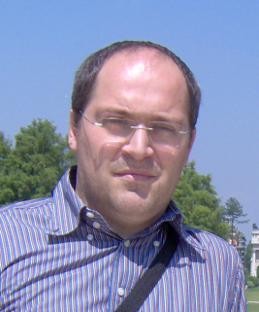
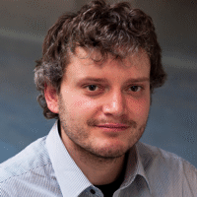
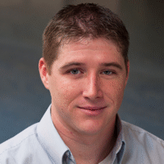
Engagement board
NGI International Liaisons
User Community Board
Competence Centres
User-facing tools (e.g. e-GRANT, DIRAC, Ops. Portal, etc.)
EGI.eu user engagement team:
Marcel
Yin
Enol
Malgorzata
Vincenzo
Sara
Gergely
Diego
Peter
Sy

Slide 6
Long-tail platform & How things this fit together?
NGIs: Consultancy for users
Tech. Providers: SW services
e-GRANT: Resource brokering
NGIs: Consultancy for users
Tech. Providers: SW services
Upgrade support from the NGIs
Technical-support-cases ticket in RT
WS-PGRADE
CSGF
DIRAC
Domain pool in EGI OR New pool in EGI OR New e-infrastructure by federating sites
Long-tail Resource pool
User Registration Portal
Users
QosCosGrid
‘Other tool’
‘Other tool’
Notes:
NGIs: Register their available resource pools in e-GRANT
Contribute with resources to the long-tail VO
Connect custom interfaces/VREs to long-tail VO

