Slide 1
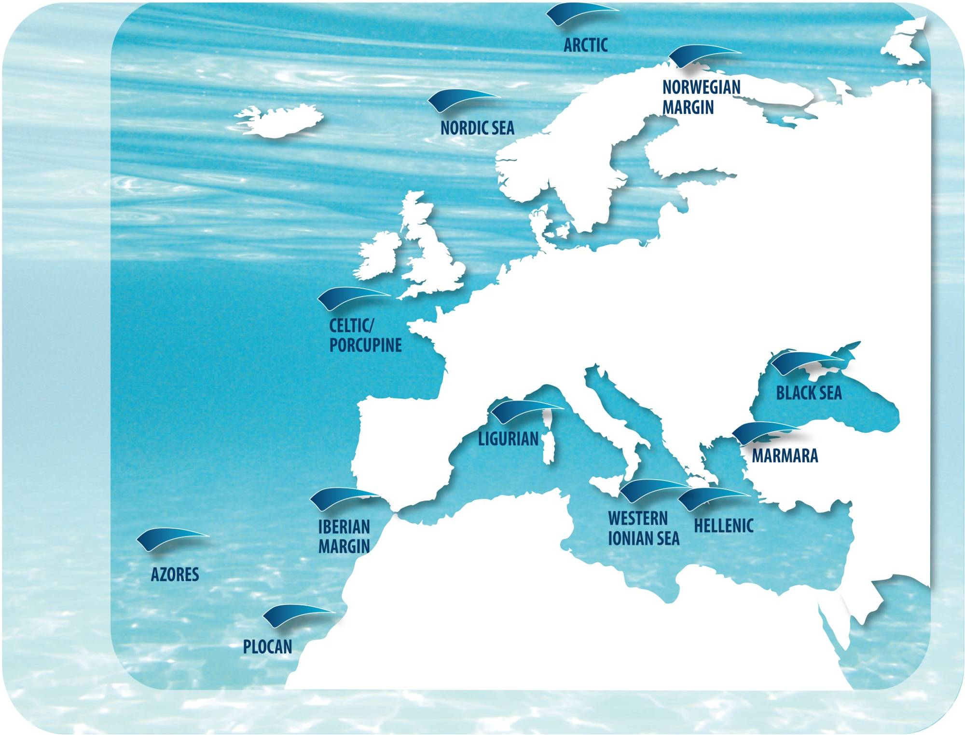

EMSO
European Multidisciplinary Seafloor and Water-Column Observatory
Lucio Badiali
on behalf of the EMSO Consortium
Notes:
Inserire logo CNRS

Slide 2
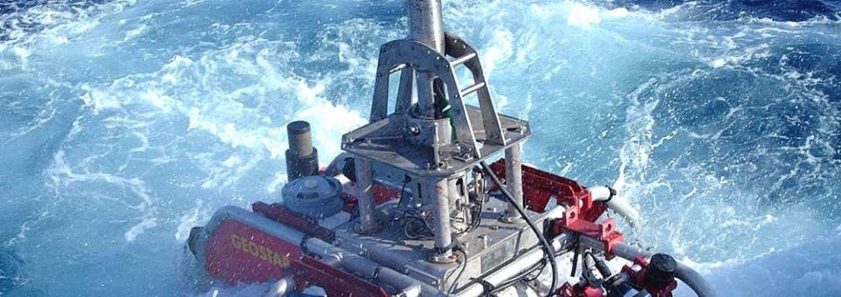
EMSO ESFRI Research Infrastructure (1/2)
EMSO is the European Research Infrastructure of fixed seafloor and water column observatories constituting a distributed infrastructure for long-term monitoring of marine environmental processes

Slide 3

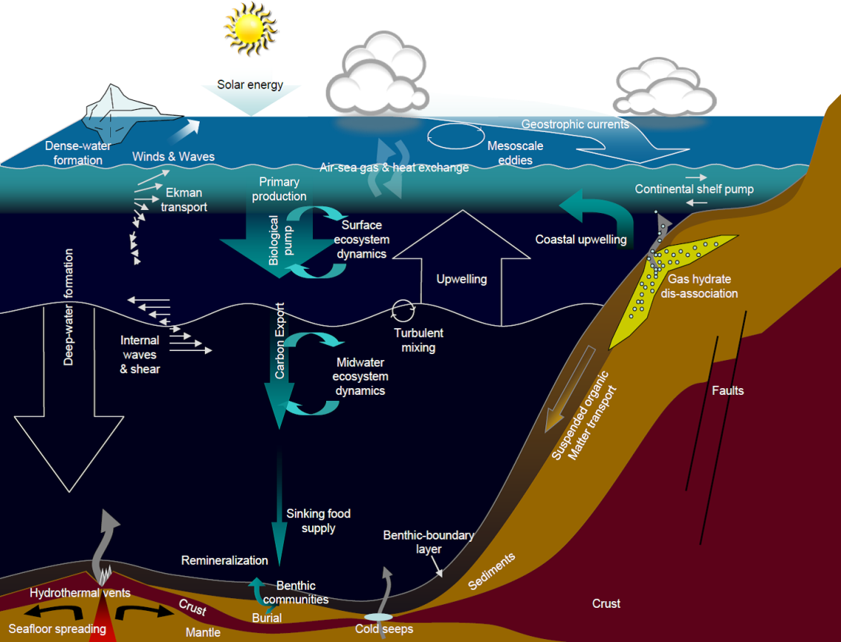

EMSO ESFRI Research Infrastructure (2/2)
  RI for Challenges such as:
  Global ocean warming and
  acidification
  Impact and sustainability of
  marine resource exploitation
  Real-time observations of
  earthquakes and tsunamis
Ruhl et al., 2011

Slide 4
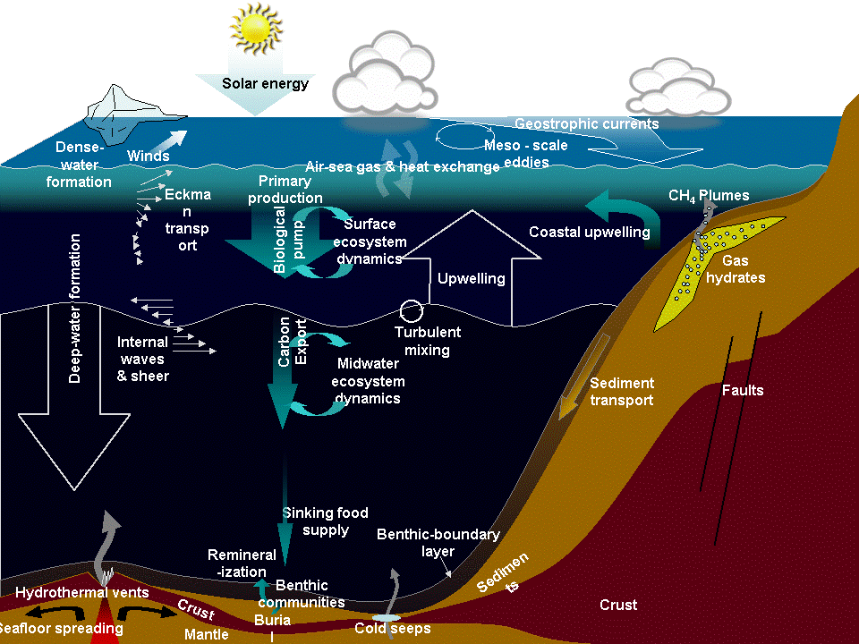
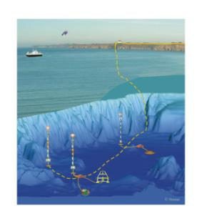
Key Scientific Objectives
Geosciences
Seismicity
Gas hydrate stability
Seabed fluid flow
Submarine landslides
Submarine volcanism
Geo-hazard early warning
Physical Oceanography
Ocean warming
Deep-ocean circulation
Benthic and water column interactions
Marine forecasting
Biogeochemistry
Ocean acidification & Solubility pump
Biological pump
Hypoxia
Deep-ocean biogeochemical fluxes
Continental shelf pump
Marine Ecology
Climate forcing of ecosystems
Molecules to microbes
Fisheries
Marine noise
Deep biosphere
Chemosynthetic ecology

Slide 5
The EMSO-ERIC:
EUROPE AS A WORLD LEADER IN
MARINE SCIENTIFIC & TECHNOLOGICAL EXCELLENCE
Cutting-edge - at the forefront of science in a strategic, global sector
Timely - climate change and natural hazards won't wait !
Truly international - uniting countries for the advancement of European research and innovation excellence
Valuable - bringing huge socio-economic benefits to scientists, SMEs and industry, education, public at large

Slide 6
Participating Countries to EMSO RI*
  10 Countries confirmed:
  Italy (coordinator) (JRU in progress)^
  France (IFREMER, CNRS, IPGP)^
  United Kingdom (NERC-NOCS)^
  Spain (CSIC, PLOCAN)^
  Portugal (IPMA)^
  Greece (HCMR)^
  Romania (GeoEcoMar)^
  Germany (KDM)+
  Ireland (MI)+
  The Netherlands (NIOZ)+
  Planned participation:
  Norway (NRC)
  Turkey (TUBITAK)
  Sweden (UGOT)
  The participation is open to
  other Countries
  ^ → Full Member (7 countries)
  + → Observer (3 countries)
  Total implementation costs: 300 M€
  Running costs: 20 M€/y
* EMSO ERIC → Indipendent Legal Entity in progress

Slide 7
Italian Ministry Letter sent to the Funding Agencies | DONE
MoU Signature process | DONE
Interim Office establishment | DONE
ERIC Official Application submission ERIC Statutes underwent informal EC check | STEP 1 COMPLETED
ERIC Application Submission | STEP 2 COMPLETED IN 2015
ERIC APPROVAL | NEXT
Steps towards EMSO-ERIC
10 Signatory Countries:
Italy, UK, Portugal, Romania, Greece, The Netherlands, Ireland, Germany, France, Spain
Expected:
Norway, Turkey, Sweden (postponed)
M1
M2
M3
M4
M5
M6
M7
Timeline for Implementation
  Arctic, Celtic/Porcupine, Azores Islands, Ligurian Sea, Western Ionian Sea, Hellenic Arc, PLOCAN, Marmara Sea, Black Sea
  Norwegian Margin,
  Iberian Margin
M1

Slide 8
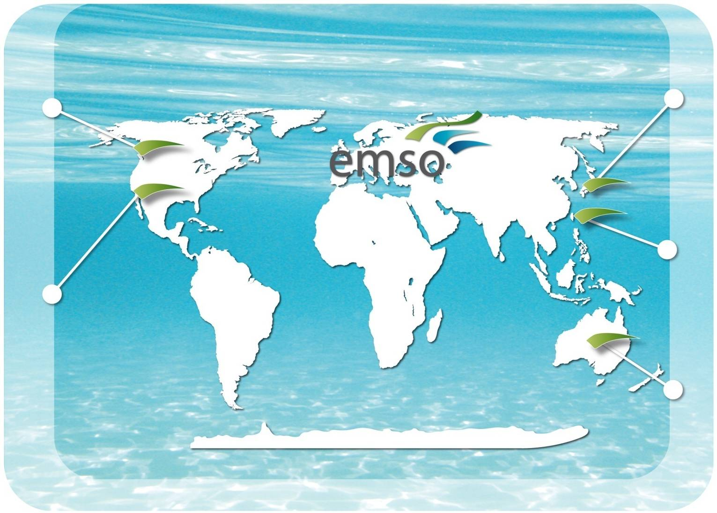
International dimension
Ocean Networks Canada
DONET Japan
ECSSOS China
MACHO Taiwan
OOI United States
IMOS Australia
Notes:
MoU with ONC
OOI partner in EC COOPEUS project with EMSO

Slide 9
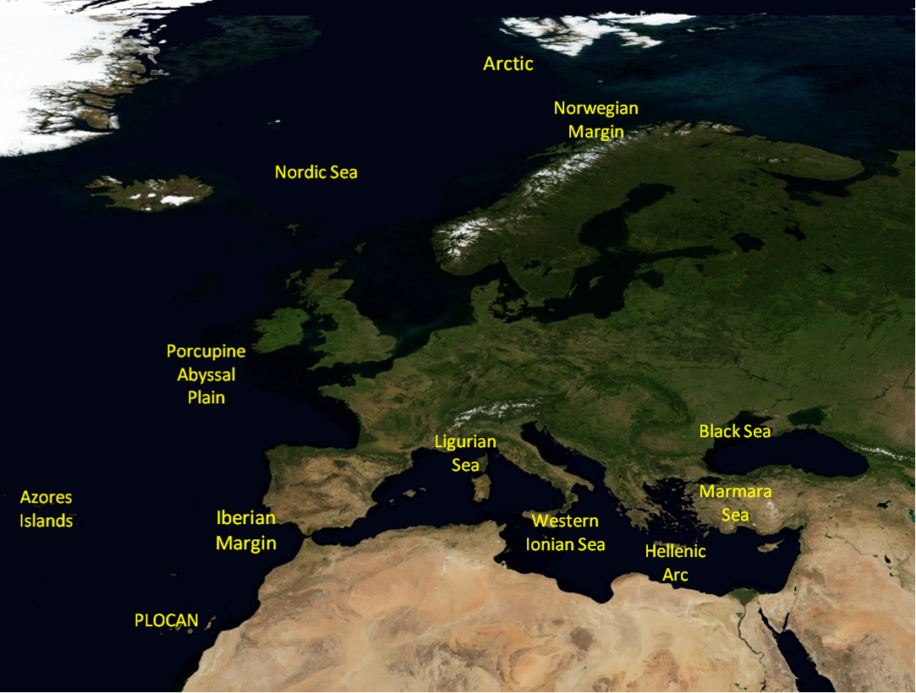
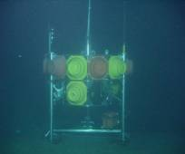
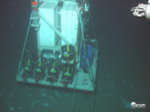
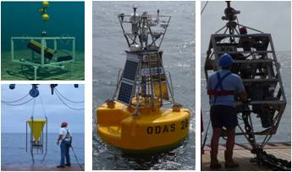

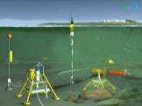
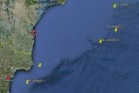
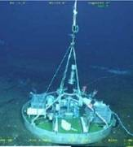
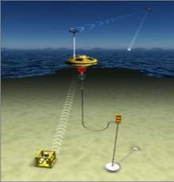
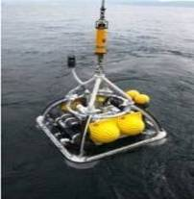

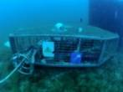
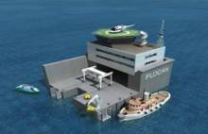
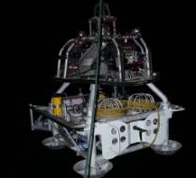
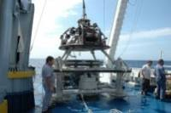
EMSO nodes (11 sites & 4 test sites) - present status
Koljö Fjord
SmartBay
MeDON
Molène
OBSEA
operating nodes (8/11)
nodes
test sites

Slide 10

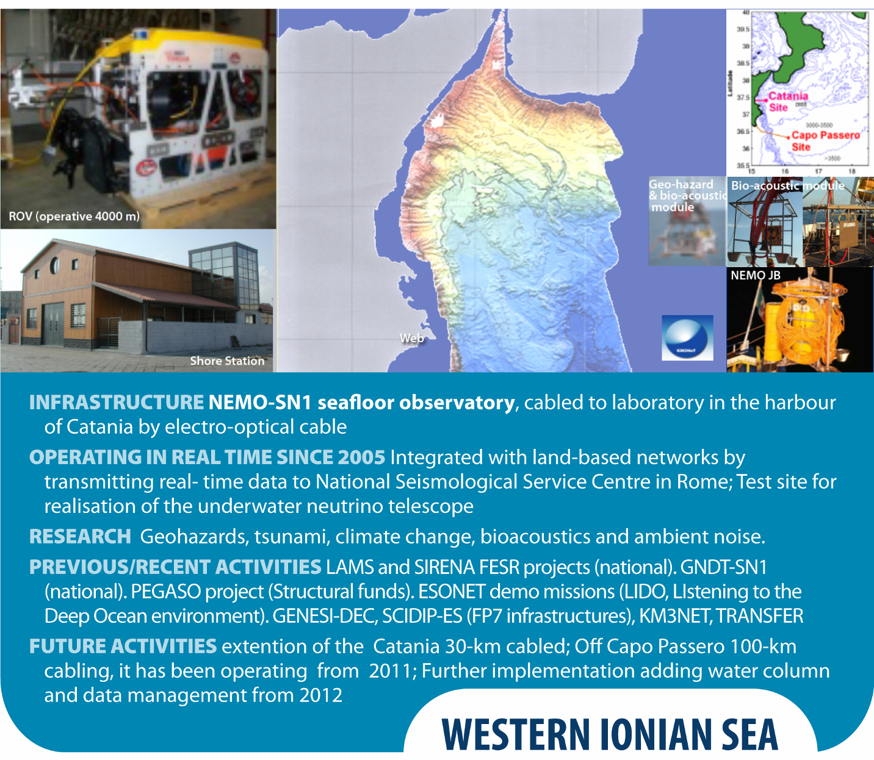
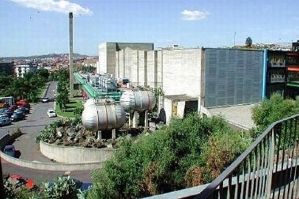
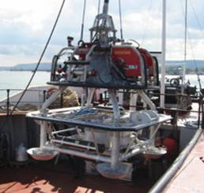

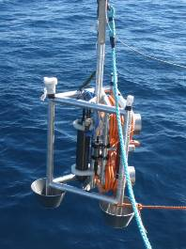
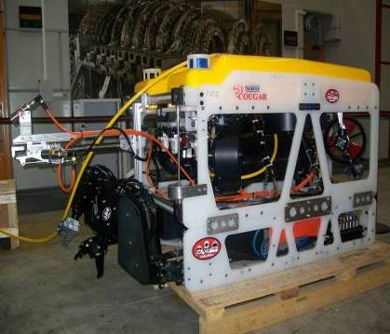
NEMO-SN1: an example of real-time node
LNS-INFN Catania
SN1
DATA REPOSITORY
Geo-hazards
(earthquakes, tsunamis, volcanic activity)
Bio-acoustics
(mammal tracking)
Oceanography
(e.g., deep water circulation, current intensity and direction, temperature, salinity)
10 Gbit GARR-X
Web
Radio Link @ 100 Mbps
5 km
OνDE2
20 km
5 km
ROV (operative 4000 m)
Stand-alone 2002-2003 - Cabled 2005-2008 & 2012-2013 real-time data

Slide 11
Example of Data Rate
daily/monthly by NEMO-SN1 observatory
INSTRUMENT | byte/day | byte/month
Oceanographic sensors | 13 M | 390 M
Gravity meter | 5 M | 150 M
Magnetometers | 2.5 M | 75 M
Seismic sensors | 933 M | 28 G
DACS monitor | 11 M | 330 M
Bio-acoustic Hydrophones* | 372 G | 11 T
Station monitoring | 163 M | 5 G
Lossless data compression algorithms (e.g., FLAC) may reduce file-size to 30% of the original size

Slide 12



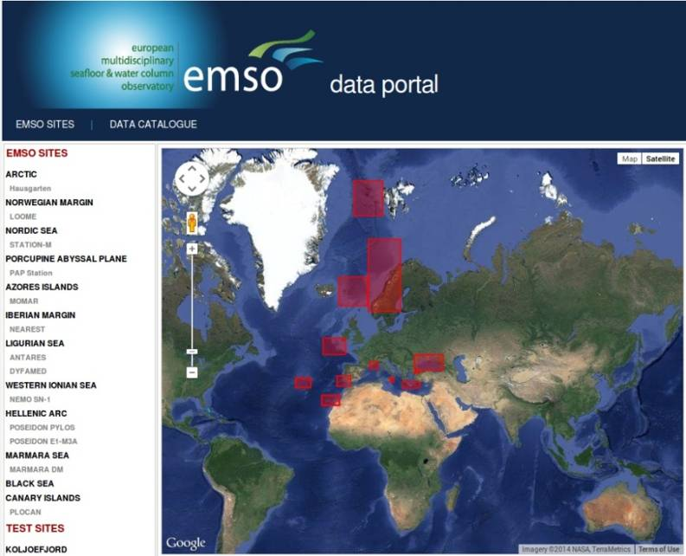
EMSO Data Management (1/2)
Archived data
⊕
metadata
https://www.earthobservations.org/
Arctic
OpenSearch
Norwegian Margin
PANGAEA
http://envri.eu/
Canary Islands
OAI
ESONET catalogue
EMSO
data
portal
Porcupine
IFREMER
FTP
Hellenic Arc
Ligurian Sea
Nordic Sea
INGV
OAI
Azores Islands
SOS Client
Iberian Margin
Marmara Sea
Real time data
Western Ionian Sea
Black Sea
SOS servers
CS-W
Distributed Data Architecture
Towards cloud computing and EMSODEV as a PAAS
http://www.emso-eu.org/
Data Portal Welcome Page
Overview of EMSO sites
Notes:
http://ws.pangaea.de/oai/ Open Archive Initiative

Slide 13
EMSO Data Management (2/2)
  EMSO has to create a data infrastructure to serve the wide communities of
  scientists studying bio and ambient acoustics, oceanography, geophysics, high
  energy astro-particle physics, and ecology.
  A special objective is also to provide open access and tools for QC/QA data use
  and exploitation.
  Facilitate the use of existing distributed computing paradigm of the EU
  e-infrastructure for advanced data elaborations.
  EMSO community will access the data through high level web-based interfaces to:
      Discover, select, download data;
      Search for, analyse/compare events and long time series from multiple sources/sensors /locations;
      Share knowledge and best practices.
The EMSODEV challenge ⇒
13

Slide 14

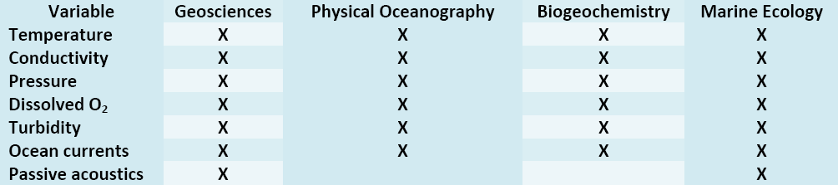
Towards the standardisation...
The main objectives of EMSODEV are:
• to design and implement a state‐of‐the‐art, standardized multidisciplinary EMSO Generic Instrument Module (EGIM), designed according to a set of common, predefined user requirements and duplication of EGIM in some sample to be deployed at EMSO nodes
• to use the Big Ocean Data produced by EGIM as a catalyst to strengthen the data management and delivery the backbone of the EMSO Research Infrastructure
Core variables captured by the EGIM
The Marine Strategy Framework Directive (MSFD) has set an obligation to define and reach a
Good Environmental Status (GES) of all Europe’s seas by 2020 and EMSODEV is following that ⇒
Notes:
Aggiungere stima flusso di dati da EGIM

Slide 15
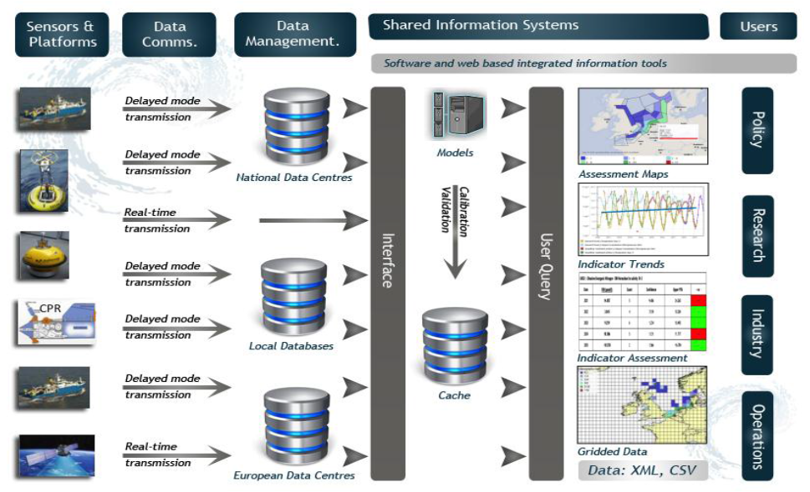
THE EMSO ERIC Data Processing Chain
Towards European Integrated Ocean Observation - Expert Group on Marine Infrastructures Final Report
(EC DG Research Green Paper, January 2013)
Notes:
15

Slide 16

THANK YOU FOR YOUR ATTENTION
Website:
http://www.emso-eu.org
Contact:
interim.office@emso-eu.org

