Slide 1
FEDSEC-CG
FEDerated infrastructure SECurity

Slide 2
OGF IPR Policies Apply
“I acknowledge that participation in this meeting is subject to the OGF Intellectual Property Policy.”
Intellectual Property Notices Note Well: All statements related to the activities of the OGF and addressed to the OGF are subject to all provisions of Appendix B of GFD-C.1, which grants to the OGF and its participants certain licenses and rights in such statements. Such statements include verbal statements in OGF meetings, as well as written and electronic communications made at any time or place, which are addressed to:
the OGF plenary session,
any OGF working group or portion thereof,
the OGF Board of Directors, the GFSG, or any member thereof on behalf of the OGF,
the ADCOM, or any member thereof on behalf of the ADCOM,
any OGF mailing list, including any group list, or any other list functioning under OGF auspices,
the OGF Editor or the document authoring and review process
Statements made outside of a OGF meeting, mailing list or other function, that are clearly not intended to be input to an OGF activity, group or function, are not subject to these provisions.
Excerpt from Appendix B of GFD-C.1: ”Where the OGF knows of rights, or claimed rights, the OGF secretariat shall attempt to obtain from the claimant of such rights, a written assurance that upon approval by the GFSG of the relevant OGF document(s), any party will be able to obtain the right to implement, use and distribute the technology or works when implementing, using or distributing technology based upon the specific specification(s) under openly specified, reasonable, non-discriminatory terms. The working group or research group proposing the use of the technology with respect to which the proprietary rights are claimed may assist the OGF secretariat in this effort. The results of this procedure shall not affect advancement of document, except that the GFSG may defer approval where a delay may facilitate the obtaining of such assurances. The results will, however, be recorded by the OGF Secretariat, and made available. The GFSG may also direct that a summary of the results be included in any GFD published containing the specification.”
OGF Intellectual Property Policies are adapted from the IETF Intellectual Property Policies that support the Internet Standards Process.
Notes:
IPR Notices Note Well for OGF meetings

Slide 3
Today’s Agenda
Overview (this presentation)
Moonshot
Umbrella
EUDAT AAI
SAFE
AARC AAI?? (from the AARCers present)
Focus on technology more than projectcoordinatology

Slide 4
Overview
Authentication
Persistence of identifier
LoA
Authorisation
Community based
Role based
Individual based
Delegation (IDEL or non-IDEL)
Accounting
Quota management

Slide 5
Principles
Technology to solve problems…
So need to identify problems first!?
Build on existing work
Make things interoperate
Conversions of credentials and stuff
Need for policy mappings, too

Slide 6
SAFE
Technology overview 1

Slide 7
What is SAFE
Account management used by PRACE and UK HPC/SC resources
SAFE
Authentication
SAFE
Project1
Account
Account
Project2
Account
Projects/sites
ssh login

Slide 8
User Workflow
Self-create account
Normally username/password based
Can use other (method.attr→id)
Apply for authorisation/resources
Project (may need project password)
Site/resource/machine – select username
Accept AUP
Password for (ssh) login

Slide 9
Mgmt workflow
Resources allocated to projects
PIs manage projects
Each project has a group, and groups may have subgroups
Accounting is by project (ie file gid)

Slide 10
Meta
In use since ~2002 IIRC
Different use at different infrastructures
Java, hosted in Apache
Some of SAFE is open source
gridsafe.sourceforge.net
Need to link account creation and accounting to resource/batch system

Slide 11
Feedback
How to register your approval — or your annoyance
Login to SAFE. Then:
Find the panel headed Quality Tokens and click Quality Token Allocation
Click on the scale somewhere between 5 penalty points and 5 gold stars indicating your level of anger or delight.
Optionally: enter a comment in the comment box.
The tokens may appear in the public service reports, although your name will not be published with them. Although an entry in the comment field is optional, it necessarily gives greater weight to your feelings—without it we cannot tell why you have set a token.

Slide 12
EUDAT AAI
Technology 2

Slide 13
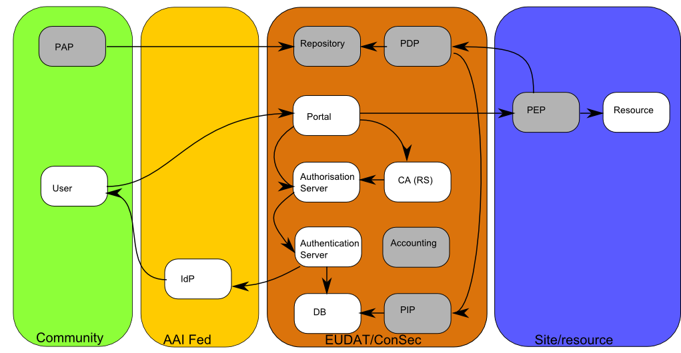
General Architecture

Slide 14
Features
Ingesting identities from xple IdPs
Multi-LoA
Harmonising credentials: adding attributes
Within infrastructure, multi-technology
Supporting a variety of services
See next slide
Authorisation infrastructure – XACML

Slide 15
Inside the e-Infrastructure
Technology | Supporting | Federated Id | Authorisation
OAuth2 | Web/browser based | N/A | Coarse-grained
SAML (WebSSO) | Web/browser based | Unique DN | Fine grained
X.509 | Command line, Portal | Unique DN | Fine grained
Supporting several technologies helps accommodate
different services.
Based on Unity (originally from Unicore) and Contrail

Slide 16
Full Copyright Notice
Copyright (C) Open Grid Forum (applicable years). All Rights Reserved.
This document and translations of it may be copied and furnished to others, and derivative works that comment on or otherwise explain it or assist in its implementation may be prepared, copied, published and distributed, in whole or in part, without restriction of any kind, provided that the above copyright notice and this paragraph are included on all such copies and derivative works.
The limited permissions granted above are perpetual and will not be revoked by the OGF or its successors or assignees.
Notes:
OGF Full Copyright Notice if necessary

