Slide 1
EGI-Engage
WP2(NA2) Strategy, Policy and Communications
NA2.2.7: EGI Marketplace and
WP3(JRA1) e-Infrastructure Commons
JRA 1.2: Registry and Marketplace
Dean Flanders
dean.flanders@fmi.ch
EGI.eu / FMI / SwiNG

Slide 2
overview

Slide 3
Open Science Commons
Pillars
Data
  subject matter for research
  dealt with according to the principles of open access and open science
  maintaining trust and privacy for researchers.
Digital services/e-Infrastructures
  technical services supporting researchers
  integrated services and interoperable infrastructures across Europe and the world.
Scientific instruments
  equipment and collaborations which generate scientific data (from small to large scale)
Knowledge
  The human networks

Slide 4
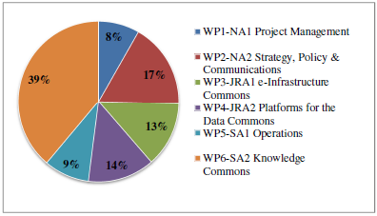
EGI-Engage: WP2.NA2 and WP3.JRA1
WP2(NA2) Strategy, Policy and Communications
  NA2.2.7: EGI Marketplace
  Leader: SwiNG(7PM) - Partners: CSIC(2PM), GRNET(3PM), INFN(3PM), TUBITAK(3PM) EGI.eu (2PM)
WP3(JRA1) e-Infrastructure Commons
  JRA 1.2: Registry and Marketplace
  Leader: SwiNG(7PM) - Partners: IASA(3PM), STFC(3PM), CYFORNET(3PM), INFN(6.5PM)

Slide 5
WP2 and WP3 Deliverables for
Marketplace Activities
WP | N. | Title | PM | Type | Owner
2 | D 2.3 | Concept of EGI Marketplace | M6 | Report | SWING
3 | D3.2 | Design of the EGI Service Registry and Marketplace | M12 | Report | SWING
3 | D3.7 | First release of the EGI Service Registry and Marketplace prototype | M18 | Dem. | SWING
3 | D3.2 | Design of the EGI Service Registry and Marketplace | M12 | Report | SWING
3 | D3.7* | First release of the EGI Service Registry and Marketplace prototype | M18 | Dem. | SWING
3 | D3.14* | Second release of the EGI Service Registry and Marketplace prototype | M26 | Dem. | SWING
3 | D3.16 | Final report on EGI Service Registry and Marketplace | M30 | Report | SWING
* Bold indicates WP3 milestone deliverable.

Slide 6
WP2 and WP3 Roadmap for Marketplace Activities
Task number (2.X) | Task name | Start date (MM/YY) | Release Date (MM/YY) | Status (Open/Closed)
2.1 | Stakeholder involvement | 04/2015 | 08/2017 | Open
2.2 | Marketplace strategy | 04/2015 | 07/2015 | Open
2.3 | Update EGI business development strategy | 04/2015 | 07/2015 | Open
2.4 | Identify/collect EGI services | 04/2015 | 07/2015 | Open
2.5 | Populate service catalog | 08/2015 | 04/2016 | Open
2.6 | Integrate service catalog to EGI web site | 10/2015 | 04/2016 | Open
2.7 | Continue releases | 04/2016 | 08/2017 | Open
2.8 | Final report | 05/2015 | 08/2017 | Open

Slide 7
People Assigned to Each Task
JRA 1.2: Registry and Marketplace
  SwiNG (7PM) – Dean Flanders (dean.flanders@fmi.ch)
  IASA (3PM) – Marios Chatziangelou (mhaggel@iasa.gr)
  INFN (6.5PM) – Diego Scardaci (diego.scardaci@egi.eu)
  CYFRONET (3PM) – Tomasz Szepieniec (t.szepieniec@cyfronet.pl)
  STFC (3PM) – David Meredith (david.meredith@stfc.ac.uk)
NA2.2.7: EGI Marketplace
  SwiNG (7PM) – Dean Flanders (dean.flanders@fmi.ch)
  CSIC (2PM) – Jesus Marco (marco@ifca.unican.es) -> Lifewatch, Pay4use, Enol Hernandez (April 14-15 meeting) -> experience with SMEs
  GRNET (3PM) – Elias Hatzakis (hatzakis@admin.grnet.gr) and Kostas Koumantaros (kkoum@grnet)
  INFN (3PM) – Need to clarify with Luciano Giado (gaido@to.infn.it).
  TUBITAK (3PM) – Onur Temizsoylu (onur.temizsoylu@tubitak.gov.tr), Feyza Eryol (feyza.eryol@tubitak.gov.tr)
  EGI.EU (~2PM) – Sy Holsinger (sy.holsinger@egi.eu) and Sergio Andreozzi (sergio.andreozzi@egi.eu)

Slide 8
JRA1.2 and NA2.2.7 Tasks
Populate Marketplace
  Get list of resource providers in GOCDB and make this list private to EGI members. (STFC)
  Get list of applications in Appdb. (GRNET)
  List of all EGI services. (INFN)
  Get list of pay4use people make them public (INFN).
  Integration to e-GRANT (CYFRONET) -> go via OTAG using RT
  Map EGI environment to new architecture. (INFN/SwiNG)
  Fix EGI web site. (INFN)
Populate directory and federation
  Map VOS into “communities”. (INFN) -> Map current EGI user info into new model.
  Connect to EGI federation. (IASA)
  Connect to Edugain. (IASA)
  Get list of all organizations affiliated with EGI (e.g. for special offerings). (INFN)
  Roadmap to merge LTOS, user portal, AAI pilot, marketplace, etc. together (SwiNG, INFN, IASA)
Features to add
  Add SLA indicator (SwiNG)
  Add redirection to e-grant (or other portals). (SwiNG)
  Improve external and public information for all resource providers. (SwiNG)
Policy
  Update business engagement strategy (https://docs.google.com/document/d/1TAEu25ww-z2SoHUELvm5mPygVDDuGYmTuF7gjTVrgLI/edit). (EGI.eu) -> dissected into different places
  Define partnership levels with commercial providers. (EGI.eu)
  Define offerings from commercial providers (either directly or via EGI with broker.) (EGI.eu)
  Merge Pay4use into Marketplace (EGI)

Slide 9
requirements

Slide 10
NA2.2.4: Statement from EGI Engage
Establishment of an EGI marketplace of IT services for science, ideally applying the one-shop-stop concept¹. This task involves the analysis and development of a legal, policy and business framework for a marketplace capability that would allow the request, provision, accounting, billing of e-Infrastructure services². The activity will develop scenarios for allocating capacity to research communities in collaborations with pilot user communities³ (user-driven scenario development), identify incentive mechanisms for resource centres to provide capacity, analyse revenue streams⁴ (e.g., PCP, PPI, direct charging to users, free service at point of delivery), analyse integration with other marketplaces⁵(e.g., Helix Nebula). Outputs of the pay-for-use activity and the procurement study will be fed into this work⁶. The EGI marketplace activity will be led by SWING with the participation of the represented NGIs and EGI.eu and will collaborate with task JRA1.1 for the technical work.

Slide 11

NA2.2.4: Requirements from Statement
Establishment of an EGI marketplace of IT services for science, ideally applying the one-shop-stop concept.
analysis and development of a legal, policy and business framework for a marketplace capability that would allow the request, provision, accounting, billing of e-Infrastructure services.
develop scenarios for allocating capacity to research communities in collaborations with pilot user communities
identify incentive mechanisms for resource centres to provide capacity, analyse revenue streams
analyse integration with other marketplaces
Outputs of the pay-for-use activity and the procurement study will be fed into this work.

Slide 12
JRA1.2: Statement from EGI Engage
The main target of this task is the design and the development of a proof-of-concept of a Service Registry and a Marketplace for the EGI infrastructure¹. The Service Registry will record the list of all the services offered by EGI² and will be available for consultation by the EGI customers. The Marketplace will allow customers to acquire services through a payment or for free, through SLAs with service providers³. An important role will be covered also by. EGI.eu, as broker/intermediary to define SLA and policies and to identify the best services for the customers and the best users for the service providers⁴ This design will be used to drive the development of the Service Registry and Marketplace proof-of-concept prototype. The implementation will be based on already existing open-source tools, identified during the analysis phase, and extensions of EGI tools (AppDB, GOCDB and e-GRANT) ⁵.

Slide 13
JRA1.2: Requirements from Statement
Development of a proof-of-concept of a Service Registry and a Marketplace for the EGI infrastructure.
Service Registry will record the list of all the services offered by EGI
Will allow customers to acquire services through a payment or for free, through SLAs with service providers.
EGI.eu, as broker/intermediary to define SLA and policies and to identify the best services for the customers and the best users for the service providers.
The implementation will be based on already existing open-source tools, identified during the analysis phase, and extensions of EGI tools (AppDB, GOCDB and e-GRANT).
+ e-GRANT for SLAs
+ e-GRANT for brokering

Slide 14
JRA1.2 and NA 2.2.7: Further Requirements in Engage (part 1)
From Objective 1: “Engagement with commercial service providers for the development of a common service marketplace”
From Objective 3: “The project will also prototype the EGI Service Registry, a new service catalogue and marketplace aimed directly at end-users.”
From EINFRA-1 sub-topic 6 Challenge 4: “…creation of a marketplace of on-demand services provided by governmental and commercial service providers.”
From INFRASUPP-7-2014 sub-topic 3: “design and prototype a new component of the commons: a user facing service catalogue and marketplace
From 1.4 Ambition section EGI Service & Solution Portfolio: ”AFTER: the full EGI Service portfolio will provide a detailed cost model, the solutions will be improved and adapted to specific target groups according to new requirements (e.g. long-tail, SMEs). A service marketplace prototype will be provided for billing and on-demand pay-for-use provisioning.”

Slide 15

JRA1.2 and NA 2.2.7: Further Requirements in Engage(part 2)
From 2.1 Expected Impact: “EGI Service Marketplace concept, the contribution to the Innovation space for the big data value chain, sustainability plans, pay-for-use models)
From 2.1.1. impacts set out in EINFRA1: “Discoverability of services through a service registry and marketplace.”
From 2.1.2. Expected impact on other policy initiatives: Greater discoverability of research data sets by contributing to the gathering of requirements from users and service providers and to the design and prototyping of a data service registry and marketplace.
From 2.2.1 (a) Dissemination and exploitation of results: “The Price will be checked according to the related business model and the targeted market or market segment (free-at-point-of-delivery or pay-for-use/marketplace).” and “The pay-for-use activity, the creation of an EGI marketplace, and the EGI Federated Cloud will allow the expansion of the research customer base” and “The marketplace, pay-for-use, and the procurement EGI-Engage activities of the project are expected to generate new revenue streams.”
Integration of data sets possible but not clear yet what data sets.
+ e-GRANT for brokering

Slide 16
JRA1.2: Service Marketplace
User Stories (1/4)
The service provider publishes a service
  The service provider (SP) registers a new service in the Service Catalogue
  The SP can assign a SLA to the new service
  The SP assigns a price to the new service (can be 0, for free)
  The SP can define a policy to access the service
  The new service is available in the service catalogue
The customer discovers the existing services
  The customer accesses the Service Catalogue and get the list of offered services
  The customer can look for a service with specific characteristics/requirements (search engine)
  The customer can read the details of a service: description, SLA, price, SPs list, etc.

Slide 17
JRA1.2: Service Marketplace
User Stories (2/4)
The customer directly selects and buys a service
  The customer accesses the Service Catalogue and look for a service
  The customer chooses the service to buy
  The customer may negotiate the SLA through a broker or accept the pre-defined SLA associated to the service
  The customer buys the service
The customer selects a service through a broker
  The customer lists the requirements that should be satisfied by the service he’s looking for
  The broker identifies the best service according to the customer’s requirements
  The broker offers the selected service to the customer
  The customer evaluates the offered service, may negotiate the SLA through a broker or accept the pre-defined SLA
  The customer buys the service
Done via e-GRANT
Done via e-GRANT
Done via e-GRANT

Slide 18
Service Marketplace
User Stories (3/4)
The customer reviews and rates a service and/or a service provider
  The customer selects a service from the list of bought services
  The customer reviews and rates the service and/or the service provider
The customer wants to check the status of his orders
The customer consults the consumption/usage
The customer manages the service (add/remove users, define quotas ?)
A Service Provider manages the published services
  A Service Provider registers into the service catalog
  Hide previously published services / changes the conditions associated / highlight the services / announce a maintenance break
Done via e-GRANT

Slide 19
JRA1.2: Service Marketplace
User Stories (4/4)
A Service Provider checks the information associated to services
  The SP controls the accounting information related to their services (usage, number of users, average consumption). They can control either by service published or total
…
Done via e-GRANT or another tool?

Slide 20
concepts to develop

Slide 21
Marketplace 1.0: Functionality
Portal catalog / registry – simple website to search through services provided by EGI, EGI members/NGIs, and EGI partners:
  NGI services: Moodle, helpdesk...
  Operational services: GGUS, GOCDB, appdb, egrant, operational portal, account portal
  Computing services: Cloud, grid, HTC
  Colaboration tools: docbd, mail, wiki, cms, SSO management, indico, RT
  Software: hosted for communities
  Commercial solutions: Dropbox, Azure, Amazon, etc.
  Etc.
Portal provides
  Listing
  Search
  Basic information – features, who is providing, who is using
  Reference – link, who to contact to get the service

Slide 22
Marketplace 1.0: Value
Value for
  EGI, EGI members, and EGI partners advertise their services (not only computing)
    Discoverability, branding, EGI stamp
  Communities: open source and commercial tools they use
  Users
    Easily finding needed services / resources / support
Policy
  Free for all supported by consortium members

Slide 23
Marketplace 1.0: Why EGI?
Why EGI?
  Single point to find / advertise any services / resources
  Stamp of EGI quality
  EGI.eu will be seen as IT expert for researchers (I need any IT service -> first goto EGI)

Slide 24
Marketplace 1.0: components
  Appdb – software / cloud VM images market
  GOCDB – list of resource providers
  e-Grant – storage / computing grid / cloud negotiation and buying (P4U)
  Open IRIS – Marketplace frontend that can be used to just list resources (e.g. redirect to e-Grant or Appdb) or to manage resources (already contains functionality for billing, management of users / groups / organizations / departments / communities / providers, federated login, issue tracking, request management, etc.). Already in production in different organizations / countries, but currently heavy focus on scientific instruments and services.

Slide 25
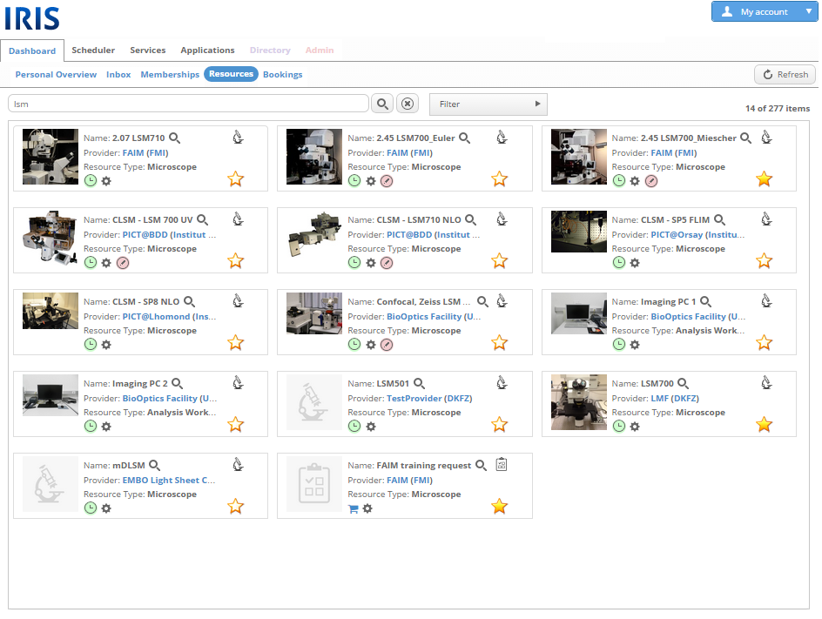
IRIS Screenshot

Slide 26
Marketplace 2.0: Future
More focus on shopping / buying / billing.
Comercial services with special offer for EGI community.
Same feel and look for all tools.
Advertising who is using EGI services / resources.

Slide 27
Business Development Priorities
(academic or commercial)
 | Topics | Strategy | Action
1 | Computing Capacity (IaaS) | Infrastructure services | Define strategy
2 | Hosting of tools (PaaS) | Back office support | Define strategy
3 | Providing tools (SaaS) | Providing SaaS | Define tools
4 | Facilitation (XaaS) | Cloud enablement | Define strategy
5 | Data Services | Hosting of data sets | Define strategy
6 | Market Intelligence | Facilitate e-Infrastructure | Define strategy
7 | Promotion | Promote partners | Define strategy
Based on: https://docs.google.com/document/d/1TAEu25ww-z2SoHUELvm5mPygVDDuGYmTuF7gjTVrgLI

Slide 28
Directory: Needs to support this model
Org A
Org B
Org C
Org D
OrgA
Org B
Org C
Org D
Org E
Org G
Org F
Org H
Old world: Hierarchical
New world: Federated
http://www.fedsm.eu/

Slide 29

Directory: Organization of Users
audience
description
requirements
trust
users
Anyone (academic, commercial, private, etc.)
Support for multiple affiliations and discover resources.
groups
A group of people affiliated with one institution.
Track usage and billing information of resources used by their group.
organizations
Any legal entity (commercial, academic, NGO, association, etc.).
A legal entity that can control users and groups, and handle billing.
projects
A group of people affiliated with one or more organizations.
Useful for providing access to data.
communities
Like an organization but with people and groups affiliated with one or more organizations.
Useful for large collaborations across multiple institutions.
providers
Can be a lab, core facility, commercial, etc.
Publish into a service catalog, authentication services, billing, etc.

Slide 30

High Level Architecture
Authentication (eduGAIN, social, enterprise, etc.)
Group management (organizational, local, etc.)
Attributes (billing information, ORCID, etc.)
Etc.
user
group
organization
community
Favorites
Ratings
Etc.
attribute providers
user profile
portal
directory / authentication
Search across all service types
Service Catalogs
Different catalogs (AppDB, GOCDB, Helix Nebula, IRIS, etc.)
Catalogs should deliver additional value to providers
Can have multiple of the same type of catalog
VM registry
software
instruments
cloud services
API
etc.
Plugin Modules
Different plugins for catalogs (e-GRANT, etc.)
Plugins should deliver additional value to service catalogs
Not mandatory to the catalogs.
Can have multiple of the same type of plugin
accounting / reporting
billing
persistent identifiers
proposals
etc.

Slide 31
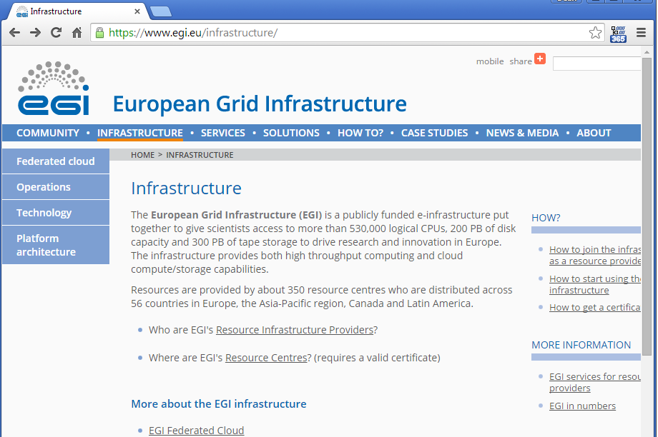
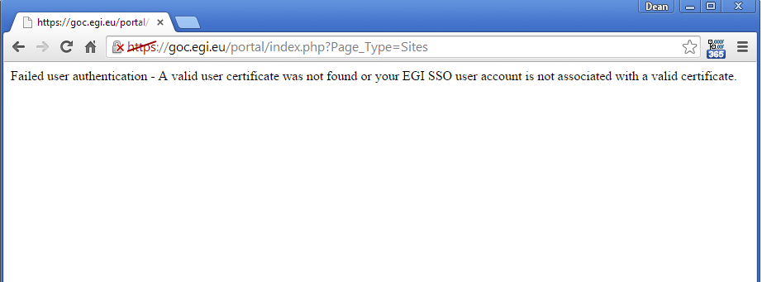
EGI Web Site: Issues (part 1)

Slide 32
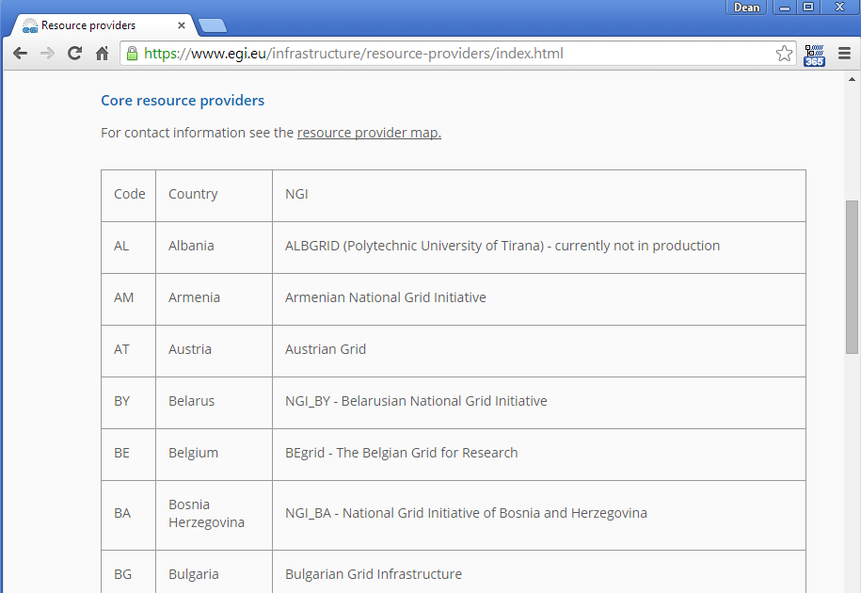
EGI Web Site: Issues (part 2)
Where are the contact details? URL?

Slide 33
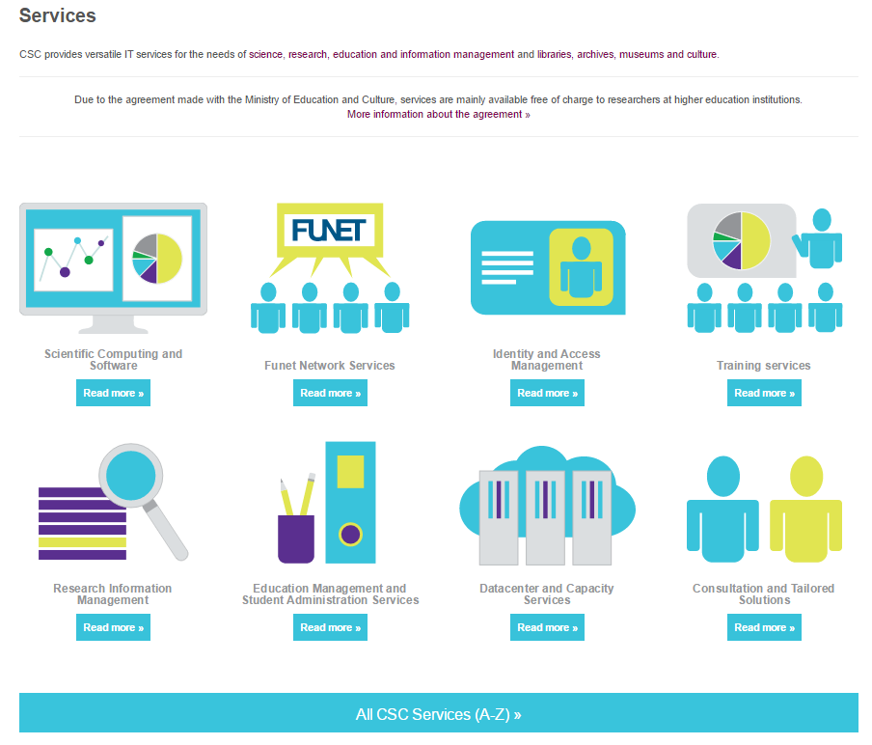
EGI Web Site: New Direction (part 1)

Slide 34
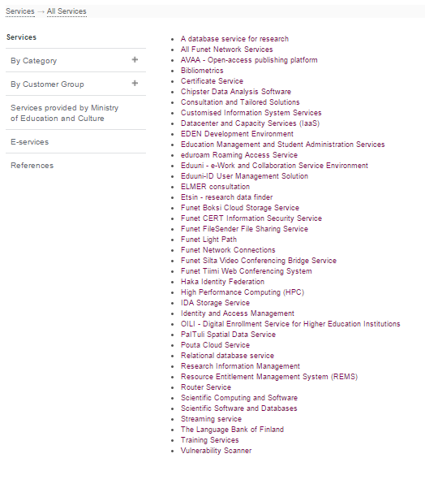
EGI Web Site: New Direction (part 2)

Slide 35
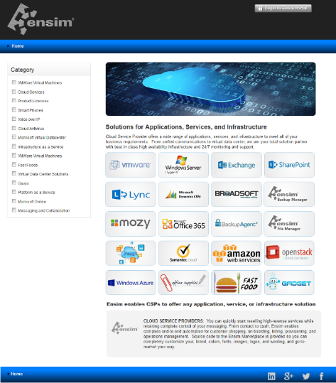
Marketplace example 1

Slide 36
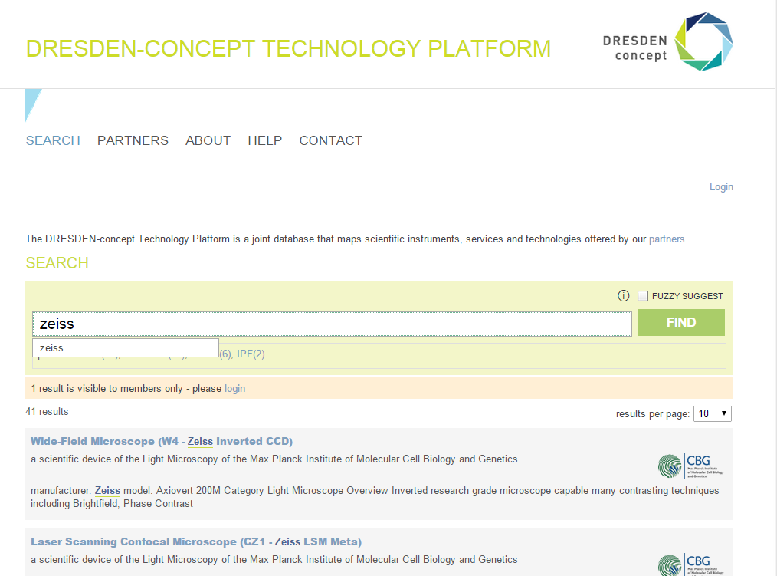
Marketplace example 2

Slide 37
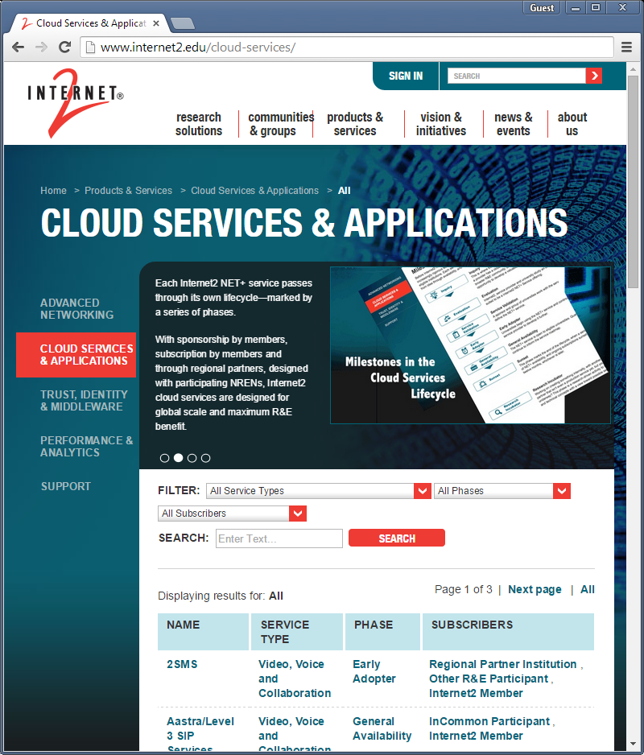
Marketplace example 3

Slide 38
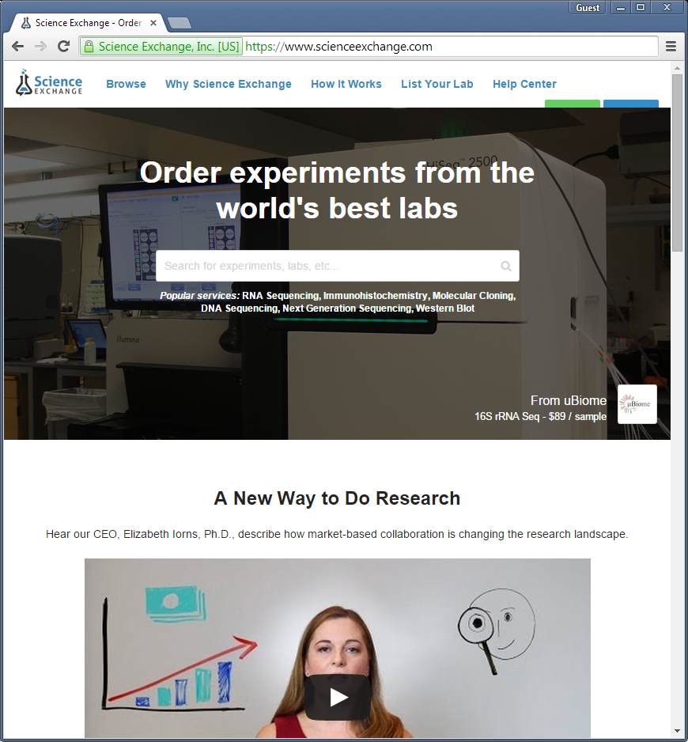
Marketplace example 4

Slide 39
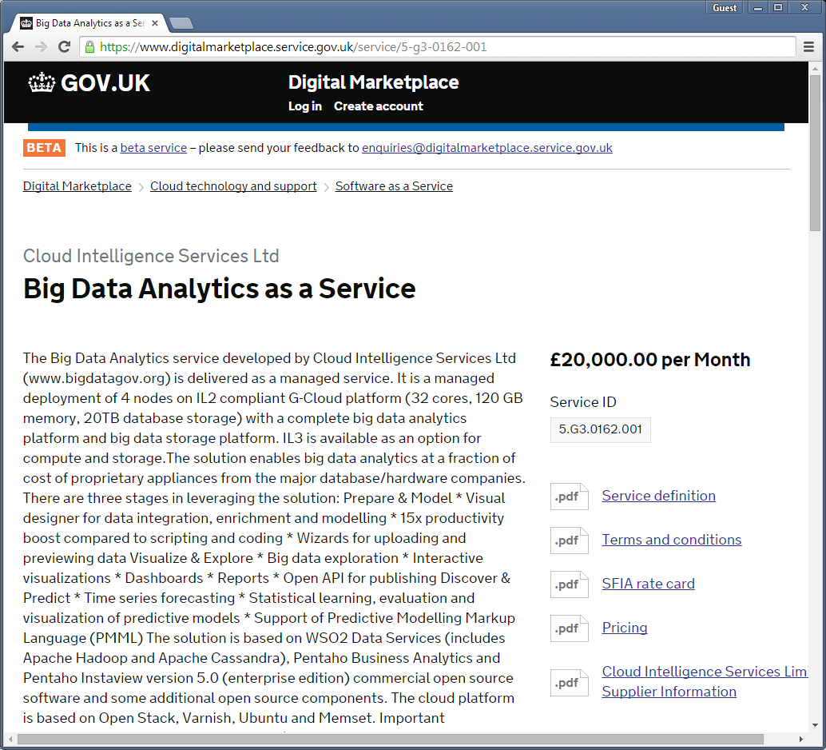
Marketplace example 5

Slide 40
Marketplace for EGI
Science Commons
EGI
Collaboration Tools
docdb
wiki
email lists
etc
Operations Tools
instruments
software
data
IaaS
IaaS
GGUS
AppDB
etc.
E-GRANT
GOCDB
grid
fedcloud
NGI / communities / commercial / etc/

Slide 41
Marketplace Strategy for EGI
Science Commons
EGI
eGRANT
APPDB
GGUS
/
VAPOR
/
Nagios
/
Pakiti
Appdb
GOCDB
Software
Instruments
IaaS
Cloud
Fedcloud
grid
IaaS
Cloud
GRID
Marketplace

Slide 42
tasks

Slide 43
JRA1.2 and NA2.2.7 Tasks
Populate Marketplace
  Get list of resource providers in GOCDB and make this list private to EGI members. (STFC)
  Get list of applications in Appdb. (GRNET)
  List of all EGI services. (INFN)
  Get list of pay4use people make them public (INFN).
  Integration to e-GRANT (CYFRONET) -> go via OTAG using RT
  Map EGI environment to new architecture. (INFN/SwiNG)
  Fix EGI web site. (INFN)
Populate directory and federation
  Map VOS into “communities”. (INFN) -> Map current EGI user info into new model.
  Connect to EGI federation. (IASA)
  Connect to Edugain. (IASA)
  Get list of all organizations affiliated with EGI (e.g. for special offerings). (INFN)
  Roadmap to merge LTOS, user portal, AAI pilot, marketplace, etc. together (SwiNG, INFN, IASA)
Features to add
  Add SLA indicator (SwiNG)
  Add redirection to e-grant (or other portals). (SwiNG)
  Improve external and public information for all resource providers. (SwiNG)
Policy
  Update business engagement strategy (https://docs.google.com/document/d/1TAEu25ww-z2SoHUELvm5mPygVDDuGYmTuF7gjTVrgLI/edit). (EGI.eu) -> dissected into different places
  Define partnership levels with commercial providers. (EGI.eu)
  Define offerings from commercial providers (either directly or via EGI with broker.) (EGI.eu)
  Merge Pay4use into Marketplace (EGI)

