Slide 1




EGI DARIAH Competence Centre
Project logistics and activity plan
Karolj Skala, Davor Davidović
skala@irb.hr, ddavid@irb.hr
Ruđer Bošković Institute, Croatia
Notes:
1

Slide 2
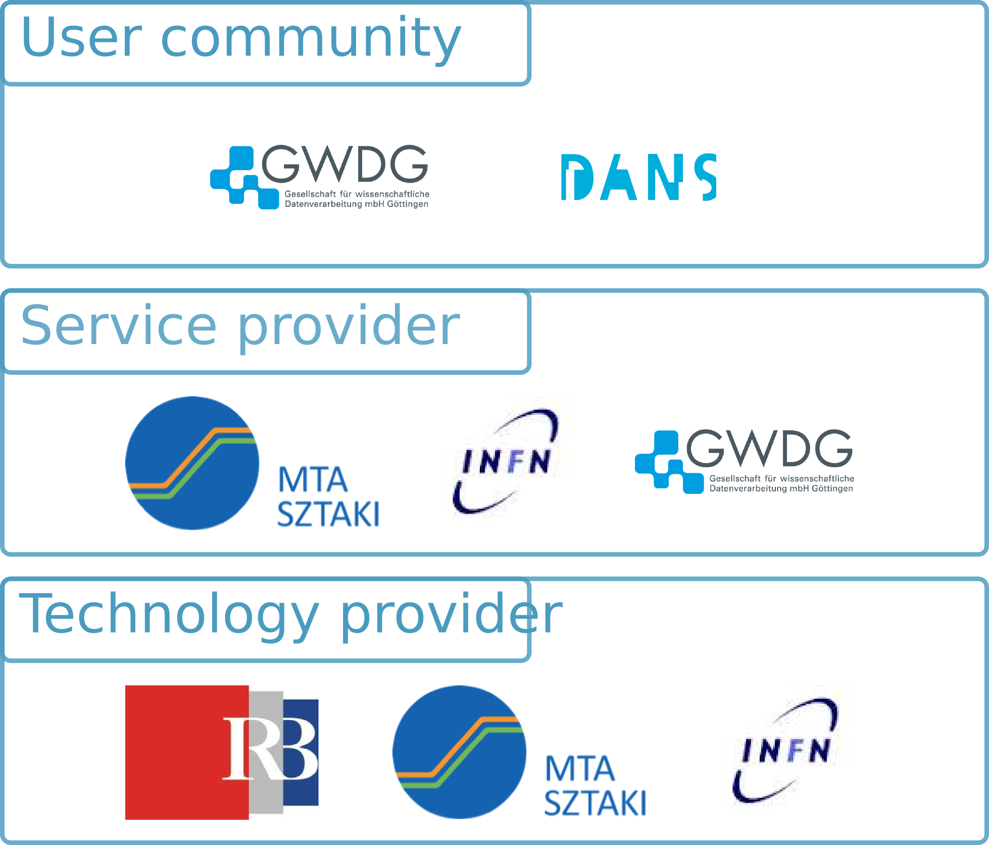
Partners

Slide 3
Partner contacts
Ruđer Bošković Institute (RBI):
Karolj Skala (skala@irb.hr), Davor Davidović (ddavid@irb.hr)
MTA SZTAKI:
Zoltan Farkás (zoltan.farkas@sztaki.mta.hu)
Instituto Nazionale di Fisica Nucleare (INFN):
Roberto Barbera (roberto.barbera@ct.infn.it),
Giuseppe La Roca (giuseppe.larocca@ct.infn.it)
Data Archiving and Networked Services (DANS):
Maarten Hoogerwerf (maarten.hoogerwerf@dans.knaw.nl)
Gesellschaft für wisseenschaftliche Datenverarbeitung Göttinger (QWDG):
Tibor Kalman (tibor.kalman@gwdg.de)
Austria Academy of Science:
Eveline Wandl-Vogl (Eveline.Wandl-Vogt@oeaw.ac.at)
European Grid Infrastructure (EGI):
Gergely Sipos (gergely.sipos@egi.eu)

Slide 4
Project coordination
CC coordinator: Karolj Skala (skala@irb.hr)
Activity coordinator: Davor Davidović (ddavid@irb.hr)
Technical coordinator: Zoltan Farkás
(zoltan.farkas@sztaki.mta.hu)
Dissemination coordinator: Eveline Wandl-Vogl
(Eveline.Wandl-Vogt@oeaw.ac.at)
EGI contact point: Gergely Sipos (gergely.sipos@egi.eu)

Slide 5
Tasks
T1: User Support and Training (RBI)
T2: DARIAH eScience Gateway on EGI (SZTAKI)
T3: Storing and Accessing DARIAH contents on EGI (SADE) (INFN)
T4: Multi-source distributed real-time search and information retrieval (SIR) (GDWG)
T5: Exploitation (DANS)
Notes:
Exploitation – transfer of the CC results (applications, repositories) to its targeted user communities and reasearchers
Increase applicability and impact of the mini-projectss – increase awareness of EGI infra in A&H, define usage policy, dissaminate mini-projects
5

Slide 6
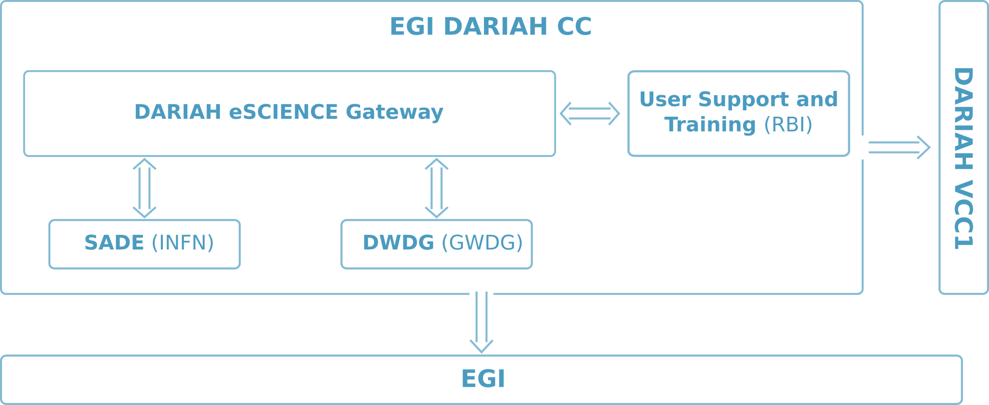
Task interaction

Slide 7
Deliverables
Upcoming deliverables(M2): D2.1, D3.1, D4.1
Requirements collection and analysis

Slide 8
Meetings
F2F meetings
  Every 6 months in the first year
  1 per/year in the following years
  In conjunction with EGI meetings (User forums, EGI conference, NGI events)
  At least one meeting in conjunction with DARIAH-EU
Online meetings (skype, indico,…)
  1 every month
    Coordination actions, follow-up
    Report on mini-project status

Slide 9
Dissemination activities
Starting date: M6
Develop training plan (A1.1, D1.1 – M9)
Training plan (to be defined by M9)
Tentative plan:
  Each partner organize at least one training event (specially those involved in mini-projects)
  At least one training event / workshop organized in conjunction with DARIAH-EU

Slide 10
Exploitation activities
Starting date: M7
Define per mini-project exploitation actions
  SADE, SIR, eScience Gateway
Activities (to be redefined):
User involvement per mini-project (D5.1)
  Sustainability plan (D5.2)
  Mini-project dissemination activities (D5.3)
  Roadmap to user community enlargement in EGI (D5.4)

Slide 11
Support activities
Consulting (starting M6)
Technical support (starting M13)
Decide on how to provide support
  Will resulted with deliverable: D1.1 (M9)
Support staff (ticketing – maybe through existing EGI ticketing?)
Populate DARIAH CC wiki pages: (wiki.egi.eu/wiki/Competence_centre_DARIAH)

Slide 12
Start-up activities
Start building wiki pages:
https://wiki.egi.eu/wiki/Competence_centre_DARIAH
Questionnaire
  survey about DARIAH users e-Infrastructural requirements (e.g. storage capacities, computational power, authN, etc...)
  Define the target group
  To be discussed via teleconferencing (end of April)
Establish EGI Virtual Organization for A&H (DARIAH community)?

Slide 13
Useful information
Mailing list: cc-dariah@mailman.egi.eu
Meetings, webinars, agendas:
http://indico.egi.eu/indico/categoryDisplay.py?categId=141
Wiki pages:
https://wiki.egi.eu/wiki/Competence_centre_DARIAH

