Slide 1
Session Agenda
EGI Business Development (16:00-16:25)
Sy Holsinger, EGI.eu
Pay-for-Use Demo (16:25-16:50)
Roksana Rozanska, Cyfronet
The First GEANT Open Call - Innovation & Outreach in an e-Infrastructure (16:50-17:15)
Annabel Grant, GEANT
Panel Led Discussion (17:15-18:00)
e-Infrastructure reps: EGI, GEANT, EUDAT
Notes:
Actually a 2-hr session, as opposed to the traditional 90-mins

Slide 2
EGI Business Development
Sy Holsinger
EGI.eu Senior Strategy and Policy Officer

Slide 3
Outline
Overview of EGI Business Development
Business Engagement Programme
Pay-for-Use Pilot
Other related activities
Innovation topics for SME collaboration
Summary/Conclusions
Notes:
So, with that in mind. I’d like to give you a brief intro into EGI, especially as many of you following the business track are potentially new to EGI.
Provide a bit of detail to the EGI business engagement programme, the lessons we have learned and the plans we have.

Slide 4
EGI Business Engagement Programme
Notes:
So then, why EGI and business

Slide 5
Business Engagement: Rationale
SMEs are considered one of the key drivers for economic growth, innovation, and employment
EGI goal to continuously innovate to provide researchers with the latest technologies and services to help support their research
The EC has made them one of the focuses in the Horizon 2020 with the aim of putting SMEs in the lead for the delivery of innovation to the market
EGI supporting this policy objective by exploring opportunities for synergies with SMEs
Address opportunities of Big (Open) Data Value
Increase sustainability
Partnerships that lead to business relationship supporting overall sustainability of the infrastructure
Bridge the skills gap
Notes:
SMEs are considered one of the key drivers for economic growth, innovation, and employment
The EC has made them one of the focuses in the Horizon 2020 with the aim of putting SMEs in the lead for the delivery of innovation to the market
Working with industry can increase sustainability by building partnerships that can lead to business relationships.
Finally, bridge the skills gap, what I mean by that is expectations aren’t just changing from a user perspective, but also from funding agencies. The EC has done really well in pushing projects to make something with lasting impact. So it isn’t enough to just conduct research, publish a paper and move on. However, what this means is the scientists and researchers are being asked to deliver on skills that the haven’t been classically trained. Therefore, there is a need to have a formal means to offer this support.

Slide 6
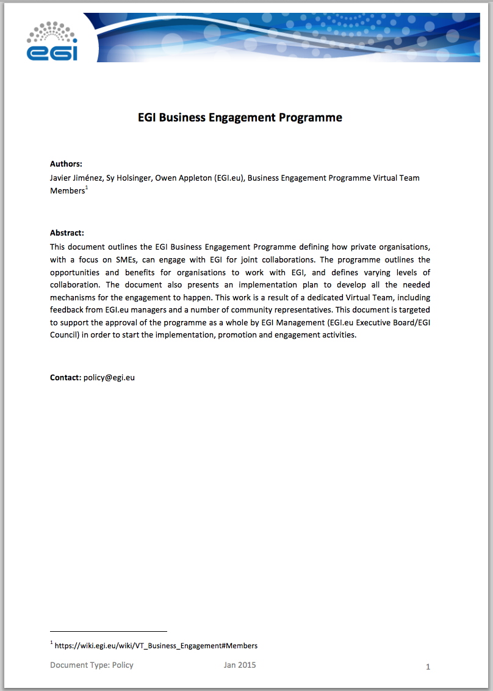
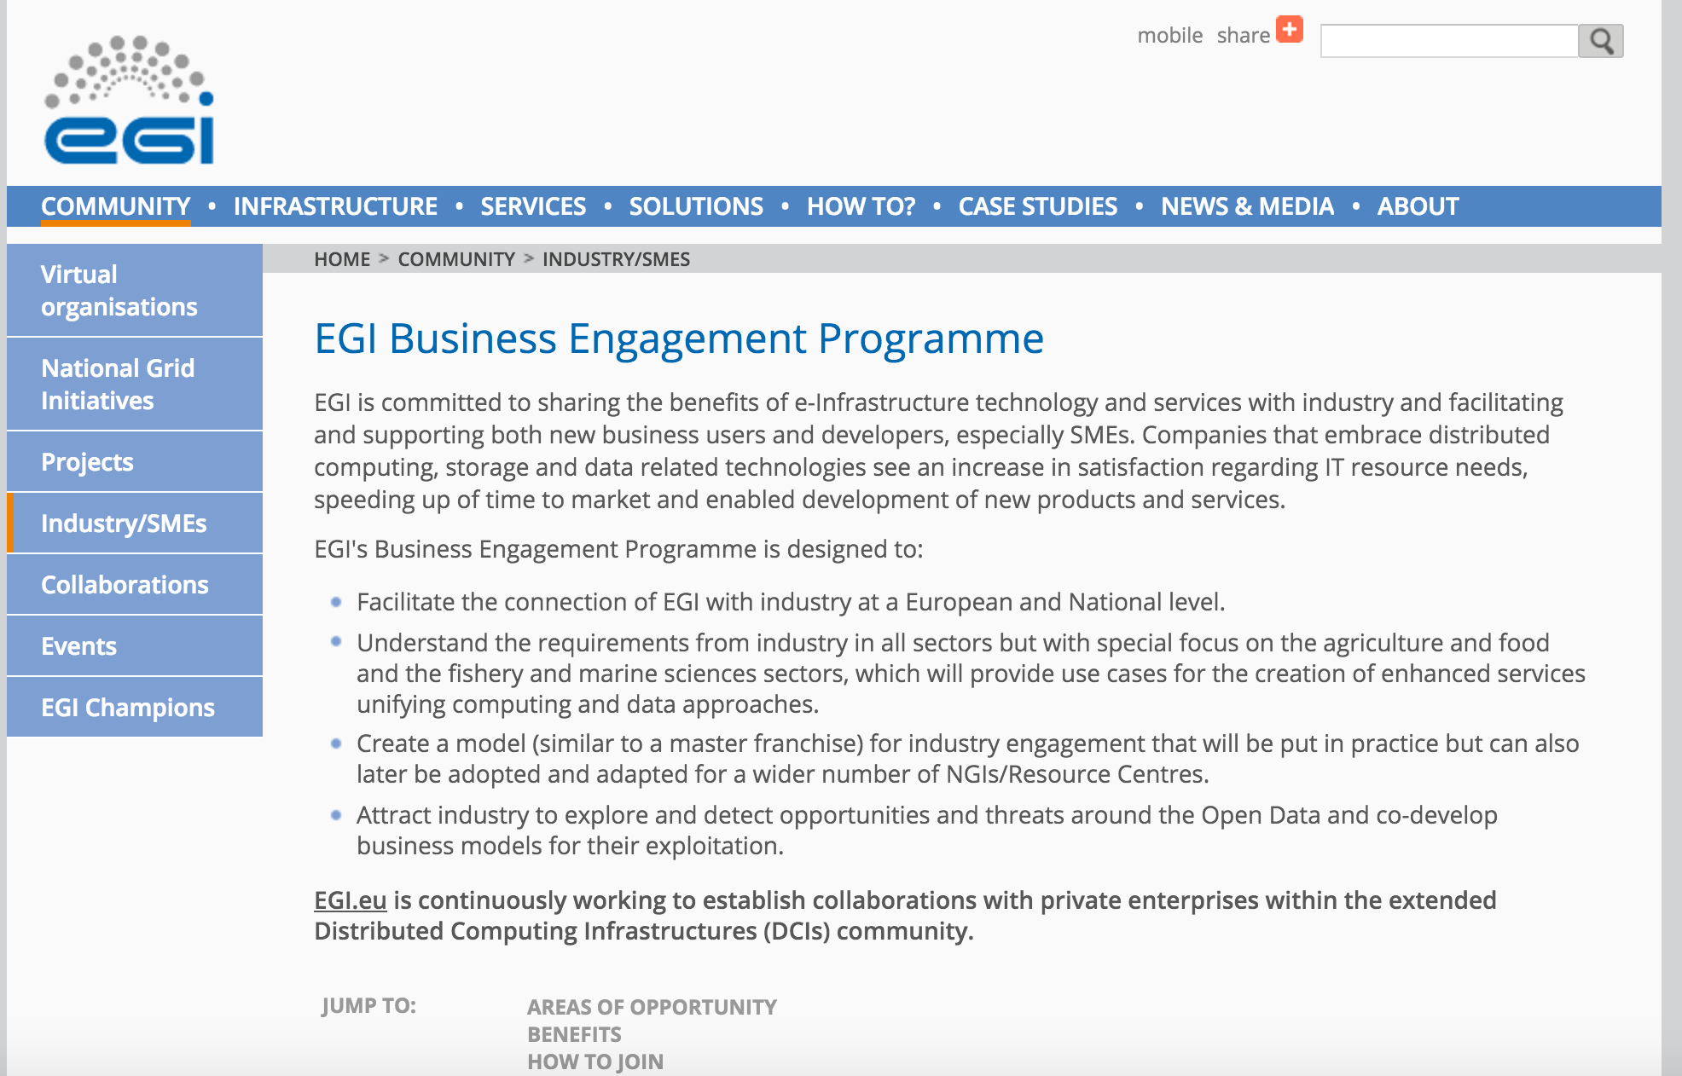
Business Engagement Programme
Need for a specific structure for business engagement
Dedicated budget
Dedicated personnel knowledgeable in business activities
Established procedures, working at local/national level and with European co-ordination
Created a dedicated
Business Engagement Programme
Notes:
So, needing a formal structure, we have created the EGI Business Engagement programme.
It is not enough to define some activities, but to be effective, it needs to be not only resourced, but staffed with personnel knowledgeable in business activities.
In addition, some level central coordination is needed, but to ensure European wide impact, then a standard set of procedures to help create a model that can be re-used on a national/local level.

Slide 7
EGI Business Engagement Programme: Collaboration Areas
Example Areas | Opportunity
Capacity | Grid, Cloud IaaS, heterogeneous resources PaaS for big data management and analysis
Technology | Re-use of domain-specific software and tools Innovative algorithms, applications, tools
Expertise & Knowledge sharing | Support in accelerating innovation
Big (open) data | Research projects generate valuable data with exploitation potential
Market intelligence & promotion | Many national partners can engage SMEs locally EGI.eu can act as EU coordination
Notes:
So in which areas do we seen potential collaborations.
This can be computing capacity, grid cloud infrastructure as a service as well as offering platform as a service
Around software products and tools
Knowledge sharing, as I said will be important not only to receive from the commercial sector, but also provide the knowledge from research and academia to accelerate innovation
Big (open) data putting data providers closer to commercial companies for value add services
Finally promotion, visibility is quite important, especially for SMEs that struggle in wide scale marketing to expand customers and collaborations with key partners needed

Slide 8
EGI Business Engagement Programme: Agreement Structure
 | Member | Associate | Partner
Inclusion in marketing material/presentations/website | ✔ | ✔ | ✔
Access to test bed resources and basic support* | ✔ | ✔ | ✔
Access to open research datasets, tools and apps | ✔ | ✔ | ✔
Lightweight Cooperation Agreement | ✔
Limited term formal MoU (max 12-month cycles) |  | ✔
Opportunity to participate in proposals |  | ✔ | ✔
Specialized consultancy |  | ✔ | ✔
Presentation and promotion opportunities at EGI events (e.g. reduced sponsorship prices) |  | ✔ | ✔
Formal allocation of resources and advanced support |  | ✔ | ✔
Membership to the Strategy and Innovation Board |  |  | ✔
Long-term Partnership Agreement (e.g. 2-year) |  |  | ✔
Stronger role in the EGI governance* |  |  | ✔
Notes:
Won’t go into detail, but one thing that worked well in the past, was to increase benefits as the level of engagement increased.
This was quite appreciated.
So from “members” which are lightweight engagement, to associates where there would be a more forma agreement, such as an MoU
To business partners, which are more long-term partnerships, that could offer opportunities to things like membership to the EGI strategy and innovation board, which is a high level board providing key insights and recommendations for the evolution of EGI service and solutions portfolio.

Slide 9
Collaborations
EGI-Engage Consortium
Industry representatives: Gnublia, Engineering, Agro-Know, CSC
Domain specific use cases and market analysis (tomorrow)
EGI Federated Cloud
100% IT (UK SME – cloud provider)
Collaborations in progress
Terradue, UberCloud, mITSM
European Space Agency, Helix Nebula
European Initiatives
Big Data Value (EGI is a Member); FIWARE (this session)
Active Contacts
~40 organisations in DB at various levels of maturity
Consumers, providers, tech developers, brokers and resellers, others
Notes:
Several collaborations are already in place and commercial organisations are working with EGI.
There is the EGI-Engage project…
There is a company participating within the EGI Federated Cloud – 100%IT
Others, many of which you will here today, but we have been working with the European Space Agency to get EGI involved in their stimulus projects, which would be paid.
EGI is also involved with Helix Nebula to be part of the marketplace.
We have several activie contacts, the goal isn’t to have a DB that is just a list of companies from searching Google, but active contacts where we are discussing potential opportunities.
I joked with someone before, that we are basically speed dating at the moment, seeing where are strategic opportunities to take forward

Slide 10
EGI Pay-for-Use Pilot
(demo to follow)
Notes:
So what now?

Slide 11
Pay-for-Use: Rationale
Strategy
Not about replicating commercial offerings
Provide additional mechanisms for researchers with funds to access resources
Increase sustainability (e.g. cost recovery, new sources of revenue)
Create new opportunities to support research and innovation (academia/ industry partnerships)
Focus
Research and innovation activities; pre-commercial applications
Dedicated high-level consultancy and support (e.g. application porting)
Competitive pricing (not undermining market)
Value Proposition
Flexible access to high quality IT resources with tailored research and innovation consultancy and support to accelerate results
Not an overhaul of the current system
Notes:
So what are the reasons for EGI to look at pay-for-use.
Well, first of all, our strategy is not about replicating commercial offering.
Most importantly, this is not an overhaul of the current system, where EGI offers services free at the point of delivery that have been paid for by public funds.

Slide 12
Pay-for-Use PoC: Overview
2014: Implementation of proof of concept (PoC) based on a policy paper (2013)
Objectives
Articulate business and responsibility models
Define prices for services from
Understand required agreements
Identify the tools and necessary development
Analyse the changes to roll out new functionalities into production
Evaluate legal, policy, and organizational issues
Final Report as concrete input to 2015 activities
Available at: https://documents.egi.eu/document/2377
EGI-Engage: Dedicated activities to move prototype to production
Beta production version available (demo to follow) - https://e-grant.egi.eu/v2/
Notes:
The pay-for-use proof of concept, which was based on a policy paper, started in early 2014 on a best effort basis, which was the supported with
Dedicated effort within the revised Dow from May to Dec.
The main objectives (pick out key words)
The final report was produced, which you will have received the executive summary, with a link to a full report, as a means for self-reflection over what was done and to have a record of activities as a foundation for continued activities in 2015.

Slide 13
Pay-for-Use PoC: Participants
43 individual participants and observers
EGI.eu (Lead), Resource Centers, NGIs, Commercial Company
Publishing Pricing Information
30 Providers across 12 Countries
20 Grid: Belarus; Bulgaria; Germany; Greece; Italy; Latvia; Poland; Spain; Switzerland; Turkey
10 Cloud: Finland, Greece; Italy; Poland; Slovakia; Spain; Turkey; UK
15 Storage sites: Bulgaria; Greece; Italy; Spain
~10 able/willing to provide service on a payment basis
~the same number with having had or plan on participating to public tenders
Price Ranges (incl. support)
Grid (HEPSPEC/hr): €0.01 - €0.15 (Avg. €0.05; Median €0.05)
Cloud (wallclock/hr): €0.03 - €0.11 (Avg. €0.05; Median €0.05)
Storage (€/GB/month): €0.01 - €0.14 (Avg. €0.04; Median €0.04)
+/- VAT 8%-24% (where applicable)
Taxation report available at: https://documents.egi.eu/document/1391
Prices to be valid for one year once in production
Notes:
The pay-for-use group had quite diverse participation, with more than 40 coming from EGI.eu as the lead, Resource Centers, NGIs, and even a commercial company
So far, 30 providers are publishing pricing information comprising grid, cloud and storage services.
Approximately 10 of those are current in a position to offer services on a payment basis with roughly the same number with regarding having had/planning to participate in public tenders.
Here you can see the various prices with the average working out to around 5 cents and hour for both grid and cloud,
Which is quite competitive considering they include support
And the VAT that would need to be applied when applicable

Slide 14
Pay-for-Use PoC: Initial Business Scenario
2. Searches
1. Publishes Services
Service / Price List
11. Makes payment
3. Selects / Submits Request
4. Agrees SLA
10. Provides Invoice & Reports
8. Adds Users / 9. Uses Services
7. Allocates
Capacity
Customer
Service Provider
5. Informs About New Customer
6. Creates VO
Virtual Organization
Broker
Notes:
In order to optimize the resources, we started by creating a general scenario from providing prices, accounting for them, etc. so we can easily identified what tool we already had that could be used, and what changes or development would be needed.
Currently, the broker plays a support role, but…

Slide 15
Business Scenario: Potential Broker Role
Publishes Services
Searches
Service / Price List
Selects / Submits Request
Informs About New Customer
Agrees SLA / Handles Payment
Agrees OLA
Broker
Creates VO
Allocates
Capacity
Service Provider
Customer
Adds Users / Uses Services
Virtual Organization
Notes:
Moving forward we can see emerging models and potential value for the broker to take a more central role.
Such as reducing many-to-many relationships.

Slide 16
Pay-for-Use PoC: Current results
Processes in business scenario for phase 1 defined
Tools adaptation
Registry extensions added to set prices
Accounting Portal accounting information
e-GRANT Broker/User Interface
Providers
30 providers publishing pricing information (20 Grid, 10 Cloud)
Legal and Policy solutions emerging
e.g. research-only purpose statements; joint collaborations
Business Cases being explored
Helix Nebula, European Space Agency, Engineering, Terradue
Notes:
So where are we now. We have:
adapted the service registry with extensions for providers to be able to insert prices
Accounting portal is able to account for the usage
e-GRANT, which was already handling the federated resource allocation, to serve as the broker and user interface

Slide 17
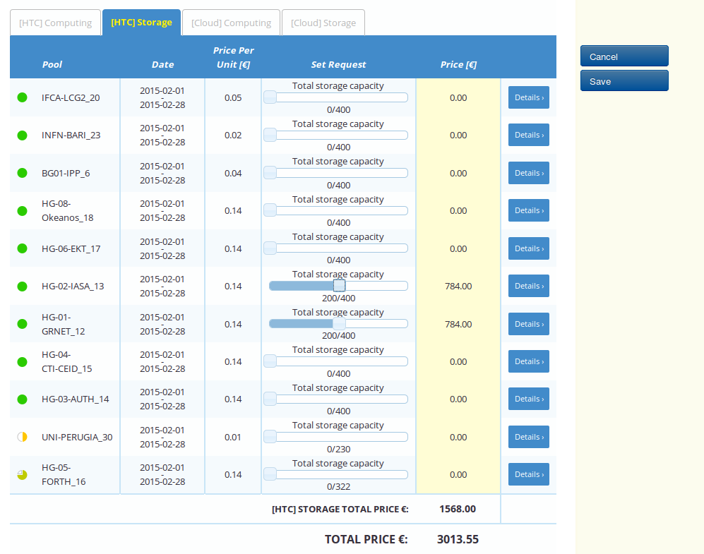
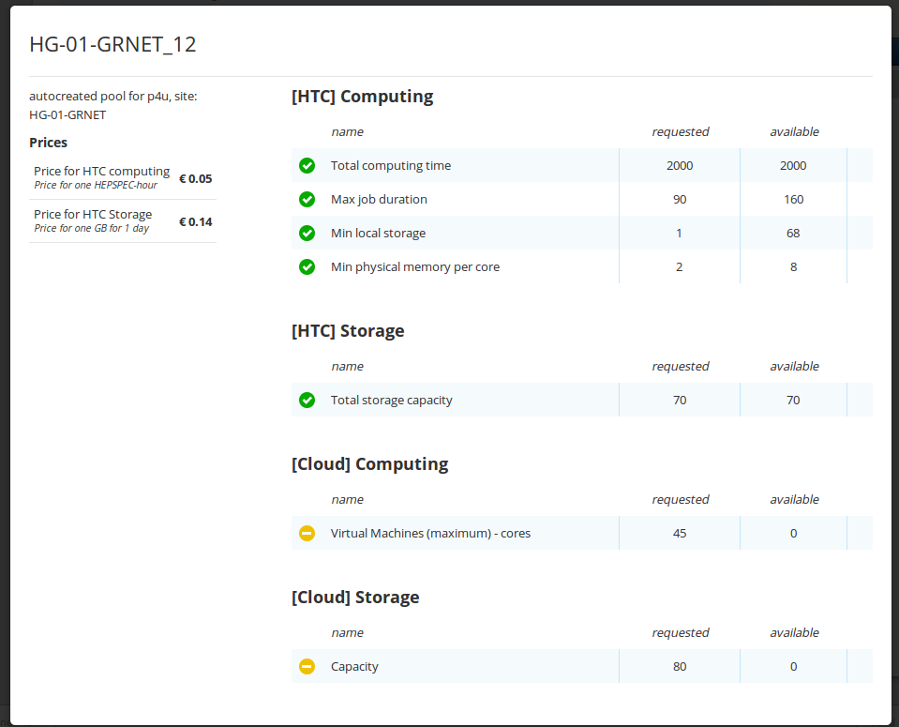
Pay-for-Use PoC: Current results (e-GRANT)
Completed
Special pool type: pay-for-use (w/ price)
Importing prices from Registry
User self-allocation: supported matching pools enabled for customers (existing broker functionality)
Automatic finding and presenting the cheapest allocation that suited requested parameters
Presenting cost of overall allocation
Planned
Proper SLA created based on template and negotiated metrics
Billing according contract/SLA (integration with accounting needed)
Notes:
From the user interface perspective, e-GRANT offers both the provider to go in and specialize what resources/services will be made available.
The user is able to go in – fill out a form – and automatically get what providers are able to satisfy the request.
Explain screen shots

Slide 18
EGI Pay-for-Use: Emerging Business Models
Infrastructure-as-a-Service (IaaS)
Charge for resources consumed to support researchers/research communities with budget to purchase services
Offer a selection menu: grid, cloud, storage; Support different pricing schemes
Means to deliver other value-added services
IaaS + Consultancy
Exploit community expertise for customers who require dedicated support
Get applications up and running with optimised usage, training, etc.
Joint development initiatives/collaborations
Develop joint work plan to exchange services
Can allow for time/effort to be charged and resources offered for “free” (value expressed in monetary equivalent)
Broker
Avoid many-to-many relationships
Facilitate customer management (e.g. discovery, allocation, agreement)
Notes:
A few different business models are starting to emerge, such as the classic IaaS – INFN has examples of offering pure compute through an industrial partnership that provides the consultancy
IFCA (Spain) has several use cases selling resources for a set amount agreed with the ministry, but then offering high level of consultancy and support
Other options for research institutes was to enter a joint development project/collaboration, where FTEs are paid, then the number of CPU provided is expressed in terms of monetary value
In addition, this could tool for communities receiving services “free at point of use” for us to demonstrate the value of the services they are consuming on a daily basis thanks to the national and European funding agencies.

Slide 19
Related Business Activities
Market Analysis (session tomorrow)
Agriculture requirements: Agro-Know
Fisheries and Marine Data policies and legal aspects: FAO, Engineering
EGI Marketplace (previous session)
Front end shop window for EGI services
Procurement (morning session)
Enable EGI providers to serve both industry and research collaborations
Cost recovery, cost sharing
Facilitate potential future funding model changes
Service Management (FitSM)
Offer (paid) training and consultancy to improve efficiency and effectiveness of service delivery based on industry best practices
Registration Open: Foundation level training and certification – 10 Dec 2015 – Amsterdam: http://go.egi.eu/netki

Slide 20
Possible Future Innovation Topics
AAI, SDN, cloud services (for education)
Services and data infrastructure for repeatability of science and reuse of open data, and scientific software for Information as a Service
Services requiring federated cloud/HTC compute, cloud storage, and possibly heterogeneous compute and storage architectures
Integration of frameworks enabling big data analytics and deep learning in the federated cloud
Solutions for citizen science that could benefit from federated storage, computing or open data
Adoption of open cloud standards
(application porting, standards development and profiling)
Draft: To be discussed with the NGIs in a dedicated meeting to follow

Slide 21
Conclusions
What do you need?
Better understanding requirements leads to developing enhanced services
What can you offer?
Ultimate goal is to support both research and innovation for the benefit of Europe
Join us! Let’s work together!
We are here to discuss potential opportunities
Notes:
I will close with:

Slide 22
Notes:
Happy to take any questions.

