Slide 1
Atmosphere: A Platform for Development, Execution and Sharing of Applications in Federated Clouds
Marian Bubak
Piotr Nowakowski, Marek Kasztelnik, Tomasz Bartyński, Tomasz Gubała, Daniel Harężlak, Maciej Malawski, Jan Meizner, Bartosz Wilk
ACC Cyfronet AGH
Krakow, POLAND
http://dice.cyfronet.pl/
EGI Community Forum 2015, November 9 – 14, 2015, Bari, Italy

Slide 2
Outline
Context: the PLGrid infrastructure
Purpose of the cloud platform
VPH-Share legacy
Integration with the PLGrid infrastructure
Atmosphere interfaces
Multitenancy support
Example: HyperFlow
Summary: Features of the Atmosphere

Slide 3
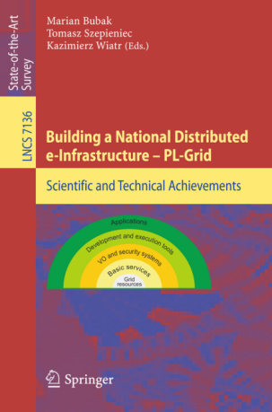
PL-Grid Project
First working NGI in Europe in the framework of EGI.eu (since March 31, 2010)
Number of users (March 2012): 900+
Number of jobs per month: 750,000 - 1,500,000
Resources available:
    Computing power: ca. 230 TFlops
    Storage: ca. 3600 TBytes
High level of availiability and realibility of the resources
Facilitating effective use of these resources by providing:
    innovative grid services and end-user tools like Efficient Resource Allocation, Experimental Workbench and Grid Middleware
    Scientific Software Packages
    User support: helpdesk system, broad training offer
Various, well-performed dissemination activities, carried out at national and international levels, which contributed to increasing of awareness and knowledge about the Project and the grid technology in Poland.
Publication of the book presenting the scientific and technical achievements of the Polish NGI in the Springer Publisher, in March 2012:
  „Building a National Distributed e-Infrastructure – PL-Grid”
  In Lecture Notes in Computer Science, Vol. 7136, subseries: Information Systems and Applications
  Content: 26 articles describing the experience and the scientific results obtained by the PL-Grid project partners as well as the outcome of research and development activities carried out within the Project.

Slide 4
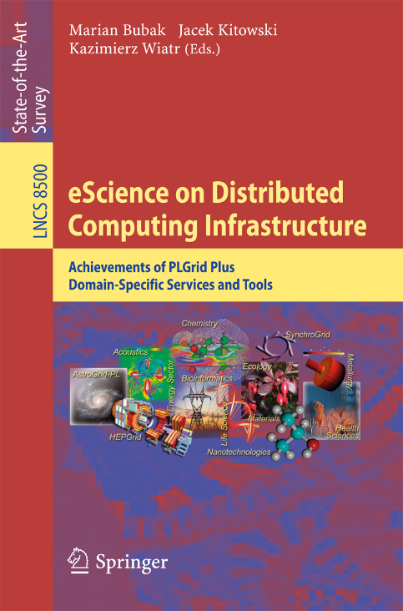
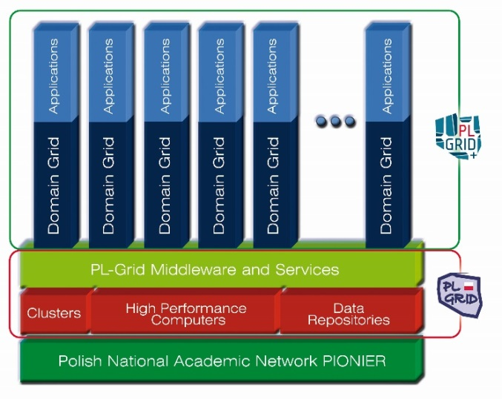
PLGrid Plus Project
New domain-specific services for 13 identified scientific domains
Extension of the resources available in the PL-Grid Infrastructure by ca. 500 TFlops of computing power and ca. 4.4 PBytes of storage capacity
Design and start-up of support for new domain grids
Deployment of Quality of Service system for users by introducing SLA agreement
Deployment of new infrastructure services
Deployment of Cloud infrastructure for users
Broad consultancy, training and dissemination offer
Publication of the book presenting the scientific and technical achievements of PLGrid Plus in the Springer Publisher, in September 2014:
  „eScience on Distributed Computing Infrastructure”
  In Lecture Notes in Computer Science, Vol. 8500, subseries: Information Systems and Applications
  Content: 36 articles describing the experience and the scientific results obtained by the PLGrid Plus project partners as well as the outcome of research and development activities carried out within the Project.
  Effort of 147 authors, 76 reviewers and editors team in Cyfronet

Slide 5
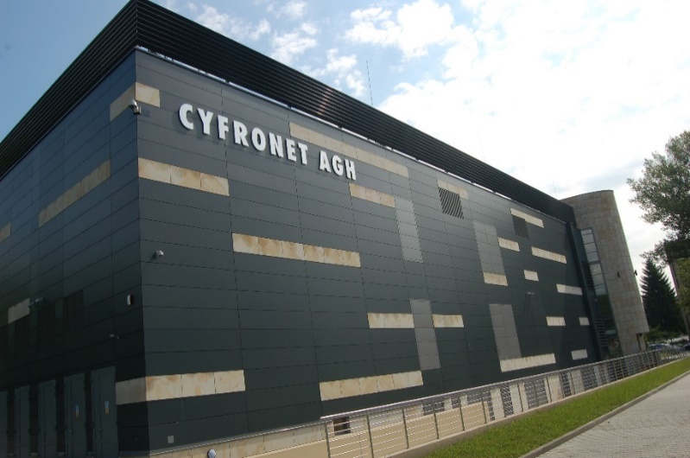
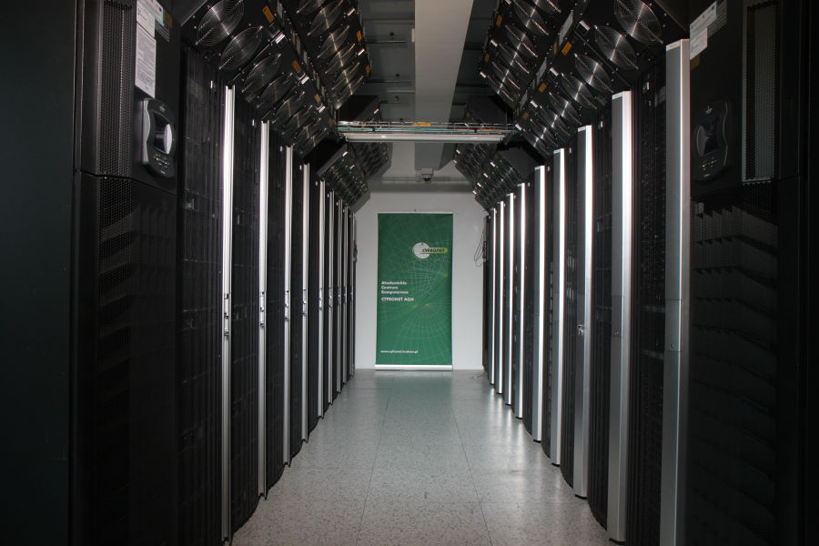
Competence Centre in the Field of Distributed Computing Grid Infrastructures
PLGrid Core Project
Budget: total 144 949 901,16 PLN, including funding from the EC : 123 207 415,99 PLN
Duration: 01.01.2014 – 31.12.2015
Project Coordinator: Academic Computer Centre CYFRONET AGH
The main objective of the project is to support the development of ACC Cyfronet AGH as a specialized competence centre in the field of distributed computing infrastructures, with particular emphasis on grid technologies, cloud computing and infrastructures supporting computations on big data.

Slide 6
PLGrid Core Services
Basic infrastructure services
  Uniform access to distributed data
  PaaS Cloud for scientists
  Applications maintenance environment of MapReduce type
End-user services
  Technologies and environments implementing the Open Science paradigm
  Computing environment for interactive processing of scientific data
  Platform for development and execution of large-scale applications organized in a workflow
  Automatic selection of scientific literature
  Environment supporting data farming mass computations

Slide 7

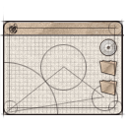


Purpose of the cloud platform
Install any scientific
application in the cloud
Access available
applications and data
in a secure manner
End user
Developer
Application
Managed application
Cloud infrastructure
for e-science
Manage cloud
computing and storage
resources
Administrator
Install/configure each application service (which we call a Cloud Service or an Atomic Service) once – then use them multiple times in different workflows;
Direct access to raw virtual machines is provided for developers, with multitudes of operating systems to choose from (IaaS solution);
Install whatever you want (root access to cloud Virtual Machines);
The cloud platform takes over management and instantiation of Cloud Services;
Many instances of Cloud Services can be spawned simultaneously

Slide 8




VPH-Share Computational Cloud: developers’ view
4. The new service is automatically registered in VPH-Share and can be shared with platform users (including other developers, who may wish to continue development work on the application).
VPH-Share Computational Cloud
MySpine v22 (cloud service)
GIMIAS (cloud service)
OpenLab v1 (cloud service)
OpenLab v1 (cloud service)
ViroLab DRS (cloud service)
MS Windows (OS template)
3. Once the developer is satisfied with the application, he/she may instruct the VPH-Share cloud platform to package and upload it as a new service to the cloud.
Developer
Ubuntu Linux (OS template)
The developer, selects and instantiates a service. This can be an existing application (e.g. MySpine) or a „raw” OS image (e.g. MS Windows Server)
Service instance
2. The VPH-Share cloud platform creates a virtual machine which hosts an instance of the selected template and provides the required quantity of hardware resources.
Service instance
2’. The developer may securely log into the machine and install any software of his/her choosing – in this case, we’re installing the OpenLabyrinth virtual patient management application.
Ubuntu Linux (OS template)
Hardware: 4 cores, 8 GB RAM, 30 GB HDD
OpenLab v1 (development)
Hardware: 4 cores, 8 GB RAM, 30 GB HDD
Notes:
Slide Objectives:
Speaking Points:

Slide 9
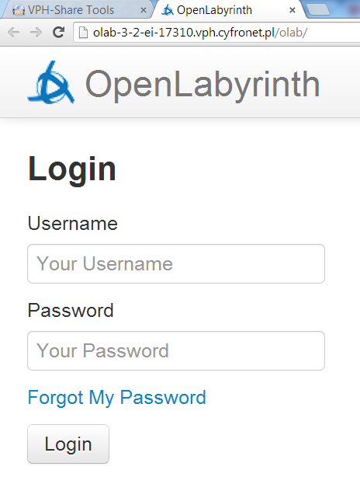





VPH-Share Computational Cloud: end users’ view
VPH-Share Computational Cloud
MySpine v22 (cloud service)
GIMIAS (cloud service)
ViroLab DRS (cloud service)
OpenLab v1 (cloud service)
Scientist
3. The user is free to interact with the service. Once the instance is no longer needed, it can be shut down in order to conserve computational resources.
The scientist browses the available services and requests access to a given service. Only published services (not OS templates) are visible to non-developers.
2. The service’s owner (typically its developer) approves the sharing request, following which the scientist may spawn instances of the service in the cloud infrastructure
Service instance
OpenLab v1 (cloud service)
Authorized users:
Developer
2’. The cloud platform creates an instance of the service with the appropriate hardware allocation (as set by the developer) and provides the user with access information.
OpenLab v1 (cloud service)
Hardware: as required by the application
Notes:
Slide Objectives:
Speaking Points:

Slide 10

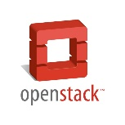



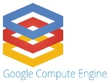

VPH-Share: cloud site integration
VPH-Share cloud site at CYF
VPH-Share services host
portal.vph-share.eu
Template repository
Worker nodes
VPH-Share cloud site at UNIVIE
WP2 Core Services Host
vph.cyfronet.pl
Secure RESTful API
(Cloud Facade)
Template repository
Worker nodes
Atmosphere-VPH
Amazon EC2 VPH-Share site
Atmosphere core (internal dependency)
Template repository
Worker nodes
RackSpace VPH-Share cloud account
Amazon EC2 CISTIB site (DARE only)
Template repository
Template repository
Worker nodes
Worker nodes
Google Compute VPH-Share cloud account
MS Azure VPH-Share cloud account
Template repository
Template repository
Worker nodes
Worker nodes
Notes:
Slide Objectives:
Speaking Points:

Slide 11

VPH-Share example: cardivascular sensititity study
Problem: Cardiovascular sensitivity study: 164 input parameters (e.g. vessel diameter and length)
First analysis: 1,494,000 Monte Carlo runs (expected execution time on a PC: 14,525 hours)
Second Analysis: 5,000 runs per model parameter for each patient dataset; requires another 830,000 Monte Carlo runs per patient dataset for a total of four additional patient datasets – this results in 32,280 hours of calculation time on one personal computer.
Total: 50,000 hours of calculation time on a single PC.
Solution: Scale the application with cloud resources.
Scientist
Launcher script
VPH-Share implementation:
Scalable workflow deployed entirely using VPH-Share tools and services.
Consists of a RabbitMQ server and a number of clients processing computational tasks in parallel, each registered as a service.
The server and client services are launched by a script which communicates directly withe the Cloud Facade API.
Secure API
Server CS
Atmosphere
RabbitMQ
Cloud Facade
DataFluo
Atmosphere Management
Service
(Launches server and automatically scales workers)
DataFluo Listener
Worker CS
Worker CS
RabbitMQ
RabbitMQ

Slide 12
VPH-Share Scientific achievements
Methods for integration of heterogeneous public cloud infrastructures into a unified computational environment
Cost optimization of application deployment in a heterogeneous cloud environment (choosing optimal resources given the available funds)
Federated data storage mechanisms with extensions for public storage services
Dealing with resource demand spikes (optimization of platform middleware and user interfaces)
An innovative approach to data-centric computing on distributed resources
Notes:
Slide Objectives:
Speaking Points:

Slide 13
VPH-Share cloud platform in numbers
Five cloud IaaS technologies (OpenStack, EC2, MS Azure, RackSpace, Google Compute)
Seven distinct cloud sites registered with the VPH-Share infrastructure
Over 250 Atomic Services available
Approximately 100 service instances operating on a daily basis
Over 1 million files transferred
3 PhD theses, over 30 papers and dozens of presentations.
Notes:
Slide Objectives:
Speaking Points:

Slide 14
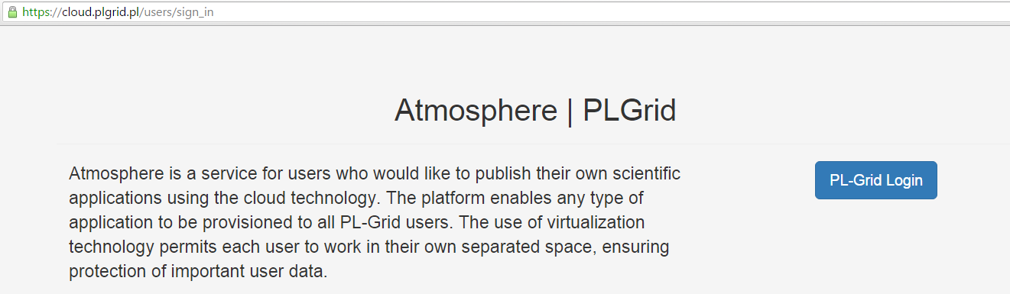
Integration with PL-Grid authentication mechanisms
Atmosphere has been integrated with PL-Grid authentication and authorization mechanisms.
In order to make use of platform features, a valid PL-Grid login must be supplied. The Atmosphere client will keep track of the user session and delegate client credentials along with every request submitted to the core application, thereby providing single sign-on capabilities for the whole platform.
If required, client proxy certificates may be further delegated to virtual machines running client services so that these VM instances may also run jobs in the PL-Grid infrastructure on behalf of the user who launched them.

Slide 15
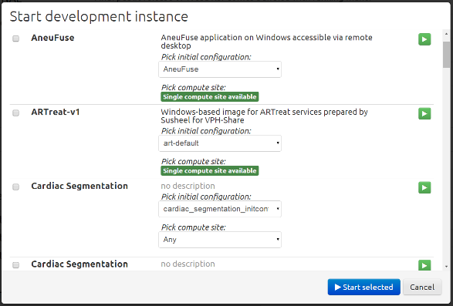
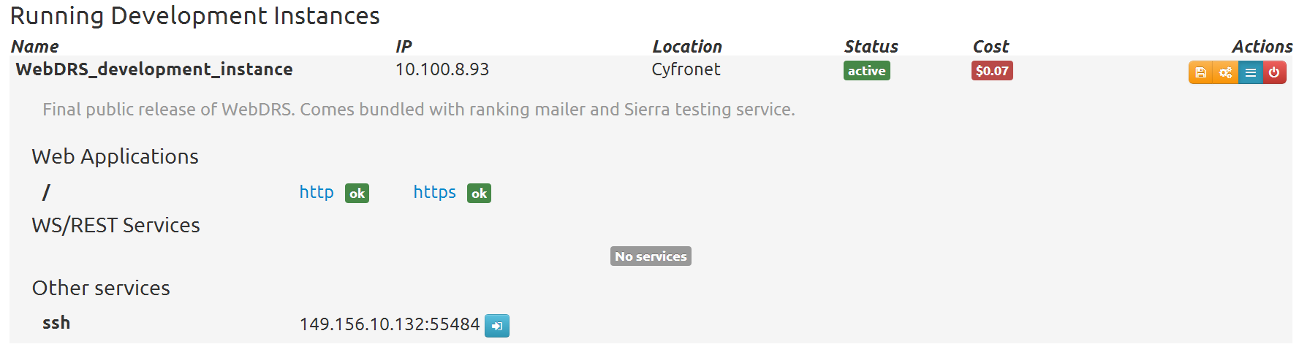


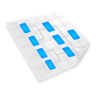



Cloud platform interfaces
End user
A full range of user-friendly GUIs is provided to enable service creation, instantiation and access. A comprehensive online user guide is also available.
The GUIs work by invoking a secure RESTful API which is exposed by the Atmosphere host. We refer to this API as the Cloud Facade.
Atmosphere
Ruby on Rails controller layer
(core Atmosphere logic)
Any operation which can be performed using the GUI may also be invoked programmatically by tools acting on behalf of the platform user – this includes standalone applications and workflow management environments.
Application
-- or --
Atmosphere Registry (AIR)
Cloud
sites
Workflow environment
All operations on cloud hardware are abstracted by the Atmosphere platform which exposes a RESTful API. For end users, a set of GUIs provides a user-friendly work environment. The API can also be directly invoked by external services (Atmosphere relies on the well-known OpenID authentication standard with PL-Grid acting as its identity provider).

Slide 16
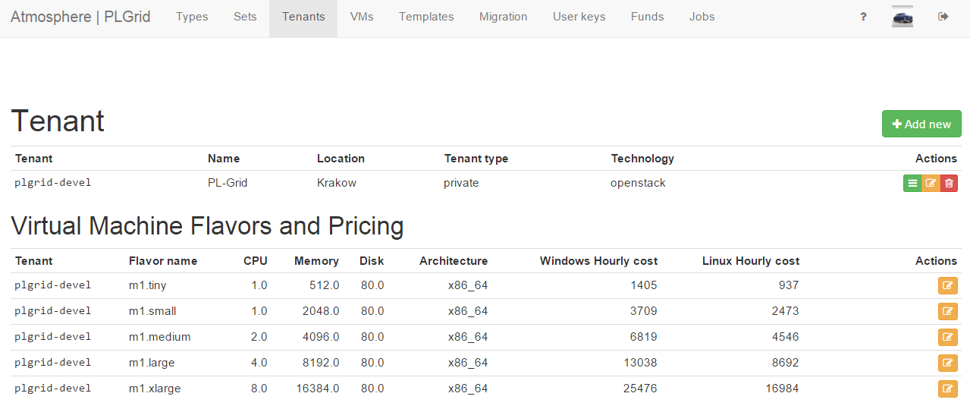
Administrative interfaces
A comprehensive suite of UIs is provided for platform administrators.
Administrators may register new compute sites for integration with the PL-Grid cloud infrastructure, review the composition and activity of individual teams, launch/terminate instances, obtain historical data regarding resource usage, register/deregister templates, set flavor pricing and perform all other actions required for proper cloud infrastructure maintenance.

Slide 17





Multitenancy support
Atmosphere now supports multitenancy in cloud environments.
A cloud site can be partitioned into multiple tenants, each of which comprises a set of service templates and computing resources for a distinct group of users.
PL-Grid
A new tenant is automatically created for each PL-Grid team whose users request access to the cloud infrastructure.
Tenants provide separation between user groups, allowing them to share resources belonging to a common cloud site.
When launching service instances each user may specify which context (represented by team names) the given instance will be run in. Atmosphere respect the user’s choice by initializing the instance within a specific tenant.
plgg-team1
plgg-team2
Atmosphere
Controller layer
Cloud site, tenant and template management interfaces
Cloud Site
(OpenStack)
Tenant 1
plgg-team1
Tenant 2
plgg-team2
Service templates
Service templates

Slide 18
Example - workflow deployed in the cloud with the HyperFlow
The user uses hflowc on the UI host
The workflow is launched in the cloud (Cloud 2.0)
User certificates are automatically injected into user VMs
Data is transferred by GridFTP to the user’s UI account

Slide 19
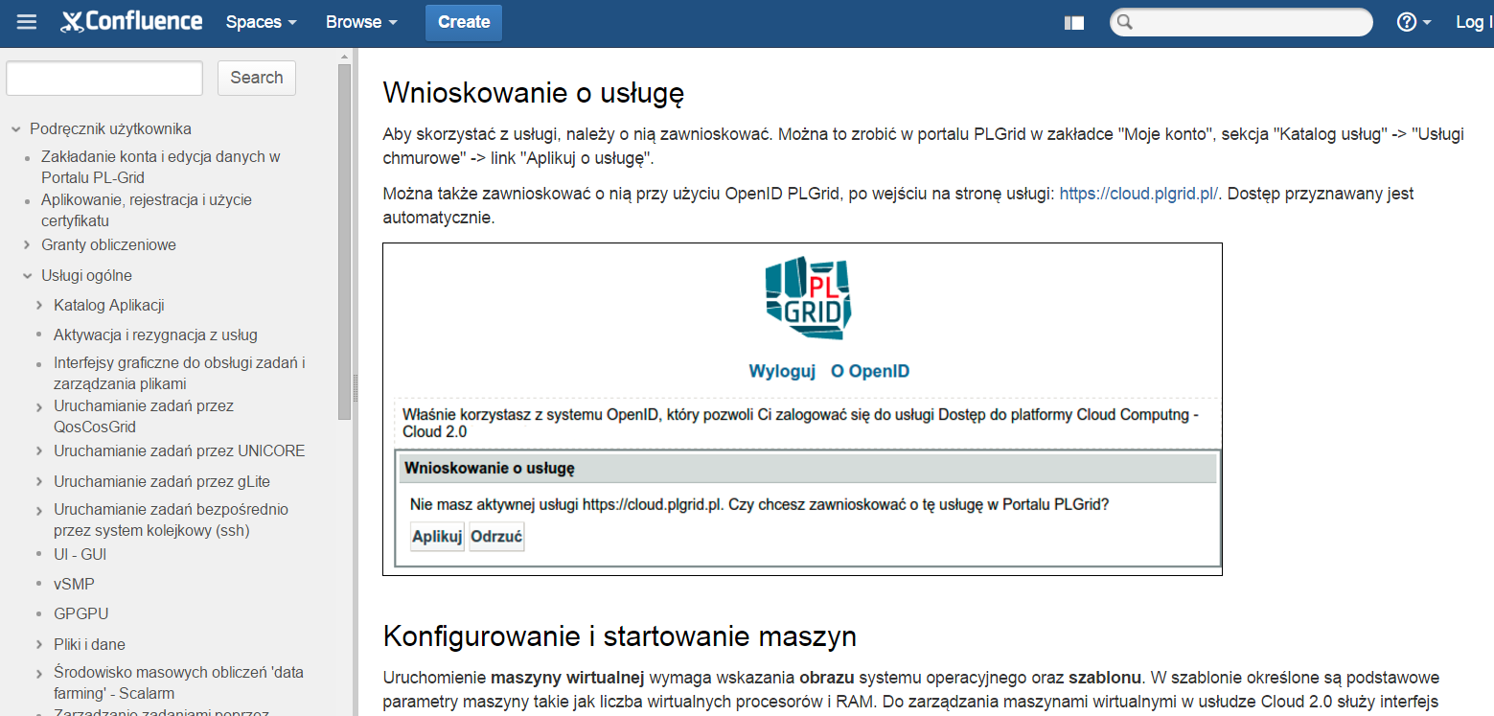
End-user tutorials and documentation
Platform tutorials and user guides are available to all registered PL-Grid users.
The guides (https://docs.cyfronet.pl/display/PLGDoc/Cloud+Computing+2.0) explain how to apply for the Cloud 2.0 service, how to access cloud resources, create/instantiate services, perform development work and save new service templates.
The documentation also provides optimal usage tips and explains common pitfalls associated with interaction with virtualized cloud resources.

Slide 20
Summary: Features of Atmosphere
Layer of abstraction over cloud-based virtual machines
A way to port scientific applications to the cloud
Automatic selection of the best resources to deploy applications
Automatic load balancing to scale up applications as needed
VM image synchronization for hybrid clouds
Billing model for commercial clouds
Support for commercial clouds: Amazon EC2, Google Compute, RackSpace, MS Azure etc.
Support for various application classes:
  Linux-based SOAP/REST services
  Web applications
  rich GUI clients running under MS Windows
Integration with the PL-Grid ecosystem:
  authentication, authorization, sharing
  co-tenancy, billing and accounting support

Slide 21
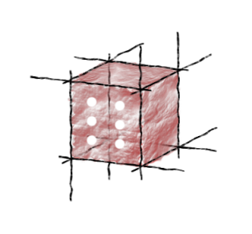
For further information…
A more detailed introduction to the Atmosphere cloud platform (including user manuals) can be found at https://docs.cyfronet.pl/x/24D0
The PL-Grid team responsible for development and maintenance of the cloud platform is plgg-cloud
You’re also welcome to visit the DIstributed Computing Environments (DICE) team homepage at http://dice.cyfronet.pl and our brand new GitHub site at http://dice-cyfronet.github.io

