Slide 1
Developing the computing environment for new research communities in Romania
Ionut Vasile, Dragos Ciobanu-Zabet, Mihnea Dulea
Dept. of Computational Physics & Information Technology
Horia Hulubei National Institute for R&D in Physics and Nuclear Engineering (IFIN-HH)
Bucharest-Magurele, Romania

Slide 2
Romanian Grid Infrastructure
9 EGI-certified sites providing > 7500 cores and 2.9 PB online storage capacity to 9 user communities
Since December 2014, NGI-RO (http://ngi-ro.ifin.ro) is represented in EGI by IFIN-HH (http://www.nipne.ro)
Key persons (the authors)
Representative in EGI Council: Dr. Mihnea Dulea (IFIN-HH)
NGI_RO Managers: Eng. Dragos Ciobanu-Zabet
Dr. Ionut Vasile
Until recently, 98% of the CPU time was consumed by the HEP community (WLCG, ILC, etc.)
There was a growing need of computing resources for research in different fields such as biology, nanophysics and new materials, nuclear physics, and for supporting large-scale projects such as ELI-NP
A new site, GRIDIFIN, was dedicated to the support of national communities of scientists that were not involved in High Energy Physics research.
Today GRIDIFIN also supports the NGI_RO Operation Centre

Slide 3
User communities supported by GRIDIFIN
GRIDIFIN provides computing and storage resources for three research communities (VOs):
Experimental groups related of the Extreme Light Infrastructure – Nuclear Physics (ELI-NP) project
eli-np.eu VO (6 registered users)
National community of researchers in computational biology
ronbio.ro VO (21 registered users)
Researchers interested in condensed state physics and nanomaterials technology
gridifin.ro VO (16 registered users).
The 3 VOs are locally administered
Hardware resources: - 6 servers providing 12 grid services
- 31 WNs with 364 CPU cores and 2048 GPU cores

Slide 4
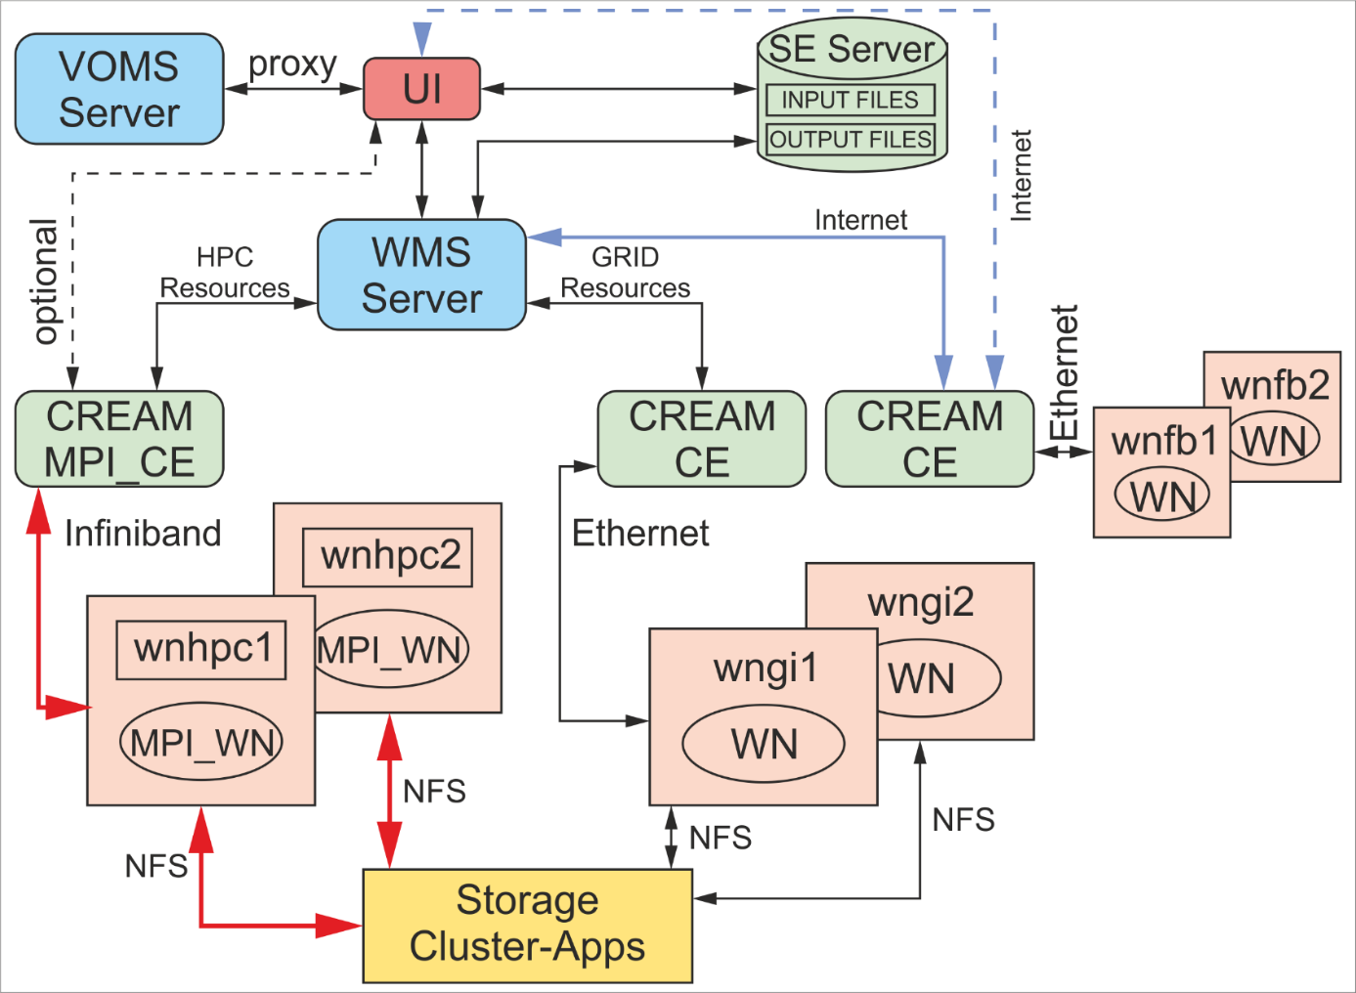
GRIDIFIN topology and data flow
GOCDB registered services and hosts:
CREAM-CE for concurrent jobs, Site-BDII, gLExec, APEL, gLite-APEL (tbit06.nipne.ro)
CREAM-CE for parallel jobs, eu.egi.MPI (hpcec.nipne.ro)
UI (tbitui.nipne.ro)
WMS (tbit04.nipne.ro)
Central-LFC, Local-LFC (lfc.nipne.ro)
SRM (segi.nipne.ro)
adding remote resources (CREAM CE - FB)
Software supported: GEANT 4, ROOT 5, PIC (for eli-np.eu); VASP, (Tran)Siesta (gridifin.ro);
NAMD 2.9, CHARMM C37, GROMACS 5, GAMESS-US, AMBER (for ronbio.ro)
Libraries: CUDA, OpenMPI, MVAPICH, Intel compilers, GNU compilers, etc.

Slide 5
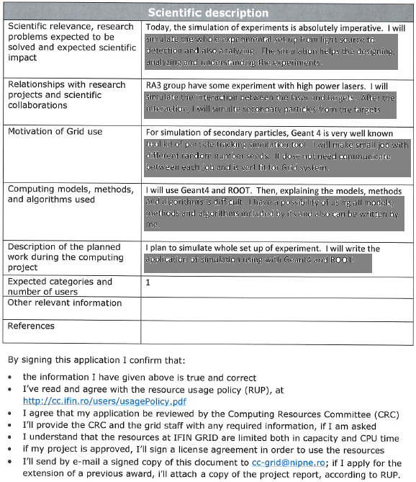
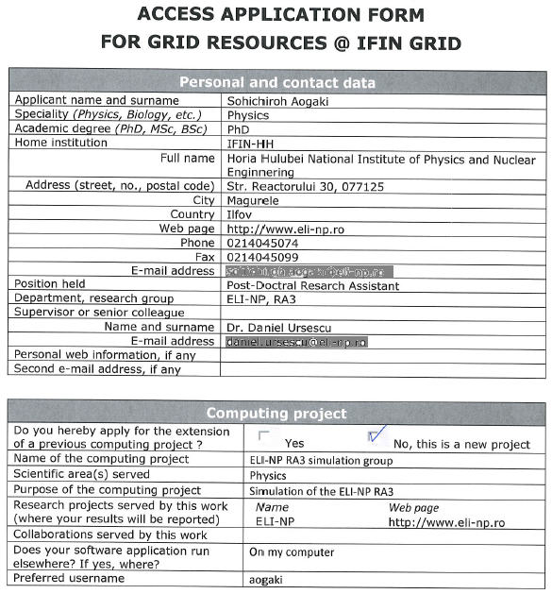
Request for resources

Slide 6
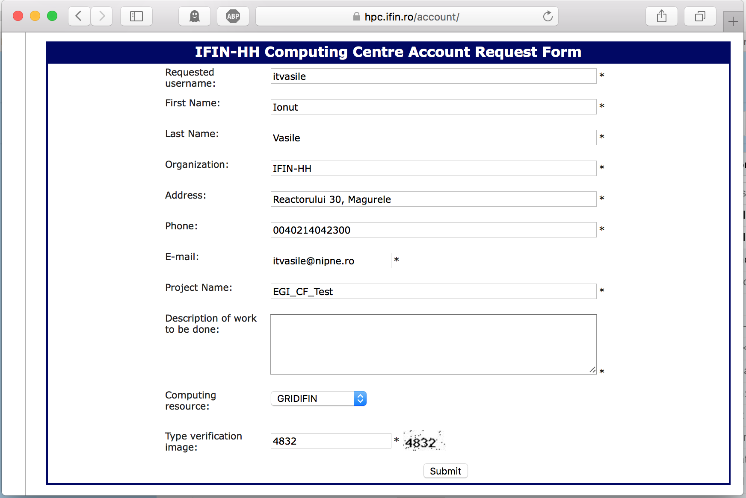
Account Request Form
Electronic access form (request of resources) -> printed, signed, e-mailed -> CRC -> technical staff -> license -> access

Slide 7
Example in computational biology (ronbio.ro)
A portal that provides sw. tools for microbiology and pharmacology researchers
Developed within the "Integrated system for biomolecular modeling, with applicability to the study of Gram negative bacteria” project
The system provides:
computational modeling at molecular level
workflows composed of tasks / modules that correspond to various modeling steps
workflows are submitted for execution on the available GRIDIFIN resources
The portal is currently customised for the modeling and simulation of subcellular structures of Gram-negative bacteria
This choice is motivated by the national priority to investigate the vulnerabilities of drug-resistant bacteria that are resposible for many hospital-acquired infections in Romania. The project will empower the researchers with software tools allowing them to perform faster and systematic numerical simulations of the drug-bacteria interactions for the bacterial strains specific to Romanian hospitals.

Slide 8
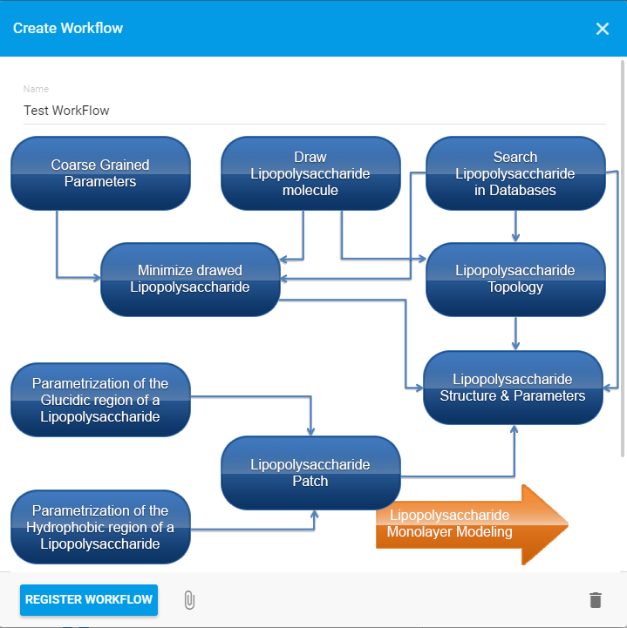
Bio-Scientifc Workflows
Example: LPS molecule modeling.

Slide 9
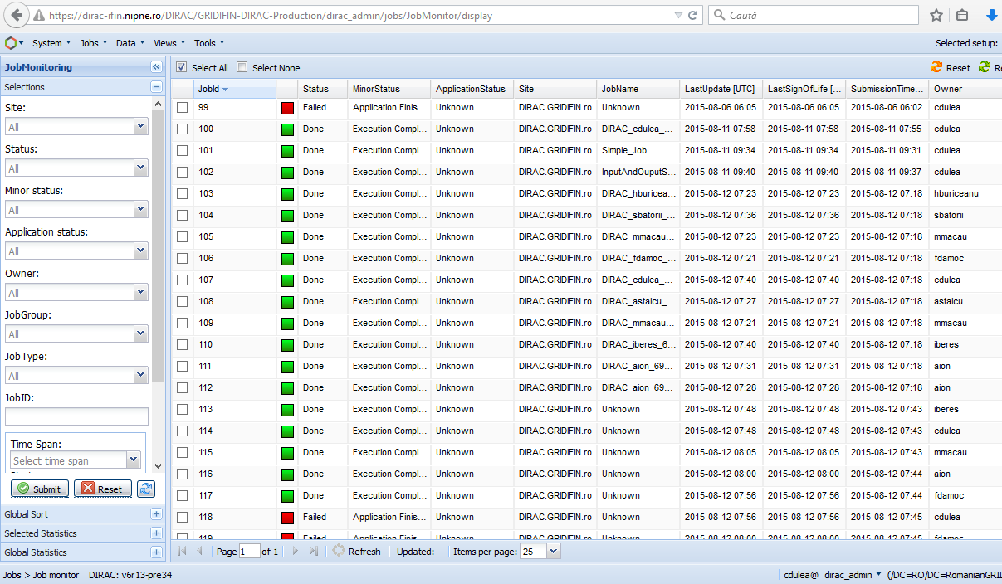
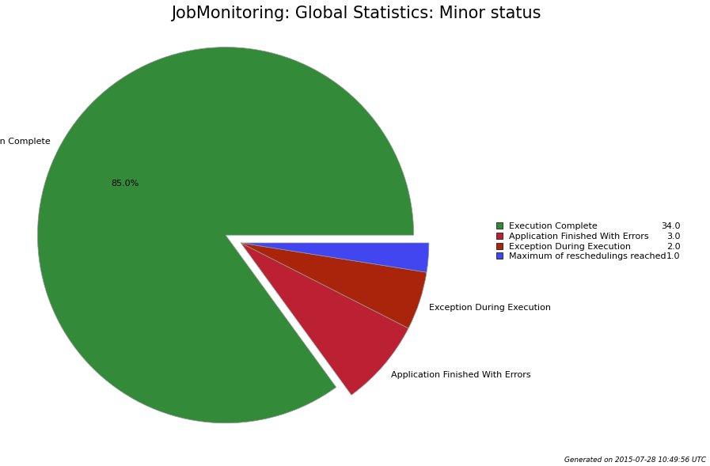
Using DIRAC for training
DIRAC framework was implemented for the integration of heterogeneous distributed systems of resources (https://dirac-ifin.nipne.ro/DIRAC)
Used for basic grid training within the user communities supported by the GRIDIFIN site

Slide 10
THANK YOU
FOR YOUR ATTENTION!
itvasile@nipne.ro

