Slide 1
LifeWatch Italy: Data Portal and Virtual Lab Integration
N. Fiore*, A. Oggioni*, P. Tagliolato*,
P. Colangelo*, G. Morgante**, I. Rosati*
*LifeWatch Italy
** Links Management & Technologies SPA
EGI Community Forum 2015
11 November 2015

Slide 2
DATA PORTAL ARCHITECTURE
DATASETS
LIFEWATCH DATA PORTAL
VIRTUAL LAB
General
Search
Advanced Data Search
Geospatial Search
Tools
R Studio
Taverna Workbench
ARCGIS Suite
…
Darwin Core
ABCD
Thesauri
CSV
RDBMS
Dataset Mapping
Inference Search (SPARQL)
REST API
Services
O&M
External Providers
ESB (Search)
SERVICE LAYER
Ontology ETL
Inference Engine
….
Cleaning ETL
API REST
Legacy Scientific Data
Persistence Layer
….
PESI
WoRMS
GBIF
LW NO-SQL
Staging Area
LW RDBMS
LW NO-SQL
Cleaned Data
LW
Triple Store
Notes:
Mongo DB NO SQL
VIRTUOSO triple store

Slide 3
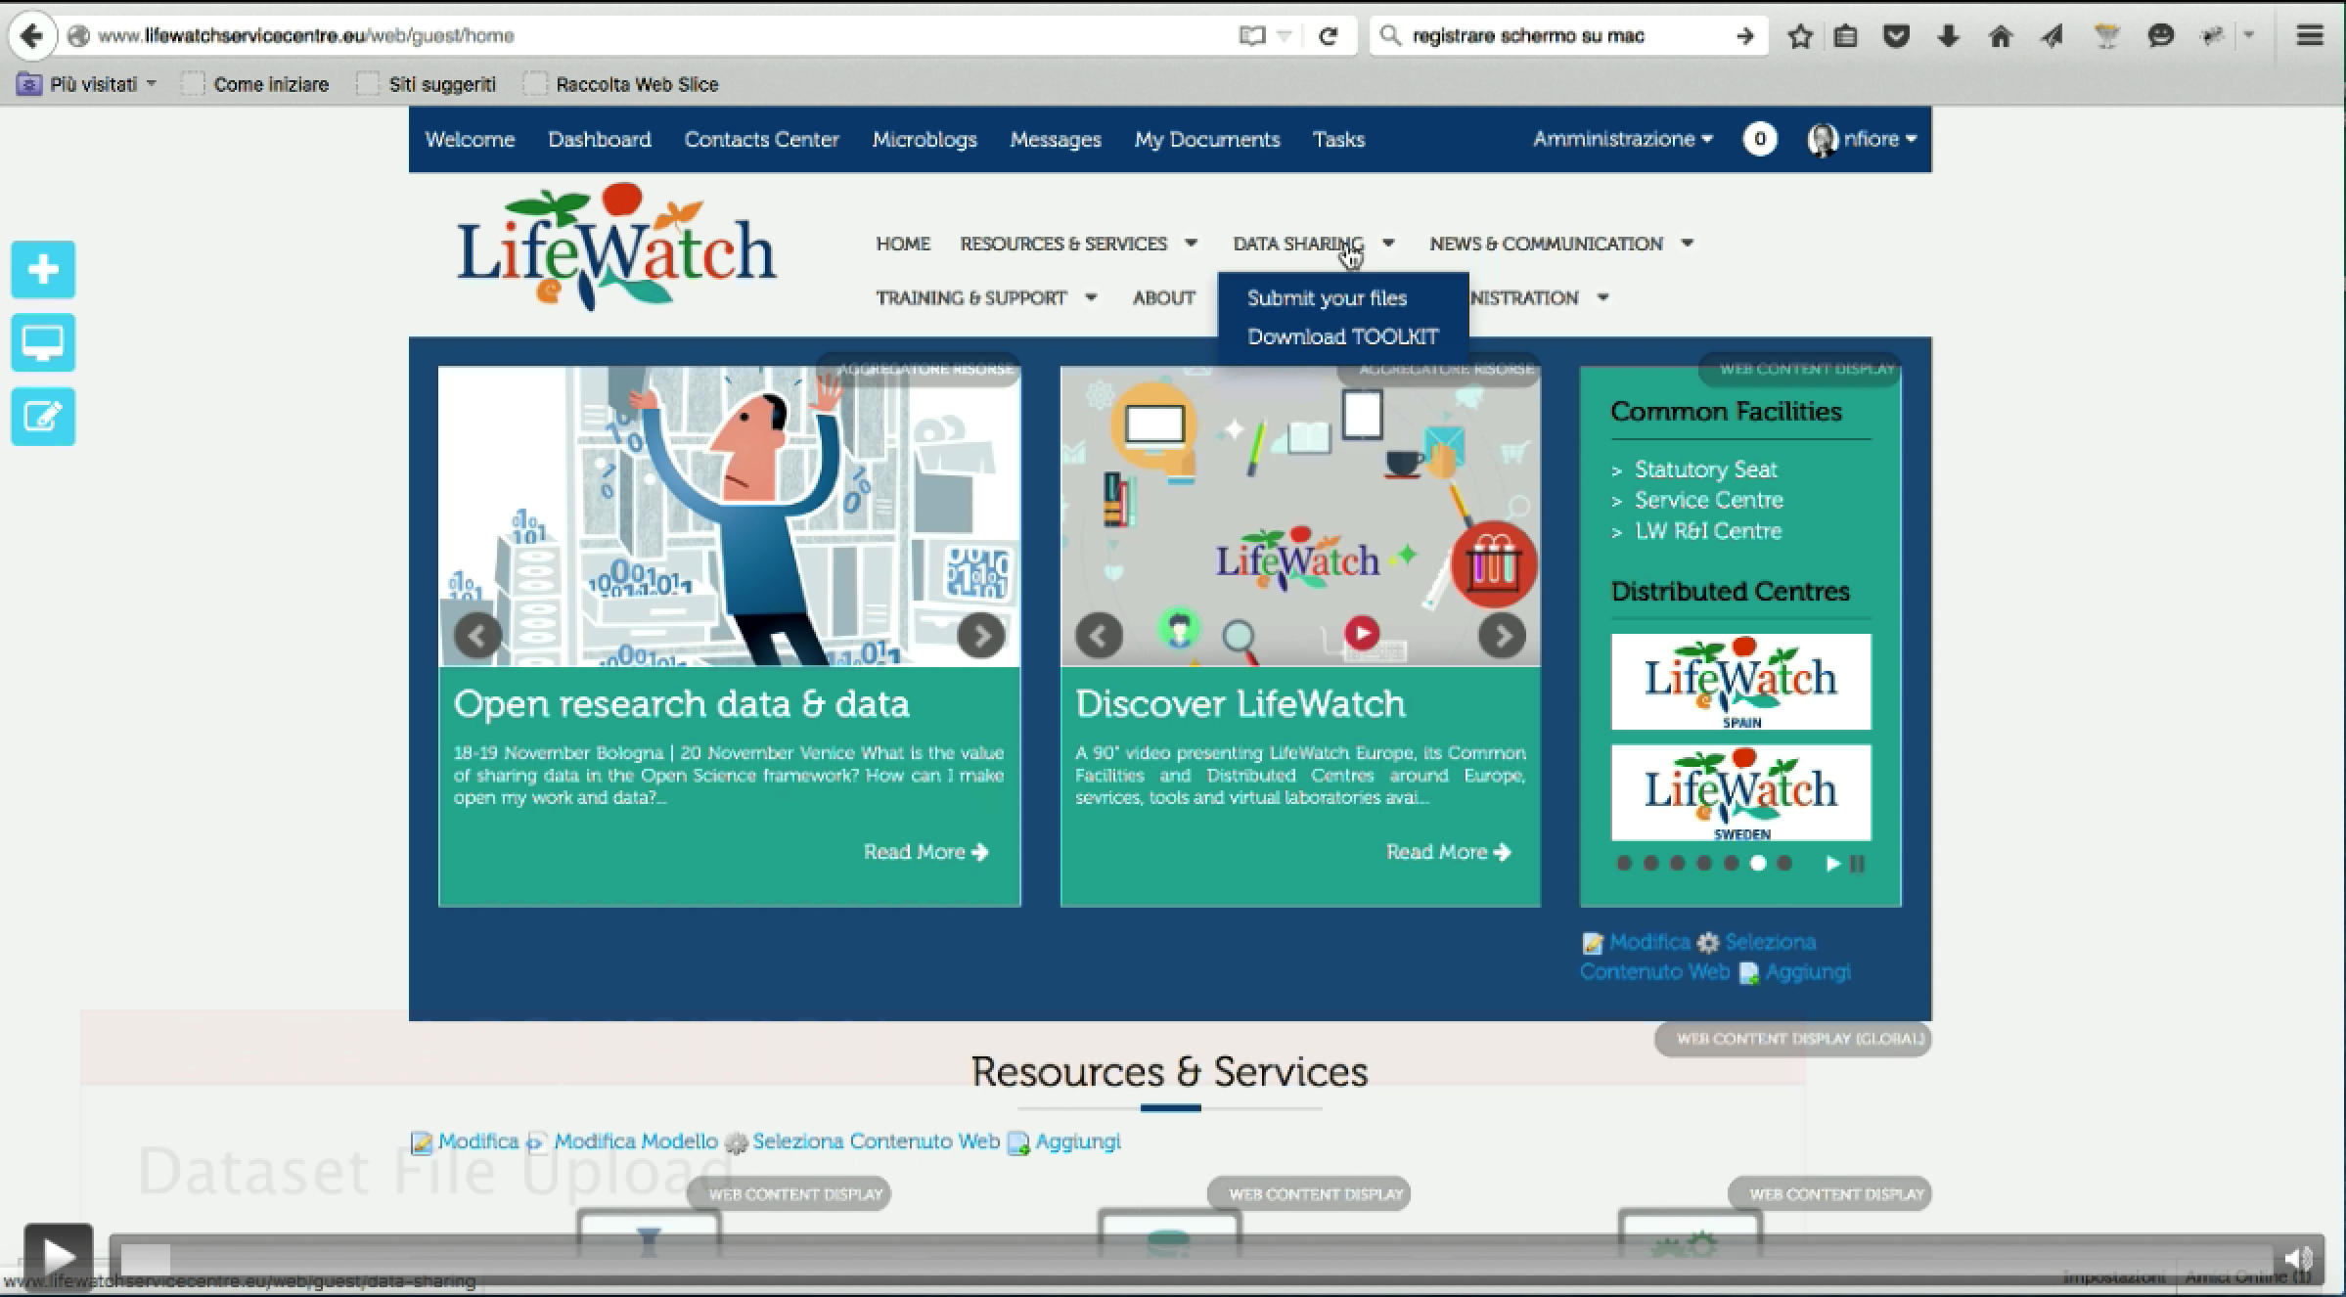
http://dx.doi.org/10.6084/m9.figshare.1600909

Slide 4
http://dx.doi.org/10.6084/m9.figshare.1597713

