Slide 1
Fishery and Marine Sciences Market Analysis Preliminary Results
Nadia Nardi
Researcher and Project Manager, Engineering
Notes:
All new – never done before
Introduc EGI to the community

Slide 2
Outline
Market size
Domains of interest to EGI
Stakeholders
Questionnaire
Next steps

Slide 3
Market size
EU-Horizon 2020 Societal Challenge “…..sustainable …marine and maritime …research” € 501 M (2014-2015)
Ocean fisheries add $270 billion to global GDP, support 260 million livelihoods, and provide protein for nearly 3 billion people
Capture fisheries account for some 90 Million tonnes annually.
The EU had a combined fleet in 2014 of around 87000 vessels, together generating an income of €7.2 Billion, and employment reaching 110.000 FTE’s .
In EU, aquaculture accounts for about 20% of fish production and directly employs some 80000 people.
The data needs to manage this sector are huge, and range from on-board monitoring of bycatch, to economic and employment indicators.
Notes:
Method
Top-down approach
Activities
Desk research
Credit: The State of World Fisheries and Aquaculture 2014,
EU-DGMARE website, DGMARE Aquaculture employment

Slide 4
Domains of interest to EGI
Marine fisheries exploitation and monitoring
Marine aquaculture production and monitoring
Fisheries/aquaculture catches traceability/certification/Quality control
Marine fisheries research (species studies, Stock population estimation, Improvement of fisheries methods, Impact of external activities on fisheries)
Maritime surveillance (MCS)/safety at sea
Marine fisheries policy making / management
Impact of fisheries on ecosystem study – Marine Protected Areas (MPA) efficiency
Marine aquaculture research
Marine environmental research
Piracy
Notes:
Large volume of data in Fisheries are found in:
Marine fisheries exploitation and monitoring
Marine fisheries research to provide stock assessment (few type of data but with large volume)
Fisheries catches traceability/certification/Quality control (large number of different type of data from different stakeholders)
Marine environmental research: trend is to compare data across domains (Impact of fisheries Vs impact of tourism on the ecosystem): need for harmonized data by public companies but also private sector consultancy companies.
Marine aquaculture research

Slide 5
Stakeholders
Bottom up Approach: data value chain mapped to supply chain, entities identified and flow of data traced.
Characterization: entity type, scope of data, type of data, domain, activites perform, purpose/interest in the data
Public (Monitoring and Management of Data)
Fisheries management institutions/Authorities
Fisheries Research Institute
Regional Fisheries Management Organization
Monitoring Control and Surveillance organization
National Bureau of Statistics
Regional organization
Regional bureau of statistics
International Organizations
Private (Exploitation of Data)
-Individual, SME and industries.
Notes:
Type of data
Detailed data (raw/individual) coming from an identified source
WHO? Private entities (individual or vessel or company)
Aggregated data/statistics: data processed from detail data
WHO? Public
Reference data or standard or classification: reference data to collect and process statistics in a harmonized and standard way (list of species, type of companies, fishing areas)
WHO? Public

Slide 6
Stakeholders
Understanding the Private Sector...
Who is producing the data? Who owns it? Who is selling it?
Who is buying and what exactly ?
Data: Catch, effort, landing, VMS, eRS, MSC operation
Fishery Example: vessel owner (industry) needs software and capacity to collect and centralize VMS data, CLS (SME) sells the software and processing capacity to do this, company buys the software.
Acquaculture Example: monitoring and managing is mainly public. Production is mainly private. Typical new farm: needs to get pollution production assessment study to comply with regulation. Buy it from a private consultancy company.

Slide 7
Survey and initial responses
Approach
Questionnaire
Interviews (5)
Case Study (bluebridge-vres.eu)
What do we need to know?
current exploitation of computing resources and type of data
If there is a willingness to use external computing and consulting resources to establish trans-national data networks
Insights into data needs
Notes:
Bluebridge is .......

Slide 8
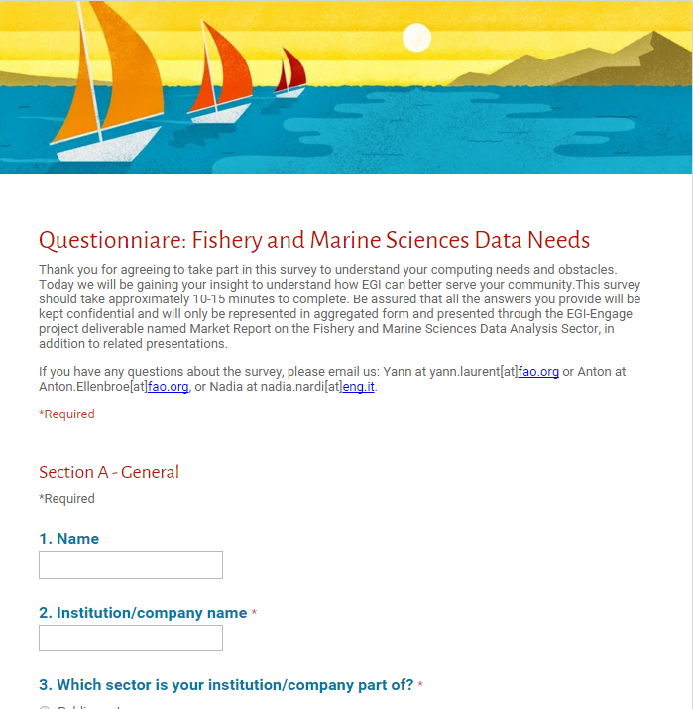
Questionnaire
Who?
Data managers and owners in the Fisheries, Aquaculture and Maritime sectors, who ideally have enough understanding of EGI related infrastructures and are involved in technical decision
comprehensive : 10 domains, 9 stakeholder types (public and private), plus others (MARIBA and Lifewatch)
Mix of question types: open and scale

Slide 9
Questionnaire
Business model: who customers/users, types of revenue streams
Insights into priorities
-application of (trans)national regulations and data standards
-access to data in other domains
-scalable processing capacities
Challenges regarding the management of data
-regulations, standards, formats, protocols etc..
-dissemination and confidentiality
-data exchange
Cloud-based services
-future plans
-obstacles to the use of
-importance of cost

Slide 10
Next steps
questionnaire + interview analysis
BlueBRIDGE case study
Detailed data flows and revenue streams in three domains
Insights into marine data coverage
Competitor analysis
Understand requirements and how EGI can support its potential users
Reveal opportuntities for EGI

