Slide 1

EGI and Data Scientists:
Demand
Sy Holsinger
EGI.eu Senior Strategy and Policy Officer
EGI Community Forum 2015
12 November 2015, Bari
EDISON – Education for Data Intensive Science to Open New science frontiers
Grant 675419 (INFRASUPP-4-2015: CSA)

Slide 2




Outline
Overview of EGI
  Role in EDISON
  Focus on EGI Data Services
EGI and Data Scientists
  Profiles and Scope
  General Market
  Current Situation
  Needs
  Recruitment
Summary/Conclusions

Slide 3
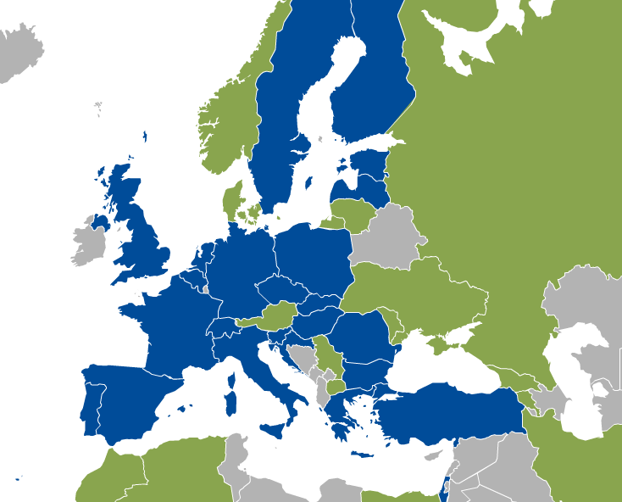
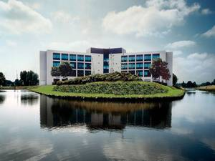
About EGI
EGI [Infrastructure]
  Federation of 350 Resource Centres across 50 countries
  Provides distributed computing and storage resources to accelerate data-intensive research
EGI.eu [Coordination Body]
  Non-profit foundation based in Amsterdam (~20 staff)
  26 participants (e.g. NGIs, EIROs) form governing body (EGI Council)
Support projects
  EGI-Engage: towards Open Science Commons
    Includes 9 research communities (competence centers)
  AARC: Federated AAI between e-Infrastructures
  INDIGO-DataCloud: EGI FedCloud and beyond
  EDISON: Building the data science profession
  +others
EGI.eu in Amsterdam

Slide 4
Role of EGI in EDISON
WP4 Leader: Sustainability and certification of the Data Scientist Profession
  Business models definition
  Definition of a certification scheme
WP3 task leader on: EDISON Online Educational Environment
  Development of the model curricula for the e-Infrastructure specialization
  Operate the training marketplace and cloud IaaS for running of the hands-on activities with students
WP2 support: Educational Focus and Data Science Body of Knowledge (BoK)
  Education and training needs and required competencies
    Computer Science, Scientific Computing, Scientific Infrastructure
  Data Scientist: Body of Knowledge (DS-BoK) and Data Science Competence Framework (CF-DS) profiles
    Provide input on required competencies and skills as well as available training courses in the EGI.eu community

Slide 5

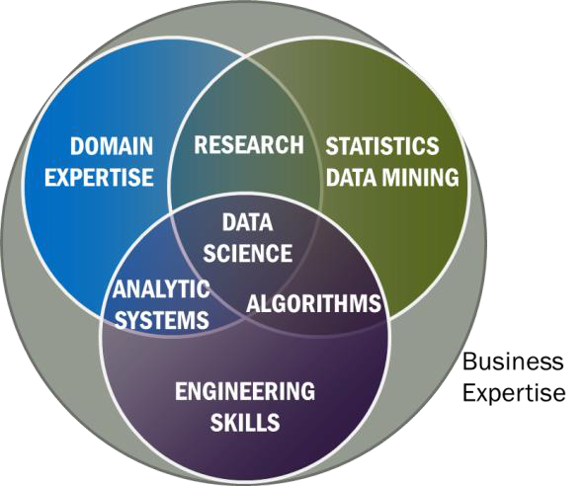
EGI Data Services
Data management is performed by interoperable components
Different components address different needs
  Storage management at site level
  Transfer between sites
  File Transfer
  Content Distribution
  Federated Data Manager
  Metadata Catalogue
  Security
  Standards

Slide 6
EGI Data Services
EGI and Data Scientists

Slide 7
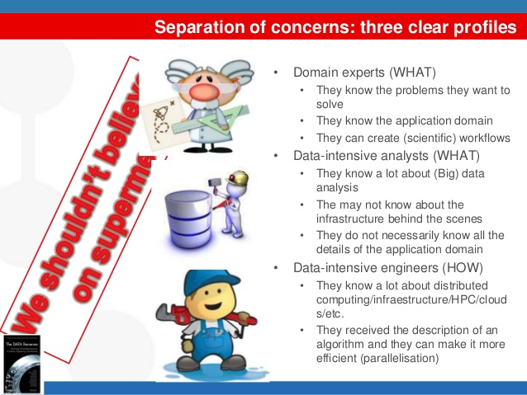
Data Scientist: Profiles
Oscar Corcho
BDVA Summit 2015 Madrid

Slide 8
Data Scientist: Profiles
Oscar Corcho
BDVA Summit 2015 Madrid
EGI Community
e.g. e-Science centers or experts at universities/research centers
EGI end-users
EGI.eu USCT
EGI Resource Providers

Slide 9
Data Scientist: Scope
Expected increase in demand over next 5 years
  Both e-Infrastructures and research infrastructures have similar needs
Difficulty finding complete profile needed
  Required knowledge in a wide range of topics – many with some
    Need to understand data requirements and translate them into technical services and solutions e.g. scalability of access; type of data; integration needs
  Staff filling DS role (or in part) from another position experience challenges
Role of Data Science
  No data analysis of scientific data (those are done by the researchers)
  Support them to develop tools that allow them to do that

Slide 10
Data Scientist: General Market in EGI
Why need a Data Scientist?
  Demand from user communities to be able to understand requirements and adapt services to their needs
  Data driven market
  Need to evolve the data infrastructure through innovation from those requirements
  Complexity requires high level of knowledge across a range of technical topics and issues
Applicable Areas
  Data management
  Data analysis
  Storage management
  Operations
  Software integration
  Federated service management

Slide 11
Data Scientist: Current Situation
Data Scientists in EGI
  Internal: 4 EGI.eu staff providing data scientist activities (20%)
    No one with the title “Data Scientist”
    Typically part of the User Community Support Team / Technical Outreach
  External: ~4 per Competence Center (~35)
  NGIs have user support teams ~3 per NGI = ~100
    Specialize in different technologies (support users based on requirements)
  Distributed nature of EGI and multi-domain require reliance on EGI Champion network to target a wider range of domains
Data Science Skills in EGI
  Data science knowledge required to provide outreach
    Know the science workflow to be able to simplify it
    Know the scientific tools that are being used in order to optimise them and integrate them with other EGI tools services
  Need access to data scientists for domain expertise
    Quite important when required tools don’t exist or apply – then deep dive happens for more customizable solutions – use case basis only

Slide 12
Data Scientist: Needs
Data Scientist skills
  Hard skills currently higher priority than soft skills
    However soft skills still required as DS is not a job carried out in a dark corner
What’s a good number?
  More data scientists increases
    Number of communities that can be supported
    Innovation through better translation of requirements
  However needs to be balanced with overall budget and diversified strategy
Education/Training
  Master’s degree, but most have a PhD.
    Not necessarily required if having specialized training/certification
  Often required and mainly provided in-house
  Externally as opportunities arise (e.g. FitSM)
    EDISON Training and Certification Scheme fills this need

Slide 13
Data Scientist: Recruitment
Timeline
  Can range from 3 months to 1 year to find and select new employees (depends on the role and specialization required)
Position Creators
  Top Management approves position to be made available
  Senior management with line manager design profile
Employment Contracts
  More specialized the flexible hiring needs to be (e.g. remote working)
  Support providing work permits for non-EU members
Visibility of Open Positions
  Rely on EGI community network
  Use of external agencies rare (if ever)
  No formal internship programme or partnership with organisation

Slide 14
Summary/Conclusions
Expected increase in demand for Data Scientists
  Data driven market
Difficult to find profile with full skill set
  e-Infrastructures is a complex environment, but still not common even industry (opportunity!)
Limitations
  Available budget vs. overall needs (balance)
Need to develop partnerships
  With universities so they know what skills are needed
  Professional training organisations and certification authorities (for those post-university)
EDISON is an excellent opportunity to support this field and the needs of e-Infrastructures

Slide 15


Thank you for your attention.
Questions?
@edisoneu
@europeangrid
@syholsinger
www.edison-project.eu
www.egi.eu
Notes:
Happy to take any questions.

