Slide 1
Community Requirements for the authentication and authorization infrastructure
Peter Solagna – EGI.eu
AARC project
Bari, EGI Community forum 2015

Slide 2
AARC JRA1 work package: Architecture
JRA1.1 Requirements gathering
JRA1.2 Blueprint architecture
JRA1.3 Guest identities
JRA1.4 Models for implementing Attribute Providers and Token Translation Services

Slide 3
Requirements gathering process

Slide 4
Requirements gathering: the process
Already available requirements:
FIM4R
TERENA AAA study
Surveys
Circulated among the AARC communities, FIM4R ML, and other targets
Open questions inspired to the hot topics of the existing documentation
Interviews
Focused interviews for the DJRA1.1:
EGI
ELIXIR
EUDAT
GÉANT Project
Dutch consortium of the National and University Libraries
To be continued..
DJRA1.1
DJRA1.1
DJRA1.1

Slide 5
Survey topics
AAI Current status
What is your community’s current experience with AAI?
Benefits, perceived barriers and user experience
Technical solutions adopted
Current coverage of federated AAI in the community
Requirements
Type of IdPs relevant for the community
How AAI penetration can be improved?
Technical requirements
Preferred technology, attribute release, LoA management, unique identifiers, group management, type of access

Slide 6
Surveys received
BioVel
DARIAH
EISCAT
WLCG
EPOS
Photon and neutron (Umbrella)
ELIXIR
CLARIN
EGI
EUDAT
D4Science
PSNC
FMI
Libraries and education

Slide 7
The requirements gathered

Slide 8
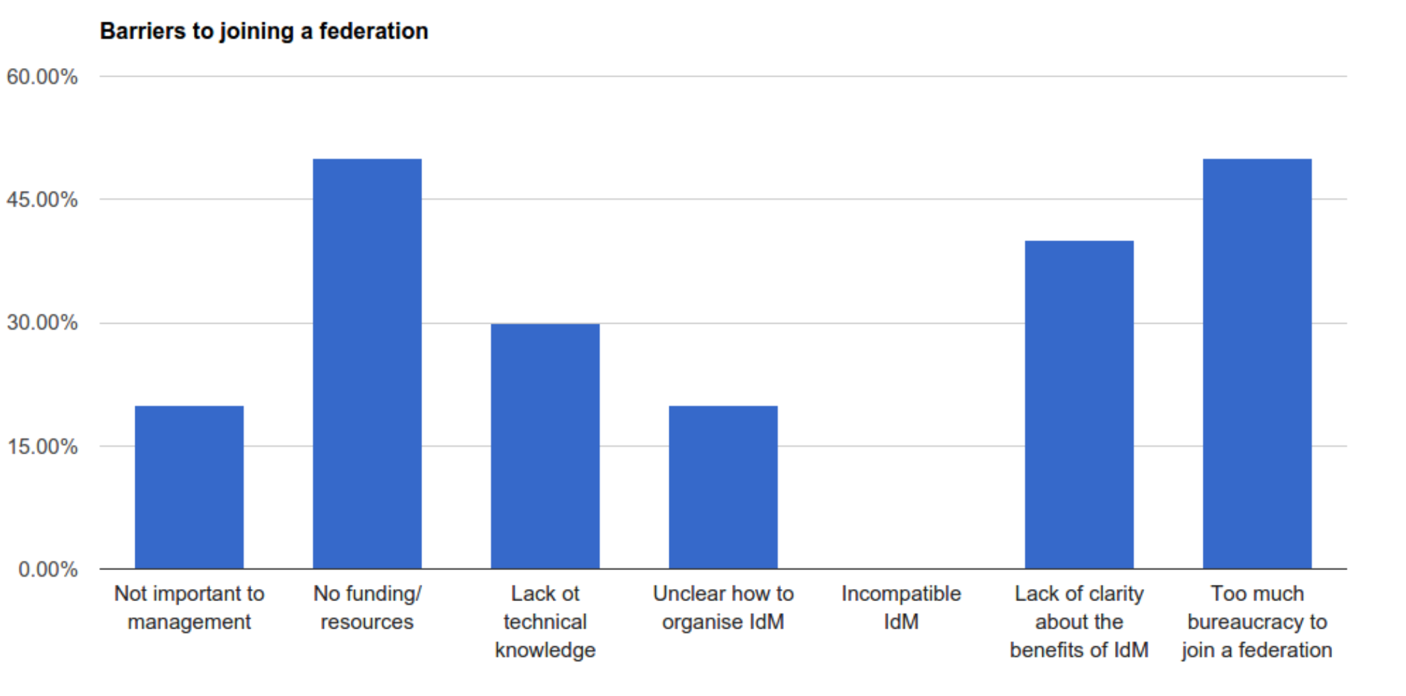
Current status, perceived barriers

Slide 9
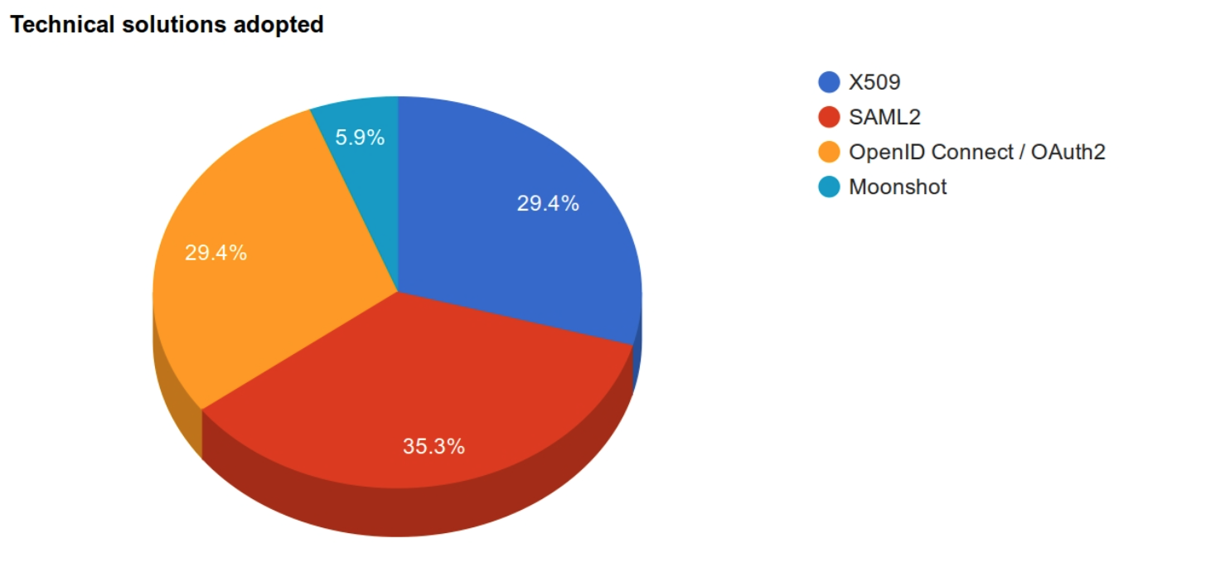
Current status, technologies
8 out of 10 communities answered in the survey that they have already a technical solution in place

Slide 10
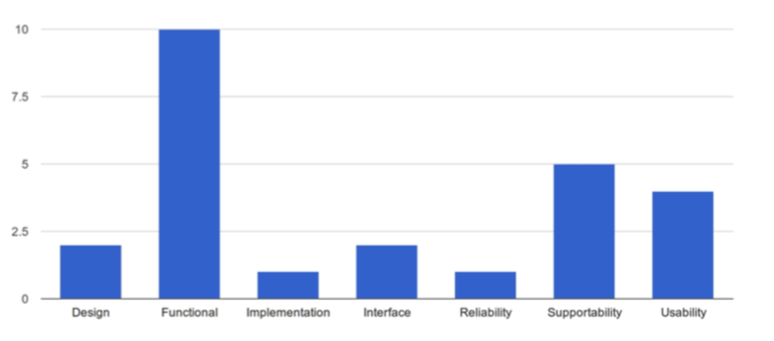
Requirements, type of requirements

Slide 11
The requirements list 1/2
28%
25%
Guest Identities / Levels of Assurance/ R2 Homeless users
R3 Different Levels of Assurance
R13 Step-­up authentication
R16 Social media identities
R17 Integration with e-­Government infrastructures
User Identification
R8 Persistent user identifiers
R9 Unique user identities
R10 User-­managed identity information Source:
Attributes: Groups and Authorisation
R4 Community-­based authorisation
R5 Flexible and scalable attribute release policies
R12 User groups and roles
R_P_5 Semantically harmonised identity attributes
Attributes: Release
R6 Attribute aggregation / Account linking
R_P_3 Sufficient attribute release
25%
25%

Slide 12
The requirements list 2/2
30%
Technology requirements
R7 Federation solutions based on open and standards
R14 Browser & non-­browser based federated access
R15 Delegation
Privacy, legal issues, and policies
R10 User-­managed identity information Source
R18 Effective accounting
R_P_1 Policy harmonisation
R_P_2 Federated incident report handling
R_P_7 Best practises for terms&conditions
Training
R1 User and Service Provider friendliness
R_P_4 Awareness about R&E federations
R_P_6 Simplified process for joining identity federations The bureaucracy involved in joining identity federations should be reduced
25%

Slide 13
How can requirements be prioritized?
Surveys, interviews and previous documentation produced a consistent set of requirements
Still manageable and non contradicting ☺
Under discussion within AARC how much these requirements need to be prioritized
Prioritization by popularity can be tricky
Dependencies, and technical barriers should be considered
It is important to have the full user stories to extract the requirements in a reliable and meaningful way
Individual interviews with the stakeholders are another useful tool for periodization
Document user stories to analyze how critical the requirements are for the workflows of a stakeholders

Slide 14
Individual interviews with the stakeholders

Slide 15
Why individual interviews
Open discussion with the stakeholders, not limited by the boundaries of a survey
But surveys have been a useful tool to gather quickly and consistently material for the deliverable.
Describe the user stories
What the users need to do
What the service providers need to know
How the workflows of the services are using authentications/authorization
Describe the expectations for AARC outputs

Slide 16
Already performed interviews
EGI
EGI Workflows
EGI critical/non-critical requirements
EGI AAI plans for evolution
ELIXIR
Requirements and use cases on which the ELIXIR AAI is being designed
EUDAT
Plans for the EUDAT AAI B2Access
Requirements
GÉANT Project
VOPaaS
Cloud Activities
Enabling user experience
Dutch consortium of the National and University Libraries
Status and penetration of AAI

Slide 17
Since we are at the EGI Community Forum
EGI Critical requirements
Single sign on
Community based authorization
Non-web access to resources
Delegation
Scalable policies for attributes release
EGI non-critical requirements, but still important
PID release
Differentiated LOA management
Credential translation services

Slide 18
Next steps with the interviews
JRA1.1 plans to continue with the open interviews until the end of the year
The outputs of these interviews will be summarized on the JRA1.1 wiki
Candidates for the future interviews:
CERN
Libraries
ESFRIs
Possibly starting already at the CF! ☺
…
Would you like to bring your requirements and use cases to AARC (on behalf of your community)?
Contact us!

Slide 19
Future work: Technologies analysis

Slide 20
AAI technologies analysis
Milestone document (AARC MJRA1.1) planned for the end of 2016
Assessment on the AAI technologies operated by the R&E: Research Infrastructures, e-infrastructures
Goal of the document:
Provide information about the technologies supporting AAI
Standards and implementations
Tools
Provide comparative analysis of these technologies grouped by capability
Sources of information:
Technologies and tools reported in the surveys
Interviews and other sources of information to gather the AAI plans of the research infrastructures/e-infrastructures
AARC knowledge base ☺

Slide 21
MJRA1.1: The topics
Authentication standards and implementation
Authorization and group management technologies
Interoperability enabling tools
Existing documentation and sources of information

Slide 22
MJRA1.1: How to compare technologies and tools
Compare by: Features/capabilities
Requirements collected: tools supporting the use cases
License
Sustainability
Additional features, e.g.tools supporting multiple standards
The comparison based on usability will be performed in the pilot testing in the AARC WP SA1

Slide 23
Summary
First set of requirements collected in the deliverable DJRA1.1
The process will continue until the end of the year with dedicated interview to further analyze the use cases and workflows involving AAI
We need to reach as many communities/infrastructures as possible!
In parallel AARC will also produce a comparison of the most relevant AA technologies and tools

Slide 24
Thanks!
For any comment or question, please contact me: peter.solagna@egi.eu

