Slide 1
Cloud-enabled, scalable Data Avenue service to process very large, heterogeneus data
Péter Kacsuk, Ákos Hajnal
MTA SZTAKI
Francesco Tusa, Junaid Arshad
Univ. of Westminster
Supported by EU FP7 (FP7/2007-2013)
283481 (SCI-BUS), 607380 (VIALACTEA),
312579 (ER-Flow), 608886 (CloudSME)

Slide 2
Accessing data Storages
Data are stored in different kind of storages having different protocols and clients to access them
Different nodes of a workflow many times require access to different data storages
If this is hard-coded into the workflow it prevents the portability of workflows among various DCIs
It is better to call a generic data access and transfer service if nodes of the workflow require data storage access
This makes the workflow generic and portable
Such a service is Data Avenue

Slide 3
Data Avenue features
Easy-to-use service, that can be accessed via several types of interfaces:
Web service SOAP
REST
Provide access to different types of storage services, using different protocols
HTTP, SFTP, GridFTP, SRM, iRODS, S3
Offer easy extensibility with new protocols
Recently Cassandra was added
Simple usage without technical knowledge (APIs, graphical user interface provided)
Provides a uniform way to access storages
URIs: storage://storage-host/path/file
operations: mkdir, delete, download, upload
Offer the possibility to exploit its features from different levels (CLI, APIs, gateways, ...)

Slide 4
Data Avenue Use Cases
1
2
3
4
5
DataAvenue
@SZTAKI
WS-PGRADE/
gUSE
Other Science Gateways
Java Applications
Other Applications
Data Avenue UI
Data Avenue UI
Data Avenue UI
Data Avenue
Java API
SOAP or REST API
SOAP and REST interface
Data Avenue Services
(Blacktop)
storage-related protocols
HTTP(s)
SFTP
GRIDFTP
SRM
iRODS
S3

Slide 5
Use case 1: Allow Users to Manage Data
Helps users: to browse, download/upload
Helps users to organize their data: to create dir,
delete, rename
Data Avenue
Storage
Service
Storage
Service
Storage
Service

Slide 6
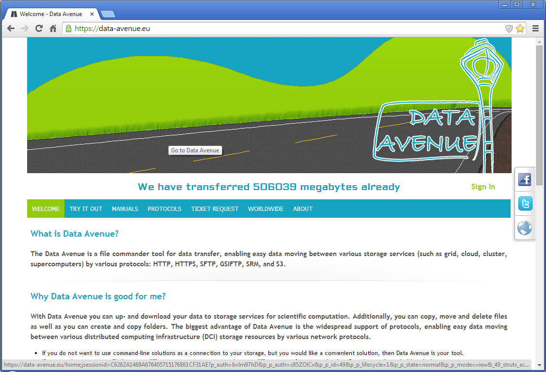
Use-case 1: DataAvenue@SZTAKI
https://data-avenue.eu: public deployment of Data Avenue UI
Users can freely try-out Data Avenue services
Sign in with your Facebook account then...

Slide 7
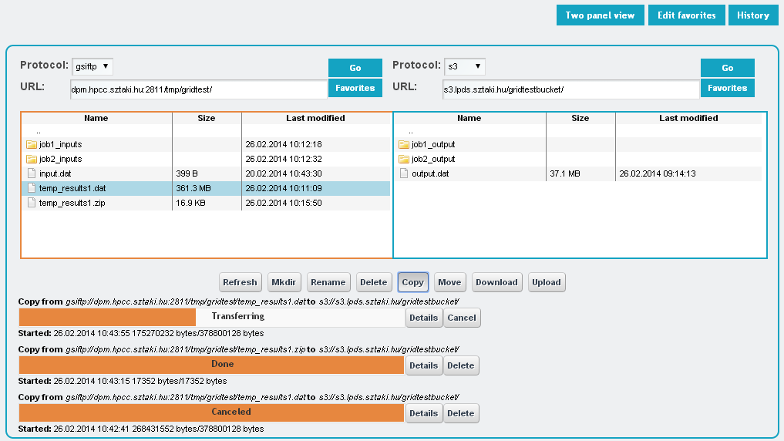
The Data Avenue Concept
Use-case 1: DataAvenue@SZTAKI
Copy between different storages
Progress bar

Slide 8
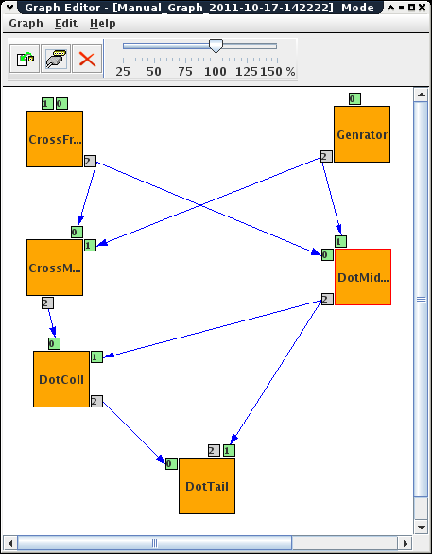
Use-case 5: Access storages from applications
Example:
Workflow nodes communicate via files created and stored in various data storages
Data Avenue
Produce data
Use data
Storage
Service
Storage
Service
Storage
Service
Problem: Data Avenue service becomes a bottleneck if many users/workflows use the service at the same time

Slide 9
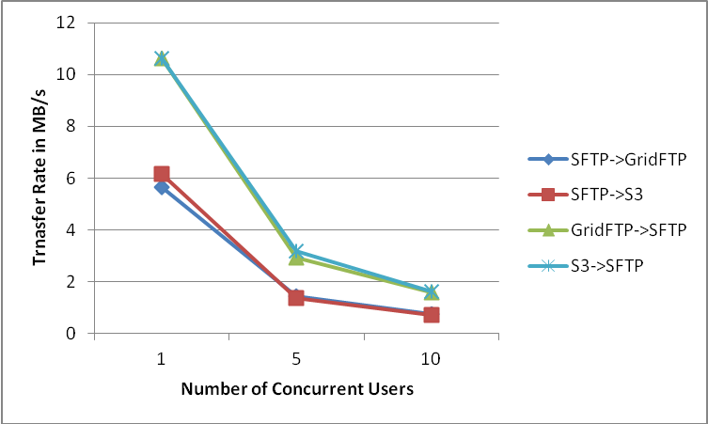
Experimental results on scalability
Transfer rate on concurrent load between S3 and GridFTP storages

Slide 10
Scalability issues
Degradation is partly due to non-scalability of the storage accessed simultaneously (e.g. in the case of SFTP server)
Partly due to the single Data Avenue server’s load (CPU and network bandwidth limits)
Our goal is to serve hundreds of concurrent file transfers at a time (e.g. a gateway with hundreds of users)
We need to reduce the effect of b) as much as possible

Slide 11
Concept of scalable Data Avenue
Pool of DA VMs in a cloud
There are several DAs in the cloud working exactly the same way as the original DA
Clients request a DA service from DAS (DA Scheduler) and not directly from a DA
DAS monitors the load of DAs and redirects clients requests to the least loaded DA
If all the DAs are overloaded it initiates the deployment of a new DA via a Cloud Manager
Cloud Manager manages the deployment and administration of these DA instances
DAs without work are removed by the Cloud Manager
Client
Client
Client
Tomcat/DA
VM
Requests
Tomcat/DA
VM
DAS
Web Load Balancer
Requests
Cloud Manager (Orchestrator)
Metrics
Tomcat/DA
VM
Virtual Infrastructure Manager

Slide 12
Scalable DA service architecture implementation
Elastic pool of VMs
3. Data Request - HTTP
Data Storage
Client
DA-1
VM
Client
Client
DA
Monitor
4. Data Transfer via DA
Tomcat
1. HTTP Request
mod_cluster
DA-2
VM
DAS
DA
Monitor
MySQL
VM
Tomcat
httpd
2. redirection
mod_cluster
User ticket management
To facilitate auto-scaling by acting on Load calculated by mod_cluster
mod_cluster
Metrics
LB_Enactor
Metrics collection from VMs through
monitors
DA-N
VM
Occopus - API
DA
Monitor
Sztaki Open Nebula
Tomcat
VM start/stop
and VM images management
mod_cluster

Slide 13
Implementation: mod_cluster and its metrics
Apache broker product
Runs on each DA 'worker node‘ and is responsible of collecting load metrics
mod_cluster defines a set of metrics out of the box
The default metric used to compute the load factor is org.jboss.modcluster.load.metric.impl.BusyConnectorsLoadMetric
Each load metric contributes a value to the overall load factor of a node
The mod_cluster load balancer expects the load factor to be an integer between 0 and 100, where 0 indicates max load and 100 indicates zero load

Slide 14
Scalable DA Service managed by Occopus
The current architecture is implemented within Sztaki cloud using Occopus
The complete architecture is deployed as a single Occopus infrastructure
The DA, DAS and MySQL nodes are independent node types defined and deployed by Occopus
Connections between the nodes are also managed by Occopus at run-time
The DAS node provides the interface for any number of clients

Slide 15
Node Definitions
'node_def:DA_node':
-
implementation_type: chef+cloudinit
backend_id: lpds
service_composer_id: dummy
image_id: ami-00001363
instance_type: m1.medium
context_template: !text_import
url: file://DA.sh
synch_strategy: basic
'node_def:DAS_node':
-
implementation_type: chef+cloudinit
backend_id: lpds
service_composer_id: dummy
image_id: ami-00001363
instance_type: m1.medium
context_template: !text_import
url: file://DAS.sh
synch_strategy: basic
'node_def:Mysql_node':
-
implementation_type: chef+cloudinit
backend_id: lpds
service_composer_id: dummy
image_id: ami-00001363
instance_type: m1.medium
context_template: !text_import
url: file://mysql.sh
synch_strategy: basic
DAS Node
DA Node
MySQL Node

Slide 16
Infrastructure Descriptor
infra_id: da_das
user_id: junaid.arshad@partners.sztaki.hu
name: scalable_da
variables:
DAS_global:
dbserver: DB
nodes:
- &A
name: DB
type: Mysql_node
- &B
name: DA
type: DA_node
scaling:
min: 2
- &C
name: DAS
type: DAS_node
dependencies:
-
connection: [ *B, *A ]
connection: [ *C, *B ]

Slide 17
Data Avenue Service with Occopus
DA node
Hosts the DA blacktop application with Tomcat
Serves as the ‘worker node(s)’ for the DAS
Dynamic connectivity with the backend MySQL node
Manual scaling implemented using Occopus
number of required DA instances specified using a parameter in infrastructure descriptor

Slide 18
Data Avenue Service with OCCO
DAS node
Hosts the mod_cluster load balancing module with httpd
Dynamically linked to any number of DA nodes using mod_cluster’s Advertise method
MySQL node
Hosts the independent MySQL server
Dynamically linked to all the DA nodes via Occopus at infrastructure start-up stage
Allows certificate based remote access to the storages

Slide 19
Conclusions
The first prototype of the scalable DA service architecture has been implemented and tested in SZTAKI Cloud
Performance measurements show good scalability
As a first practical usage the long-tail science WS-PGRADE gateway of EGI FedCloud will be enhanced with such a scalable DA service
It could be used as a data access backend service for other higher level services like workflows, gateways, etc.
We would like to make it a standard tool/service of EGI FedCloud

Slide 20
Questions?

