Slide 1
Tutorial on Hybrid Data Infrastructures D4Science as a case study
PAGANO, Pasquale (CNR)
CORO, Gianpaolo (CNR)
{pagano,coro}@isti.cnr.it
EGI Community Forum 2015
10-13 November 2015
Bari, Italy

Slide 2
Outline
E-Infrastructures and Virtual Research Environments
D4Science
Geospatial data management and visualisation
Data processing
Data access and discovery: biodiversity data
Data harmonisation

Slide 3
E-Infrastructures and Virtual Research Environments
D4Science
Geospatial data management and visualisation
Data processing
Data access and discovery: biodiversity data
Data harmonisation

Slide 4
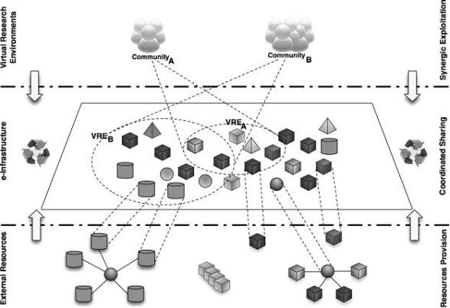
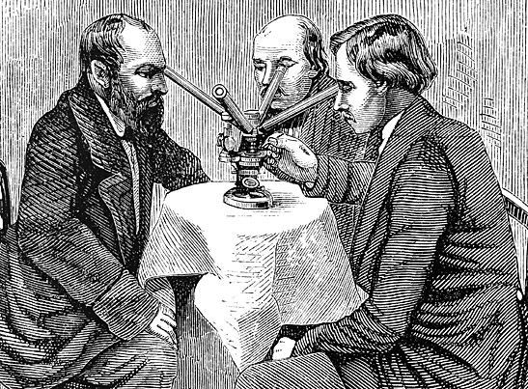
e-Infrastructures
“e-Infrastructures enable researchers in different locations across the world
to collaborate in the context of their home institutions or in national or multinational scientific initiatives. They can work together by having shared access to unique or distributed scientific facilities (including data, instruments, computing and communications)*.”
Examples:
*Belief, http://www.beliefproject.org/
OpenAire, http://www.openaire.eu/
i-Marine, http://www.i-marine.eu/
EU-Brazil OpenBio,
http://www.eubrazilopenbio.eu/

Slide 5
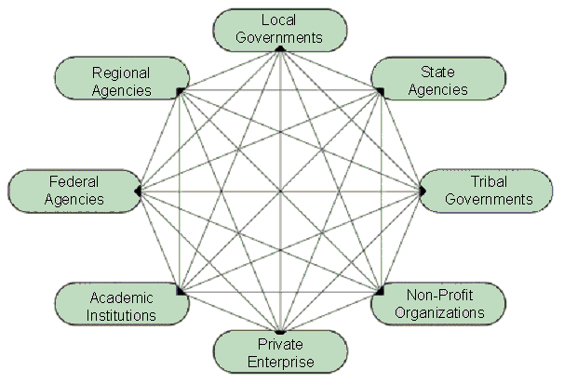
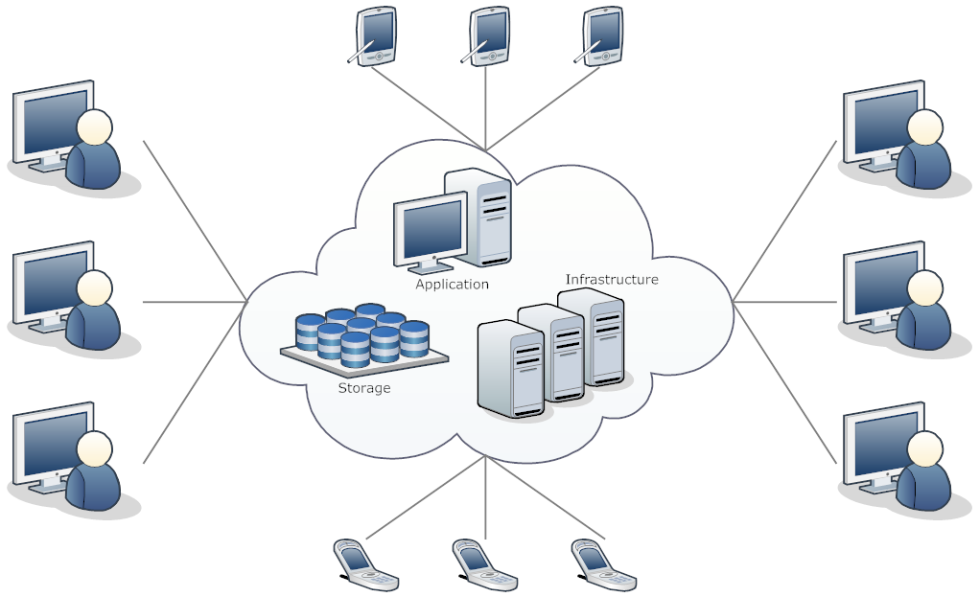
e-Infrastructures
Data e-Infrastructure: an e-Infrastructure promoting data sharing and consumption. Addresses the needs of the research activity performed by a certain community.
Computational e-Infrastructure: an e-Infrastructures offering computational resources distributed in a network environment. Uses Cloud computing to execute calculations with a large number of connected computers. Offers collaboration facilities for scientists to share experimental results.
Notes:
E-Science (or eScience) is computationally intensive science that is carried out in highly distributed network environments, or science that uses immense data sets that require grid computing; the term sometimes includes technologies that enable distributed collaboration, such as the Access Grid.

Slide 6
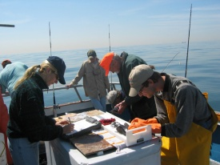
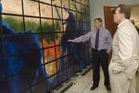
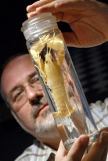
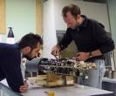
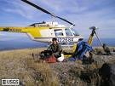
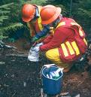
Virtual Research Environments
Virtual Research Environments: virtual organizations of communities of researchers for helping them collaborating.
Define sub-communities inside an e-Infrastructure;
Allow temporary dedicated assignment of computational, storage, and data resources to a group of people;
Very important in fields where research is carried out in several teams which span institutions and countries.
VRE
VRE
VRE
e-Infrastructure

Slide 7
E-Infrastructures and Virtual Research Environments
D4Science
Geospatial data management and visualisation
Data processing
Data access and discovery: biodiversity data
Data harmonisation

Slide 8
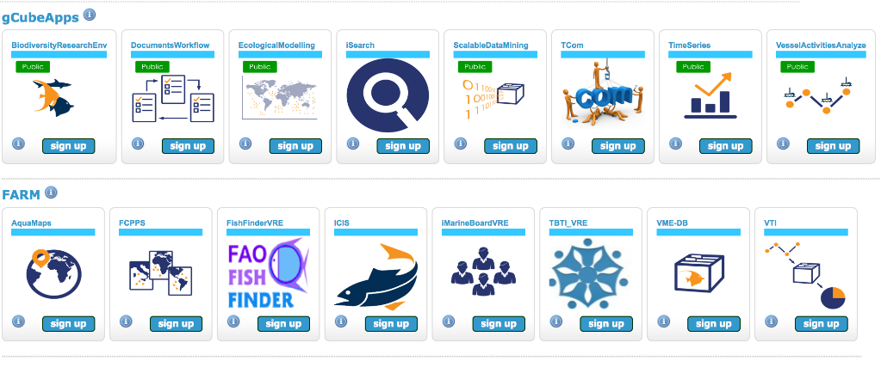
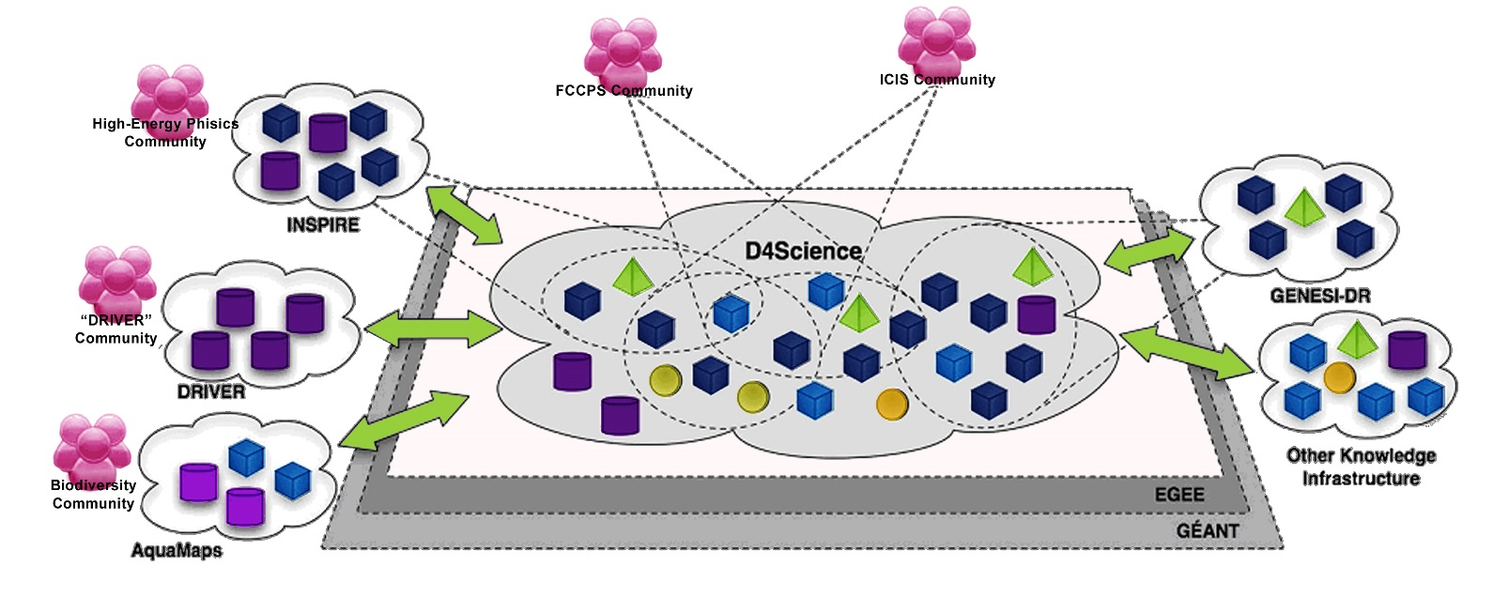
D4Science
D4Science is both a Data and a Computational e-Infrastructure (Hybrid Data Infrastructure)
Used by several Projects: i-Marine, EUBrazil OpenBio, ENVRI, BlueBRIDGE;
Implements the notion of e-Infrastructure as-a-Service: it offers on demand access to data management services and computational facilities;
Hosts several VREs for Fisheries Managers, Biologists, Statisticians…and Students.
DILIGENT 2004
BlueBRIDGE
Today

Slide 9
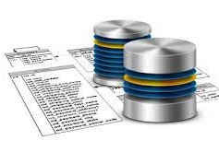
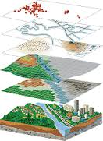
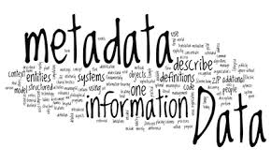
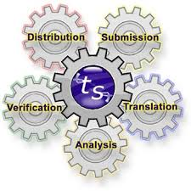
D4Science services
Storage
Databases
Cloud storage
Geospatial data
Data management
Metadata generation and management
Harmonisation
Sharing
Processing
Cloud computing
Elastic resources assignment
Multi-platform: R, Java, Fortran

Slide 10
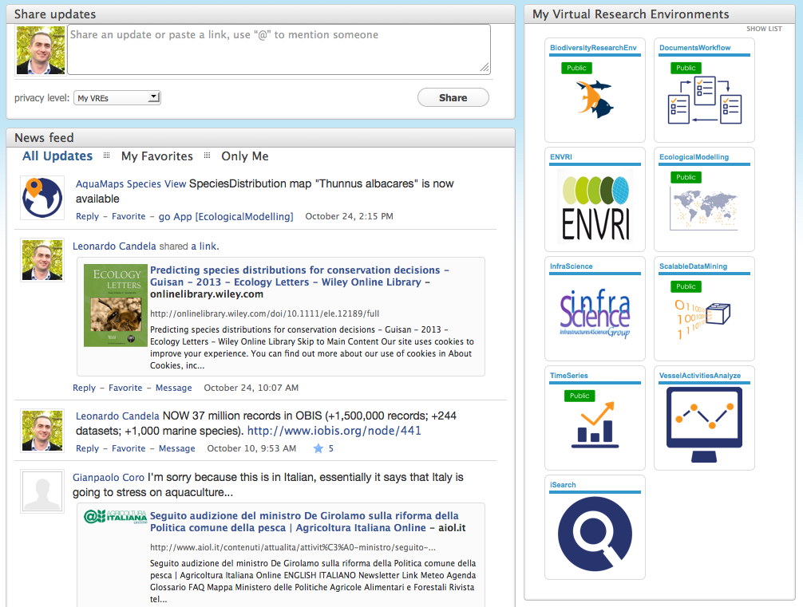
D4Science Social
A continuously updated list of events / news produced by users and applications
Share News
Application-shared News
User-shared News

Slide 11
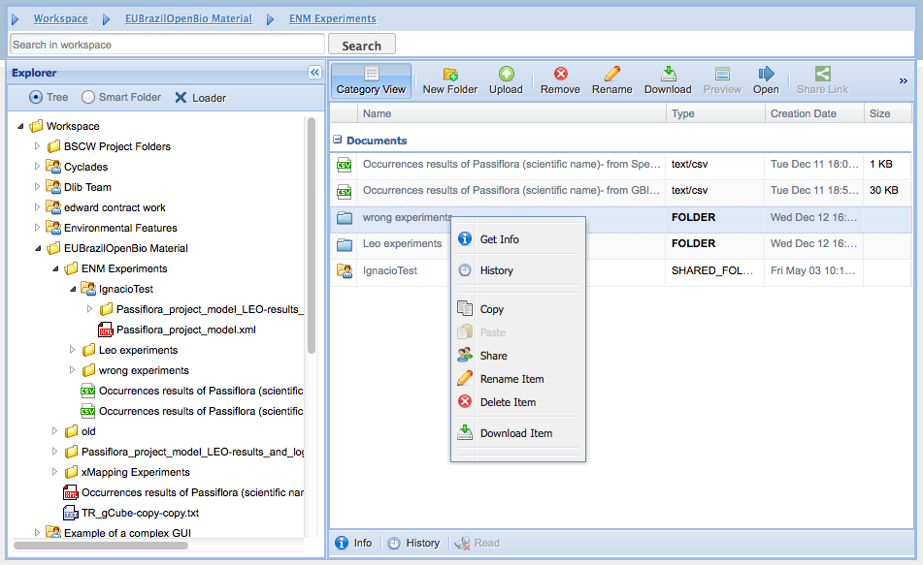
D4Science Workspace
A folder-based file system allowing to manage complex information objects in a seamless way
Information objects can be
files, dataset, workflows, experiments, etc.
organized into folders and shared
disseminated via URIs
accessed via WebDAV

Slide 12
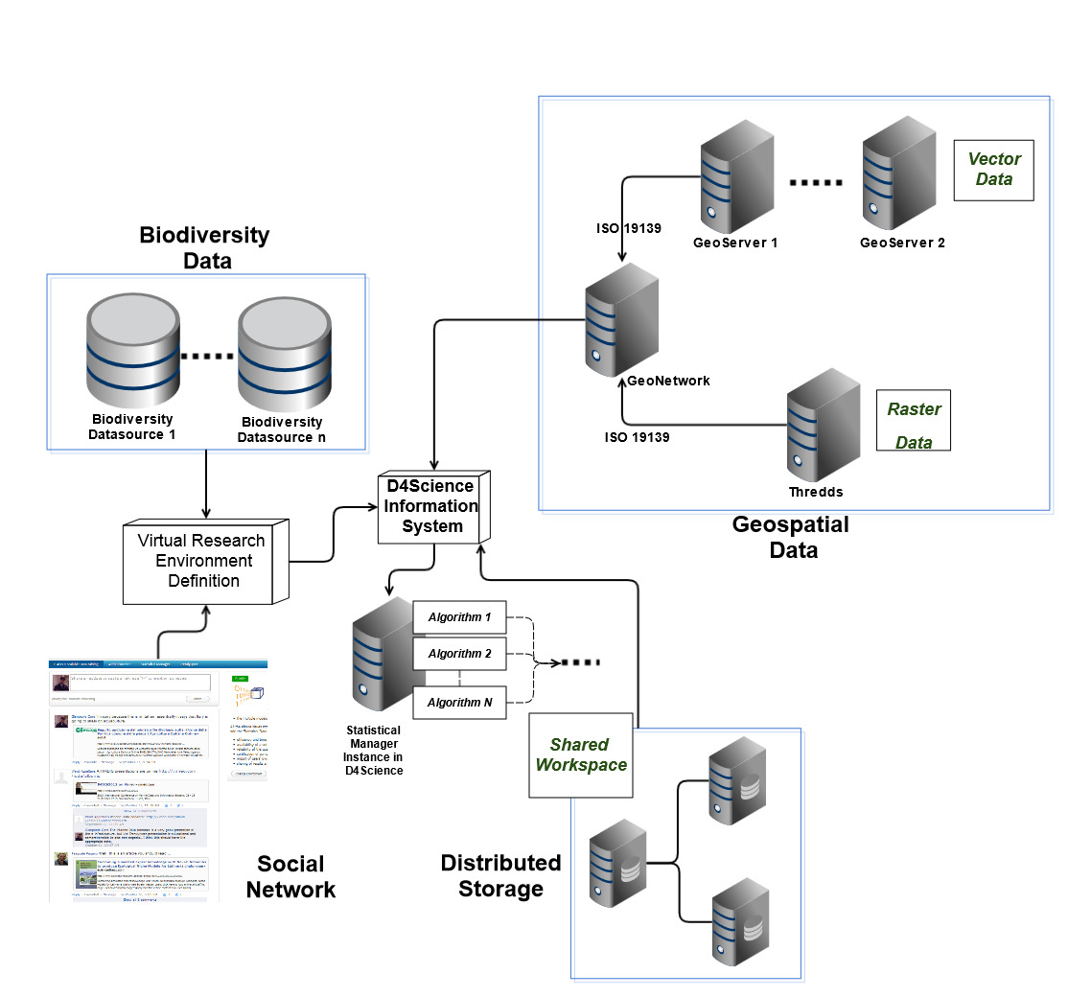
D4Science - Architecture
Large Set of Biodiversity and Taxonomic Datasets connected
A Network to distribute and access to Geospatial Data
A Social Network
to share opinions and useful news
Distributed Storage System to store datasets and documents
Algorithms for Biology-related experiments

Slide 13
D4Science-based web portals
Services Portal
(services.d4science.org)
i-Marine Portal
(i-marine.d4science.org)
Geothermal Portal
(egip.d4science.org)
ISTI-CNR Portal
(social.isti.cnr.it)

Slide 14
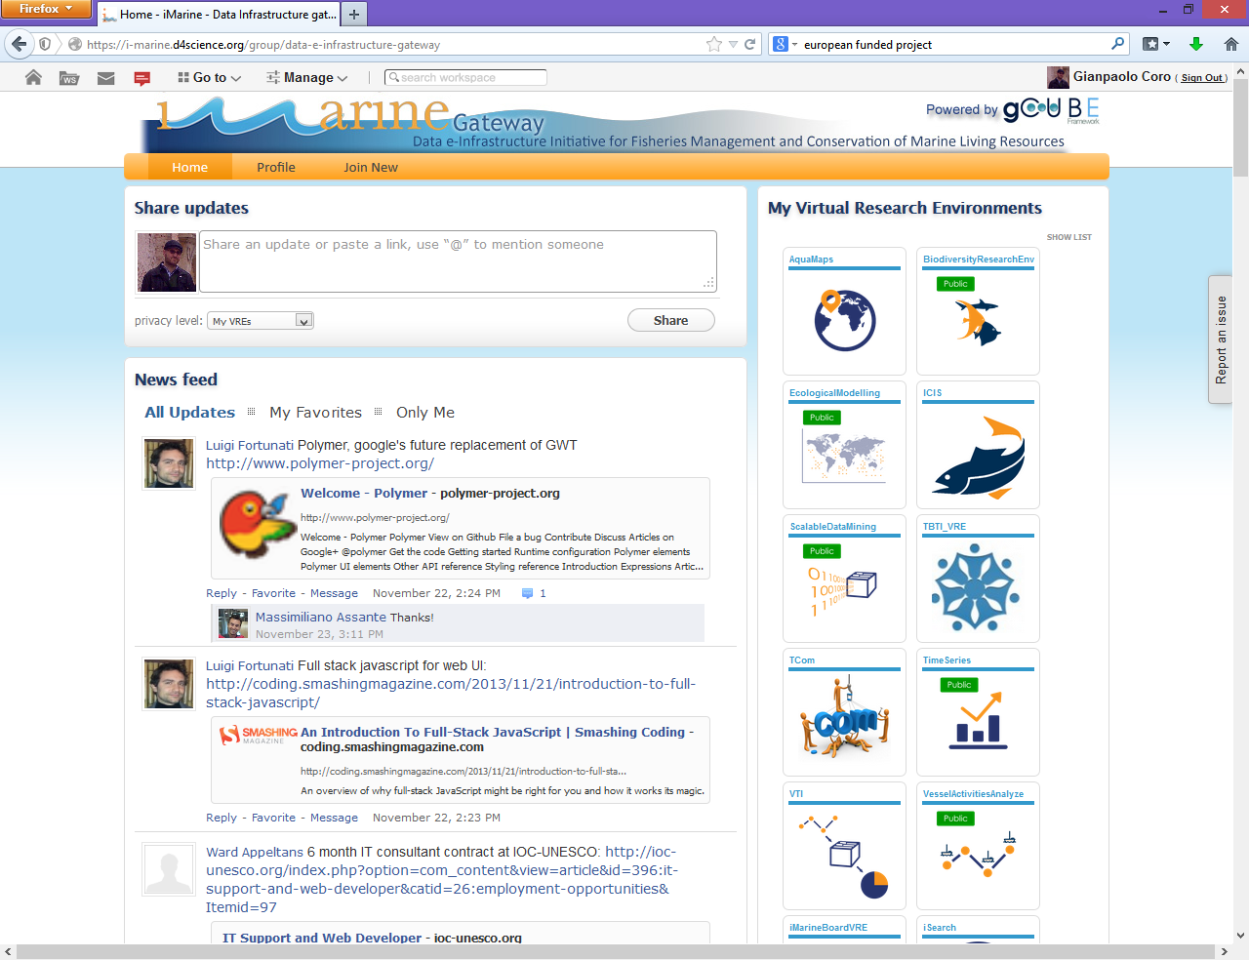
Online examples:
the i-Marine
Web Portal and basic functions
http://i-marine.d4science.org

Slide 15
E-Infrastructures and Virtual Research Environments
D4Science
Geospatial data management and visualisation
Data processing
Data access and discovery: biodiversity data
Data harmonisation

Slide 16
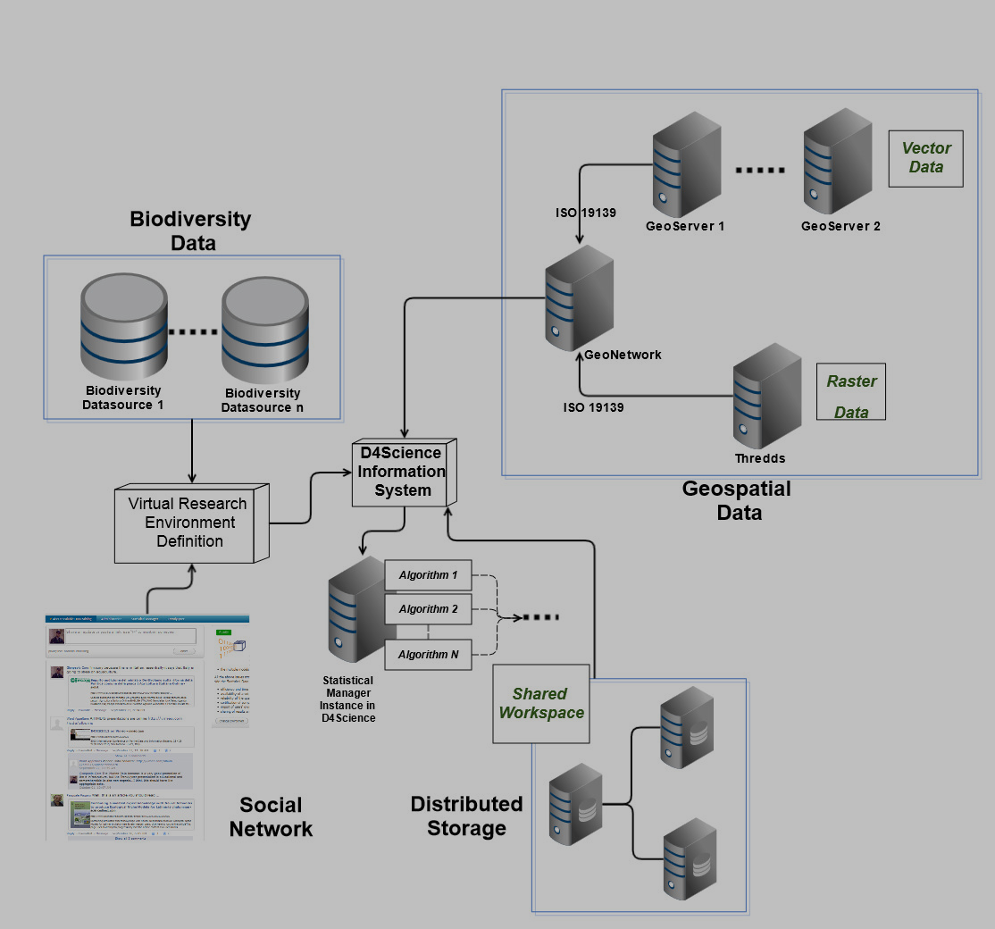
Geospatial Data

Slide 17
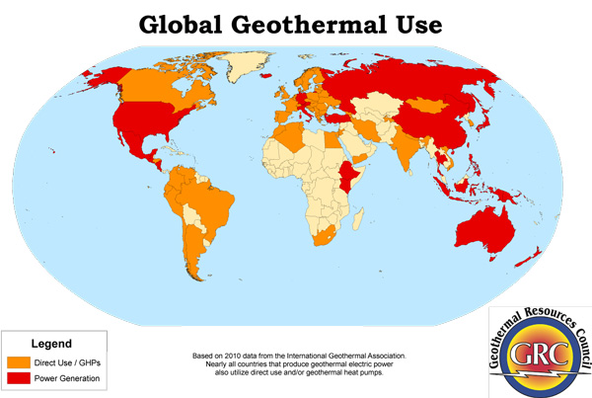
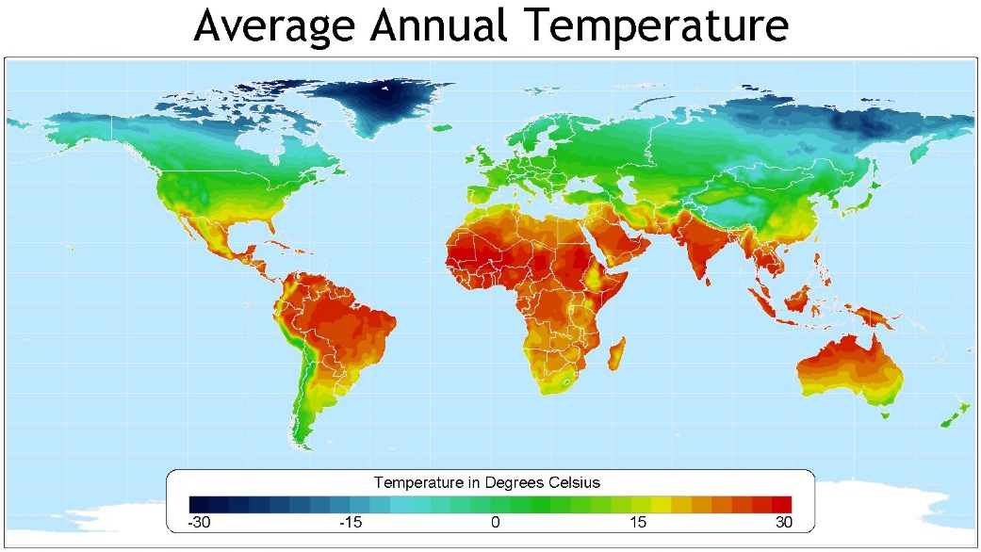
Geospatial data
Data that identify the geographic location of features and boundaries on Earth
Usually stored as coordinates and topology
Accessed and processed through Geographic Information Systems (GIS)

Slide 18
OGC Standards
The Open Geospatial Consortium (OGC) is an international organization involving more than 400 organizations. Promotes the development and implementation of standards to describe geospatial data content and processing.
Some standards:
Web Maps Service (WMS): XML-based protocol that allows to display the datasets on an interactive map viewer;
Web Coverage Service (WCS): XML-based representation of space-time varying phenomena (especially used for raster maps)
Web Features Service (WFS): XML-based representation for discrete geospatial features (especially used for polygonal maps)

Slide 19
D4Science - Supported OGC Standards
Managed Standards and Formats:
Web Maps Service (WMS)
Web Coverage Service (WCS)
Web Features Service (WFS)
OPeNDAP (Access to NetCDF GRID files)
ESRI GRID raster files (ASC)
GeoTiff

Slide 20
Data Catalogues
Describe metadata for a geospatial dataset in a structured and standardized way
Indispensable for
all kinds of data transfers
interoperability
Include ISO / CEN / OGC work

Slide 21
Data Catalogue within D4Science
The GeoNetwork web application is accessible through the portal
Users can inspect metadata
Metadata are possibly compliant with the INSPIRE recommendations*
* http://inspire.ec.europa.eu/index.cfm/pageid/62

Slide 22
Online examples:
A D4Science GeoNetwork
http://geonetwork.d4science.org/geonetwork/
http://geonetwork.geothermaldata.d4science.org/geonetwork/srv/en/main.home

Slide 23
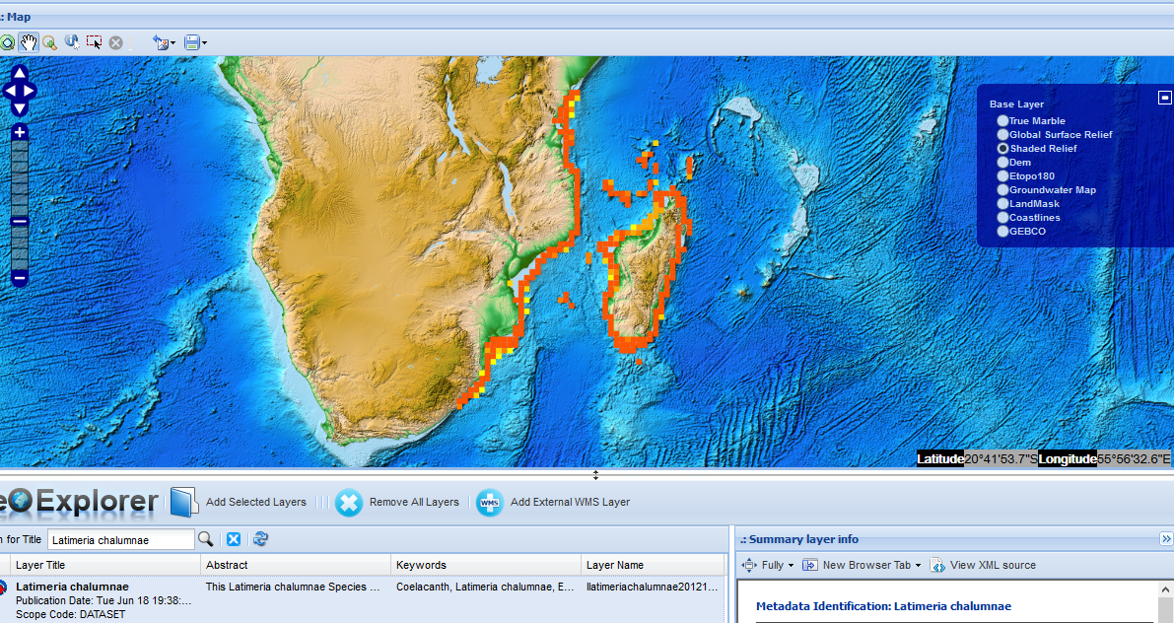
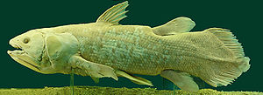
D4Science Geospatial Data access and visualisation
GeoExplorer is a web application (Portlet) for geo-spatial layers to:
Discover
Inspect
Overlay
Save
WMS, WCS, WFS
The map depicts the native range (~actual distribution) of Latimeria chalumnae

Slide 24
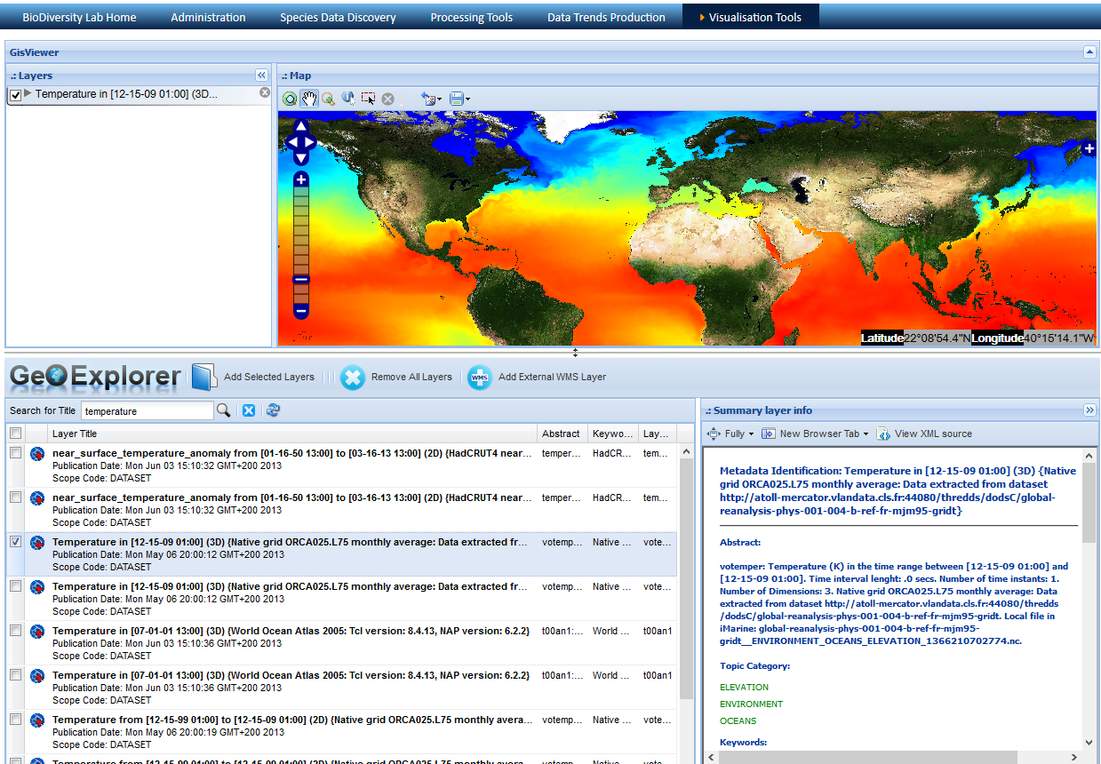
GeoExplorer: Data Discovery and Visualization
Functions
Visualization
Layers Stack
Discovery
Metadata

Slide 25
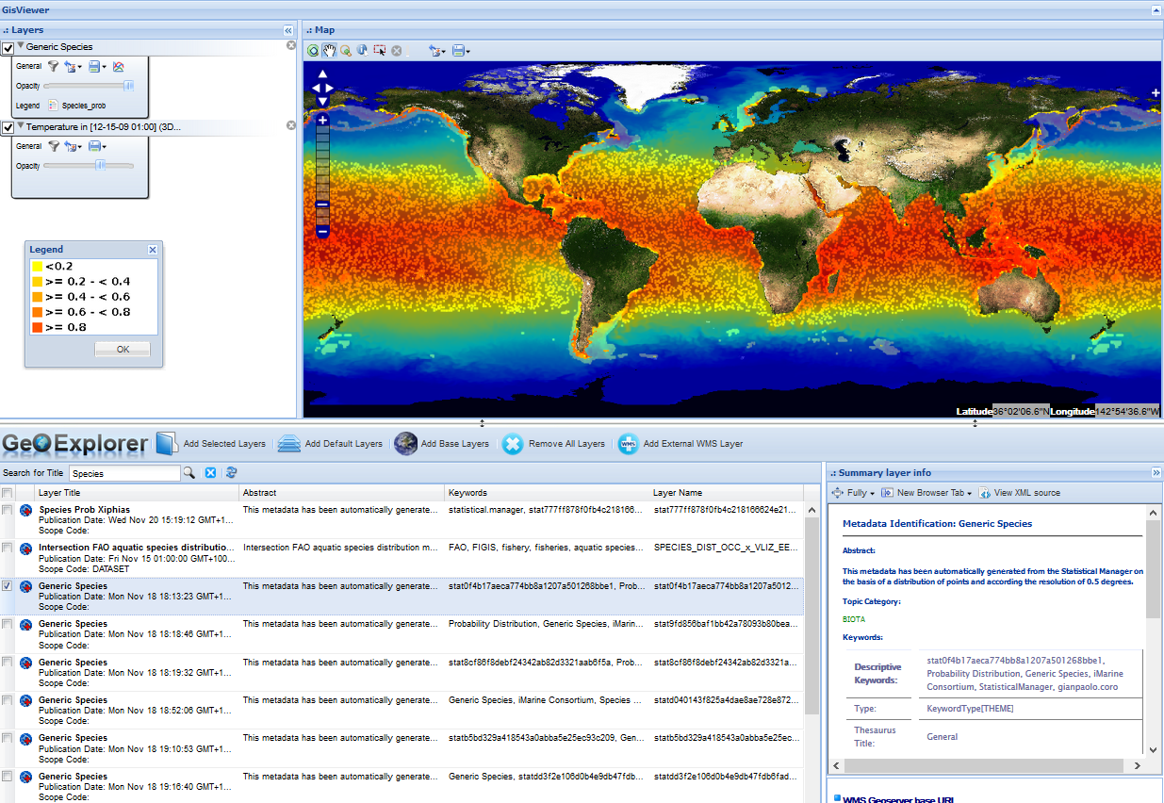
Example:
GeoExplorer
https://i-marine.d4science.org/group/biodiversitylab/geo-visualisation

Slide 26
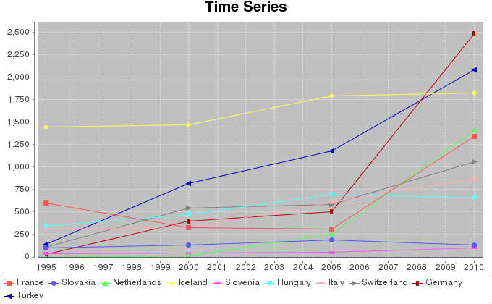
European Geothermal e-Infrastructure
GeoServer
[Others]
Visualization: GeoExplorer
GeoServer
Italy
GeoServer
Hungary
Documents
Sharing: Workspace
Social
EGIP
GeoNetwork
D4S
I.S.
GeoServer
Switzerland
Processing: Statistical Manager
MapServer
France

Slide 27
European Geothermal e-Infrastructure
D4Science GeoExplorer for EGIP:
Visualize the Temperature and Heat Flow maps of the contributors
Inspect contents
Get a summary of the metadata

Slide 28
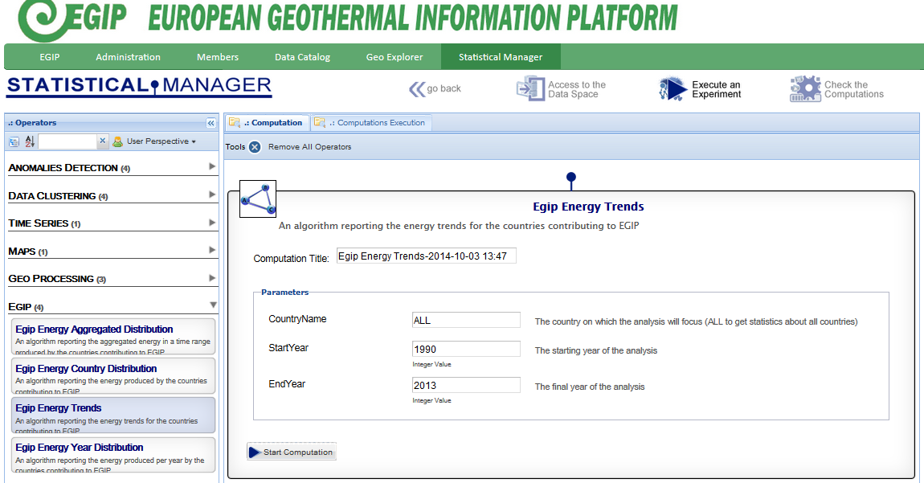
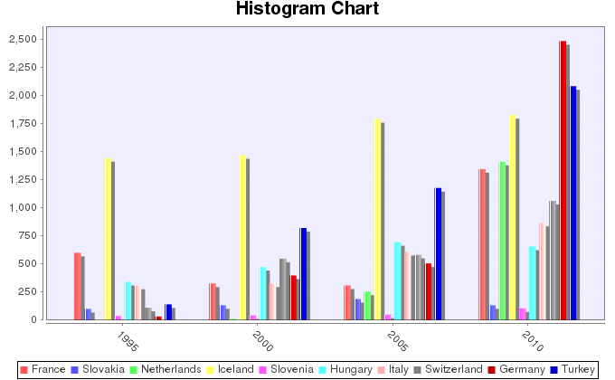
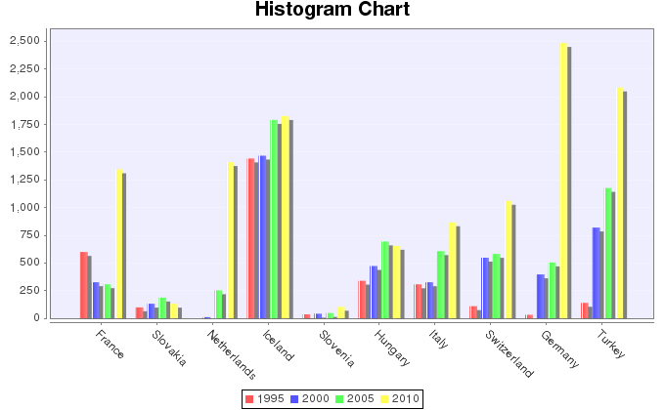
Processing
Collect and aggregate Information
Energy Production Trends per country and year
EGIP
GeoNetwork
Processing: Statistical Manager

Slide 29
E-Infrastructures and Virtual Research Environments
D4Science
Geospatial data management and visualisation
Data processing
Data access and discovery: biodiversity data
Data harmonisation

Slide 30
Data Processing

Slide 31
Issues
Some interests by communities of practice in Computational Statistics:
Repetition and validation of experiments
Exploitation of algorithms in several contexts
Hide the complexity of the calculations
Facilitate the management and the publication of the algorithms

Slide 32
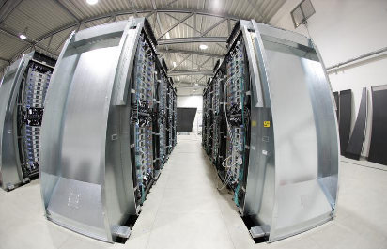
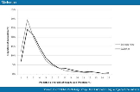
Statistical Manager – Users’ View
The Statistical Manager is a set of web services that aim to:
Help scientists in computational statistics experiments
Supply precooked state-of-the-art algorithms as-a-Service
Perform calculations by using Map-Reduce in a seamless way to the users
Share input, results, parameters and comments with colleagues by means of Virtual Research Environment in the D4Science e-Infrastructure
Setup and execution
Statistical
Manager
D4Science
Computational
Facilities
Sharing
Notes:
Just a note for readers: Software as a service (SaaS, pronounced sæs or sɑs^{[1]}), sometimes referred to as "on-demand software" supplied by ISVs or "Application-Service-Providers" (ASPs),^{[2]} is a software delivery model^{[3]} in which software and associated data are centrally hosted on the cloud. SaaS is typically accessed by users using a thin client via a web browser.

Slide 33
Computational services
Processes developed by scientist usually require long computational time and come under several programming languages.
E.g. FAO stock assessment process has been imported on the D4Science e-Infrastructure with several benefits.
Standard R environment
Sequential execution
For R experts only
D4Science
Cloud computation
Web interface available for non experts
Requires 30 days
Requires 15h and 20 min
Produces the same output as the R process
97.8% processing time reduction
Output snippet

Slide 34
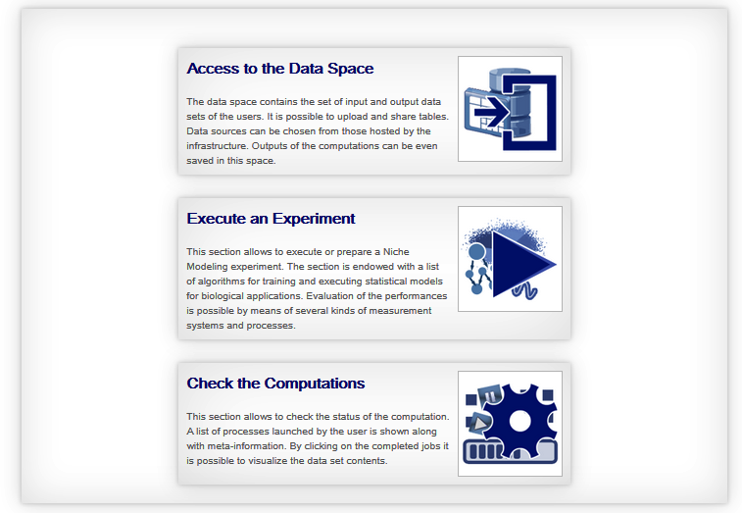
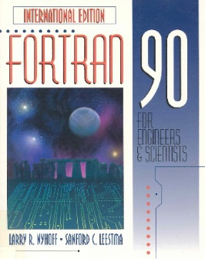
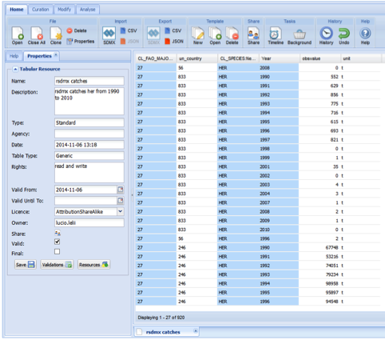
Data Analytics
Statistical services
External Computing Facility
OGC WPS
Interface
WPS
Prepare data
Analyse
Recommend actions to decision makers
Data standardisation services
Notes:
Several formats: NetCDF, WFS, WCS, Esri-Grid, GeoTiff – CSV, RDB - DwC

Slide 35
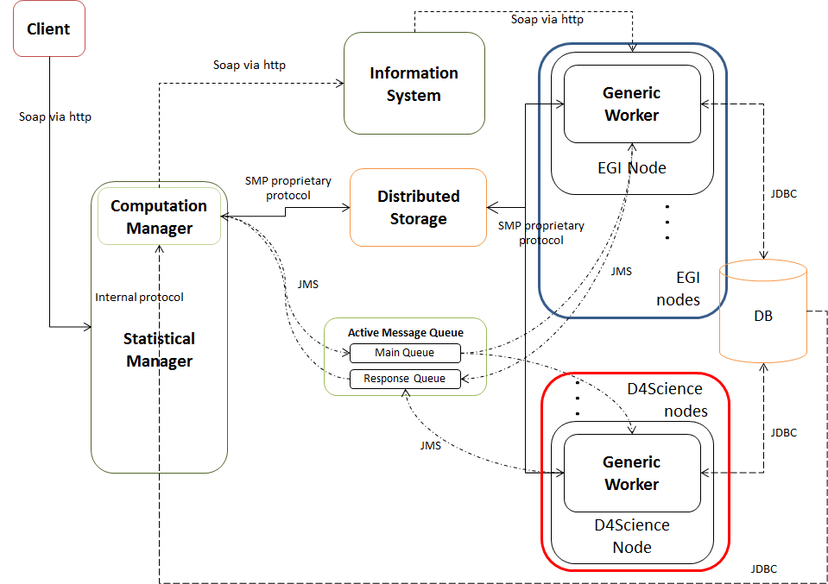
Statistical Manager Architecture

Slide 36
Example:
the D4Science Statistical Manager
https://i-marine.d4science.org/group/biodiversitylab/processing-tools

Slide 37
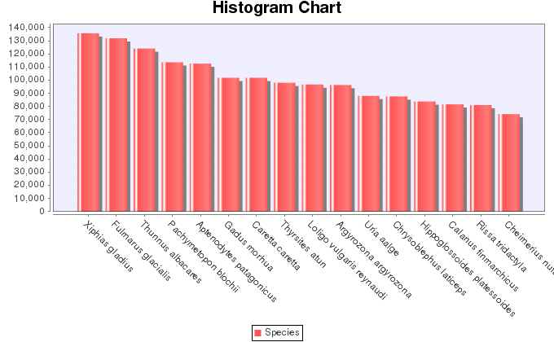
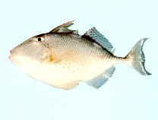
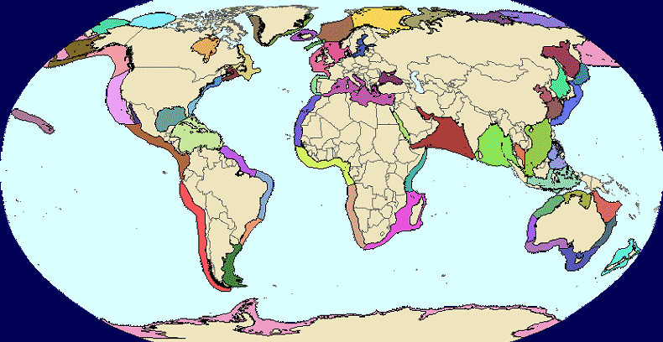
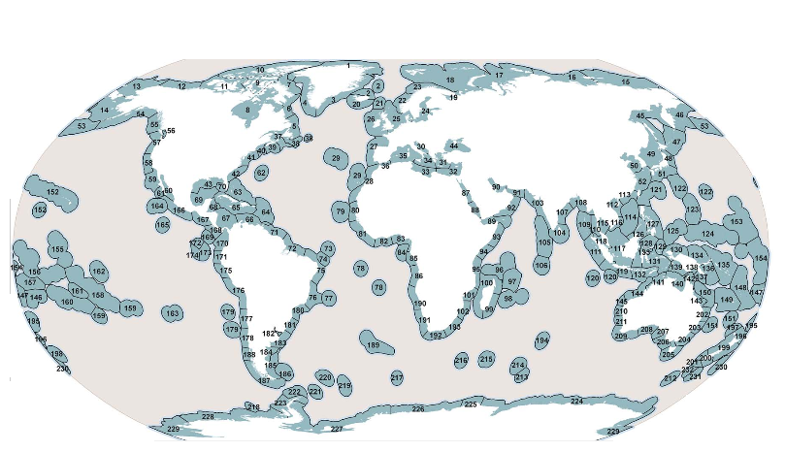
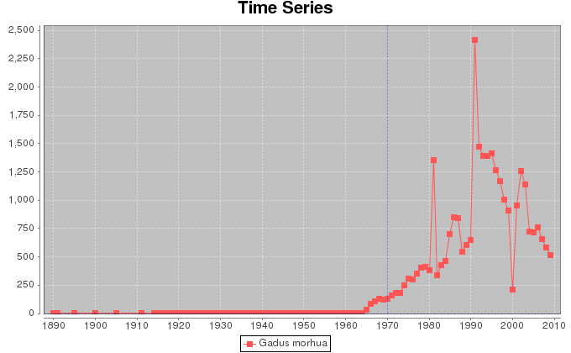
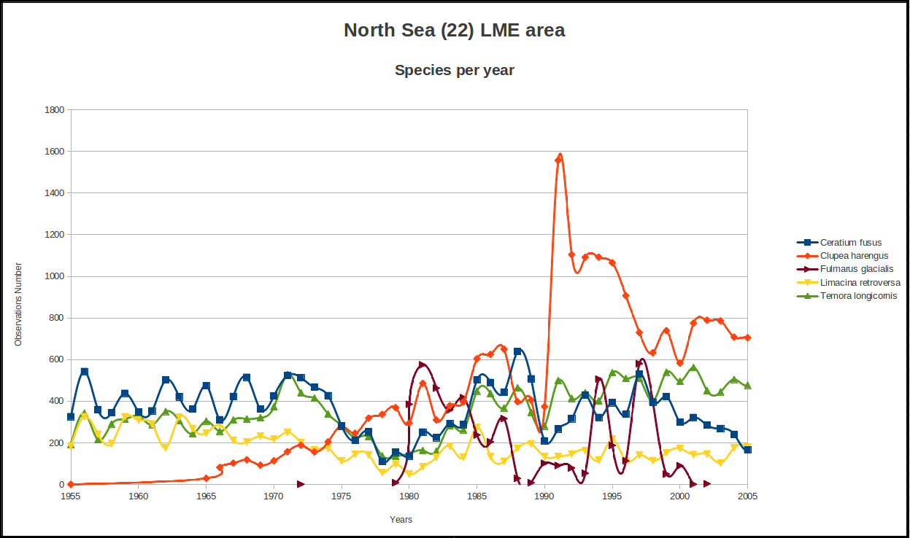
Biodiversity
LME - MEOW
Fill knowledge gaps on marine species
Account for sampling biases
Define trends for common species
Herring recovered after the fish ban
Plankton regime shift

Slide 38
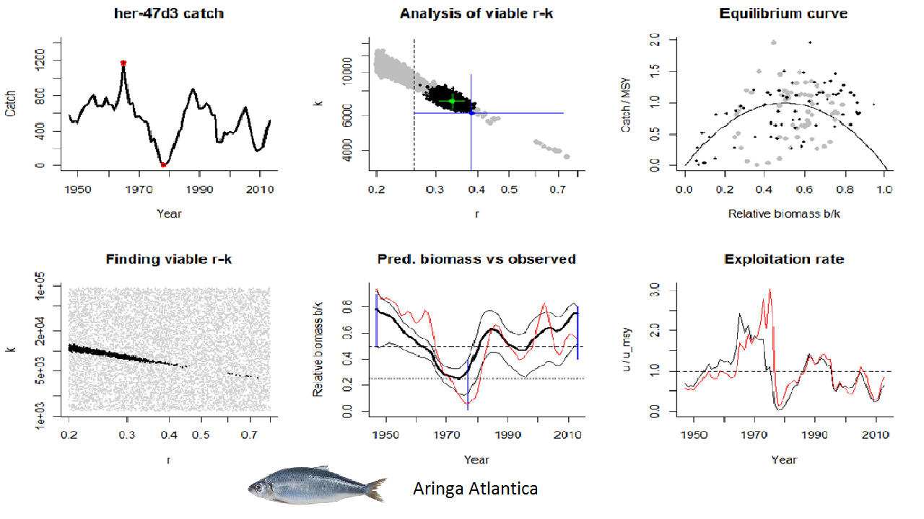
Stock assessment
Length-Weight Relations: estimates Length-Weight relation parameters for marine species, using Bayesian methods. Developed by R. Froese, T. Thorson and R. B. Reyes
SGVM interpolation: interpolation of vessels trajectories. Developed by the Study Group on VMS, involving ICES
FAO MSY: stock assessment for FAO catch data. Developed by the Resource Use and Conservation Division of the FAO Fisheries and Aquaculture Department (ref. Y. Ye)
ICCAT VPA: stock assessment method for International Commission for the Conservation of Atlantic Tunas (ICCAT) data. Developed by Ifremer and IRD (ref. S. Bonhommeau, J. Bard)
CMSY:estimates Maximum Sustainable Yield from catch statistics. Prime choice for ICES as main stock assessment tool. Developed by R. Froese, G. Coro, N. Demirel, K. Kleisner and H. Winker
Atlantic herring
D4Science reduced time-to-market:
State-of-the-art models to estimate Maximum Sustainable Yield
computational time reduced of 95% in average

Slide 39
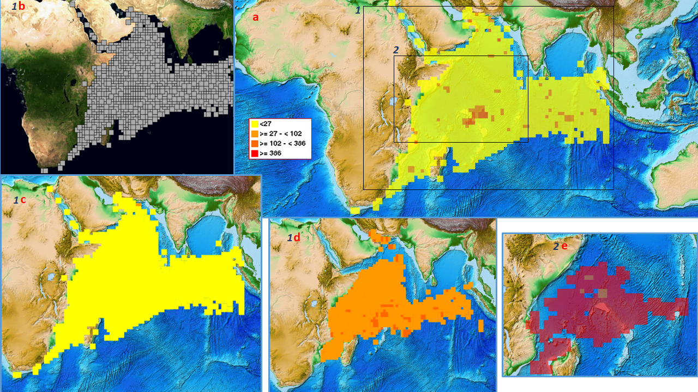
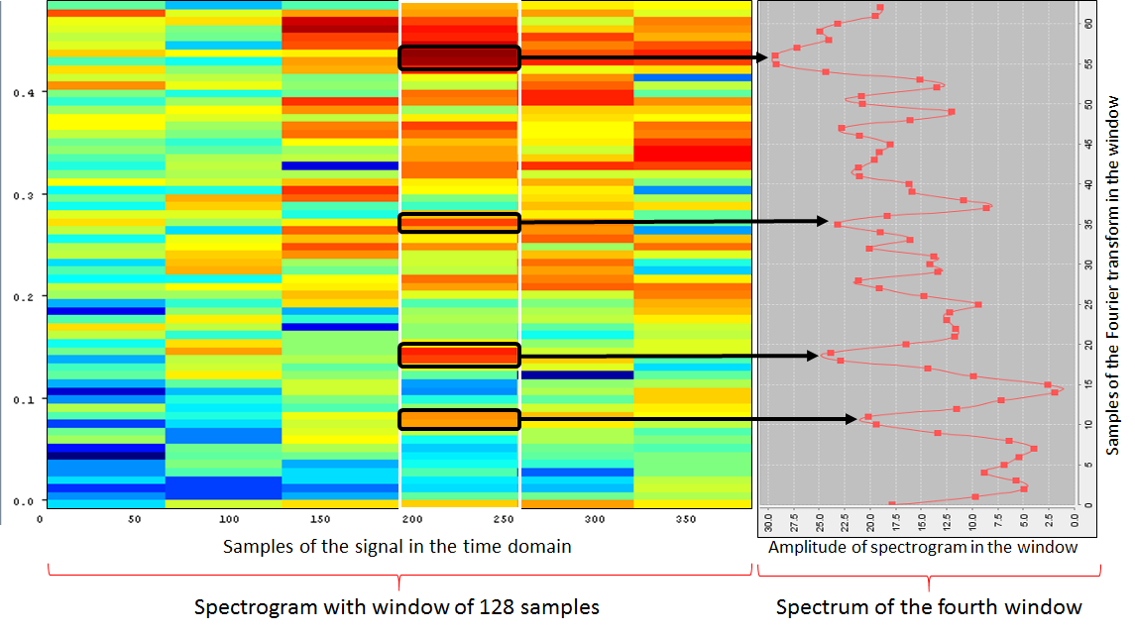
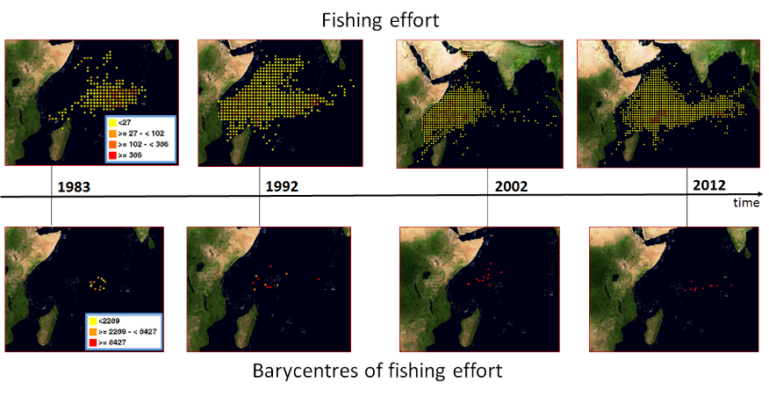
Time series forecasting

Slide 40
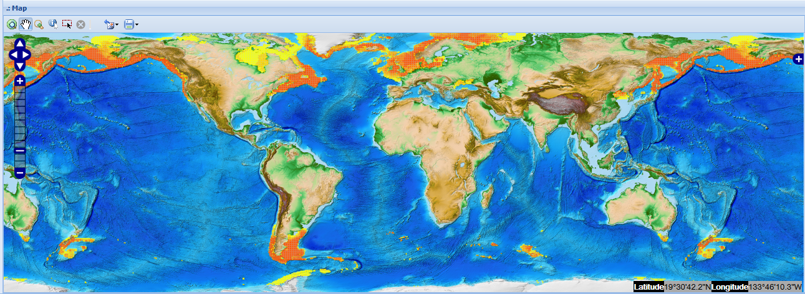
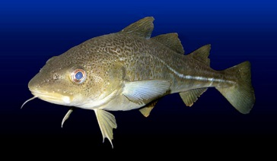
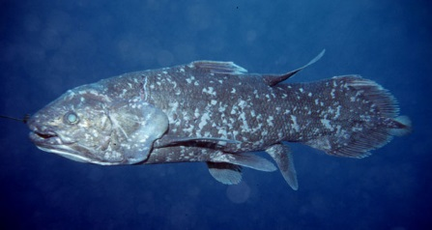
Ecology
AquaMaps
Atlantic cod
Neural Networks
Coelacanth
Neural Networks and MaxEnt
Giant squid

Slide 41
Geospatial data processing
Maps comparison
Data extraction
Signal processing
Periodicity detection
Maps generation
NetCDF
file

Slide 42
E-Infrastructures and Virtual Research Environments
D4Science
Geospatial data management and visualisation
Data processing
Data access and discovery: biodiversity data
Data harmonisation

Slide 43
Biodiversity Data Providers
Remote

Slide 44
Taxonomies
Biology
In biology, a taxon (plural taxa) is a group of one or more populations of an organism or organisms seen by taxonomists to form a unit.
Computer science

Slide 45
Biodiversity Data
Occurrence data
Records of species presence, usually provided by scientific surveys
Specimen, Human Observations (direct/indirect)

Slide 46
Biodiversity Data Providers
D4Science integrates biodiversity datasets coming from several data providers:
Some are remotely accessed and are maintained by the respective owners;
Other ones are resident in the e-Infrastructure.
Currently, the accessible datasets are:
Catalogue of Life (CoL)
Global Biodiversity Information Facility (GBIF),
Integrated Taxonomic Information System (ITIS),
Interim Register of Marine and Nonmarine Genera (IRMNG),
Ocean Biogeographic Information System (OBIS),
World Register of Marine Species (WoRMS)
World Register of Deep-Sea Species ( WoRDSS )
Some data providers are collectors of other data providers, but the alignment is not guaranteed!
The datasets allow to retrieve:
Occurrence points (presence points or specimen)
Taxa names

Slide 47
Biodiversity Data Retrieval
Data provisioning
OBIS
FishBase
SeaLifeBase
Usage in other applications
Web Interfaces
Client programs
RESTful Web Services
GBIF
SpeciesLink
ITIS
…
Web Interfaces

Slide 48
D4Science Species Products Discovery
Species Products Discovery allows to retrieve detailed information from several data providers in a common representation
Remote
We can visualize the occurrence points on a map and visually detect the errors.
We can inspect the points metadata

Slide 49
Online example:
the D4Science Species Products Discovery
https://i-marine.d4science.org/group/biodiversitylab/species-data-discovery

Slide 50
E-Infrastructures and Virtual Research Environments
D4Science
Geospatial data management and visualisation
Data processing
Data access and discovery: biodiversity data
Data harmonisation

Slide 51
Tabular Data Manager
Manipulates Big Tabular Datasets
Prepares data for Analyses
Makes data compliant with external Code Lists
Visualizes, represents and inspects data

Slide 52
1- TabMan imports datasets with tuna catch statistics
Yellowfin
Skipjack

Slide 53
2- Allows modifying columns

Slide 54
3- Allows curating columns
d. Produce a new codelist
a. Duplicates deletion
b. Column splitting
using regular expressions
c. Changing columns types
and Codelists compliancy
e. Denormalization:
one column per row value

Slide 55
4- Adding Geometries

Slide 56
5- Datasets can become interactive GIS maps published under standard formats (WMS, WFS, WCS)

Slide 57
6- Time series can be forecasted and analysed using an online R development environment

Slide 58
7- Charts and analytics help discovering indicators

Slide 59
Regional fisheries data harmonisation
Reach a common standard format for all RFMOs statistical datasets
Year / quarter / species / geartype / square ID /catches
Requirements
Normalize data
Delete detail columns and aggregate catch
Detect duplicate records
Aggregate valid duplicates, discard invalid ones
Aggregate Time dimension to quarter
Apply reference data codes
Discover errors in codes
Fix errors in codes
Merge all tuna datasets to the Tuna Atlas Dataset
Simple pre-processing
Publish and share datasets with colleagues
Example of TA Code List
FIC_ITEM | NAME_E | ALPHA 3CODE
2494 | Skipjack tuna | SKJ
2496 | Albacore | ALB
2497 | Yellowfin tuna | YFT
2498 | Bigeye tuna | BET
2500 | Black marlin | BLM
2501 | Striped marlin | MLS
2503 | Swordfish | SWO
3296 | Atlantic bluefin t | BFT
3298 | Southern bluefin t | SBF
3303 | Blue marlin | BUM
3305 | Atlantic white mar | WHM
18734 | Pacific bluefin tu | PBF

Slide 60
Example:
the D4Science Tabular Data Manager
https://i-marine.d4science.org/group/tabulardatalab/tabman

Slide 61
Thank you

