Slide 1
Governing the Open Science Cloud Background information
Sergio Andreozzi
Strategy and Policy Manager, EGI.eu
Shaping the Open Science Cloud of the Future
Bari, 13 Nov 2015

Slide 2
Outline
Open Science & Open Science Cloud
Complex resource management system
Private vs. Public vs. Commons
Example of governance structures
Internet Governance
PPP
Questions for the panel

Slide 3
Open Science
Opening of the creation
and dissemination
of scholarly knowledge
towards a multitude of stakeholders,
from professional researchers to citizens

Slide 4
Open Science Cloud: Complex Resource System
Resources:
Research data
Compute/storage/network
Software and tools
Standards and specifications
Scientific publications
Educational and training
Expertise
IPR
…
Digital services and applications
Knowledge & Expertise
Research Data
Standards

Slide 5
Commons
Institutionalised community governance of the production and/or sharing of a particular type of resource (from natural to intellectual)
GÉANT: European Communications Commons
Constructing Genome Commons
Wikipedia
…
e-Infrastructure Commons
Linux
Internet

Slide 6
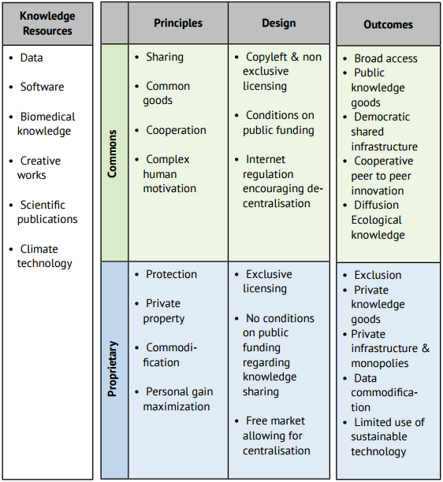
Knowledge resources: Commons vs. Proprietary
E.g. Human Genome Project and Bermuda Principles
E.g. Biological patents
Source: The EU and the Commons: a Commons approach to European Knowledge policy

Slide 7
Example: Commons dimensions for an Online Creation Community
Collective mission or goal of the process
Cultural principles and social norms
Design of the platform of participation
Conditions for self-management of contributions
Formal rules or policies for community interaction
License
Decision-making and conflict resolution systems
Infrastructure provision
Source: “Governing Knowledge Commons” book (2014), p.288

Slide 8
Internet Governance

Slide 9
Internet Governance: Definition
The development and application by
Governments
The private sector
Civil society
In their respective roles, of:
Shared principles
Norms
Rules
Decision-making procedures
Programmes
That shape the evolution and use of the Internet

Slide 10
Internet Governance: A Multi-Stakeholder System
Governments
Business sector
Domain-name companies, Internet Service Providers, telecommunication companies, software companies, Internet content companies
Civil society
WGIG (Working Groups on Internet Governance)
International organisations:
ITU (International Telecommunication Union), WSIS (World Summit on Information Society), UNESCO (UN Educational, Scientific and Cultural Organization), UNDP (United Nations Development Programme)
The Internet community
Institutions and individuals who have developed and promoted the Internet since its inception
ICANN
Internet Corporation for Assigned Names and Numbers

Slide 11
Internet Governance: Layers
The "physical infrastructure" layer
Where the information travels
The "code" or "logical" layer
Controlling the infrastructure
The "content" layer
The information that signals through the network

Slide 12
Internet Governance: Mix of Commons and Market
Clear separation between the parts of the system subject to:
private initiative and control
commercial or not-for-profit
global coordination and nonexclusive access
Internet combines
exclusive, private network facilities and services
open, non-proprietary standards
(Some) winning principles:
End-to-end design argument
Net neutrality

Slide 13
Public-Private Partnerships (PPP)

Slide 14
Public-Private Partnerships
Public procurement arrangement between
public sector
world of business
where risks, rewards and responsibilities are shared
Often used for infrastructure projects where responsibilities are assigned for
design, funding, construction, management, maintenance or operation
of the infrastructure assets

Slide 15
PPPs in Horizon 2020
Difference between IPPP and CPPP

Slide 16
Why Public-Private Partnerships in Horizon 2020?
To solve problems together with industry
To strengthen European industrial leadership
To facilitate prioritisation of R&I in line with the Europe 2020 objectives and industry needs
To leverage research and innovation elements
To strongly commit industry to joint objectives

Slide 17
An example of cPPP on Big Data
European Commission
Contractual
Arrangement
Association proposes research objectives
Grant Agreement
per project
EU and Industry agree on a cPPP to conduct strategic Big Data Value research and to run innovation projects
Requires setting up of a Big Data Value association
Involvement of a broad stakeholders community
Stakeholder Community
NESSI
Big Data Value Association
Industry driven, Defines Research and Innovation Agenda, Specifies Key Performance Indicators
Big Data Projects
within Horizon 2020
Projects running within 2017 – 2021
Expected Total Funding ~ 500 MEUR
Stakeholders
Industry Large
Industry SME
Research
User
…

Slide 18
Questions for the panel
What needs to be governed in Open Science Cloud?
Who has to take care of the Open Science Cloud, who should feel responsible? Who are the actors?
How do you foresee options for structuring the governance of the open science cloud? What we can learn from other federated infrastructures such as the Internet?
How, in what form, can we ensure the involvement and participation of the researchers and any other stakeholders to steer the evolution of the Open Science Cloud?
Possible business models of the Open Science Cloud for sustainability?

