Slide 1
Next generation Science Gateways in the context of the INDIGO project: a pilot case on large scale climate-change data analytics
Roberto Barbera, Riccardo Bruno, Marco Fargetta, Emidio Giorgio, Davide Salomoni (INFN)
Sandro Fiore (CMCC), Cosimo Palazzo (CMCC), Giovanni Aloisio (CMCC)
Marcin Plociennik (PNSC)

Slide 2
Overview
The INDIGO-DataCloud project
INDIGO Work packages
Climate Data Analysis
Ophidia
Catania Science Gateway Framework and FutureGateway
Demo
Future steps
Q&A
References

Slide 3
The INDIGO Project
INDIGO is a H2020 project aiming at developing a data/compute platform targeting scientific communities
Focus on cloud computing uptake, lacking in several scientific areas, especially at PaaS and SaaS level
INDIGO will also develop a flexible and modular presentation layer connected to the underlying IaaS and PaaS frameworks
innovative user experiences including web/desktop applications and mobile appliances

Slide 4
INDIGO Work Packages
User communities (WP2) provide input to technical work packages
WP6 responsible for the development of high-level UIs

Slide 5
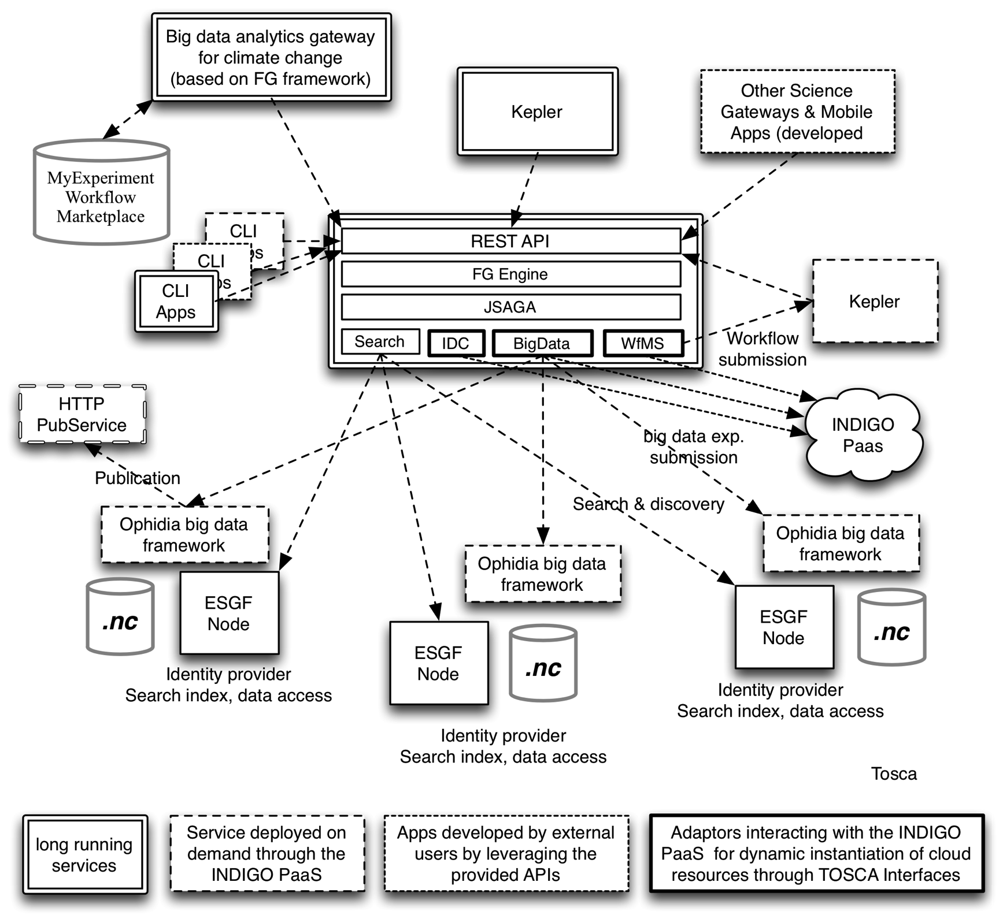
WP6 Architecture, from a user perspective
The Future Gateway Framework (FG) will provide the proper entry point for scientists
Workflow solutions (e.g. Kepler) will be adopted to run distributed workflows across multiple sites
Workflows will be published on community-based platforms (myExperiment) to address workflows sharing and re-use;
Ophidia will be exploited as big data analytics framework;
The Fabric layer will be represented by test sites with ESGF nodes (e.g. CMCC);
Real dataset from the CMIP5 experiment will be used for implementation, test and validation.
Interoperability with the ESGF ecosystem will be properly addressed

Slide 6
Climate Data Analysis
Case study on Climate model intercomparison data analysis
Directly related to the CMIP* experiments
CMIP studies output from coupled ocean-atmosphere general circulation models
Main Use cases
Anomalies analysis, Trend analysis, Climate change signal analysis
Ophidia is a big data analytics framework for eScience
Primarily used for the analysis of climate data, exploitable in multiple domains
“Datacube” abstraction and OLAP-based approach for big data
Support for array-based data analysis and scientific data formats
Parallel computing techniques and smart data distribution methods
~100 array-based primitives and ~50 datacube operators
i.e.: data sub-setting, data aggregation, array-based transformations, datacube roll-up/drill-down, data cube import, etc.

Slide 7
From Catania SGF to FutureGateway
The Catania Science Gateway Framework (CSGF) is a technology, based on Liferay, allowing to create a platform to access distributed computing and data infrastructures through web browsers and mobile devices
Main components : AAI module, Grid & Cloud Engine, pluggable portable and modules
FutureGateway will be an evolution of CSGF taking into account (also) INDIGO requirements such as the implementation of RESTful APIs for the Engine
Interoperability : exposing the FutureGateway Engine API through this REST platform to eliminate Java constraints for the application, facilitating integration of both web portals and applications developed with other technologies
Lightweightness : less client/server interactions and bandwidth through JSON usage
Security : combination of state of the art security in HTTP/S protocols and support of AAI mechanisms defined by INDIGO

Slide 8
From CSGF to FutureGateway
Classic CSGF (before INDIGO)
FutureGateway Approach (INDIGO)
Current (intermediate) approach
Web/Mobile
Apps
Liferay/Tomcat
Web/Mobile
Apps
Liferay/Glassfish
Liferay/Tomcat
Portlet
Portlet
…
Portlet
Portlet
…
Portlet
Portlet
…
REST APIs
REST APIs
GridEngine
API Server
API Server
Engine
GridEngine
JSAGA
JSAGA
JSAGA
Comunication Portlet-GridEngine-JSAGA
only possible with JAVA libraries
Comunication Portlet-API Server via REST APIs, this allows to serve external applications
The API Server interacts via JAVA libraries to JSAGA
Same model of the previous schema
The API Server Engine instructs the existing Grid Engine cutting development efforts in re-writing ad hoc JSAGA handlers

Slide 9
The demo
The goal of this demo is to show the interoperability between already existing scientific software and INDIGO stack, starting from the IaaS/Paas level up to the high-level interface (toolkit, libraries, science gateways, etc.)
In the current configuration, users provide input to Ophidia executions via FutureGateway
FG submits the user created instance to an Ophidia cluster, and makes the output available when ready
There are some limitations, though…
Restricted set of instances
Instances configured statically
INDIGO PaaS orchestration services are not yet used
Restricted set of models and related parameters (see the demo)

Slide 10
DEMO
The actual demo…

Slide 11
Future steps
Both FutureGateway and Climate Data Analysis use case will evolve :
Rather than running a command to the Ophidia cluster, the application will instantiate dynamically a cluster on a private cloud by exploiting the Indigo PaaS
FutureGateway will exploit a richer set of features for VM management
INDIGO PaaS Orchestrator
New data analytics workflow interfaces will enable more complex experiments
From single-experiment, single-model to multi-model ensemble experiments
Two-level workflows will be implemented to enable geographically distributed experiments on climate data

Slide 12
Questions ?
Thanks for your attention !
References
INDIGO web site
http://www.indigo-datacloud.eu
INDIGO SG Portal (based on FutureGateway)
https://sgw.indigo-datacloud.eu
Ophidia home page
http://ophidia.cmcc.it

