Slide 1
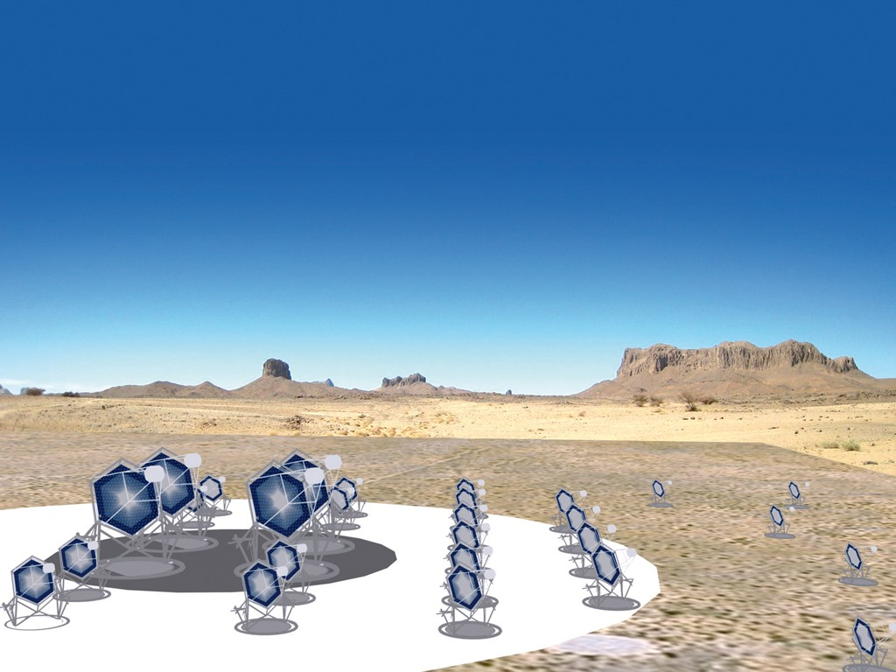
Cherenkov Telescope Array:
a production system prototype
L. Arrabito¹
C. Barbier², J. Bregeon¹, A. Haupt³, N. Neyroud²
for the CTA Consortium
¹LUPM CNRS-IN2P3 France
²LAPP CNRS-IN2P3 France
³DESY
EGI Community Forum, 10-13 November 2015, Bari

Slide 2

Outlook:
CTA in a nutshell
CTA computing model:
  Data volume
  Data flow
  Data processing
CTA production system prototype:
  Current MC simulations and Analysis
  DIRAC for CTA
  Resource usage: 2013-2015
Future developments
Conclusions

Slide 3
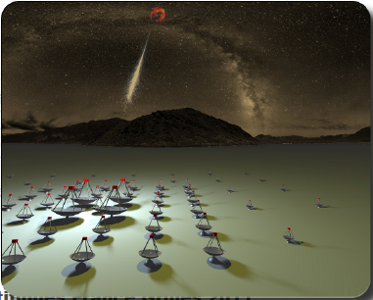
CTA in a nutshell
CTA (Cherenkov Telescope Array) is the next generation instrument in VHE gamma-ray astronomy
2 arrays of 50-100 Cherenkov telescopes (North and South hemispheres)
10x sensitivity with respect to current experiments
Consortium of ~1200 scientists in 32 countries
Operate as an observatory
Site locations decided for further negotiations this year:
  North site: La Palma, Spain
  South site: Paranal ESO, Chile
Currently in ‘Pre-construction’ phase (2015-2022)
Operations will last ~30 years
Scientific goals:
Cosmic rays origins
High Energy astrophysical phenomena
Fundamental physics and cosmology

Slide 4
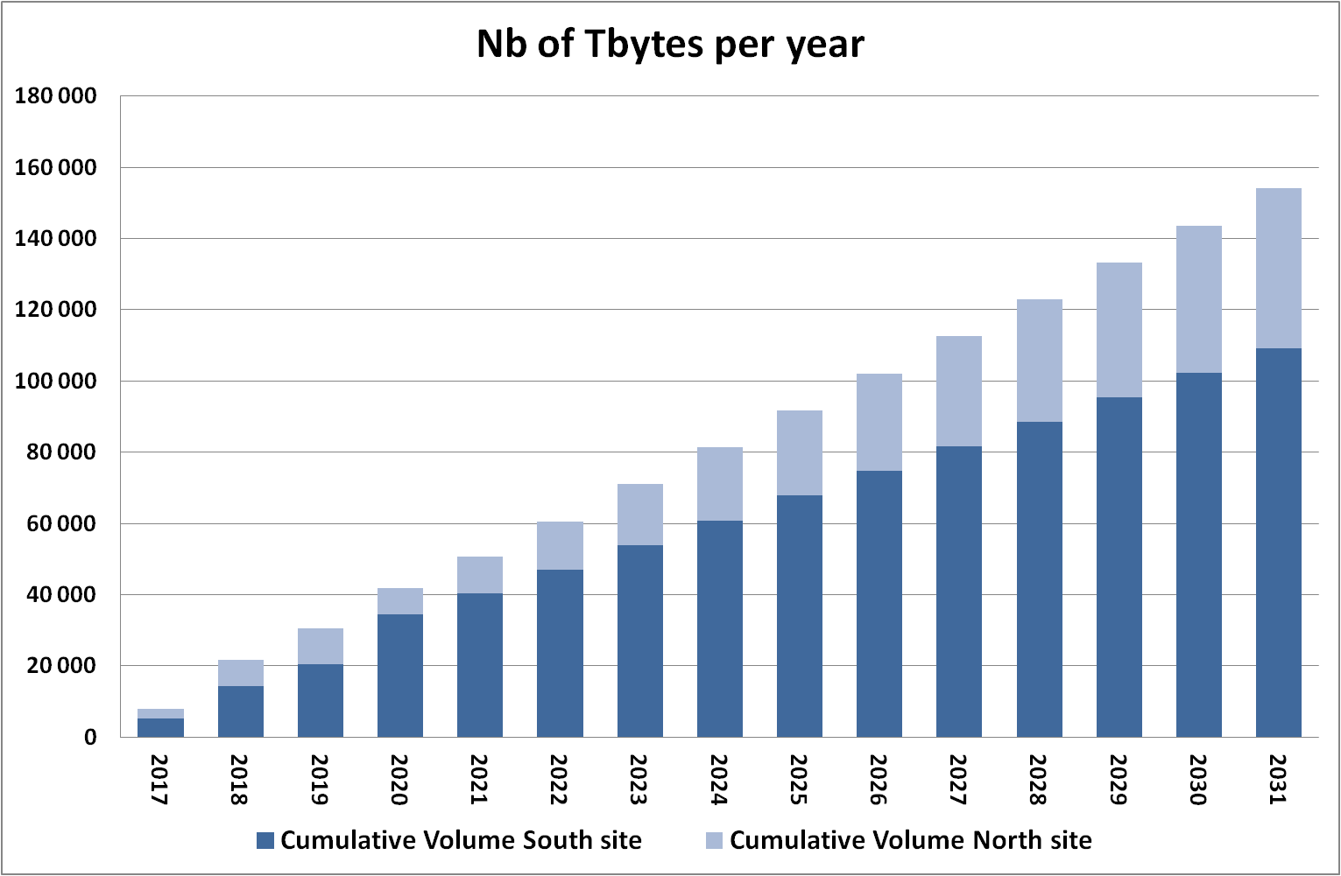
CTA Computing: data volume
Raw-data rate
CTA South: 5.4 GB/s
CTA North: 3.2 GB/s
1314 hours of observation per year
Raw-data volume
~40 PB/year
~4 PB/year after reduction
Total volume
~27 PB/year including calibrations, reduced data and all copies

Slide 5
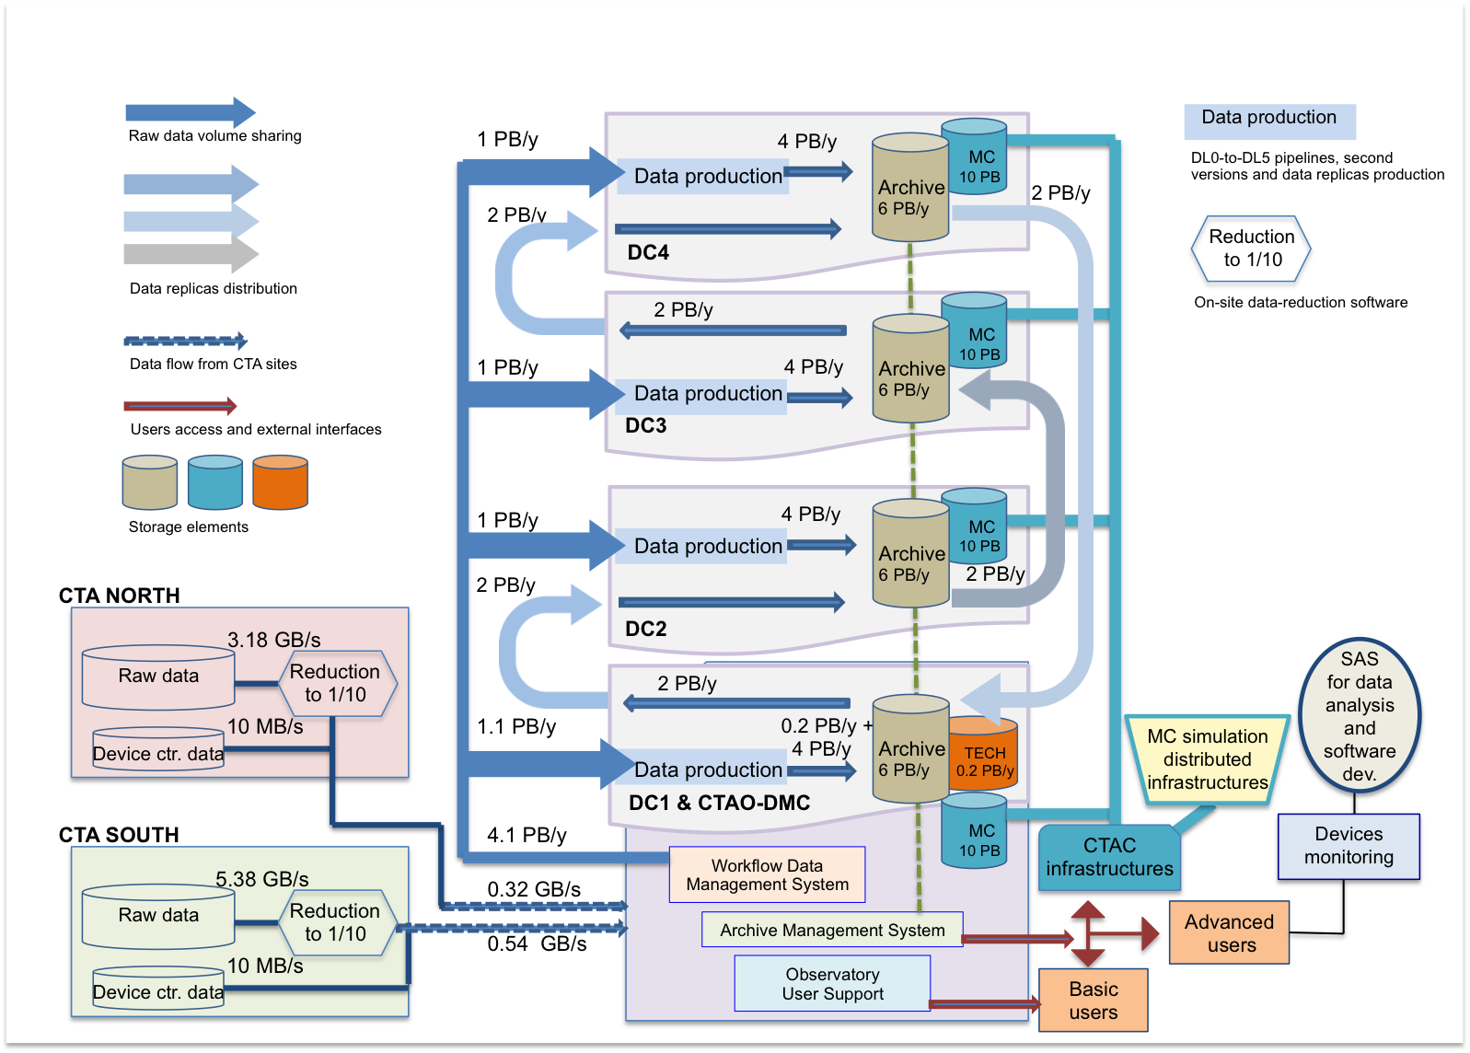
CTA Computing: data flow

Slide 6
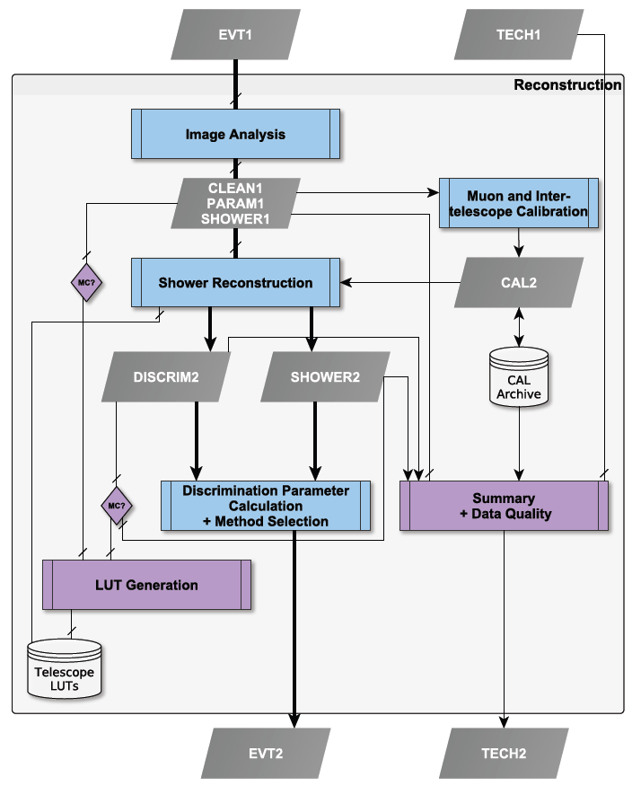
CTA Computing: data processing
Reconstruction Pipeline
shower reconstruction step
From raw-data to high level science data:
Several complex pipelines (Calibration, Reconstruction, Analysis, MC, etc.)
Assume 1 full re-processing per year

Slide 7
MC simulations and Analysis
CTA is now in ‘Pre-construction’ phase
  Massive MC simulations and Analysis running for 3 years
  ‘Prod2’ (2013-2014)
    Characterize all site candidates to host CTA telescopes to determine the one giving the best instrument response functions
    4.6 billion events generated for each site candidate, 2 different zenith angles and 3 telescope configurations
    8 full MC campaigns (5 sites for the South and 3 for the North)
  ‘Prod3’ (2015) in progress:
    For the 2 selected sites: study the different possible layouts of telescope arrays, pointing configurations, hardware configurations, etc.
    800 telescope positions, 7 telescope types, multiple possible layouts, 5 different scaling
    Run 3 different Analysis chains on the simulated data
      Each one processing about 500 TB and 1 M of files
      for 36 different configurations
Computing is already a challenge!

Slide 8


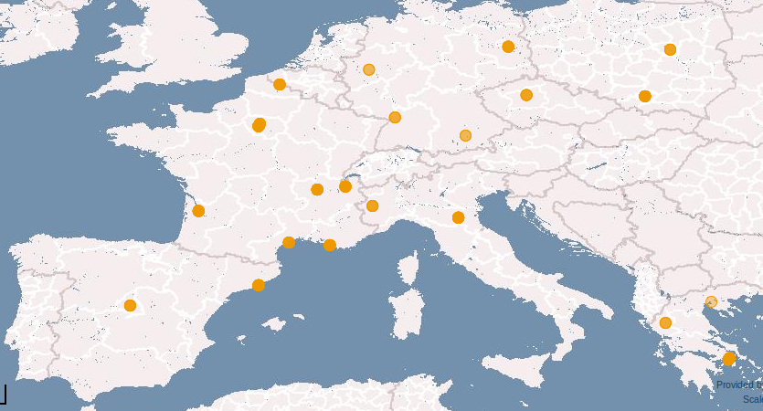
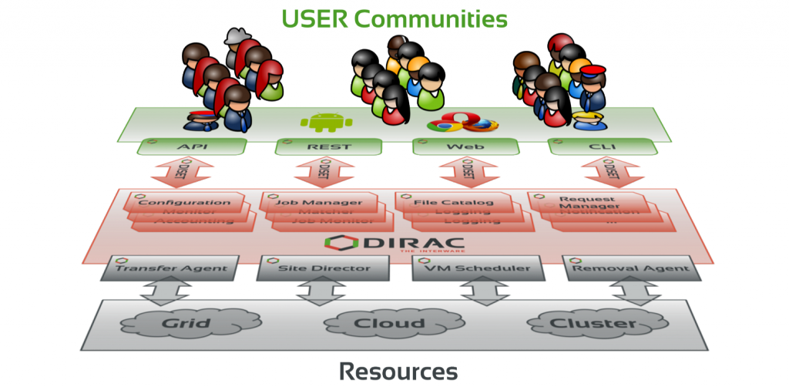
MC simulations and Analysis
  Use of an existing and reliable e-Infrastructure: EGI grid
  Use of DIRAC for Workload and Data Management
CTA Virtual Organization:
Active since 2008
19 EGI sites in 7 countries and 1 ARC site
About 100 members
Resources:
Dedicated storage:
  Disk: 1.3 PB in 6 sites:
  CC-IN2P3, CNAF, CYFRONET, DESY, GRIF, LAPP
  Tape: 400 TB in 3 sites
CPU: 8000 cores available on average
DIRAC for CTA:
Dedicated DIRAC instance composed of
4 main servers at CC-IN2P3 and PIC
Several DIRAC Systems in use
CTA-DIRAC software extension

Slide 9
MC simulations and Analysis
Computing Model:
Use of CTA-DIRAC instance to access grid resources
MC simulation uses CPU resources of all 20 grid sites supporting the CTA VO
Output Data are stored at 6 main SE
MC Analysis takes place at the 6 sites where MC data are stored
Computing Operations (small team of people):
Receive production requests from MC WP (nb of events to be generated, sw to install, etc.)
Adjust the requests according to the available resources
Negotiate resources with grid sites on a yearly basis
Run the productions and perform data management operations (removal of obsolete datasets, data migration, etc.)
Support users to run their private MC productions and analysis
DIRAC servers administration
Development of CTA-DIRAC extension

Slide 10
DIRAC for CTA: main Systems in use
Workload Management System
  Job brokering and submission (pilot mechanism)
  Integration of hetereogenous resources (CREAM, ARC)
  Central management of CTA VO policies
Data Management System
    All data operations (download, upload, replication, removal)
    Use of the DIRAC File Catalog (DFC) as Replica and Metadata catalog
Transformation System
    Used by production team to handle ‘repetitive’ work (many identical tasks with a varying parameter), i.e. MC productions, MC Analysis, data management operations (bulk removal, replication, etc.)

Slide 11
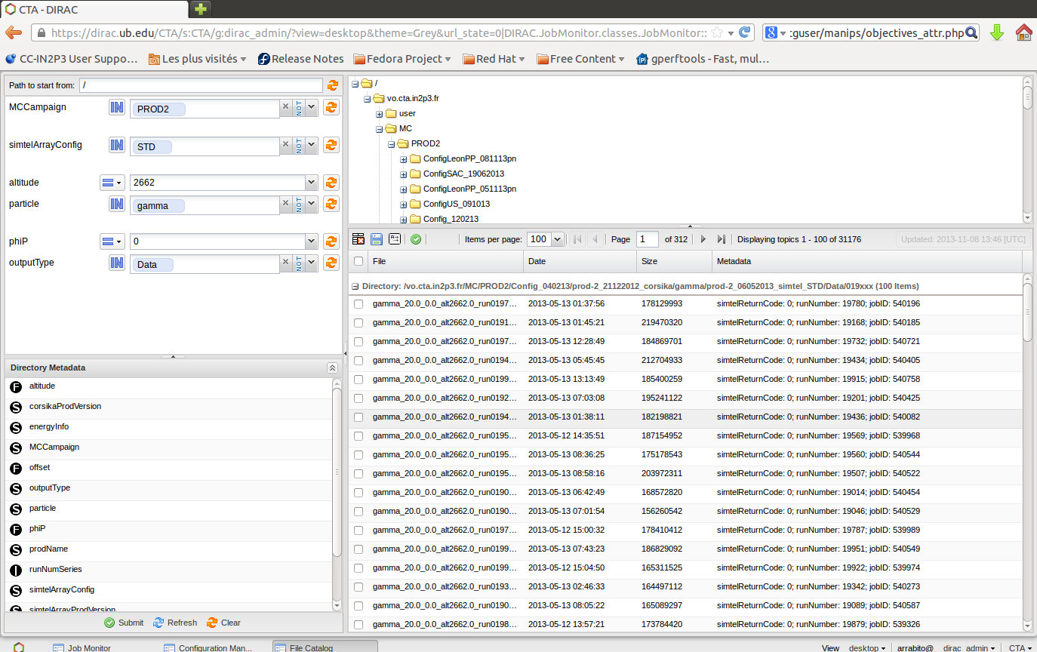
DIRAC for CTA: DIRAC File Catalog
In use since 2012 in parallel with LFC. Full migration to DFC in summer 2015
More than 21 M of replicas registered
About 10 meta-data defined to characterize MC datasets
DFC web interface
Query example:
Catalog browsing
cta-prod3-query --site=Paranal --particle=gamma --tel_sim_prog=simtel
--array_layout=hex --phiP=180
--thetaP=20 --outputType=Data
Typical queries return several
hundreds of thousands of files
Metadata selection
Query result

Slide 12

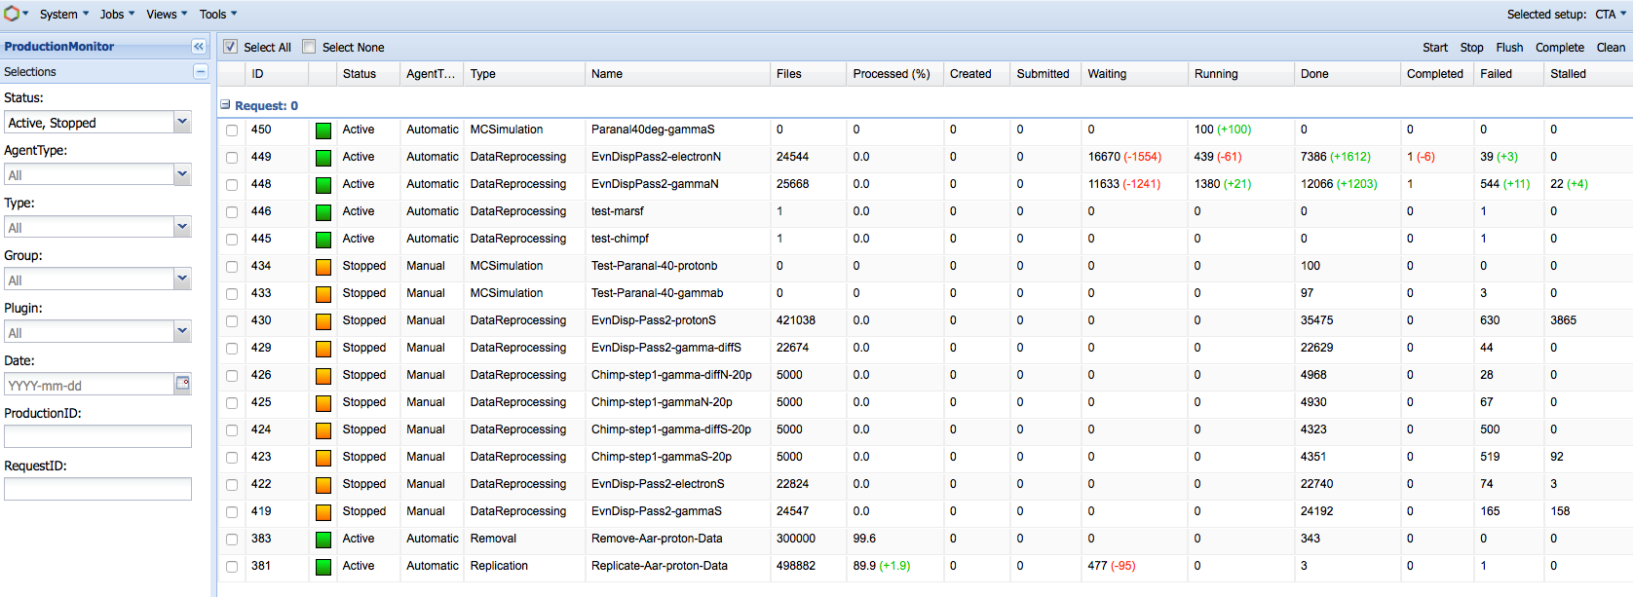
DIRAC for CTA: Transformation System
DFC
Transformation System Architecture
The Production Manager defines the transformations with meta-data conditions and ‘plugins’
InputData Agent queries the DFC to obtain files to be ‘transformed’
Plugins group files into tasks according to desired criteria
Tasks are created and submitted to the Workload or Request Management System
MC jobs
Transformation System
InputData
Agent
Files
Production
Manager
InputDataQuery
Tasks
Transformation
Agent
Request
Task Agent
Workflow
Task Agent
Transformations
Plugins
Database table
Request
Management
System
Workload
Management
System
Agent
Transformation Monitoring

Slide 13
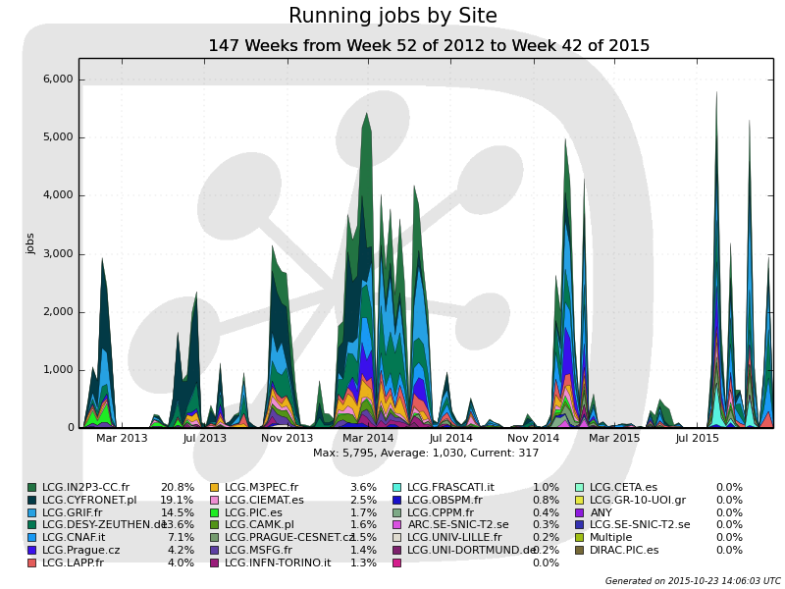
Resource usage: 2013-2015
Use of about 20 grid sites
5000-8000 concurrent jobs for several weeks
Users analysis also running in parallel (private simulations, analysis)
More than 7.7 M jobs executed
Running jobs by site
5000 jobs
Prod2
148.56 M HS06 hours
640 TB
Prod3
28.8 M HS06 hours
785 TB
Start prod2
MC Paranal
SAC
US
Paranal
Start prod3
MC Analysis
El Leoncito
Aar
SPM
Tenerife
Users Analysis

Slide 14
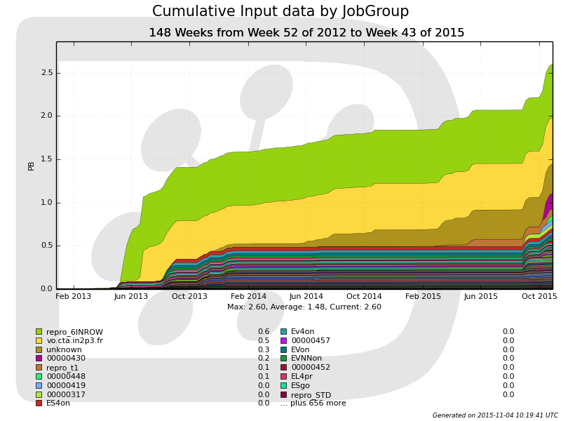
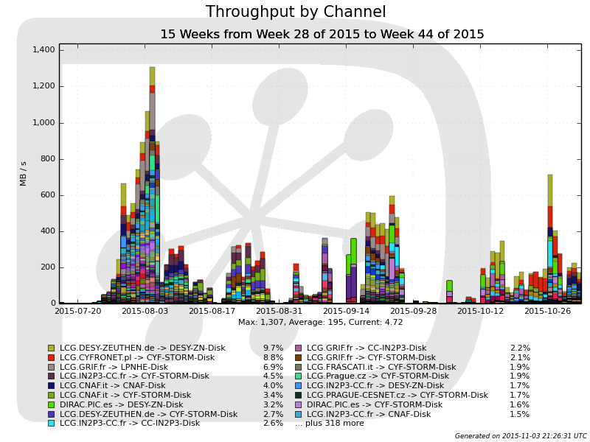
Resource usage: 2013-2015
About 2.6 PB processed (MC Analysis)
Throughput of 400-800 MB/s during ‘prod3’
Processed data
Throughput
2.6 PB
1 GB/s

Slide 15
Future developments
  Until now, we have been using almost all DIRAC functionalities
  For long term operations CTA is developing several systems:
    Archive system to store and manage CTA data
    Pipeline framework to handle all CTA applications
    Data model to define the whole meta-data structure of CTA data
    Science gateway for end-users data access
    DIRAC will be used for the Workload and Production Management
  Future developments:
    Develop interfaces between DIRAC and the other CTA systems
    Improvement of the DIRAC Transformation System toward a fully data-driven system (next slide)
    Improve CTA-DIRAC hardware setup

Slide 16
Toward a fully data-driven Transformation System
Archive Catalog
Pipeline
Files with
meta-data
Filter by meta-
data
Transformation System
InputData
Agent
Database table
Files
Agent
Production
Manager
InputDataQuery
Tasks
Transformation
Agent
Workflow
Task Agent
Workload
Management
System
Transformations
Plugins
Developments in progress:
When new files are registered, a filter based on meta-data is applied to send them on the fly to their matching transformation
  No need anymore to perform heavy queries of the Archive

Slide 17
Improve CTA-DIRAC hardware setup
DIRAC is based on a Service Oriented Architecture
Each DIRAC System is composed of Services, Agents and DBs
CTA-DIRAC instance is a rather modest installation, composed of:
  3 core servers:
    1 server running all Services (except DM) and a few Agents (4 cores)
    1 server running all Agents except TS (2 cores)
    1 server running the DataManagement System and Transformation Agents (16 cores)
  2 MySQL servers:
    1 server hosting all DBs except FileCatalogDB
    1 server hosting the FileCatalogDB
  1 web server
Observed high load on the core servers when running several ‘productions’ in parallel
Need to add more servers, but also optimize the component distribution on the servers

Slide 18
Conclusions
CTA will produce about 27 PB/year and it will operate for ~30 years
A production system prototype based on DIRAC has been developed for MC simulation productions:
  Required minimal development of a CTA-DIRAC extension
  Minimal setup and maintenance of the instance running all the components, mostly the work of 1 person with help of DIRAC team and sys admins upon request
Successfully used during last 3 years for massive MC simulations and analysis:
  > 1.6 PB produced
  ~ 2.6 PB processed
  > 20 M files registered in the Catalog
Future developments:
  Improve production system for real data processing pipeline
    Build interfaces between DIRAC and other CTA systems (Archive, Pipeline, etc.)
    Further develop DIRAC Transformation System toward a fully data-driven system

