Slide 1

ICOS
Integrated Carbon Observation System
  “A pan-European research infrastructure for quantifying and understanding the greenhouse gas balance of the European continent and adjacent regions”
To collect high-quality observational data relevant to the greenhouse gas budget of Europe
To make the ICOS data freely available to all interested parties
To promote the use of the ICOS data for further scientific study
To support modeling activities for “elaborated products”:
  Greenhouse gas flux maps in time & space (inversions)
  Other model output (ecosystem, vegetation,…)

Slide 2
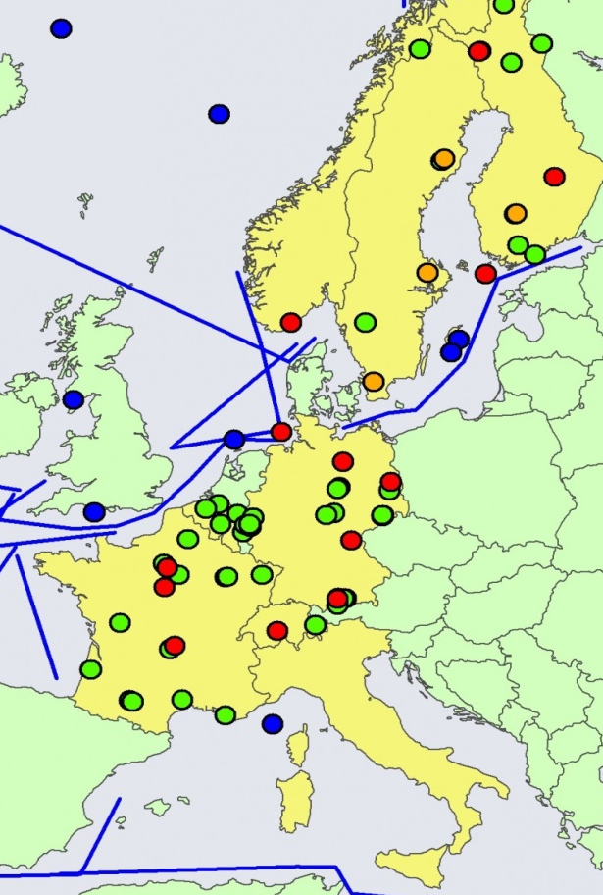
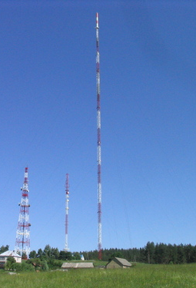
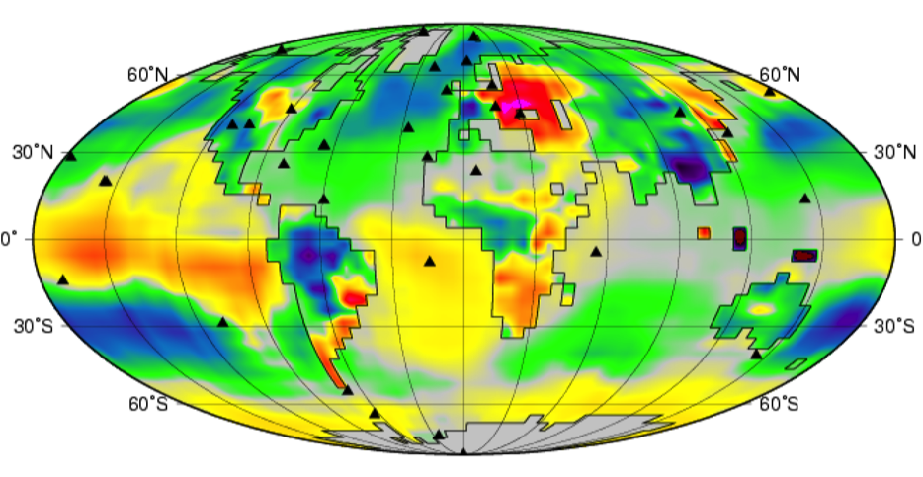
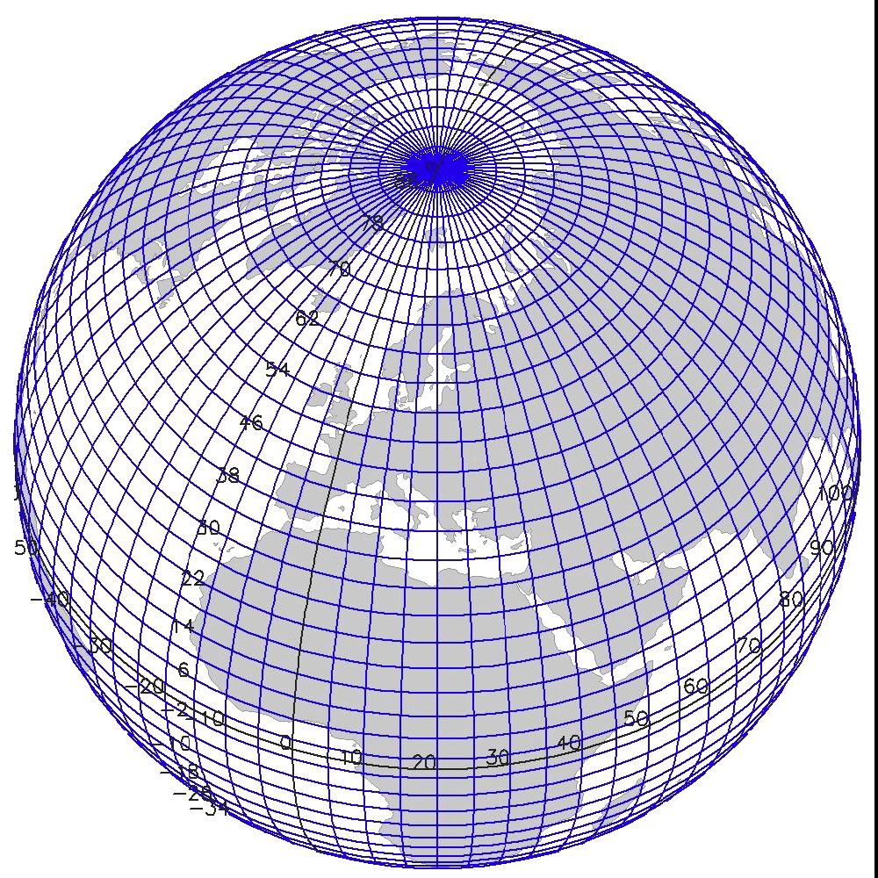
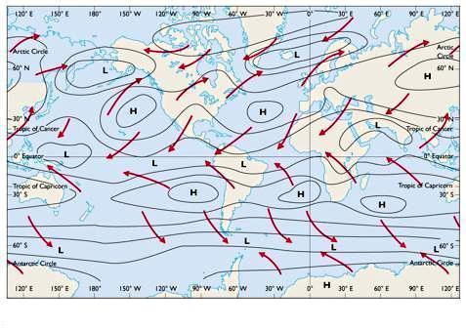
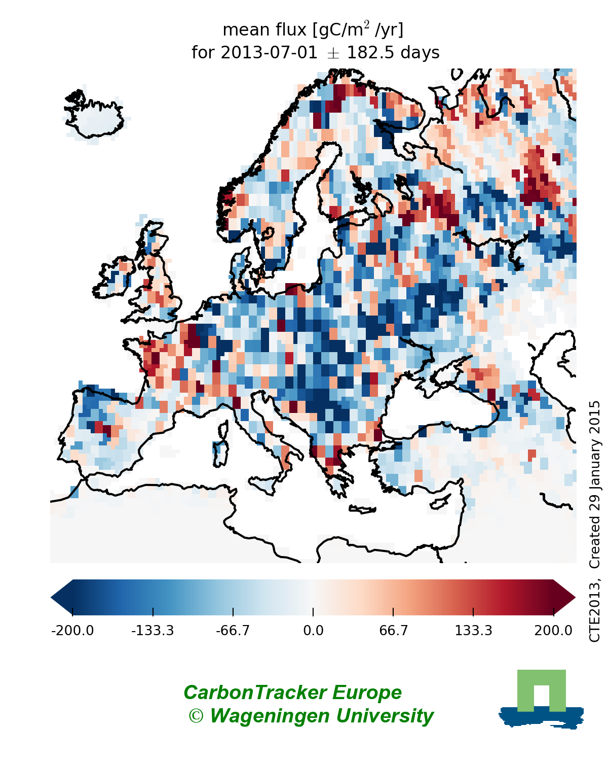

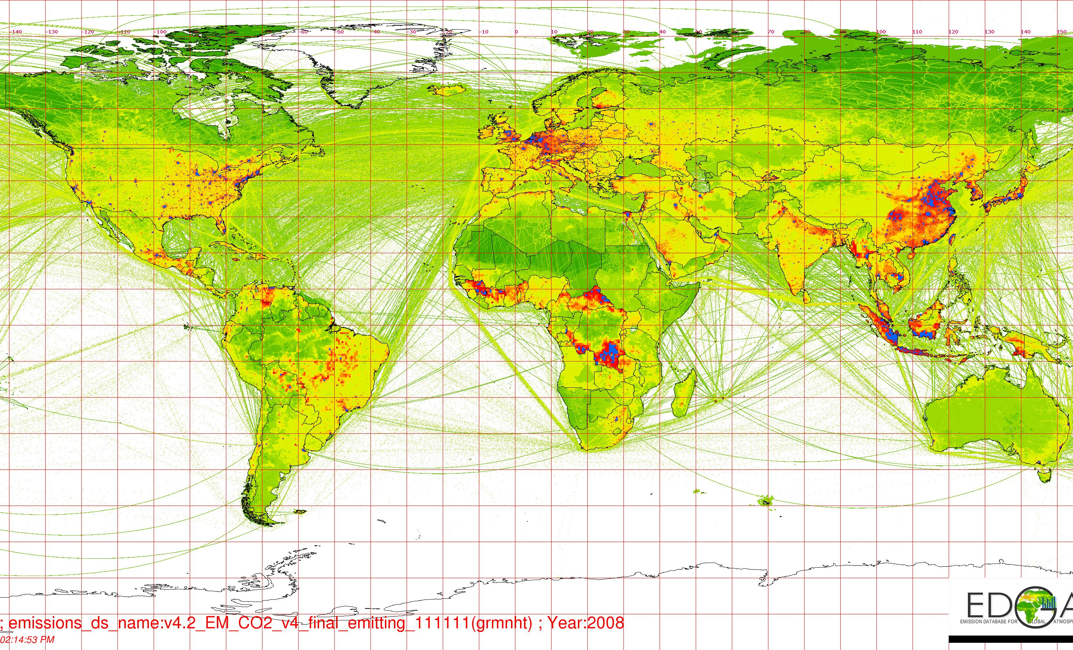

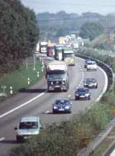
Greenhouse gas flux estimates based on inverse modelling
Atmospheric observations
Optimized flux estimates
Inversion
Meteorological
driver fields
Transport model
+
Optimization
Prior fluxes
+ uncertainty estimates
+ optimized 3-d concentrations

Slide 3
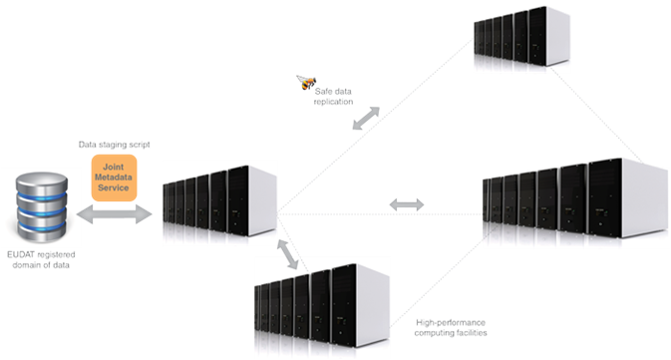
Approx. storage and HPC needs for inverse modeling
Atmospheric observations
Data centers
ICOS
NOAA
≈ 1 GB
Optimized flux estimates
Inversion
≈ 50000 CPUh
≈ 2-3 TB
Prepro
Meteorological
driver fields
≈ 1-2 TB
ECMWF
NCEP
≈ 6 TB
+ uncertainty estimates
+ optimized 3-d concentrations
Prior fluxes
≈ 0.5-1 TB
Estimates for a 10-year-long inversion
based on a current inversion system with
high spatial resolution (1°x1°) for Europe
-> inversions will be repeated 1-2 times per year
Inventories
Model output

Slide 4
EGI - EUDAT cross-infrastucture service Benefits for ICOS
Environment that facilitates the efficient application of an atmospheric inversion system by providing access to high-performance computing and large storage facilities
Safe, long-term storage with fast access for ICOS data and elaborated products (B2-SAFE)
Transfer of large input and output data sets between storage facilities and HPC facilities (B2-STAGE)
Service and tools to allow easy preprocessing of data possibly directly at data storage centers
More information about ICOS: www.icos-ri.eu
and the Carbon Portal: www.icos-cp.eu
Contact: ute.karstens@nateko.lu.se

