Slide 1
Energising Scientific Endeavour through Science Gateways and e-Infrastructures in Africa: the Sci-GaIA project
Roberto Barbera (roberto.barbera@ct.infn.it)
12 November 2015 – EGI Community Forum - Bari

Slide 2
Outline
Introduction
The Sci-GaIA project and its Open Science Commons platform
Summary and conclusions

Slide 3
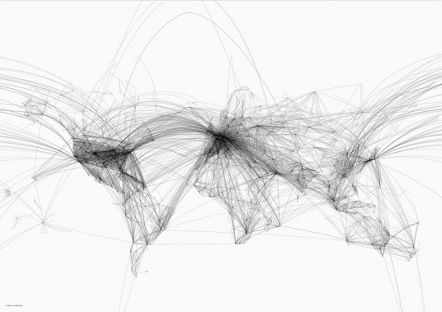
Different kinds of “connections”

Slide 4
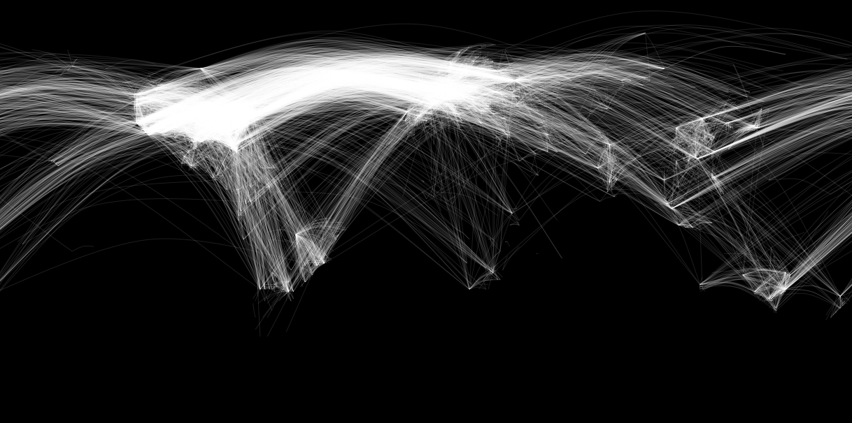
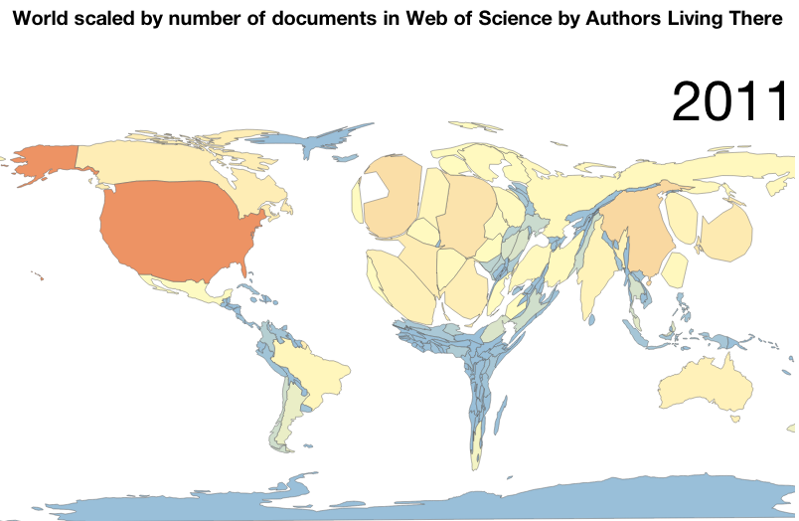
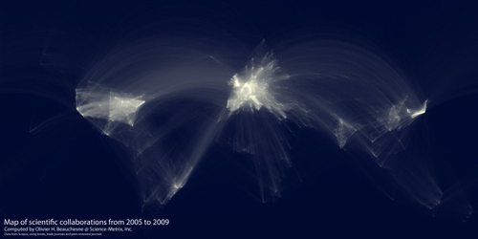
Different kinds of “connections”
Challenge: make African science/scientists more «visible»
Opportunity: exploit e-Infrastructures to do it
Goal: promote the Open Science paradigm in Africa

Slide 5
The Sci-GaIA Project (www.sci-gaia.eu)
Energising Scientific Endeavour through Science Gateways and e-Infrastructures in Africa
Research Infrastructures – Coordination & Support Action
Grant Agreement no. 654237
EC contribution: ~1.4 MEuro
Start date: 1 May 2015
Duration: 24 Months

Slide 6
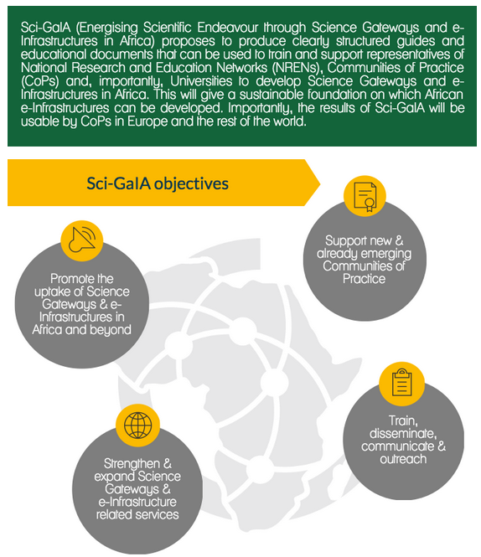
Sci-GaIA is strongly committed to promote Open Science

Slide 7
A virtuous cycle to promote/enable Open Science
Access
Inclusion

Slide 8
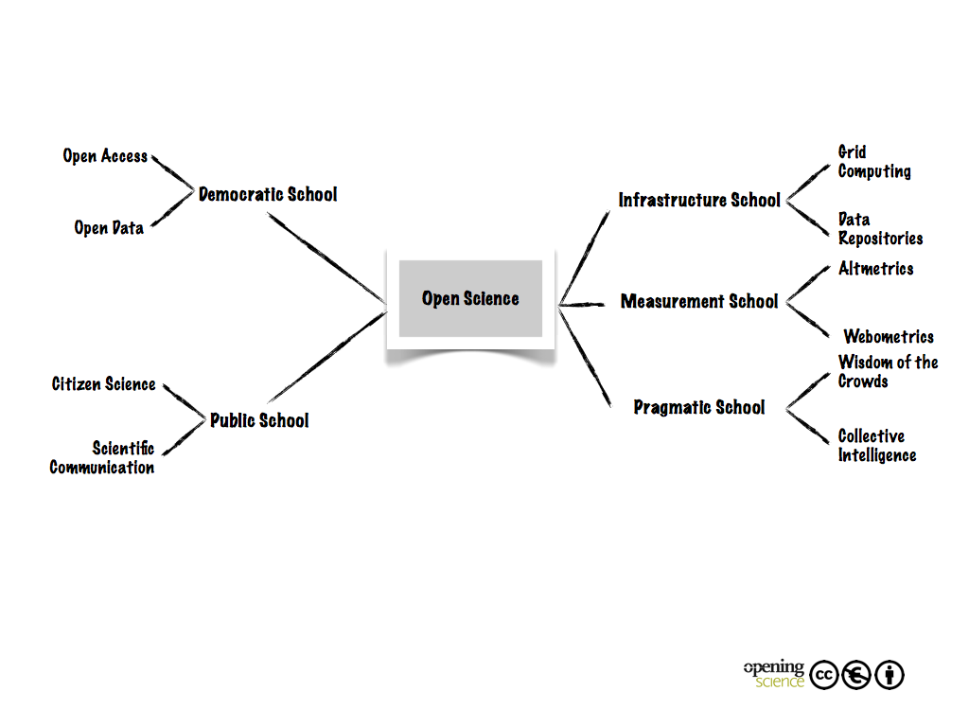
Open Science Schools of Thought mostly followed by Sci-GaIA (http://book.openingscience.org)
/Cloud

Slide 9
Pillars
(www.egi.eu/news-and-media/publications/OpenScienceCommons_v3.pdf)
Data:
“Data is the subject matter for research. It should be dealt with according to the principles of open access and open science, while maintaining trust and privacy for researchers”
e-Infrastructures:
“The technology and technical services supporting researchers, building towards integrated services and interoperable infrastructures across Europe and the world”
Scientific instruments:
“The equipment and collaborations which generate scientific data, from small-scale lab machines to global collaborations around massive facilities”
Knowledge:
“The human networks, understanding and material capturing skills and experience required to carry out open science using the three other pillars”
On top of the above: «Communication» and «Awareness»

Slide 10
The Sci-GaIA Federated Platform for an Open Science Commons in Africa

Slide 11
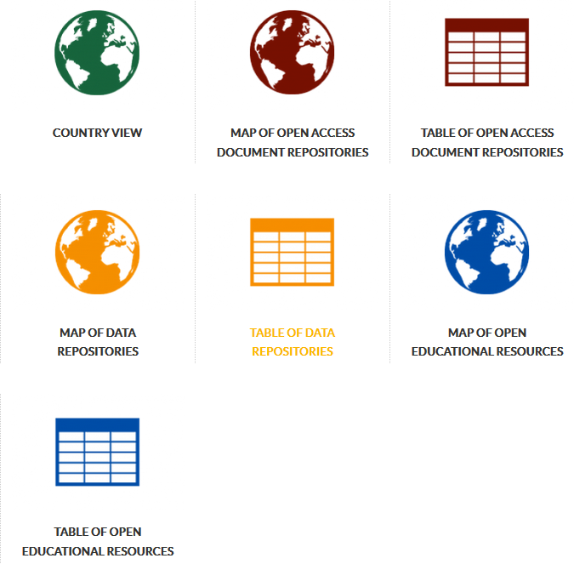
The e-Infrastructure Knowledge Base (http://www.sci-gaia.eu/e-infrastructures/knowledge-base/)
The largest e-Infrastructure
related knowledge base

Slide 12
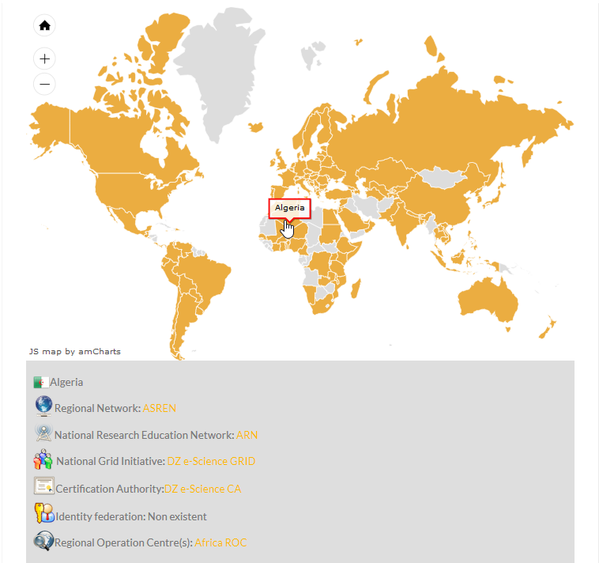
The e-Infrastructure Knowledge Base (Country view)

Slide 13
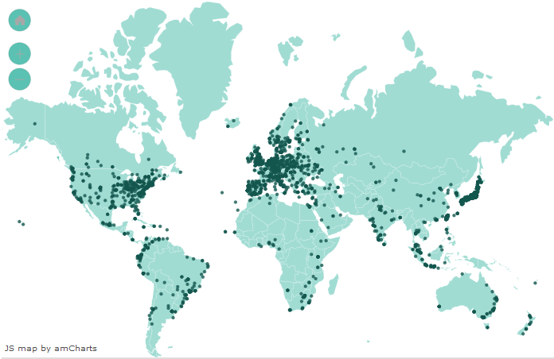
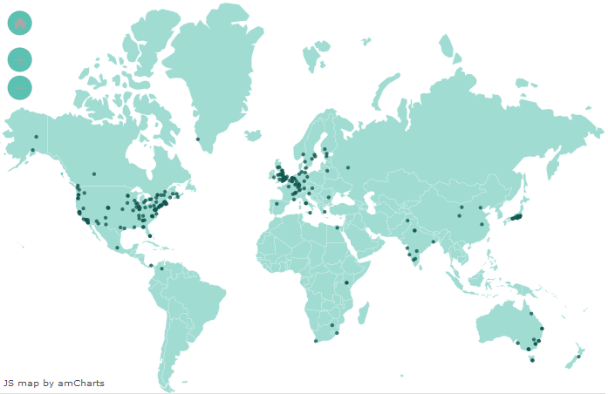
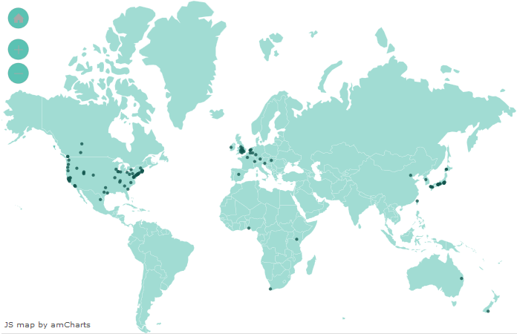
The e-Infrastructure Knowledge Base (Open Access Document Repositories, Data Repositories and Open Education Resources)
> 4,000 repositories
> 30 million resources

Slide 14
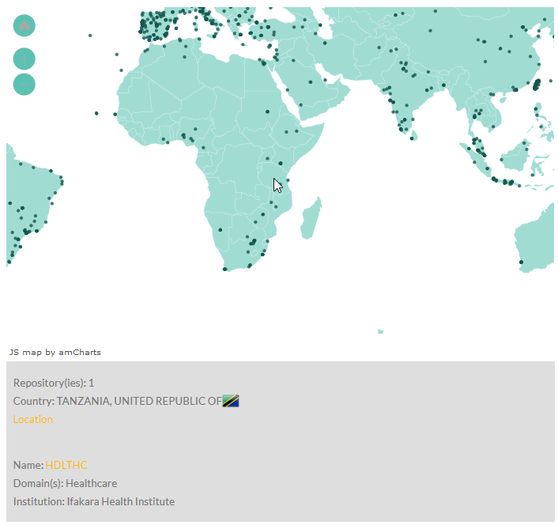
The e-Infrastructure Knowledge Base (Repository’s detailed view)

Slide 15
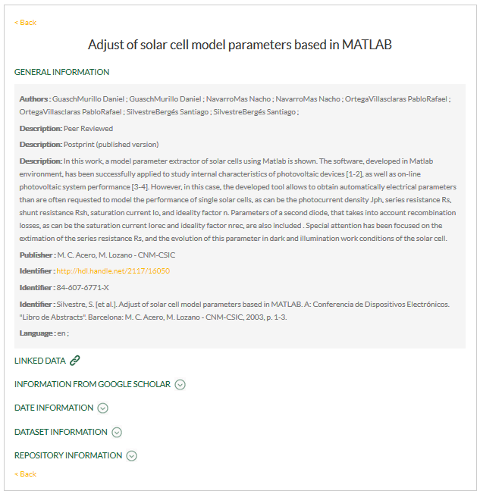
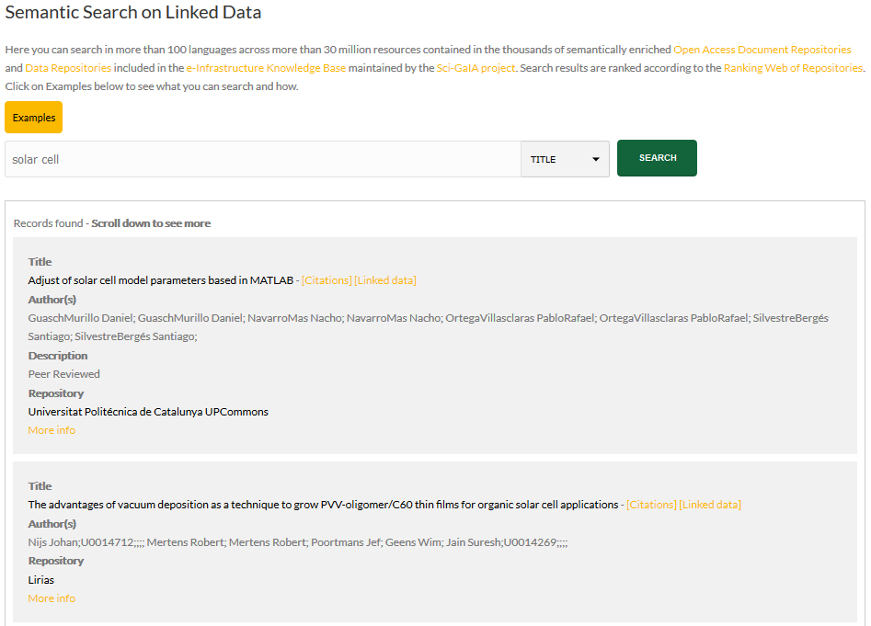
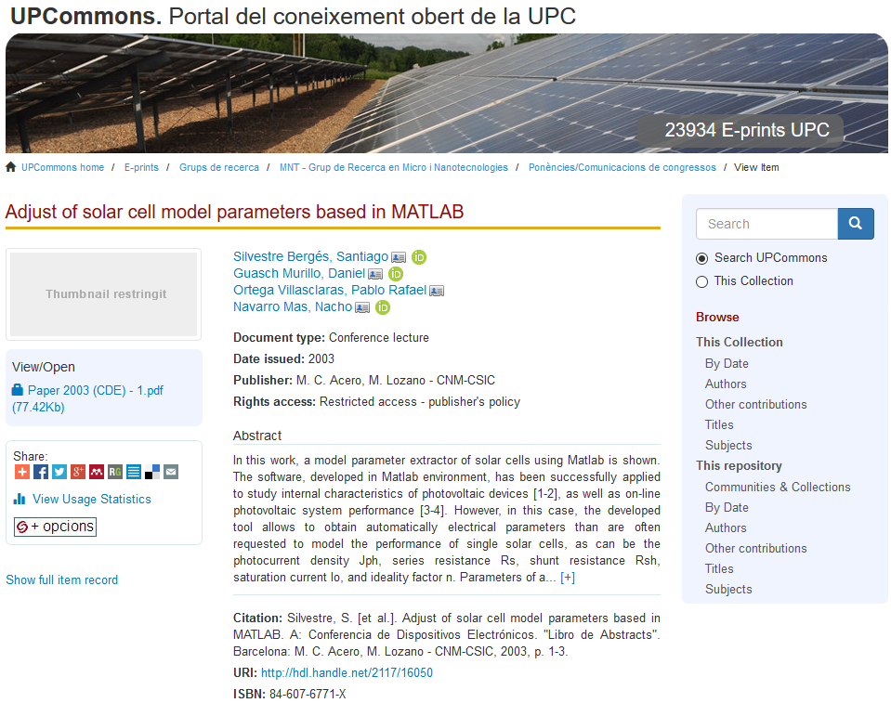
The Semantic Search Engine (www.sci-gaia.eu/semantic-search/)

Slide 16
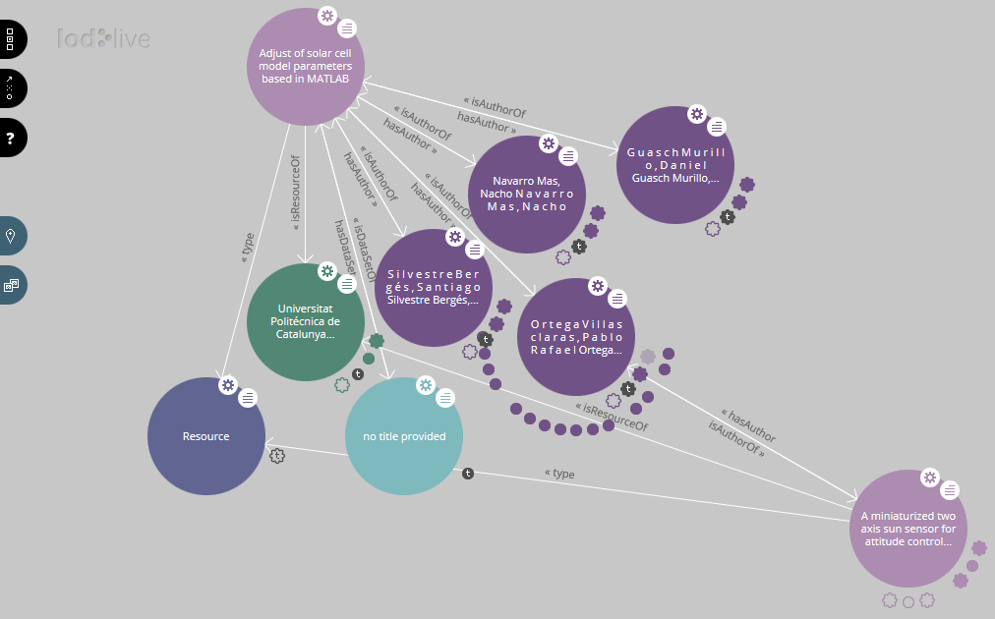
The Semantic Search Engine (Semantic connections – via LodLive)

Slide 17
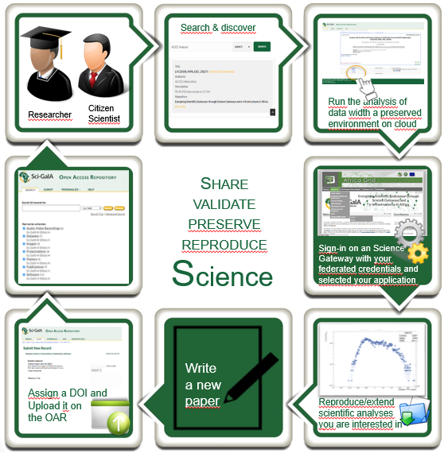
The Open Knowledge workflow – How can we implement it?

Slide 18
The Sci-GaIA requirements for an Open Access Repository
Requirements:
Open source
Standard compliant
Well supported
Scalable up to O(10⁶)-O(10⁷) resources (to begin with)
Choice:
Invenio (www.invenio-software.org) – actual version: 1.2.1 + our «add-ons»
Motivations:
Fully compliant with OAI-PMH and Marc21 standards
Co-developed by an international collaboration comprising institutes such as ​CERN, ​DESY, ​EPFL, ​FNAL, ​SLAC and used by about 30 scientific institutions worldwide
ZENODO (OpenAIRE flagship repository), SCOAP³ and inSPIRE HEP repositories are based on Invenio
The CERN Document Server (http://cds.cern.ch/), based on Invenio, contains more than 1.3 million documents
UNESCO and UEMOA are leading an initiative to create a virtual library based on Invenio in 8 West African countries

Slide 19
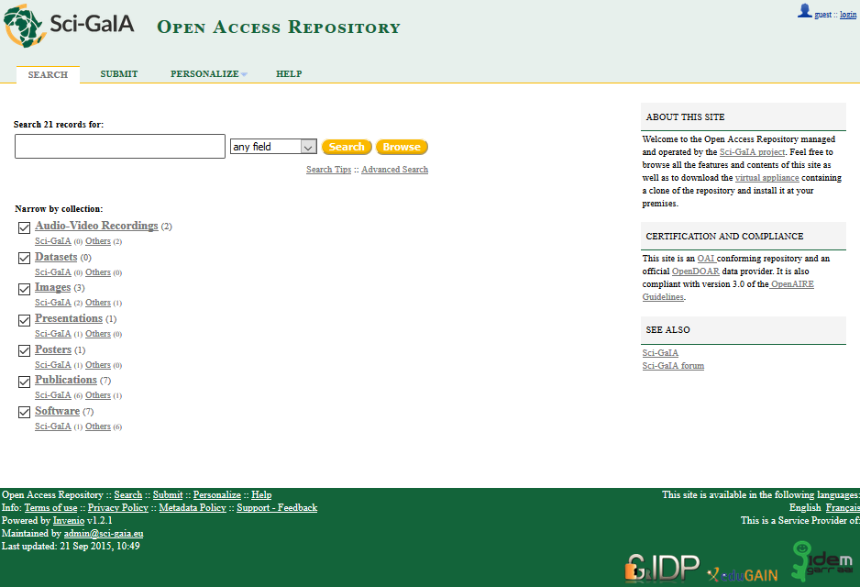
The Sci-GaIA Open Access Repository (http://oar.sci-gaia.eu)
Resources can be:
Manually uploaded
Automatically harvested and ingested from external sources
federated
authentication

Slide 20
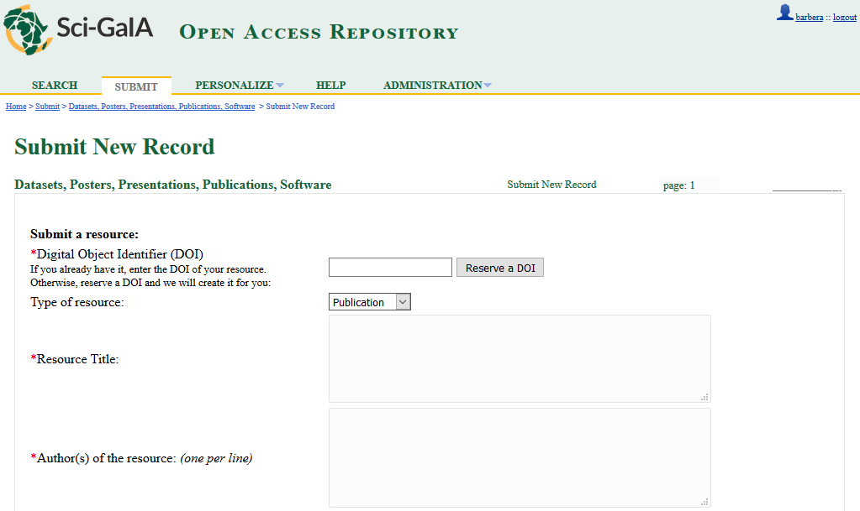
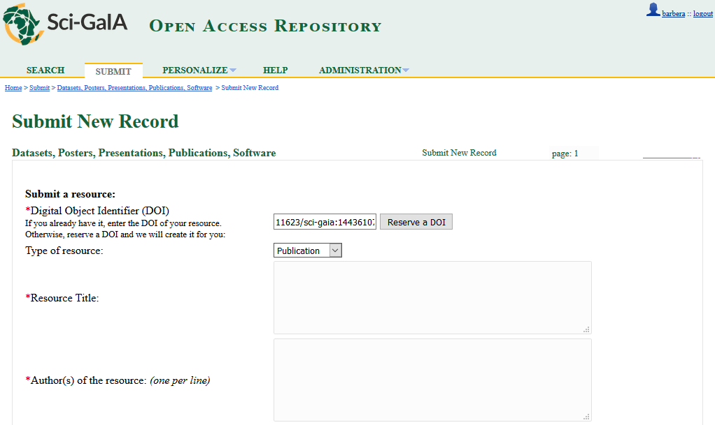
(Single) resource upload and DOI registration
The Sci-GaIA OAR
has already a prefix of:
And we are also discussing with:

Slide 21
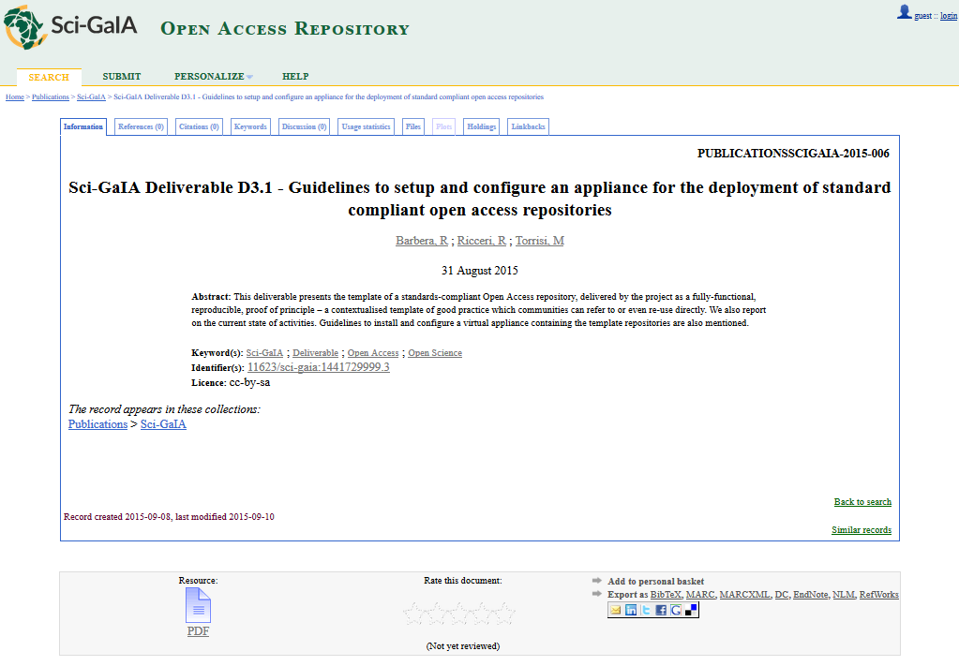
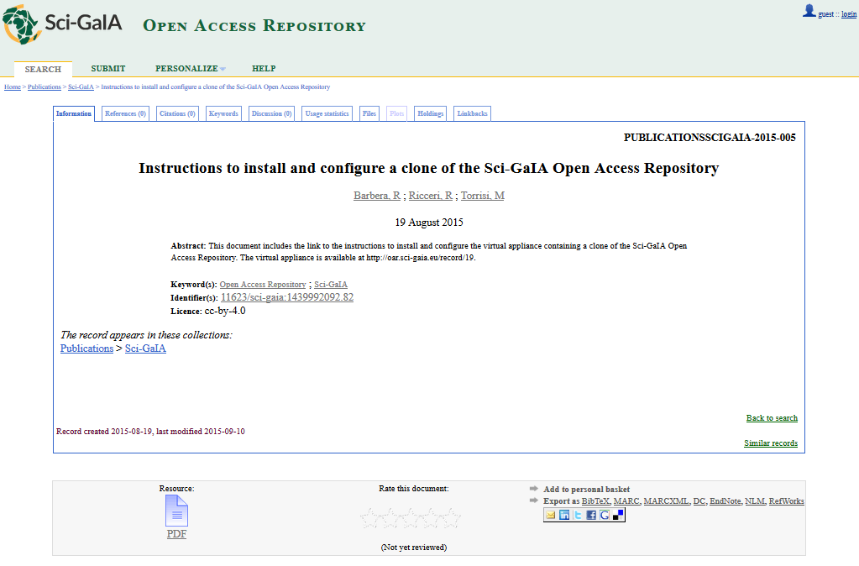
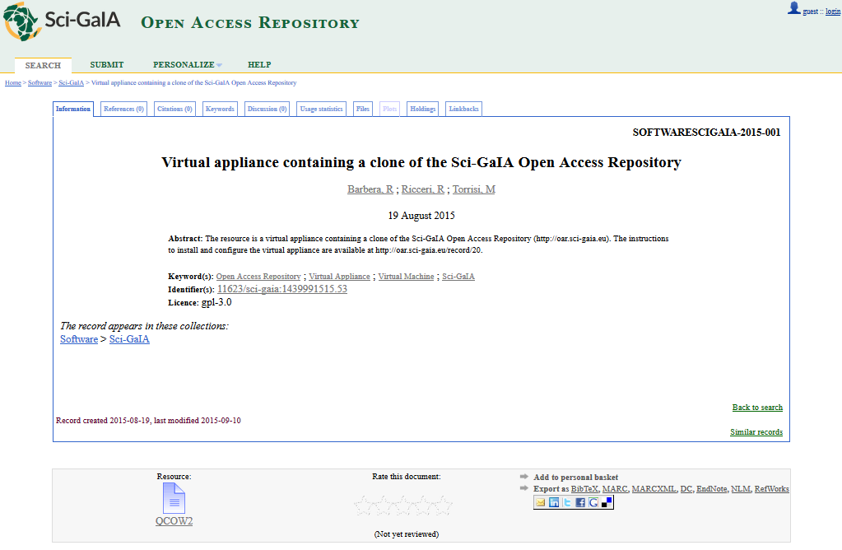
Sci-GaIA OAR can be “cloned” wherever and whenever it is needed

Slide 22
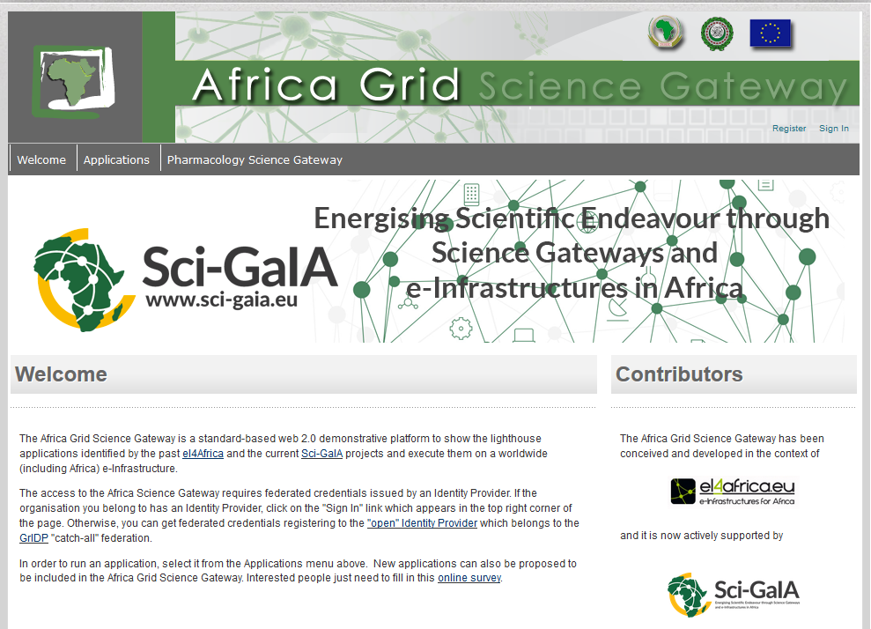
The Africa Grid Science Gateway (http://sgw.africa-grid.org)

Slide 23
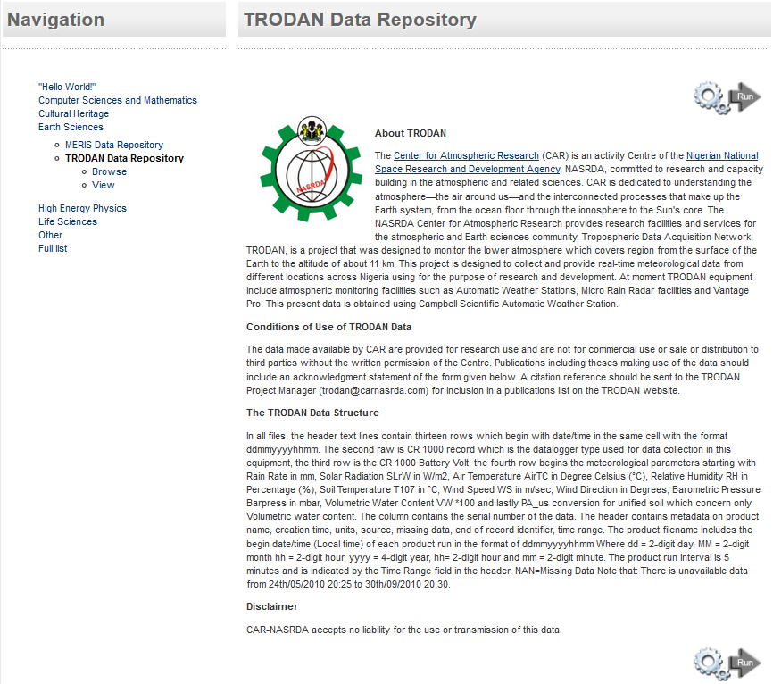
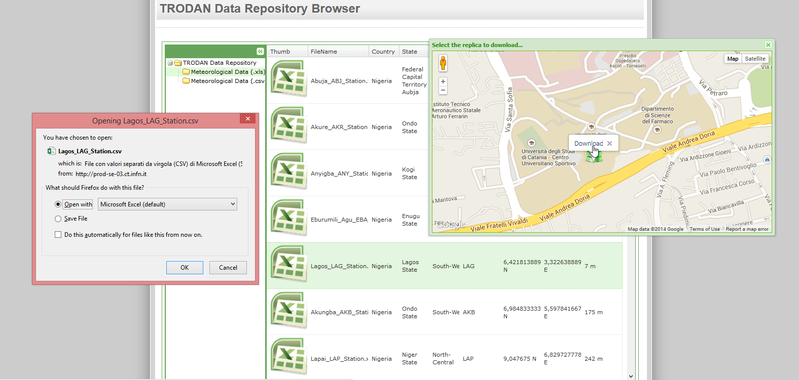
Examples of applications available in the Africa Grid SG: The TRODAN data repository
Browser

Slide 24
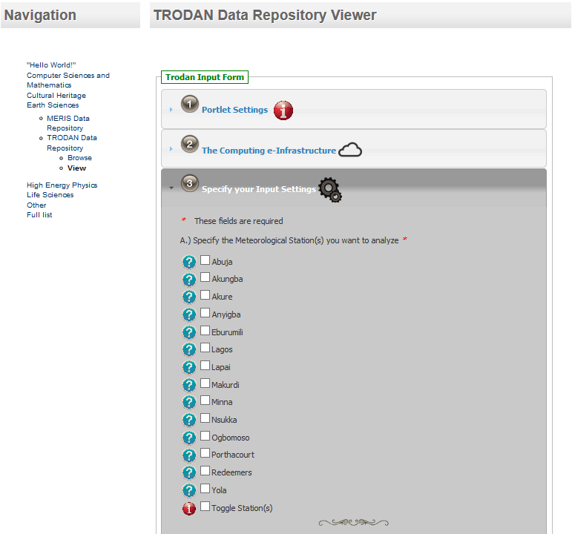
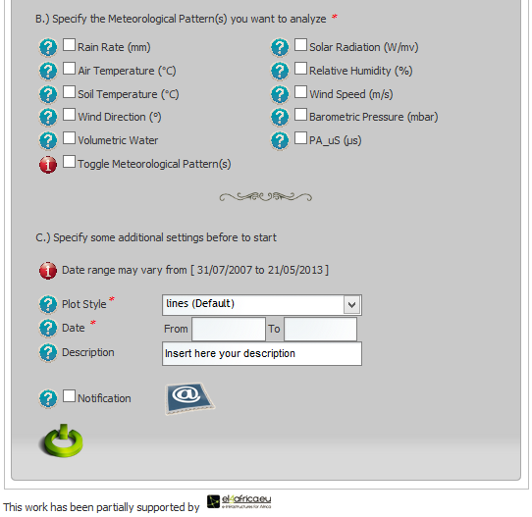
Examples of applications available in the Africa Grid SG: The TRODAN data repository
Viewer

Slide 25
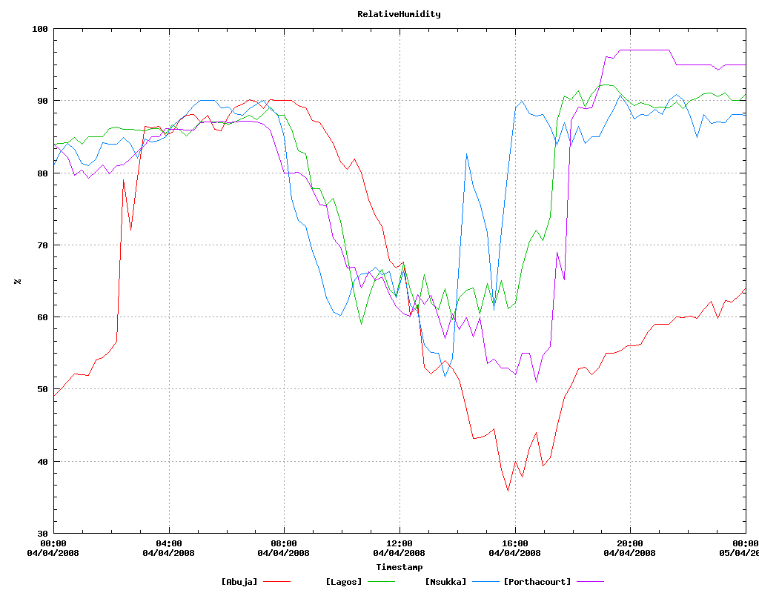
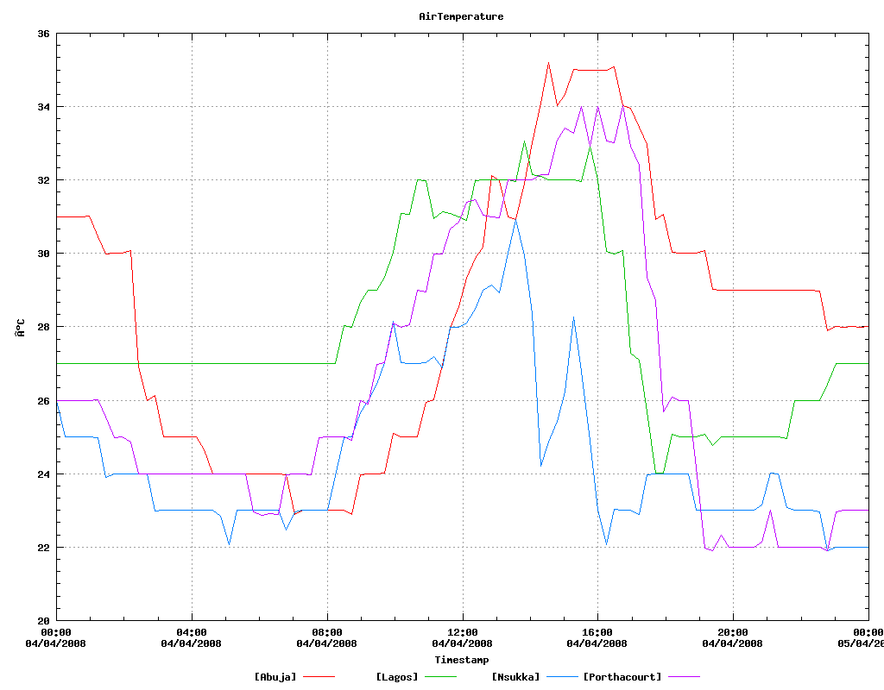
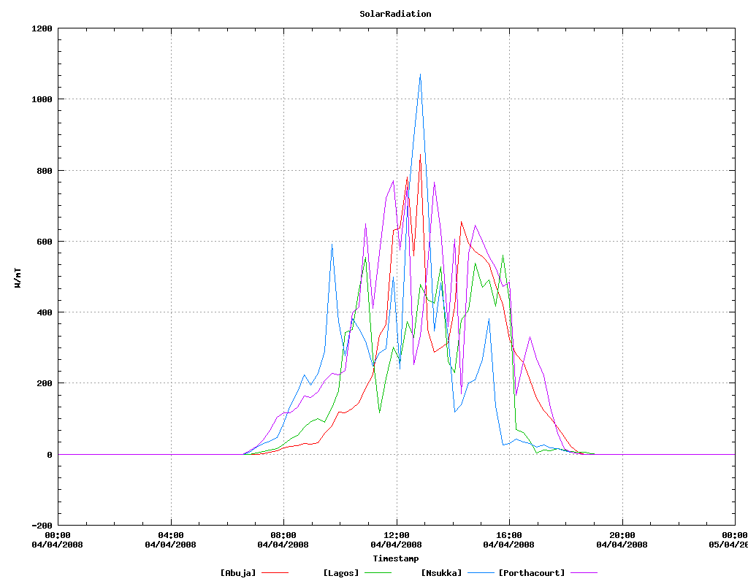
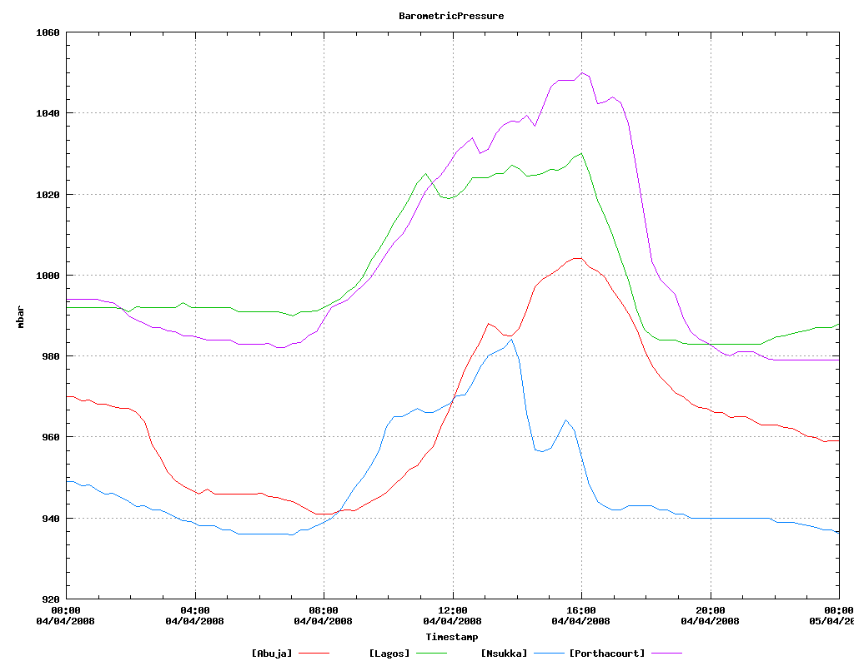
Examples of applications available in the Africa Grid SG: The TRODAN data repository

Slide 26
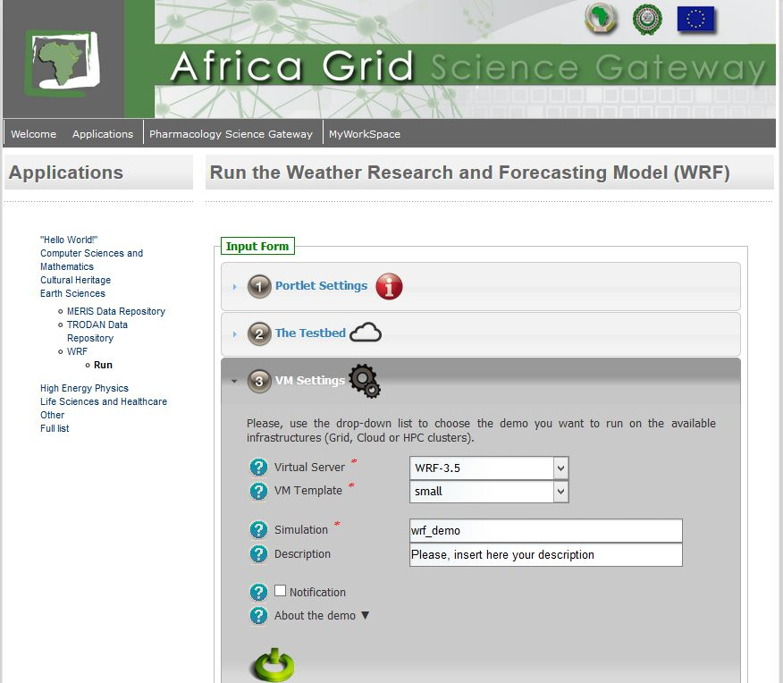
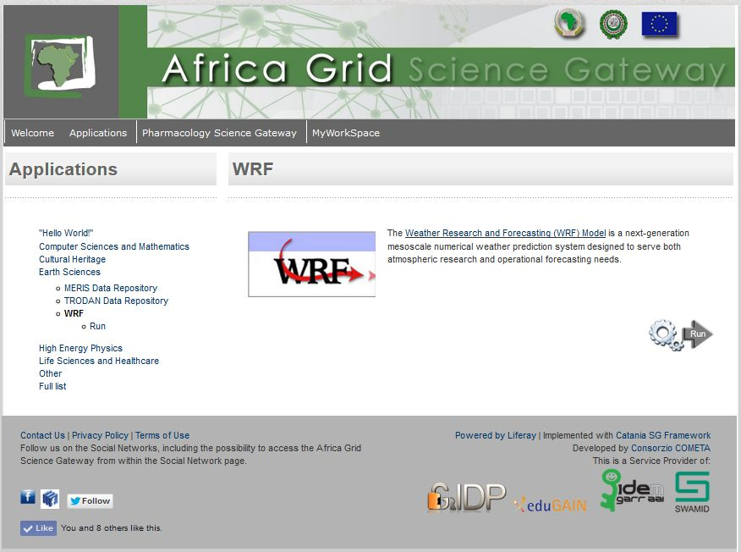
Examples of applications available in the Africa Grid SG: The Weather Research & Forecasting Model (WRF)

Slide 27
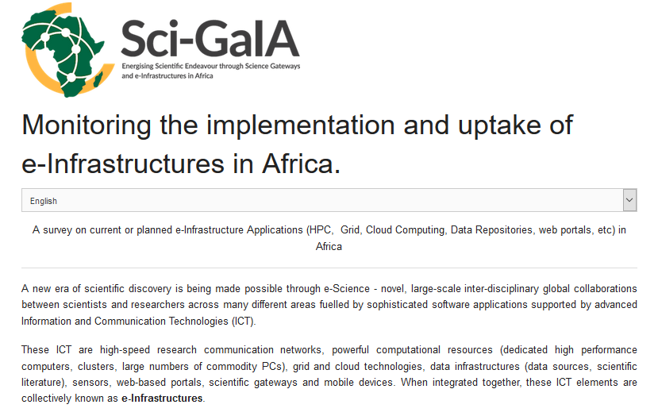
Everybody can propose new applications (http://surveys.sci-gaia.eu/)

Slide 28
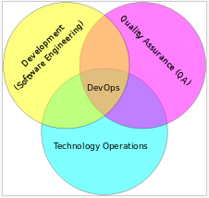
The Africa & Arabia Regional Operation Centre (ROC) (www.africa-grid.org)
Unique entry point to explore/monitor the African e-Infrastructure and/or to join it with HPC, Grid and Cloud sites
Fully compliant with DevOps paradigm:
e-Infrastructure services (IdP, SG, OAR, etc.) and applications can be automatically deployed

Slide 29
The Open Knowledge workflow: we do know how to implement it … and we are actually doing it!

Slide 30
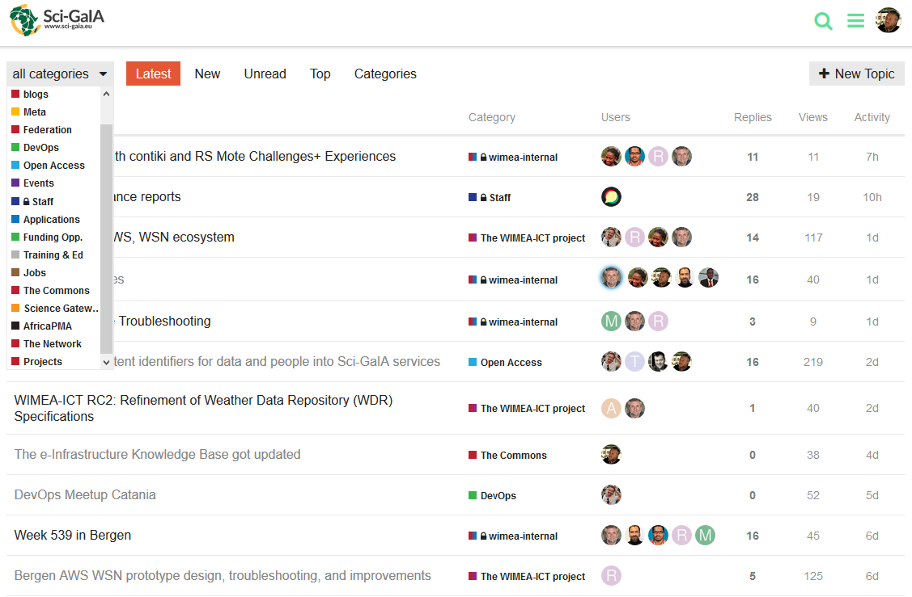
The e-Infrastructures discussion forum (http://discourse.sci-gaia.eu)

Slide 31
The e-Infrastructures discussion forum (http://discourse.sci-gaia.eu)
The forum is meant to be an open environment where to discuss about:
Open Science Commons
Open Access
Training and Education
Identity Federations
Science Gateways
Applications
Funding Opportunities
Job Opportunities
... and much more
The forum has been registered as a Service Provider of eduGAIN so you can sign in using the credentials provided by your organisation. For those who don't have institutional credentials, you're welcome to enroll on our "catch-all" Identity Provider
Although it's been delivered by the Sci-GaIA project and mainly targets sub-Saharan Africa, the forum is widely open to external projects and to all other regions so people working in other projects and initiatives are very welcome to join and contribute to the discussions

Slide 32
The Triangle of Knowledge
Research & Development
e-Infrastructure
t-Infrastructure
Education
& Training
Innovation
t-Infrastructure
Building e-Infrastructures is a waste if we
don’t “build”, at the same time, their users
Along with e-Infrastructures, t-Infrastructures and training
programmes are thus needed as well as Open Education
Resources (OER)

Slide 33
Sci-GaIA Educational Modules
www.sci-gaia.eu
To be eventually adopted in university curricula in EU and Africa
courses.sci-gaia.eu
Other OER’s
Catania SG
Framework
A&A ROC

Slide 34
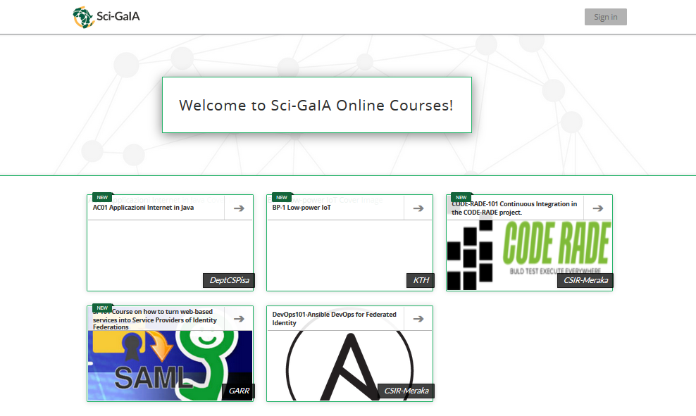
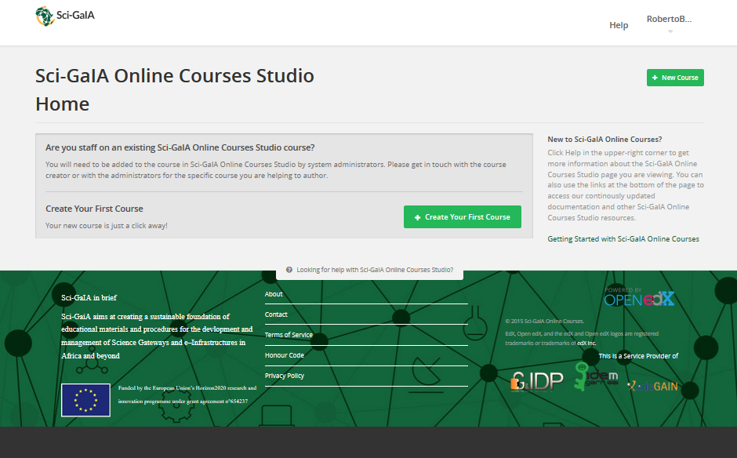
Sci-GaIA Online Courses (http://courses.sci-gaia.eu)
Everybody is welcome to contribute with full
courses and other training & education materials

Slide 35
The Sci-GaIA Winter School (http://www.sci-gaia.eu/winter-school)
The application form will open next week until the 22th of January 2016

Slide 36
Summary and conclusions
Open Science vision can be implemented only if the “openness” paradigm becomes pervasive in day-by-day research
Science outputs’ reproducibility, but also re-usability and extensibility, are key to walk through the “knowledge path” in both directions
The Sci-GaIA project is strongly committed to promote the uptake of the Open Science paradigm and it’s building a viable federated platform for Open Science Commons across Europe and Africa
A novel approach connects Open Access Repositories to Science Gateways and exploit Grid/Cloud/local resources worldwide to easily reproduce/extend scientific analyses

Slide 37
Thank you!
sci-gaia.eu
info@sci-gaia.eu

