Slide 1
BBMRI Competence Center
Assoc. Prof. RNDr. Petr Holub, Ph.D.
IT & Data Protection Manager@BBMRI-ERIC
EGI Community Forum 2015, 2015–11–10

Slide 2
What is BBMRI-ERIC
European Research Infrastructure Consortium to facilitate access to high-quality biobanks and biomolecular resources
  legal entity on European level,
  est. 3 December 2013,
  headquarters moved in into the offices in Graz, AT, in May 2014.
BBMRI-ERIC shall establish, operate, and develop a
pan-European distributed research infrastructure of
Biobank and Biomolecular Resources in order to facilitate
the access to resources as well as facilities and to
support high-quality biomolecular and medical research.
BBMRI-ERIC shall implement its Work Programme as
adopted by the Assembly of Members.

Slide 3
What is BBMRI-ERIC
Follows on the previous approx. 10 year of development of the BBMRI ecosystem
  BBMRI Preparatory Phase, various projects, etc.
A number of ongoing related projects, e.g.,
  BBMRI-LPC to develop facilities for large prospective cohorts and then integrate them in BBMRI-ERIC,
  BiobankCloud for processing related data in private clouds.
BBMRI-ERIC is today the largest
health-oriented ERIC ever
launched in Europe.

Slide 4
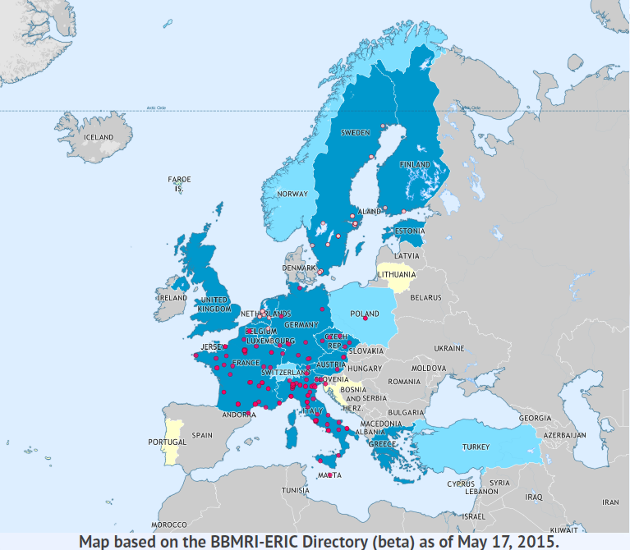
What is BBMRI-ERIC
Full members:
  Austria
  Belgium
  Czech Republic
  Estonia
  Finland
  France
  Germany
  Greece
  Italy
  Malta
  Netherlands
  Sweden
  United Kingdom
Observers:
  Norway
  Poland
  Switzerland
  Turkey
  IARC

Slide 5
What is BBMRI-ERIC
An infrastructure that provides secure and privacy-protecting access to key resources in order to support biomedical research and to support healthcare advancement:
  biosamples from biobanks,
  related data: clinical, omics, etc.,
  biomolecular resources.
The infrastructure pays particular attention to
  high-quality of delivered resources on all levels: from samples to data,
  has fundamental impact on reproducibility of biomedical research (Begley, C. G. & Ellis, L. M. Nature 483, 531–533; 2012.
  Bisel M. Nature 503, 333; 2013.),
  infrastructure is open to all participants that have quality in mind.

Slide 6
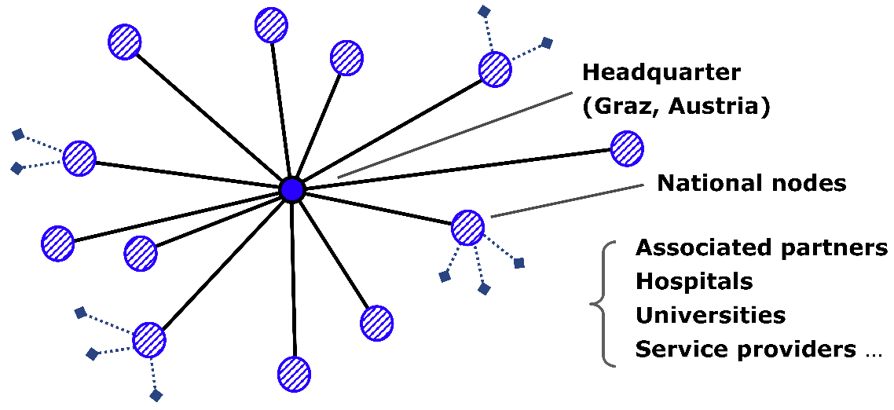
IT Architecture of BBMRI-ERIC
Federalized design of all the systems
  Following the hub-and-spoke
  architecture of BBMRI-ERIC itself,
  In many cases, a data
  set as a whole is not
  allowed to leave the
  sites of origin, for various legal,
  organizational, or even technical reasons.

Slide 7
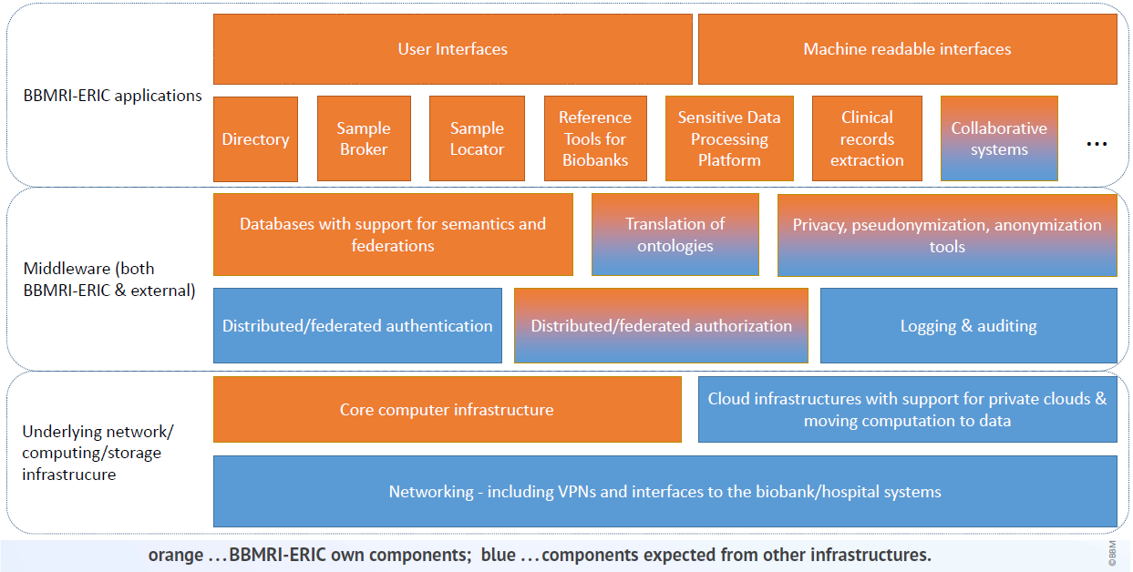
IT Architecture of BBMRI-ERIC

Slide 8
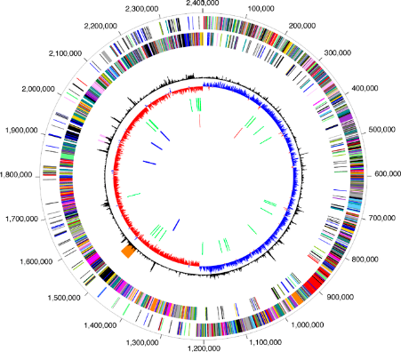
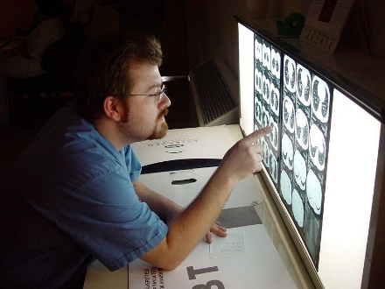
What Data Does BBMRI-ERIC Deal With?
Clinical data
Phenotype data, including
  Imaging data: pathology, radiology, …
  Volumetric data: CT, …
Omics data
  Genomics, proteomics, metabolomics, …
  Data come in many vocabularies (flavors)
    support for translation of semantics and data harmonization is critical.
Access to virtual physiological models
Value of biobanks is in samples and data and expertise.

Slide 9
What Data Does BBMRI-ERIC Deal With?
It’s not just about ``open data everywhere’’
  Raw data typically must not leave the biobank (or even clinical institution)
  Pseudonymized data is still very sensitive and must be subject to DTA
  Even anonymized data must ensure compatibility of research intent and informed consent
Importance of quality aspect
  Data & Sample Provenance
Biobanks must also provide expertise on data interpretation & harmonization

Slide 10
How Is Data Processed in BBMRI-ERIC
Moving data to computations
  Moving computations into the biobanks
    Large biobanks are becoming also large data storage & processing facilities
    Aggregating data across biobanks without sharing it (e.g., DataSHIELD, ``kind of map-reduce’’ using generalized linear models)
  Moving data to trusted sensitive data processing and sharing platforms
    MOSLER, TSD/TSD 2.0, etc.
    Still subject to many regulations

Slide 11
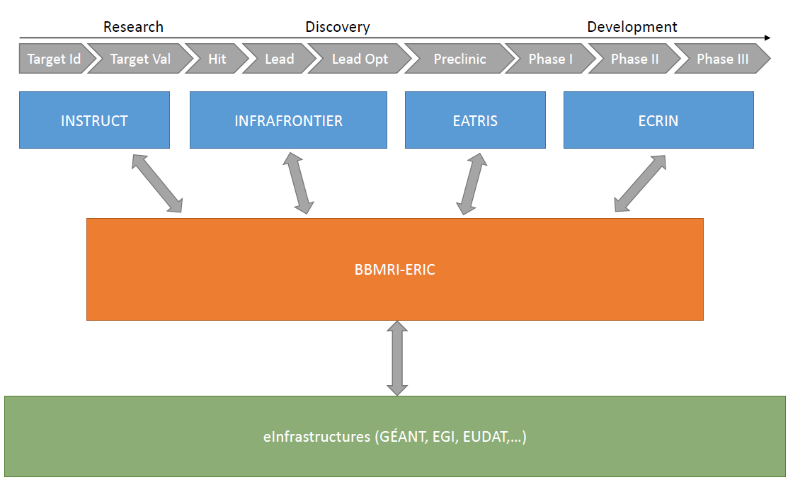
BBMRI-ERIC In The Context of Infrastructures

Slide 12
Recent BBMRI Updates
BBMRI-ERIC Directory 1.0
  Released in July 2015
Common Service IT
  The main framework to implement IT services of BBMRI-ERIC
  Approved by BBMRI-ERIC Assembly of Members in October 2015
  Scheduled to start in November 2015
ADOPT BBMRI-ERIC
  Booster to accelerate IT development
  Started in October 2015

Slide 13
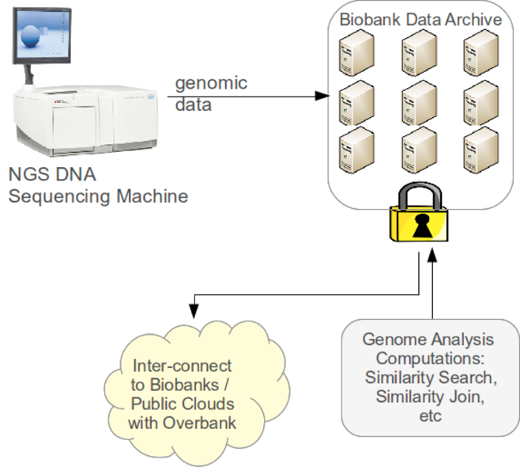
BBMRI-ERIC CC in EGI-ENGAGE
Delayed by 6 months to give BBMRI-ERIC headroom to establish the CS IT
Pilot deployment of BBMRI-ERIC
genomic data processing on EGI
infrastructure
  reuse of BiobankCloud software suite,
  use of EGI federated cloud infrastructure, moving computations to data,
  involves also exploration of how EUDAT can help in long-term data curation & preservation.

Slide 14
BBMRI CC Partners
Infrastructure
  EGI, EUDAT
  CESNET, SURFsara
``Content’’
  BBMRI-ERIC + BBMRI.nl, BBMRI.se, BBMRI.cz
  KTH

Slide 15
BiobankCloud: Bringing together Biobankers and Bioinformaticians

Slide 16
What Governs Access in Biobanking?
Informed consent
  Given by participant (=patient/donor), limiting what can be done with their samples/data
  Broad vs. narrow informed consent, dynamic consent
Research project
  Specifies goals of the research, must be reviewed by ethical board
An informed consent and a research project must match

Slide 17
Multi-Tenancy & Data Sharing
Study NSA
Member of
authorize
access
No Unauthorized Copying/Cross-Linking of Data
Member of
Study Lifegene
DataSet
owns

Slide 18
Goals for BBMRI CC
Deploy BiobankCloud on EGI Federated Clouds
  So far BiobankCloud runs on Hadoop & JClouds
  Closely coupled with custom modifications of HDFS for multi-tenancy
  Find mapping to EGI infrastructure
  Deploy EGI infrastructure into biobanks
Integrate BiobankCloud with federated AAI
  So far GlassFish with, e.g., LDAP backend
  Support for project affiliations and LoA > 2 (multi-factor authentication)…
  Collaboration also with GÉANT AARC & VOPaaS
Deploy system in pilot biobank(s)

Slide 19
Progress of BBMRI CC
Kick-off in October 2015
First technical meeting in October 2015
  BiobankCloud and EGI developers people
    Add EGI auth into JClouds as OpenStack already supports JClouds
    Add OCCI support to JClouds
    Add Shibboleth support to BiobankCloud
Upcoming BiobankCloud workshop in Vienna
  November 25, 2015

Slide 20
Conclusions
BBMRI-ERIC aims to be the one-stop “shop” for biobanking and biomolecular resources, supporting biomedical research and advancement of healthcare.
BBMRI Competence Center is to enable large-scale secure data processing in BBMRI-ERIC
  Privacy-sensitive data
  Use of federated cloud architecture to deploy data processing in federation of biobanks

Slide 21
Thank you for your attention!
Petr.Holub@bbmri-eric.eu
http://www.bbmri-eric.eu/

