Slide 1
Disaster Mitigation Competence Centre Project Meeting
Coordinator: Simon Lin
June 2, 2015

Slide 2
Agenda
Introduction (Simon Lin)
From Previous Meeting on May 18, 2015 (Eric Yen)
Progress Report (Eric Yen)
Partner Status Report
Discussion
Future Events
AOB

Slide 3
Minute of DMCC Project Meeting on May 18
1700-1830, May 18, 2015 at EGI Conference, Lisbon, Portugal
Participants: Simon Lin and Eric Yen (TW), Rahim (MY), Cerlane (DE), and Gergely (EGI)
Progress Report
Partner contributions are summarized as the next slide
Proposed case studies: Flood 2011 (TH), Flood 2014 (MY), Tsunami (PH)
EGI Collaboration: CCs will meet the EGI-AAI team on May 22 for AAI requirements and services
Discussion
Detailed steps, schedule and roles of partners for the designed case studies have to be well planned as soon as possible.
Scenario design: Partner needs to identify what we have and what are missing, the target of the disaster analysis from the next meeting.
Cerlane explained the Advanced visualization facility and working model with scientific group.
Next Meeting: June 2, 2015

Slide 4
Excellence Strategy Capacity Building and Shaping the Sustainable Society Open Collaborations to All APGI Partners and Beyond
 | Earthquake & Tsunami | Extreme Weather | Long Distance Dust Transportation | Urban Heat Island Impact
Web Portal | TW | TW | TW | TW
Case Study | ID, PH, TW | MY, PH, TH, TW | ID, TW | TW
Resource Center | EGI compatible regional e-Infrastructure (TW and all Asian partners)
Visualization | DE
Service & Support | ID, PH, TW | MY, PH, TH, TW | TW | TW
Other Collaborations | EGI: infrastructure, AAI, application technology etc. Domain experts/project in Europe, etc.

Slide 5
From EGI Conference 2015

Slide 6
Current VRCs and UCB representatives

Slide 7
Competence Centres in EGI
Experiment, develop and deploy community-specific ICT platforms using EGI solutions
Evolve the EGI technical services with community requirements → co-development with NGIs
Promote community services within scientific groups
EGI-enabled scientific applications
Joint training programme
Technical user support
Promote reuse of solutions of common interest across research communities
Initial model in EGI-InSPIRE, new model in EGI-Engage
EGI-InSPIRE – NGI/Community/Technology; Flat list
EGI-Engage – ‘Projects within the project’; Focus, timeline

Slide 8
Competence Centre model in EGI-Engage wiki.egi.eu/wiki/EGI-Engage:WP6_(SA2)_Knowledge_Commons
Implementation in WP6 (Knowledge Commons)
7 Comp. Centres for 7 RIs from the ESFRI roadmap
BBMRI, DARIAH, EISCAT_3D, ELIXIR, EPOS, INSTRUCT, LifeWatch
1 Asian Competence Centre for Disaster mitigation
Goals
Experiment, develop and deploy community-specific ICT platforms
Sustainable adoption of e-infrastructure services
Dissemination, training, exploitation within the RIs
Implementation
CC=group of Sci. institutes + Software providers + Resource centres
5-7 core partners + Unfunded contributors from any NGI
Focused workplan with tasks, effort, owners, deliverables, deadlines

Slide 9
Outcomes
Community clouds
Data products
Active Repositories
Training resources
GPU federations
Science gateways
Scalable applications
User support
Advanced AAI
Open Science
MoBRAIN/ INSTRUCT
Environment (disaster mitigation)
BBMRI
DARIAH
EISCAT-3D
ELIXIR
LifeWatch
EPOS
EGI community
Federated Cloud
High Throughtput Computing
Security, access control
Data management and federation
Gateway systems

Slide 10
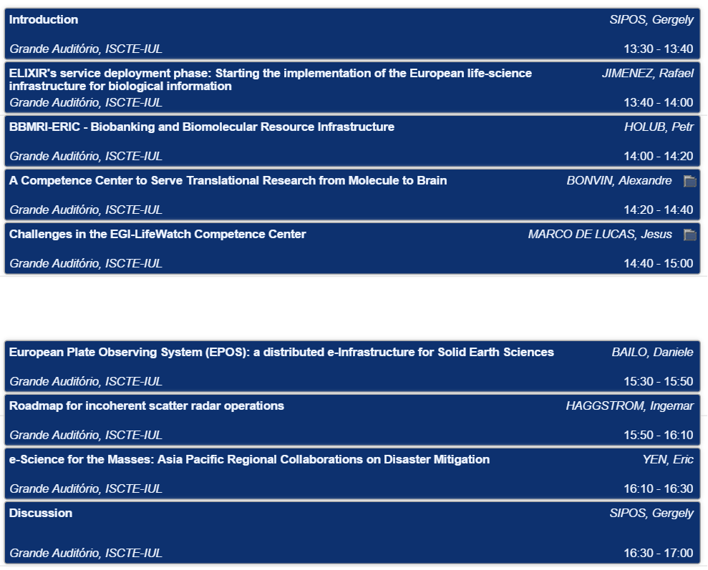

Slide 11
Conference programme overview
Key sessions for VRCs and CCs
Technology topics – IaaS, PaaS and Operations, Open data, AAI
Service operations – Tools and services
Outreach and engagement with new communities
E-learning – needs, tools, plans
Business - Industry engagement, Procurement, Marketplace
Comm. Spec. topics – Licences, Citizen involvement, GPGPU
Training courses – FitSM, Security, CernVM-FS
Notes, Q&A - Links in the agenda (e.g. go.egi.eu/iaas)
For session conveners: workshop reports! (see my email)

Slide 12
AAI Requirements of DMCC
 | Earthquake & Tsunami | Extreme Weather | Long-Dist Dust Transportation | Urban Heat Island Impact
Input (Multiple Sources/countries) | Rupture Profile; Precomputed DB; Bathymetry; Obs; | Time varing meteo fields; Terrain, Landuse, soil; | Aerosol source; Time varing meteo fields; Terrain, Landuse, soil; | Land Use; Terrain; dynamic meteo. Data;
Output (Scientific Results) | Time-series Seismograms/Tsunami wave @site; hazard map; animation; Pub. | Time-series gridded data (NetCDF); animation; Pub. | Time-series gridded data (NetCDF); animation; Pub. | Time-series gridded data (NetCDF); animation; Pub.
AP Platform | Model, Program, Platform, Web Portal, and Services (with version control)
Scientist | Access to Web Portal & EGI compatible regional/global e-Infrastructure; Management of Scientific Results (various stages; organized/DB)
Other Users | Access to open contents: Pub., Animation, Report, Case Study
Service & Support | Roles: Data Source; Scientist; Tech Supporter; Resource Providers; General Public
System Requirement | AAI (Simplest workflow to get services; SSO; required data and access protection); Certified system images and app platform; Access Control;
Notes:
Some input data are from the government and is not open to public →
Gridded data: pressure, temp, ozone, wind speed, humidity, heat flux

Slide 13
Summary
Based on the use cases and requirements from user communities, and the DCI federated environment
Based on certificates of IGTF, the APGridPMA network
VO, Science Gateway will be implemented
Role-based access control
AAI is not just for access control, but also for supporting the service provenance, level of assurance, and trust (between user and service provider; between service providers; between application platform and infrastructure).
Required Services
Integration with user’s existing data/storage/service
Federated ID
Credential translation, group/attribute management
Endorse personal data attributes
Certification of services, resources, etc.
Interoperability with the raw data sources: distribution center model
Common Policy for DCI: Compliance to standards, agreed policy and practices

Slide 14
EGI Training Development Steps
Who do you want to train?
What is their existing knowledge / skills that are relevant?
What extra knowledge, skills or behaviour do they want to acquire?
How many are there (e.g. demand/year)?
What resources can they contribute?
What is the syllabus?
New material (skills, methods, knowledge, judgement, behaviour) you plan to deliver.
This needs to be reviewed with the stakeholders identified in 1 to see if it is what they want.
But the stake holders are also their (future) employers, etc.
How will the content of the syllabus be developed and delivered so that people absorb the required increments to their knowledge and skills?
How can this be resourced from the point of view of developing the material and delivering the material?
How can the identified students (people engaging to learn) find (a) the prerequisites if they don't have them, (b) the time & engagement to learn, and (c) coping with the pace and duration? i.e. should there be identified stages?
How will the learners be supported, e.g. tele-tutoring and group discussions?
How will it be made concrete so progress is appreciated?, e.g. What practical exercises are there?
How are the preparation staff resourced to deliver?
How are the delivery staff resourced to support each replay of the course?
How are the technical support arrangements made, e.g. we need to book time on EGI machines to teach forward wave propagation modelling, about 20 nodes / student.
How do the courses deal with student feedback? Solicit it? Discussions during the course and a suitable time later?
Review of their progress by their organisations
Integration and distillation of the analysis
Identification of the areas needing action.
Revision of any of the previous stages.
This is key particularly the first rendition of the course must be considered a trial run, before it is considered prepared!

Slide 15
Action Items
Plan for the DMCC Face-to-Face Meeting in APAN 40 (Aug. 10-14 in Kuala Lumpur) (ALL)
Objectives:
Review the preliminary results, services and workflow by Interacting with Users on target case studies
Review the requirements, collaboration model, system architecture and the outcomes
Arrangement: Half day or Full day
Agenda
Support WRF analysis first before the new gWRF portal is available (ASGC)
Review the status of proposed cases (ALL)
Invite APGI and other regional user communities to work together (ASGC)
Engage or make use of EGI, VRC and other CCs (ALL)
Environmental Computing Workshop, ISGC 2016 (ALL)

Slide 16
Next Meeting & Future Events
June 16, Progress Checking
June 30, Progress Checking
Aug. 10-14, APAN40, Kuala Lumpur, MY
DMCC face-to-face meeting
Environmental Computing Workshop, ISGC 2016

