Slide 1
EGI FedCloud User Support coordination meeting
Diego Scardaci - EGI.eu/INFN
Technical Outreach Manager

Slide 2
Agenda
Welcome and updates about support resources from EGI.eu (Diego Scardaci, EGI.eu/INFN)
Training events
EGI Federation Model
Use cases
Updates about use cases (from every site)
Updates from high level tools (tool providers)
Update from FedCloud Task Force and Operations
AOB

Slide 3
EGI FedCloud Training Infrastructure
training.egi.eu VO ready
http://operations-portal.egi.eu/vo/view/voname/training.egi.eu
sites:
BIFI, CESNET, CETA-CIEMAT, IFCA, INFN-Catania
VM-wide image list:
Problem: some images not available in the sites

Slide 4
Next Training events
EGI FedCloud Tutorial in UK (Feltham, London)
17 July 2015
Invitation from Harness project/Imperial College
https://harnesscloud.github.io/2015-07-15-feltham/
EGI FedCloud Tutorial at HPCS conference (Amsterdam, The Netherlands)
20-24 July 2015
Abstract accepted
http://hpcs2015.cisedu.info/

Slide 5
EGI Federation Model

Slide 6
Principle
The EGI Cloud Federation is open
All cloud providers adhering to the established policies, procedures and processes, can join in by adopting different federation models according to the needs
Providers can choose the type of federated services while still relying on local tools and exposing own service interfaces to the federation, as applicable
Low entry barriers

Slide 7
Definitions
EGI Cloud Federation: hybrid cloud (private, community, public)
EGI Cloud Realm: subset of cloud providers exposing homogeneous cloud management interfaces and capabilities. The Open Standards Cloud Realm supports OCCI and CDMI
Community Platform: set of community-specific data, tools, applications and brokering solutions, which can be supported by one or more realms of the federation.

Slide 8
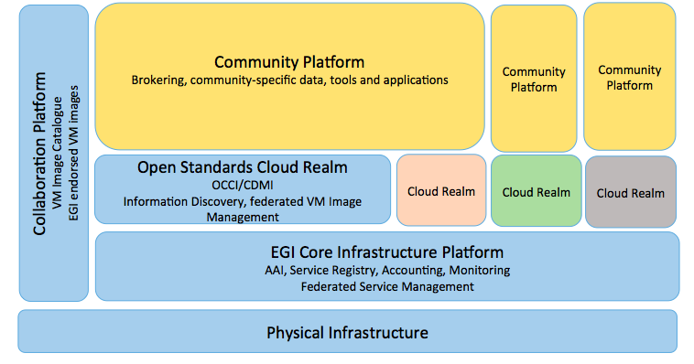
Federation model

Slide 9
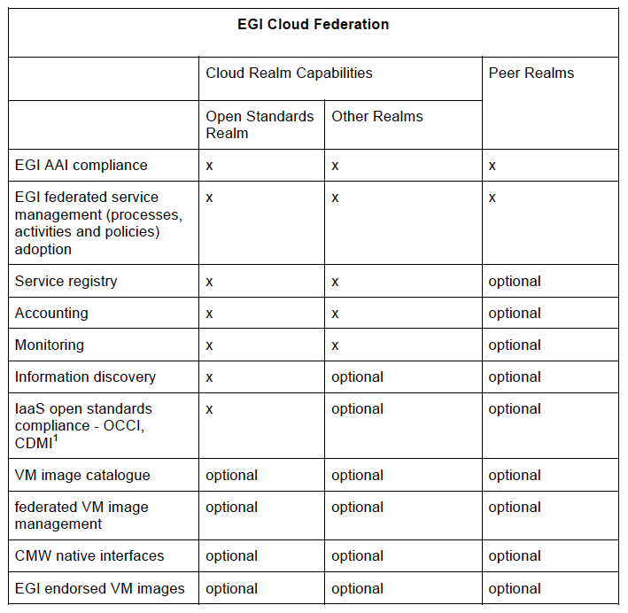

Slide 10
Use Cases (1/3)
Use Case | Supporter(s) | Status | Comments & Requirements
DRIHM | INFN-Bari | Production | disseminate results exploitation plan (depends on the approval of the follow-up project) manage licenses in the FedCloud
Chipster | INFN-Bari | Production | 1 pilot just started Deploy Chipster in the other interested sites: (1) CESNET, (2) GRNET CVMFS: first successfully test
CMS/LHCb/ ATLAS | Many sites | Pre-production | Requirements on accounting Still looking for sites willing to support these VOs
LOFAR/GIPSY | BSC | Test & Integration | COMPSs
CLARIN ERIC - VLO | EGI.eu | Test & Integration | Very strict HW requirements Tests at CESNET site

Slide 11
Use Cases (2/3)
Use Case | Supporter(s) | Status | Comments & Requirements
Universidad de Granada / AUGER | BIFI | Pre-production | Deploy CORSIKA and OFFLINE Interested to support this use cases?
ESA/Terradue | EGI.eu | Preparatory | ESA exploitation platform Batch processing in the FedCloud VM with 2 cores 4GB-8GB RAM (some with 32GB RAM) - 120GB disk
BILS (Swedish Elixir Node) | EGI.eu | Pre-production | Solution to manage/share big datasets in efficient way VO SLA in definition Interested to support this use cases? for free & for pay

Slide 12
Use Cases (3/3)
Use Case | Supporter(s) | Status | Comments & Requirements
ESA Stimulus project | EGI.eu | Assessment | Pay-for-Use
EGI/EUDAT pilot | EGI.eu | Assessed | interconnect EGI/EUDAT resources in a unique pilot to be applied in EPOS and EISCAT-3D CC
INSTRUCT/ Scipion | EGI.eu | Assessed | enmr.eu VO RPs: INFN Padova & CESNET

