Slide 1

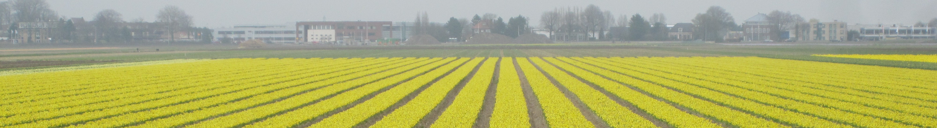
EGI FedCloud User Support
trans-National Infrastructure for Plant Genomic Science
Programmatic services for genome-scale data

Slide 2
Project
transPLANT is a consortium of 11 European partners gathered to address challenges related to plant genomes research.
Develop a trans-national infrastructure for plant genomic science. Bringing together groups with strengths in data analysis, plant science, computer science, and from the academic and commercial sectors.
transPLANT develops integrated standards and services, undertaking research and development to capitalise on the sequencing revolution across the spectrum of agricultural and model plant species.

Slide 3
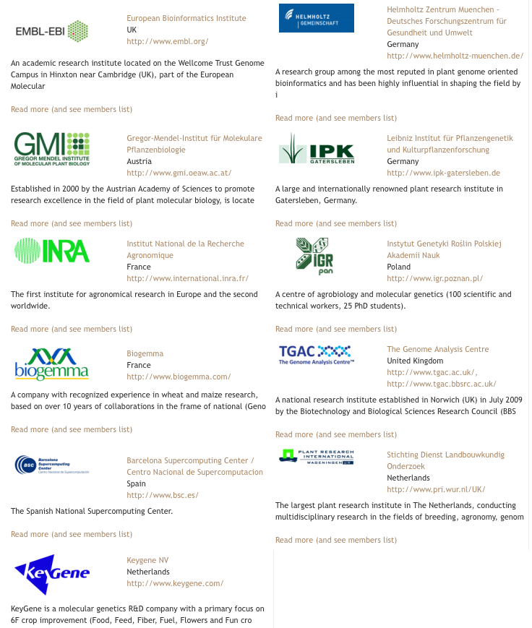
Partners

Slide 4
Programmatic services for genome-scale data
Develop programmatic services, and environments for running programmatic analyses for plant genomes
Provision of a cloud compute environment
Implementation of HPC web services
Provision of web services for computational analysis

Slide 5
Provision of a cloud compute environment
Objective
  Provide a cloud compute environment for parallel, portable processing of large data
Highlights
  Cloud environment to manage hardware resources
  HPC aware workflow manager (COMPSs)
  Compatible with available web-services technologies
  Compatible with applications’ native execution

Slide 6
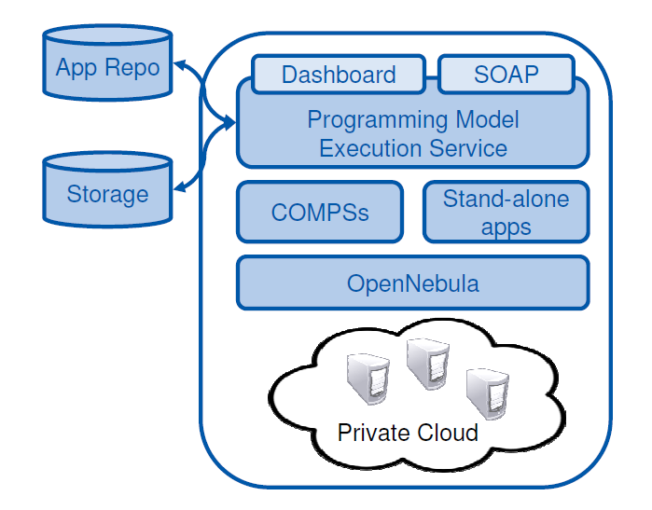

Programmatic access from any WS-aware prog. language or WS clients
Apps. as collection of
VM’s
Web-based access
Data from external of local repositories
OpenNebula to manage hardware resources
COMPSs workflows usable in HPC without change

Slide 7
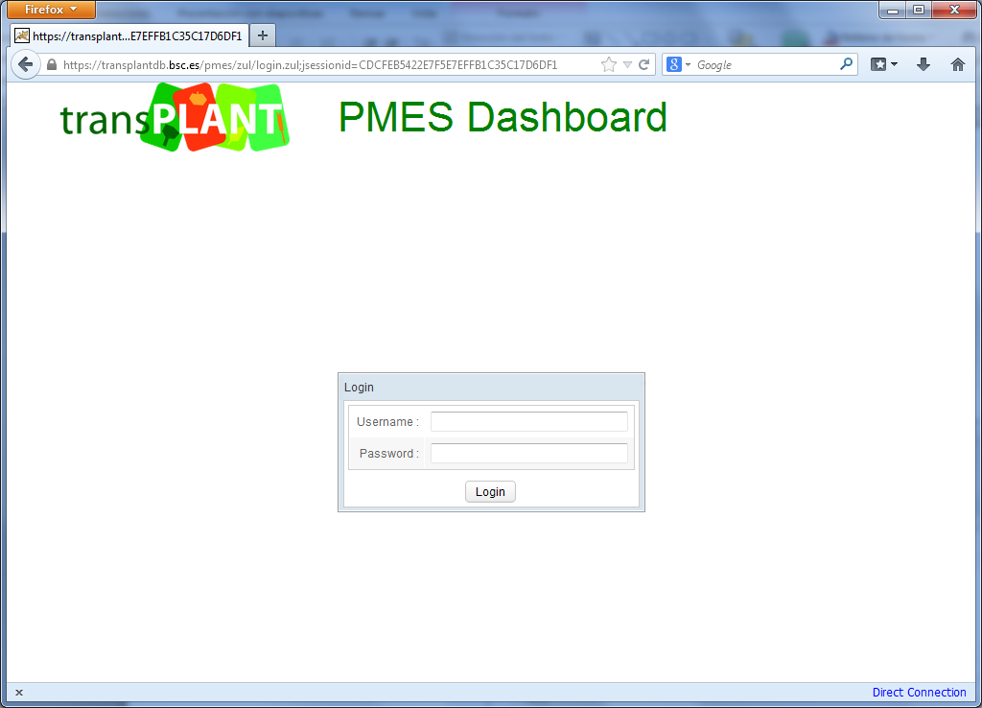
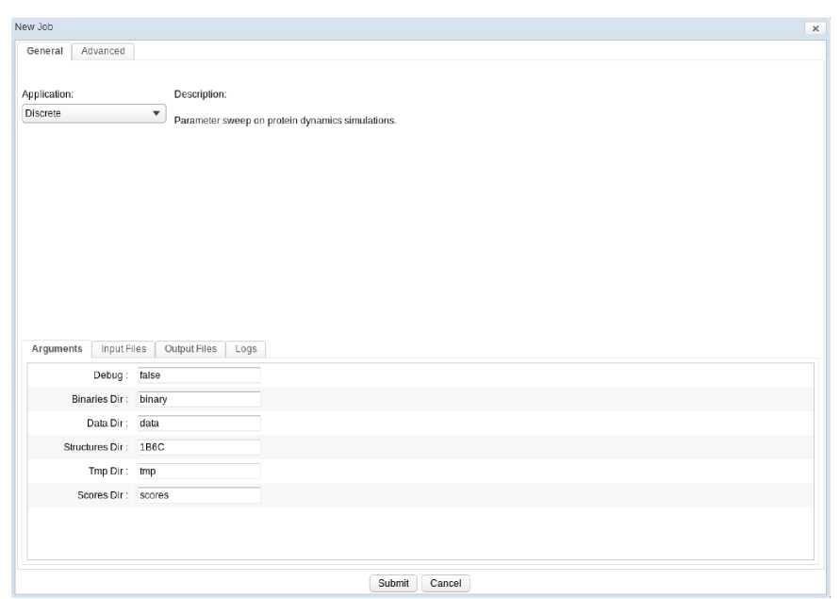
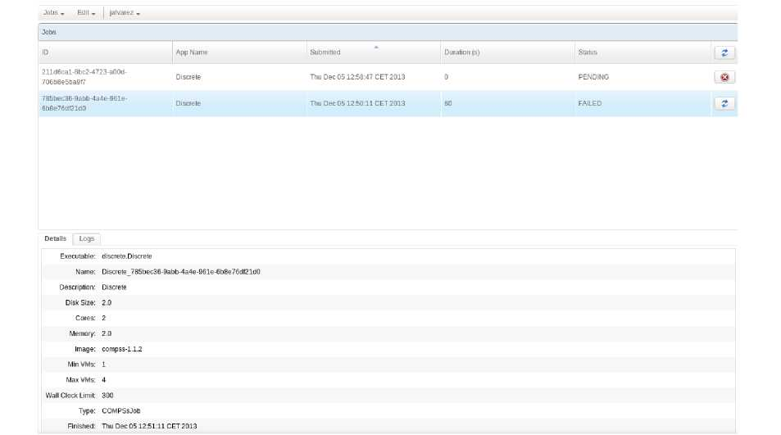
PMES Dashboard http://transplantdb.bsc.es/pmes

Slide 8
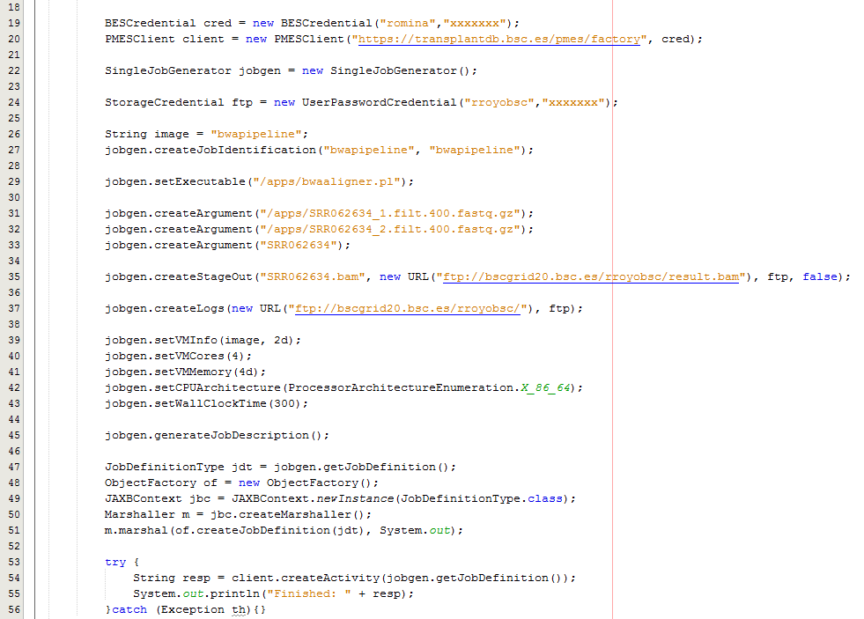
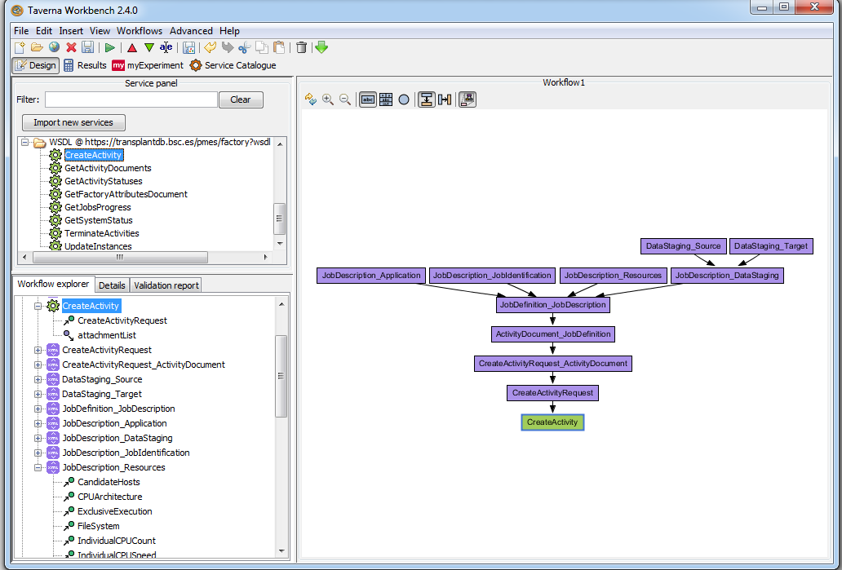
Programmatic access to PMES
Example Java code
Taverna Workbench

Slide 9
Galaxy interface and access to PMES

Slide 10
Implementation of HPC services
Objectives: Provide an environment for compute-intensive data analysis
Highlights:
  COMPSs programming model is compatible both with cluster/cloud scale and large HPC systems
  First genome assembler available in the cloud environment (Abyss-COMPSs)

Slide 11
Implementation of HPC services
Genome assemblers available to run in MN supercomputer
  Abyss, SoapDeNovo, Masurca, Velvet
Genome assembly suite Abyss as a standalone application powered by (intra-node, up to 12 cores) MPI parallelism.
  A pyCOMPSs version of Abyss is available for testing.
  Benchmark to compare with performance in a traditional environment
Input test case | Read size | #Reads | RAM Usage
 |  |  | MN | VM
SRR077421 (Nipponbare) | 150 bp (Illumina Gen. Analyzer II) | 1.10⁸ (2x15Gb fastq) | 49.5 Gb | 38.3 Gb
MN: SUSE Linux Enterprise 11, Intel Sandy Bridge-EP 2.6 GHz, 16 cores per node / 32 Gb RAM. gcc 4.3.3 (-O2). VM: Debian 4.4.5 (virtual), QEMU Virtual CPU version 0.12.5 (virtual). Host: Intel(R) Xeon(R) CPU E5649 @ 2.53GHz, 12 cores per node / 96GB RAM. gcc 4.4.5 (-O2). Run details: #CPU: 8, k-mer=31

Slide 12
Applications
Application | Implementation | Requirements | Storage
Blast | COMPSs | 1 Core, 4GB RAM. 4VMs | 4GB Dataset
Gene-detection | COMPSs | 2 Core, 8GB RAM. 8 VMs | 8GB Dataset
Repet | COMPSs | 4 Cores, 8GB RAM. 16 VMs | 50GB Dataset in shared storage
Abyss | COMPSs | 16 Cores, 4GB, MPI. 2 VMs | 4GB
Maker | Stand alone | 2 Cores, 8GB RAM | 16GB Dataset
Exonerate | Stand alone single VM | 4 Cores, 4GB RAM
Augustus | Stand alone single VM | 4 Cores, 4GB RAM
Bowtie | Stand alone single VM | 8 Cores, 8GB RAM
TopHat | Stand alone single VM | 8 Cores, 4GB RAM | 50GB Dataset
GatK | Stand alone single VM | 2 Cores
Cufflinks | Stand alone single VM | 8 Cores
BWA | Stand alone single VM | 2 Cores, 4GB RAM

Slide 13
Sustainability
Permanent installation at BSC. Will be moved to a larger hardware facility when available.
Installable packages or VMs available
COMPSs/PMES available on EGI Fedcloud
  Easy porting of applications
New VRE project EINFRA-9-2015 (Multi-Scale Complex Genomics) starting november 2015
  IRB BARCELONA, BSC, PARC CIENTIFIC DE BARCELONA (ES), CNRS (FR), EMBL-EBI (DE), UNIVERSITY OF NOTTINGHAM (UK).
  Extend and adapt transPLANT computational infrastructure.
INB Spanish ELIXIR node will include the services as technological offer.

Slide 14
Sustainability
Service/Tool | URL | Number of unique users (by IP) | Number of site visits
LAILAPS | http://lailaps.ipk-gatersleben.de | 101 | 971
GnpIS | https://urgi.versailles.inra.fr/Tools/GnpIS | 13334 | 39362
GrapeMine | http://urgi.versailles.inra.fr/GrapeMine/begin.do | 144 | 193
GWA-Portal | http://gwas.gmi.oeaw.ac.at | 1133 | 106602
GWAPP | software | 1329 | 46111
REPET | software | 559 | 798

