Slide 1
Disaster Mitigation Competence Centre Project Meeting
Coordinator: Simon Lin
July 7, 2015

Slide 2
Reminder
Please mute your microphone if you are not speaking
Please do not turn video on to ensure good audio quality
Should you have any material to share, please send it to everyone. Eric will put it on the Indico page

Slide 3
Agenda
Introduction (Simon Lin)
From Previous Meeting on June 23, 2015 (Eric Yen)
Progress Report (Eric Yen)
Partner Status Report
Discussion
Future Events
AOB

Slide 4
Minute of DMCC Project Meeting on June 23
1630-1730, June 23, 2015 (Taipei Time) at WebEx Virtual Room
Participants: Simon, Stella, Vicky and Eric (TW), Cerlane (DE), Rafael (PH)
Apologies: Basuki (ID), Rahim (MY)
Progress Report & Discussion:
Case studies identified, together with participating partners
Training Plan at APAN40 and ISGC2016
Agenda of next DMCC F2F meeting at APAN40
Potential new partner of IAMI, Vietnam
Task force for regional infrastructure and application integration
DMCC activity at EGI Community Forum 2015
Action Items
Case Study: workflow, training and data collection
F2F @ APAN40: bring your user(s)
Next Meeting: July 7, 2015

Slide 5
Agenda of DMCC F2F Meeting at APAN40
Date & Time: 1400-1730, Aug. 11, 2015
Please register at APAN40 as a regular participant (for 5 days, Aug. 10-14)
http://www.apan.net/meetings/KualaLumpur2015/
Early Bird Registration is due on July 15, 2015
Tentative Agenda
DMCC Status Report (ASGC): 20 min
Progress Report from all members (10 min/each): 60 min
Case study, user community engagement, requirements, etc.
Thematic Talk 1 -- Tsunami and Storm Surge Simulation (Prof. TR Wu from NCU, TW): 30 min
Thematic Talk 2 -- Weather Simulation and Analysis (Prof. CY Lin from AS, TW): 30 min
Training by Demonstration of iCOMCOT: 30 min
Discussion: 10 min
Please bring your users with requirement and question, etc. to the meeting

Slide 6
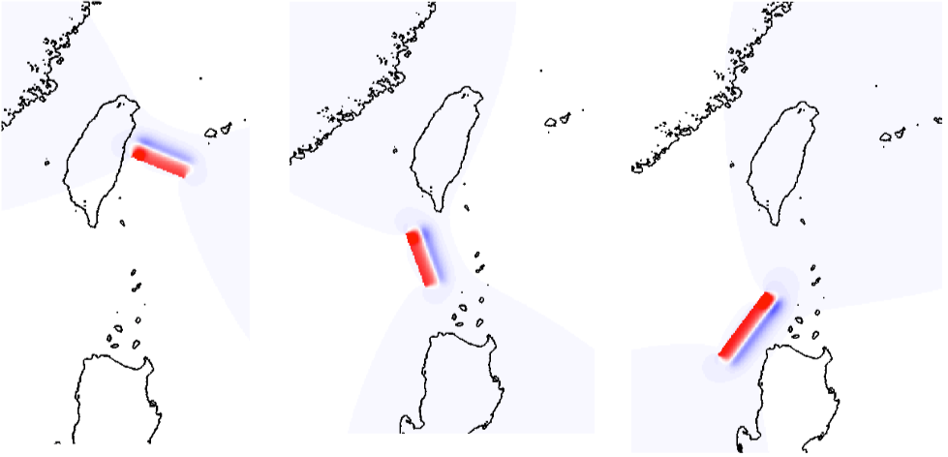
iCOMCOT for Tsunami Simulation http://icomcot.twgrid.org Please apply your account and start to work. Demonstration/Training will be arrangement in next F2F or future meetings.

Slide 7
Discussion I: Progress of Case Study
Buildup reliable modeling and simulation for future events analysis
Data Collection: observation data from tidal gauge, rainfall (hourly, daily), radar, satellite, etc., the more the better
Impact Assessments of Tsunami Hazards from Manila Trench (AS)
Tidal gauge data in PH, VN, TW, and iCOMCOT
Historical Tsunami in South China Sea (AS)
By Reverse Tracking Method for potential tsunami sources with iCOMCOT
Storm Surges Cases in PH and TW (AS)
Thailand Floods in 2011 (TH)
https://en.wikipedia.org/wiki/2011_Thailand_floods
Malaysia Floods in 2014-15 (MY)
https://en.wikipedia.org/wiki/2014–15_Malaysia_floods

Slide 8
Discussion II
Training
The first chance of the application portal training would be APAN40.
Next one should be at ISGC2016
Logo of DMCC
New Partner and Recommendation
IAMI (Institute of Applied Mechanics and Informatics) of VAST (Vietnam Academy of Science and Technology), together with scientists from IOIT (Institute of Information Technology), DFCK (Dep. Computational and Knowledge Engineering), DOME (Dep. Ocean Mechanics and Engineering), HCMIRG (HCM Institute of Resource Geography), GIRS (GIS & Remote Sensing Research Center) and SRHC (Southern Regional Hydrometerological Center) are interested in joining the collaboration.
Topics: Sea level rise, Remote sensing and GIS on hazard mitigation, Flood mitigation
Instruments: Ocean ADCP and river ADCP to collect: tidal gauge data, river discharge rate, river velocity etc.
Recommendation of new partners are welcomed

Slide 9
Discussion III
Regional Infrastructure and Integration with Application Portal: simplified and flexible infrastructure, Application platform and resource access
AAI, VO, Operation, Data Management, AP development, Federated Cloud Architecture, etc.
Need a task force to review the EGI services and related EU project products, then plan for the implementation: 3 months ?
EGI CF2015
Time & Place: 10-13 Nov. 2015, Bari, Italy
contributions in the form of workshops, user community meetings, tutorials, posters and demonstrations for the following topics are welcomed
Community Engagement and Innovation
Virtual Research Environments
Data and Computing
Identity provisioning, Authentication, Authorization and Accounting
Open Science Commons
What’s DMCC’s contribution ?

Slide 10
Next Meeting & Future Events
July 21, Progress Checking
Aug. 10-14, APAN40, Kuala Lumpur, MY
Aug. 11, DMCC face-to-face meeting (& training)
Aug. 25, Progress Checking
Sep. 8, Progress Checking
EGI CF2015, 10-13, Nov. 2015, Bari, Italy
Environmental Computing Workshop, ISGC 2016

