Slide 1
Dynafed
FTS3
Human Brain Project use cases
Fabrizio Furano
Alejandro Alvarez

Slide 2
Intro
An activity inside EGI is collecting requirements for the HBP distributed computing
Dynafed and FTS3 have been mentioned several times
They match well some of the HBP use cases

Slide 3

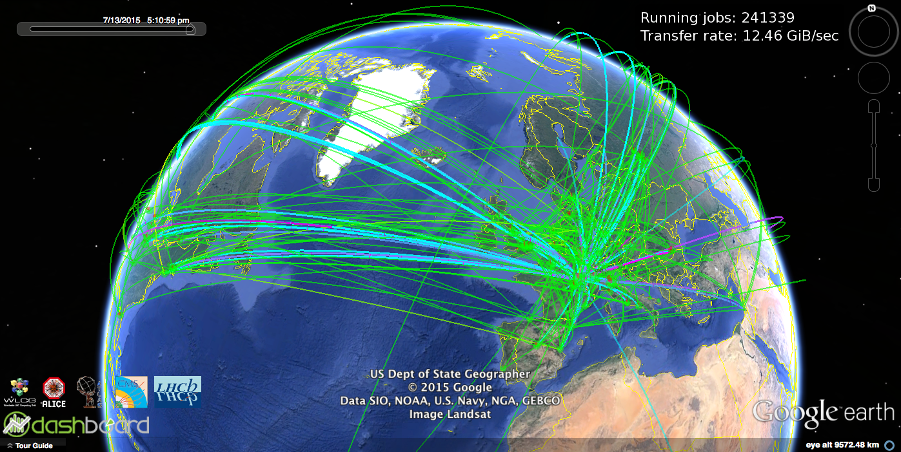
FTS3
FTS stands for “File Transfer Service”
Used by ATLAS, CMS and LHCb. CERN production instance transferred ~10PB during June

Slide 4
FTS3
FTS3 matches at least HBP UC1, being specialized for high throughput, mission critical massive transfers
Just submit source and destination files to the queue
The smart scheduler automatically adapts to the storage and network link capacities
Third-party transfers (for max throughput)
Built-in retry mechanism
Transfer protocol-agnostic
Extremely rugged and well tested

Slide 5
FTS3
Provides a complete REST API
  JSON messages
Easy to integrate in other platforms
Messaging supported
  No need for polling if client uses it
No need for deep technical knowledge to operate it

Slide 6
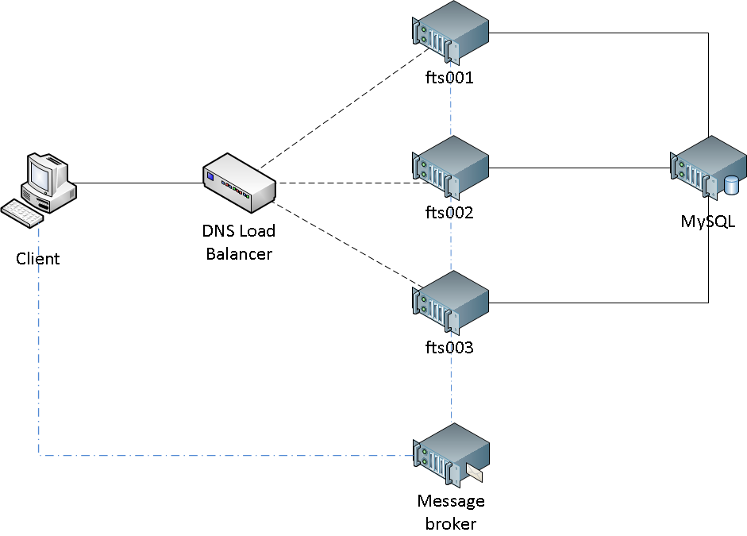
FTS service deployment diagram
A typical deployment of the FTS service
Can be replicated in more than one site

Slide 7



What is WebFTS?
https://webfts.cern.ch
Web based tool to transfer files between grid/cloud storages
Modular protocol support
  gsiftp, http(s), xrootd and srm
  Cloud extensions: dropbox, CERNBox
Initial development funded by

Slide 8
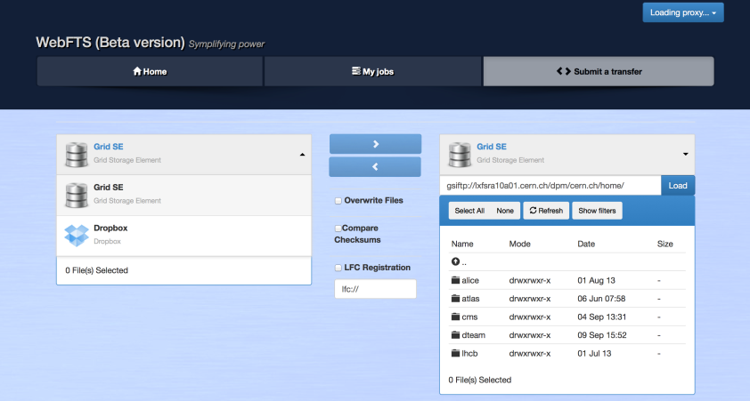
WebFTS

Slide 9
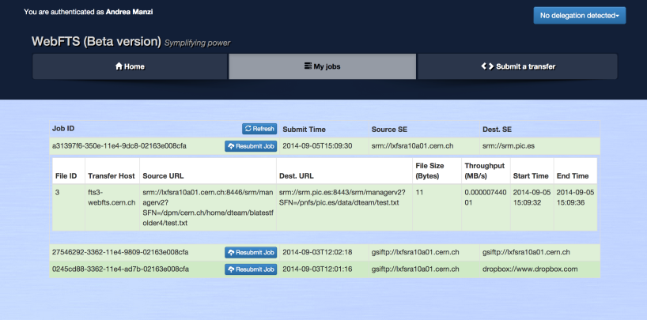
WebFTS

Slide 10
Dynamic Federations
An interactively browsable system able to dynamically discover its metadata content and transparently present it to the clients
Supports HTTP(s) and S3, replicas, hierarchical listings and writing into the federation
Browse and access a huge repository made of many sites without requiring a static index
  No “registration”, no maintenance of catalogues
  If catalogues are needed, can talk to more than one at the same time or just be agnostic
Redirect intelligently clients asking for replicas
  Automatically detect and avoid sites that go offline
Efficient with algorithmic name translations
  Can also accommodate non algorithmic ones
Accommodate client-geography-based redirection choices
Dynamic partial namespace caching: fast and scalable
  Top constant speed is in the order of 7-10K transactions per sec per frontend machine

Slide 11

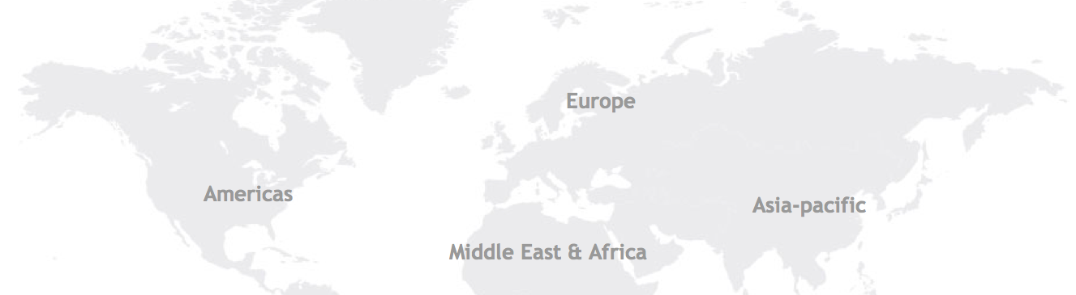

On the fly friendly visualization
Full WebDAV access
Redirection-based
Robust against failures
Fully scalable
With 2 replicas
/dir1
/dir1/file1
/dir1/file2
/dir1/file3
DESY Prototype:
14/15 LHCb sites
60 ATLAS sites
Geography-based
Client-aware redirections
Improves as HTTP deployment improves
Curl/Wget clients just work
Full WebDAV power
Using DAVIX
Site A
(HTTP/S3)
Site B
(HTTP/S3)
.../dir1/file1
.../dir1/file2
.../dir1/file2
.../dir1/file3

Slide 12
Dynafed HBP use case
Dynafed matches UC2: there are brain researchers interested in navigating through existing brain scans using a Web browser
Dynafed is designed to ease access to large worldwide distributed repos through browsers and HTTP/WebDAV clients
It can show the full HBP repositories in a browser
Resilient to site downtimes and glitches
Agnostic to the data management system that is used to populate storage in the sites
  HBP has their own
  Works better if the DM system does not mangle filenames
Agnostic to the foreseen POSIX access to the data locally in the sites
Agnostic to the presence of FTS moving files around
Can build Web apps on top of it, using normal Web tools

Slide 13
Simple assumptions
Each site’s content is accessible via HTTP/DAV to the other sites (at least)
Same path/name means same file (modulo a site prefix)
    /<pfx of site A>/data/prod01/myimage.jpg
    /<pfx of site B>/data/prod01/myimage.jpg
    http://lxfsra04a04.cern.ch/dpm/cern.ch/home/dteam/dynafeds_demo/everywhere/file_1000.txt
    http://sligo.desy.de:2880/pnfs/desy.de/data/dteam/dynafeds_demo/everywhere/file_1000.txt
    Federated as: http://federation.desy.de/fed/dynafeds_demo/everywhere/file_1000.txt
  More complex forms of translation are possible. Simpler is better.
Replicas and folders across sites must have homogeneous access rights (e.g. groups)
  In the S3 case the federator can apply S3 delegation
All participating sites allow the federator to read file metadata (HEAD and PROPFIND) in the federated folders

Slide 14
Dynafed Deployment
If the assumptions are met, deployment is a matter of well planning a worldwide structure of storage elements exposing HTTP/WebDAV
  If some are not met, things just become more difficult. Advice: keep it simple.
Dynafed is lightweight, multicore-friendly and trivially scalable
Best start is to setup one federator in a place that minimizes latency to its clients
The federator is configured with:
  Proper credential accepted for reading metadata
  a list of WebDAV URLs that compose the federation
  A recent version of GeoLiteCity ™ Also works with the free one (less precise)
Hardware: best is >8 cores, >16GB, non virtualized (very high transaction rate, low throughput)
  If several DNS-balanced frontends are needed in the same site, one will be dedicated to memcached for all the others

Slide 15
Security deployment
Each site exposing HTTP/WebDAV is responsible for:
  Managing group (ev. VOMS) permissions (ev. ACLs) for the HBP directories
  Following HBP rules for allowing access to shared folders
  Translate them into proper ACLs/groups/etc.
  Allow the Dynamic Federator to do HEAD and PROPFIND on all the material that has to be seen through HTTP/WebDAV

Slide 16
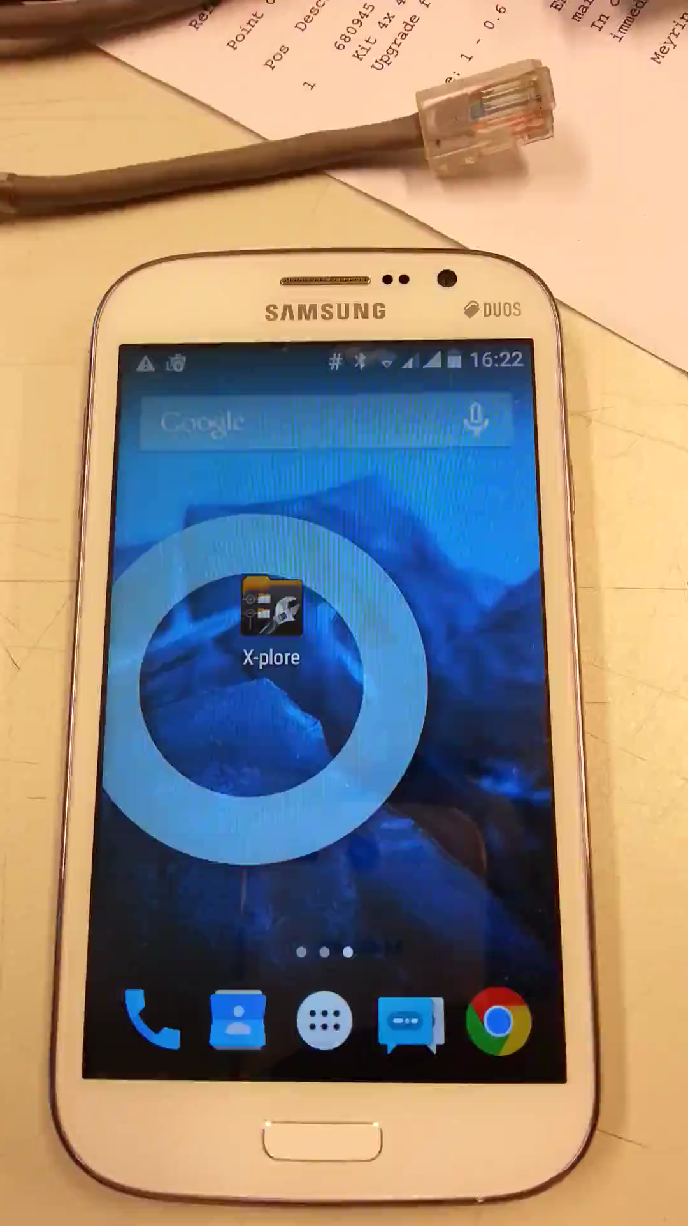
Easy access
Main Dynafed testbed with dozens of Grid endpoints and several demos
The file being accessed is hosted in an XrdHTTP instance… somewhere. We don’t know and we don’t want to. Just want the file.
Data discovery is dynamic, no static indexing involved
The HTTP ecosystem can give unprecedented flexibility to Grid data access, fully supporting the historical Grid workflows

Slide 17
For more info
Dynafed homepage: http://lcgdm.web.cern.ch/dynamic-federations
Full Dynafed documentation: https://svnweb.cern.ch/world/wsvn/lcgdm/ugr/trunk/doc/whitepaper/Doc_DynaFeds.pdf
FTS: http://fts3-service.web.cern.ch/
Web FTS homepage: https://webfts.cern.ch/
fts-support@cern.ch
DAVIX (powerful client) : http://dmc.web.cern.ch/projects/davix/home

