Slide 1
Onedata for Human Brain Project
Lukasz Dutka
Cyfronet AGH

Slide 2
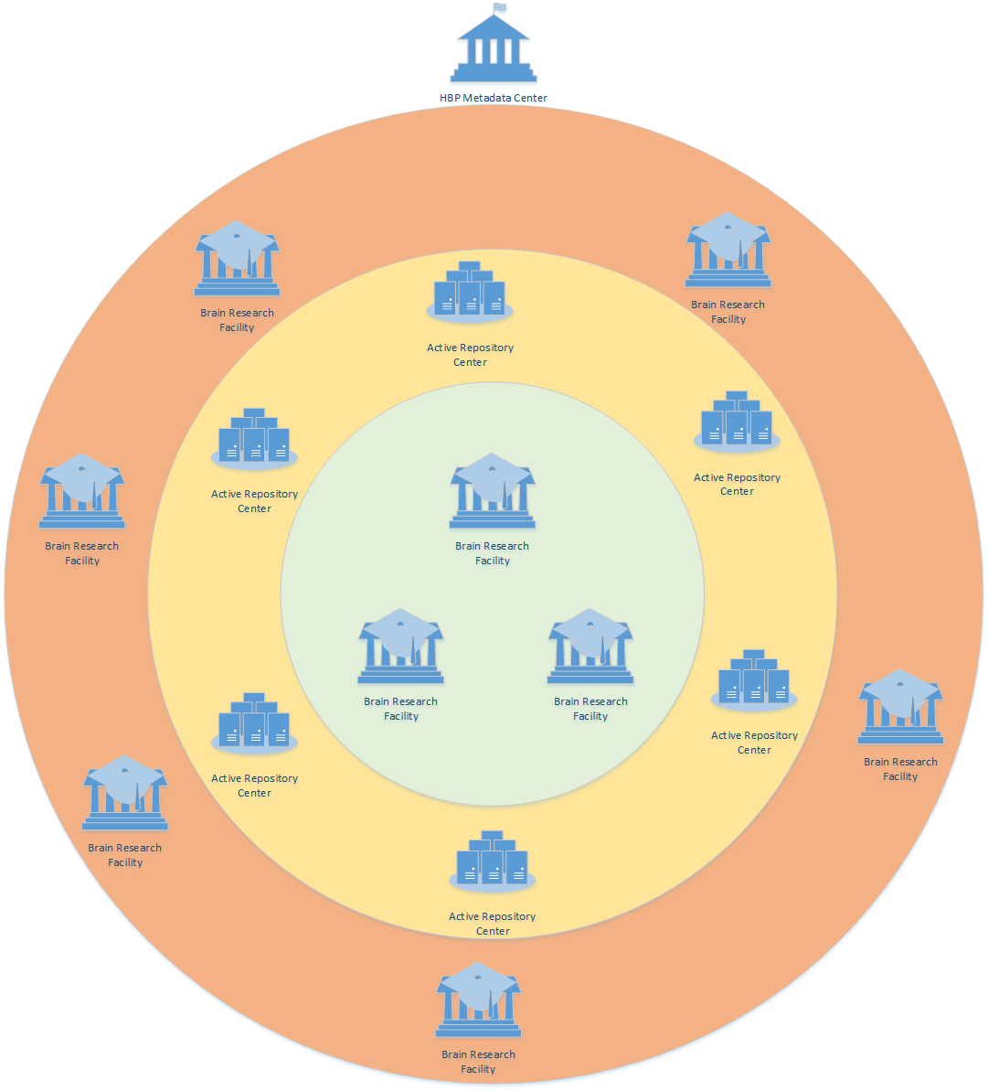
Distributed HBP Infrastructure

Slide 3
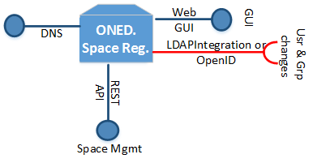
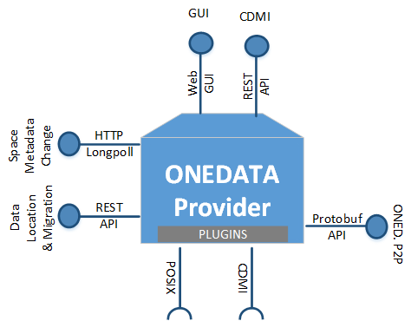
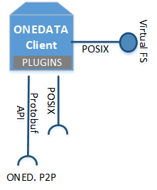
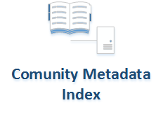
Onedata Components
For Community Data Spaces Mgmt.
Works with OpenID
out of the box but groups
might need to integrated
(LDAP or API)
For Authentication
For POSIX Virtual FS
For In-site Orchestration
and data migration
Metadata, Control
Data if no direct way
Direct access
only if possible
For metadata indexing
Storage

Slide 4
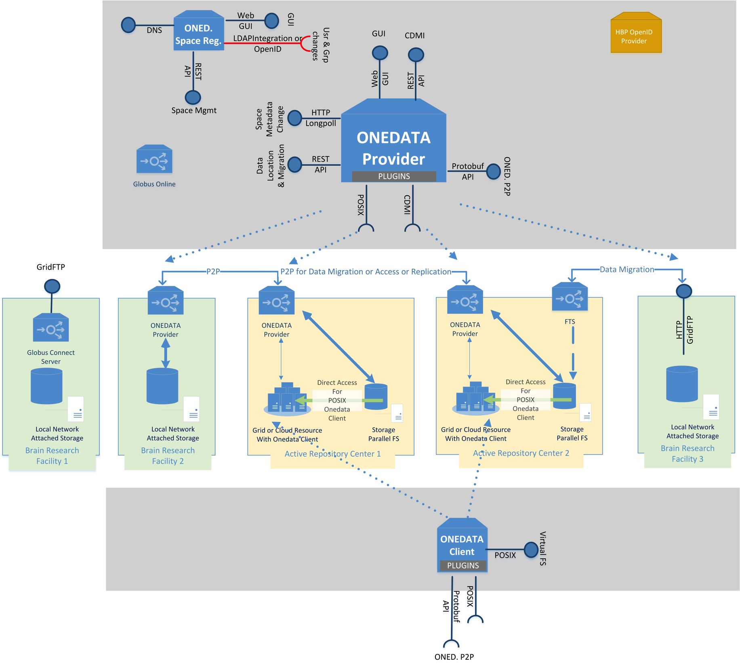
Onedata Components Deployed on HBP Infrastructure
OpenID at all levels
Provider is scalable
It can work as
a gateway to
NAS Storage
Can work as a data orchestrator in large data centres

Slide 5
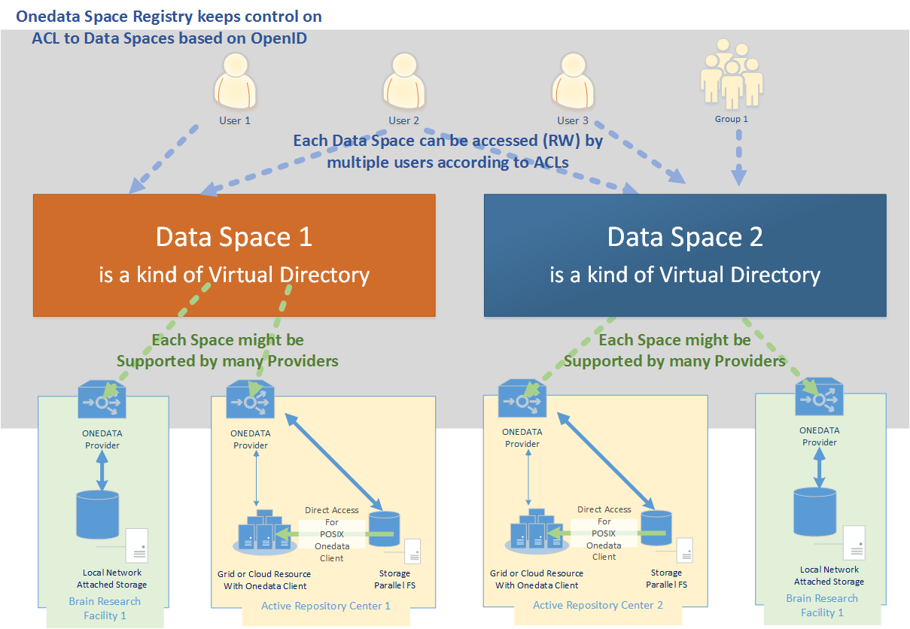
Onedata Spaces
Metadata change feed
Metadata change feed

Slide 6
Prerequisites
Sites involved in the loop should deploy Onedata Provider basing on the resources they have
Users are registered in HBP OpenID Registry
It should be defined strategy for creation data spaces:
based on the ownership of data.
each data space has own administrator managing rights
onedata providers might support individual data spaces according their own policy
each space should be supported at least by one “Active Repository” and “Brain Research Facility” for transfer data.
Community metadata indexing service
(for example based on elasticsearch)
should register to the dataspaces’ live feeds in order to index in one place metadata crom many data spaces

Slide 7
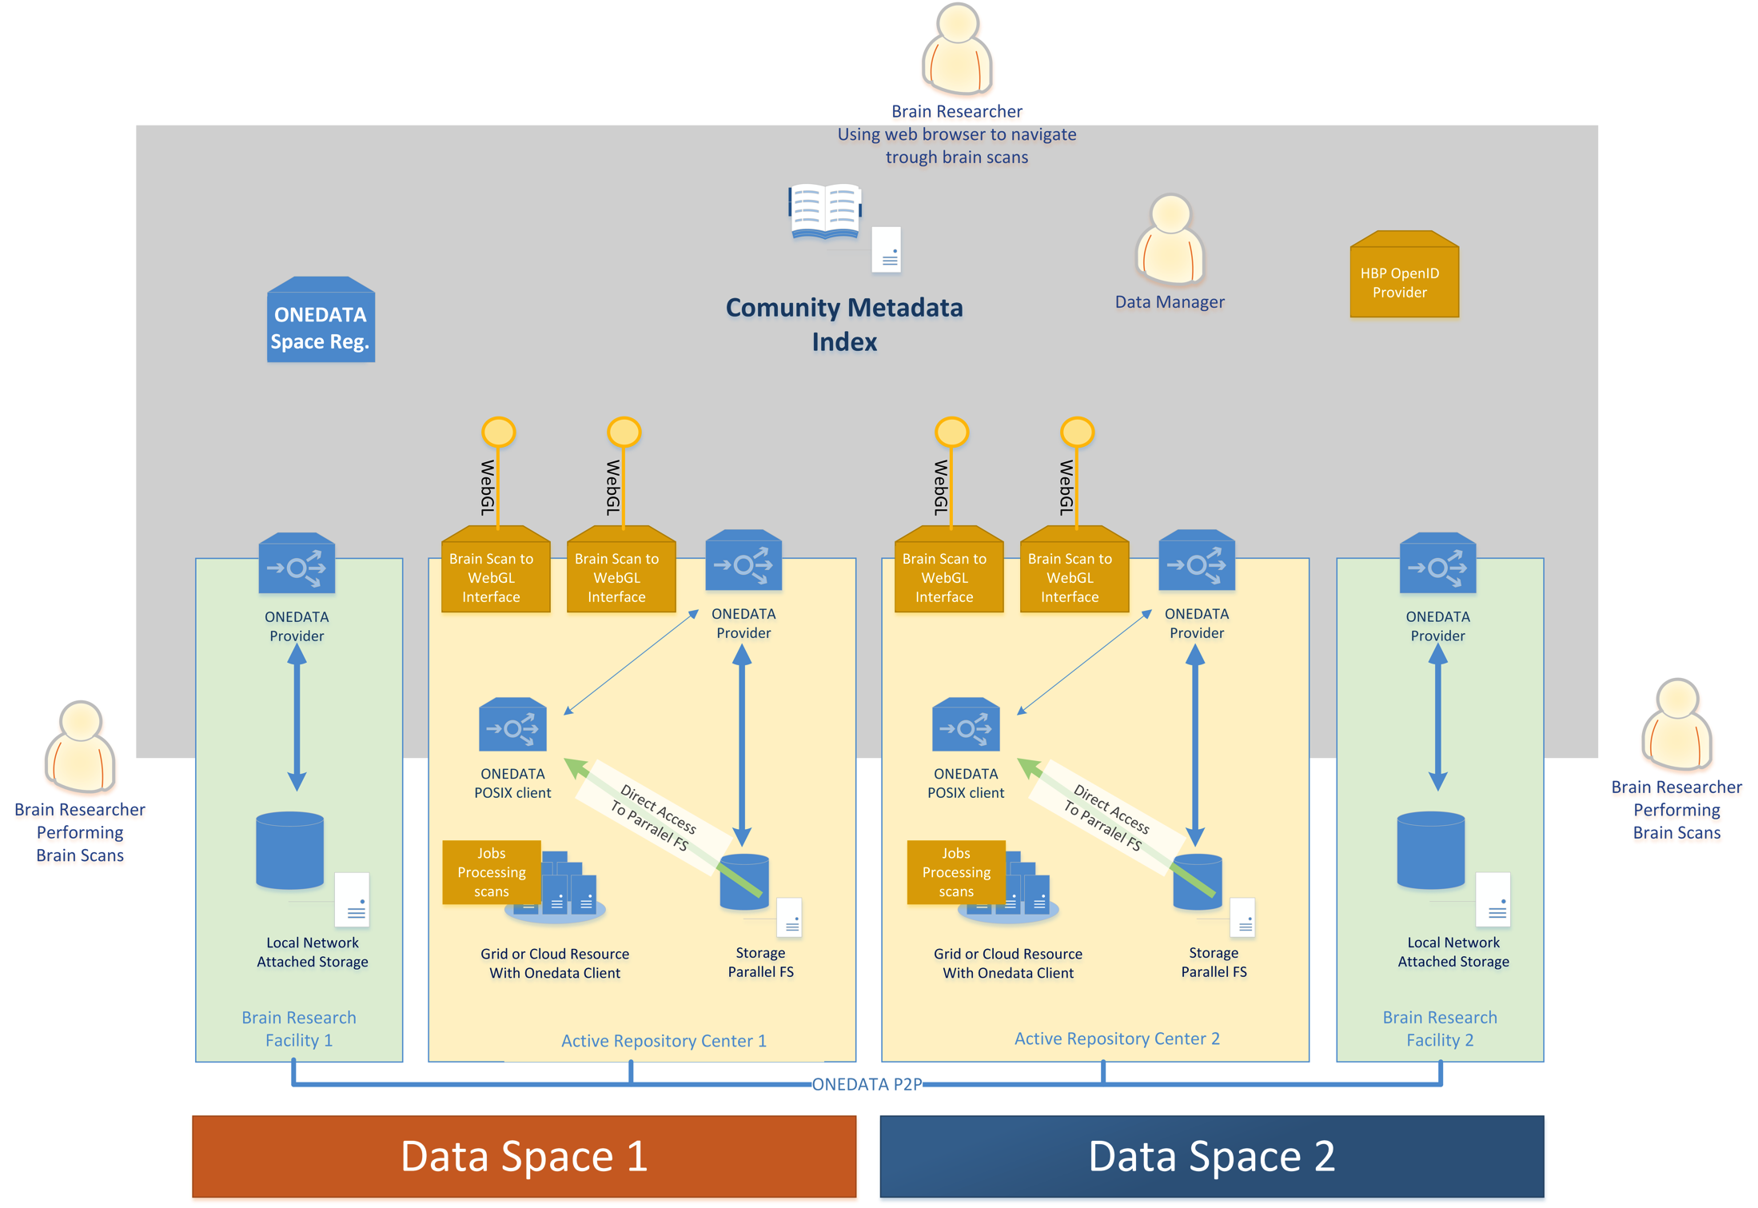

Slide 8
Use Cases Summary
UC1: Brain Scan Creation
Fully supported including efficient data transfer between sites and metadata management
UC2: Remote interactive multiresolution visualization of large volumetric datasets
Fully supported including ACL aware access to the data
UC3: Feature extraction and analysis of large volumetric datasets
Fully supported including cloud or grid infrastructures
UC4: Publication and citation of data
Not supported yet, It will be supported by onedata extension developed for EGI Engage called Open Data Platform
UC5: Management of Access Control Rights
Fully supported, keeping ACL aware at all access level.
Integrated with OpenID out of the box
Supporting concepts of multiple communities keeping ACL to their data by their own
ACLs at levels of data spaces and individual files

