Slide 1
Using iCOMCOT

Slide 2
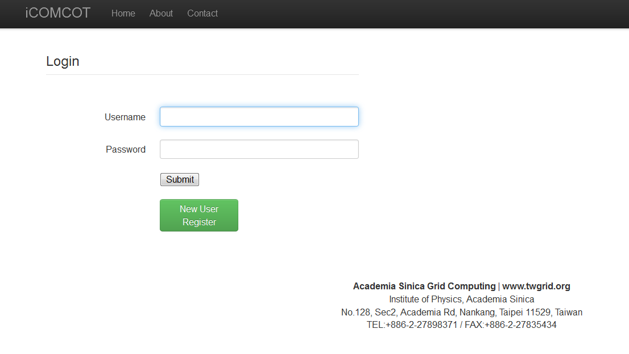
http://icomcot.twgrid.org/
iCOMCOT Homepage
Log in
Account Application

Slide 3
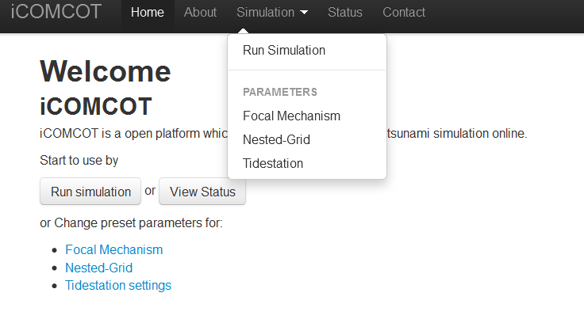
Are you ready? Let’s go!
Simulation starts from filling in the parameters of Focal mechanism

Slide 4
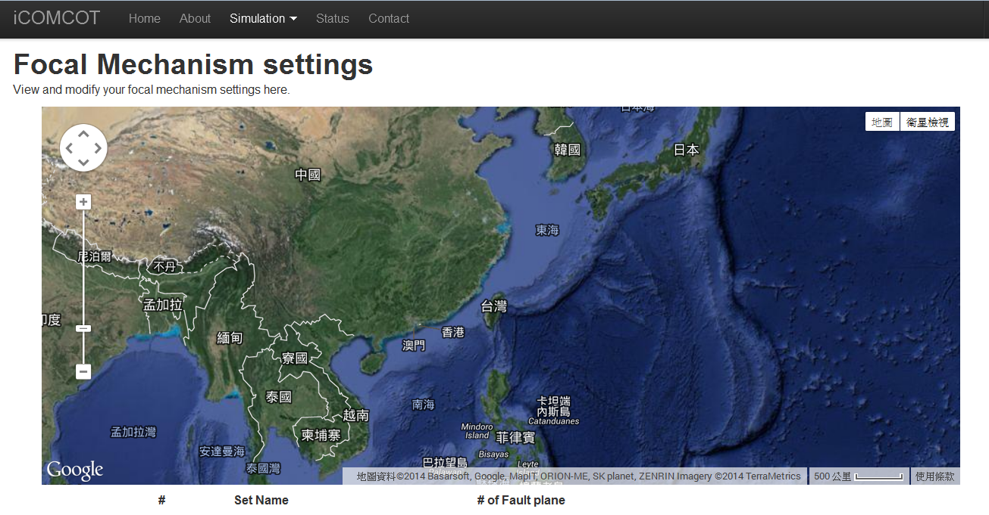
我們先來設計一個花蓮外海的地震，斷層的長寬和滑移量，對等於一個規模7.1的地震!
Name of the earthquake
Dimension of fault: L(km) x W(km) x D(m)
Longitude & Latitude of epicenter)
Depth of hypocenter
Angle of Stike, Dip and Rake

Slide 5
Define the Simulation Space

Slide 6
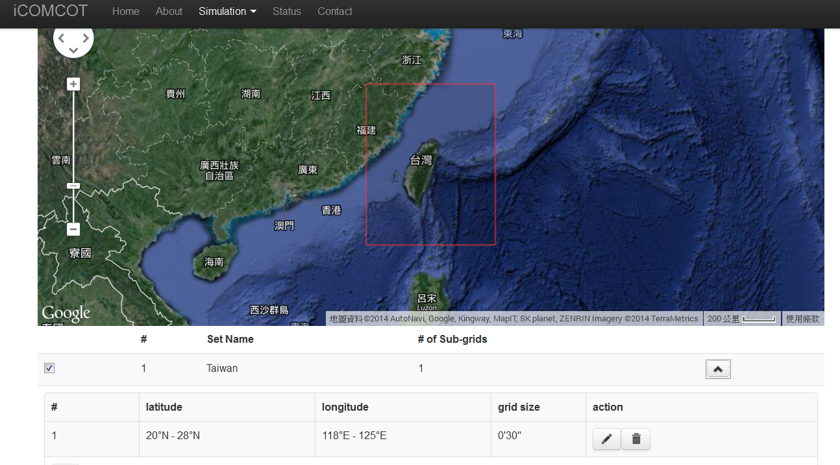
Example of areas surrounding Taiwan
Range in degree of Long & Lat
Generate a wave height per 30 minute (around 50km)

Slide 7
Define the observation point

Slide 8
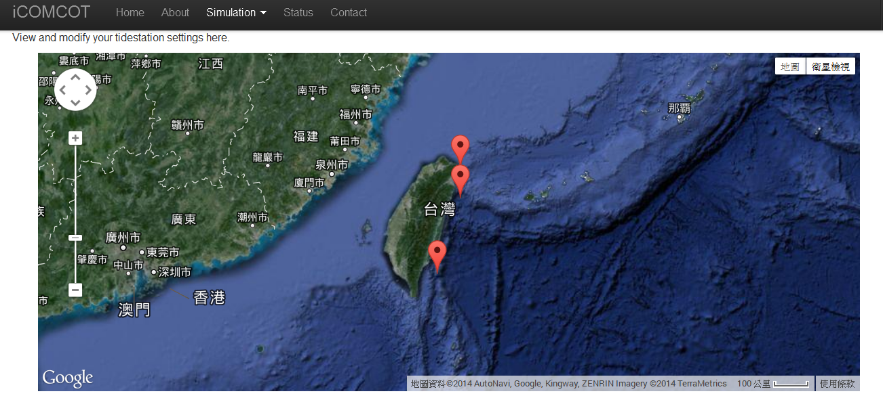
Three observation sites selected in east coast of Taiwan
Exact location defined by long & lat.

Slide 9
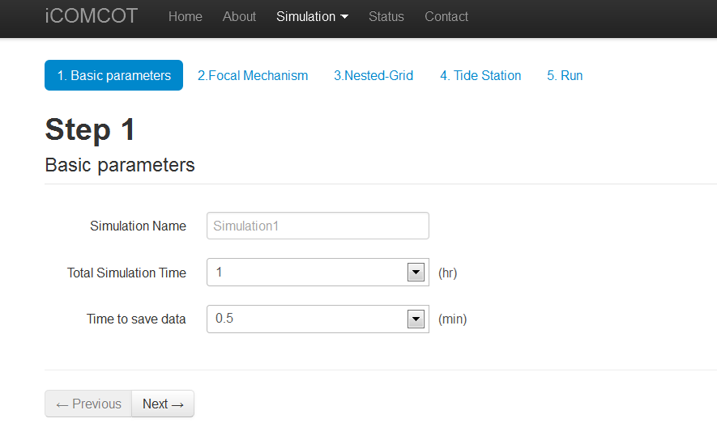
Start to run by choosing “Run Simulation” from the menu bar
Time range of simulation
Generate data set in what cycle (in minute)

Slide 10
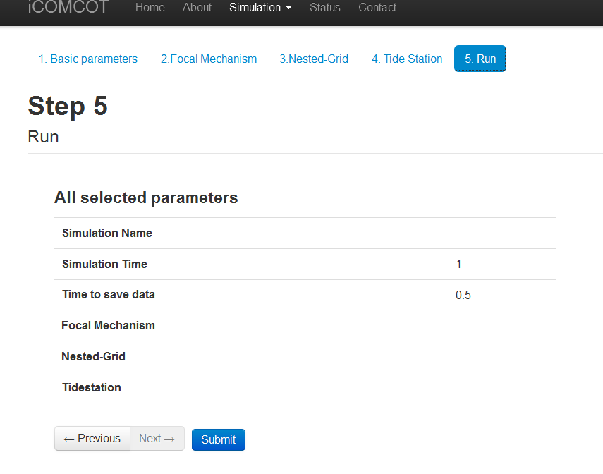
Submit and Start Simulation

Slide 11
Checking Status of the Simulation
Status is “Done” when simulation is finished
Check Results
Save Results in your local computer

Slide 12
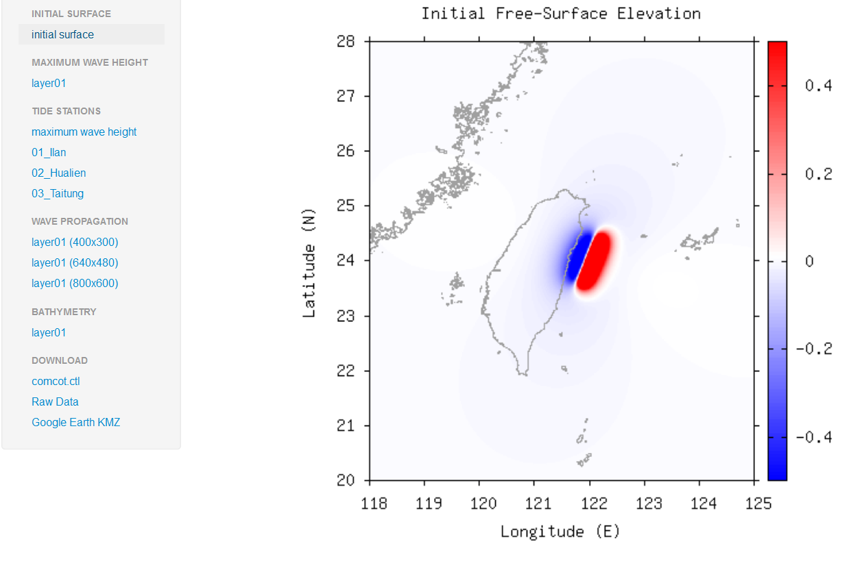
Result: Initial surface

Slide 13
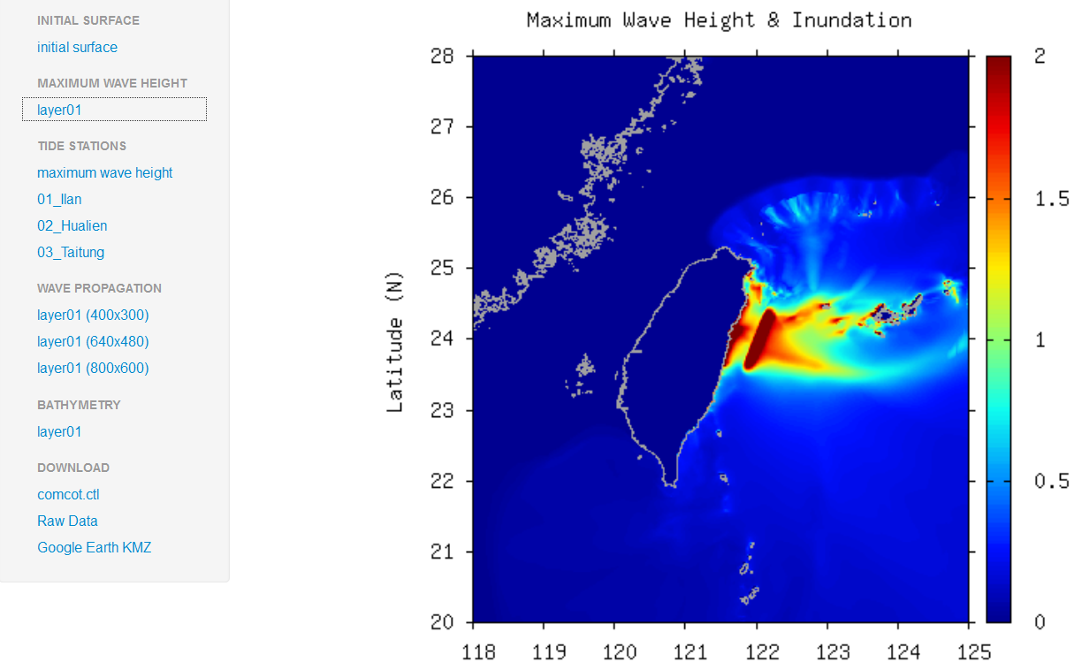
Result: Maximum wave height

Slide 14
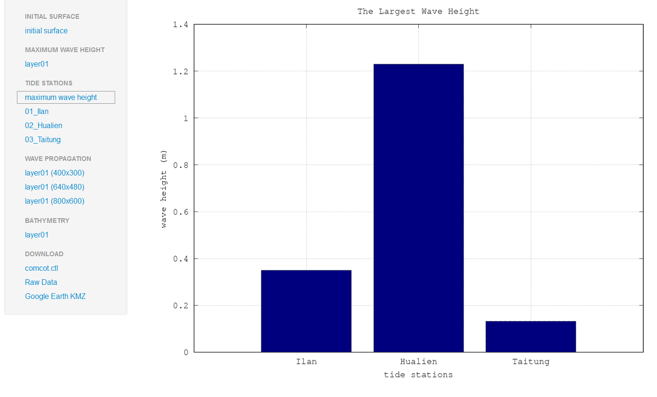
Result: Tide stations

Slide 15
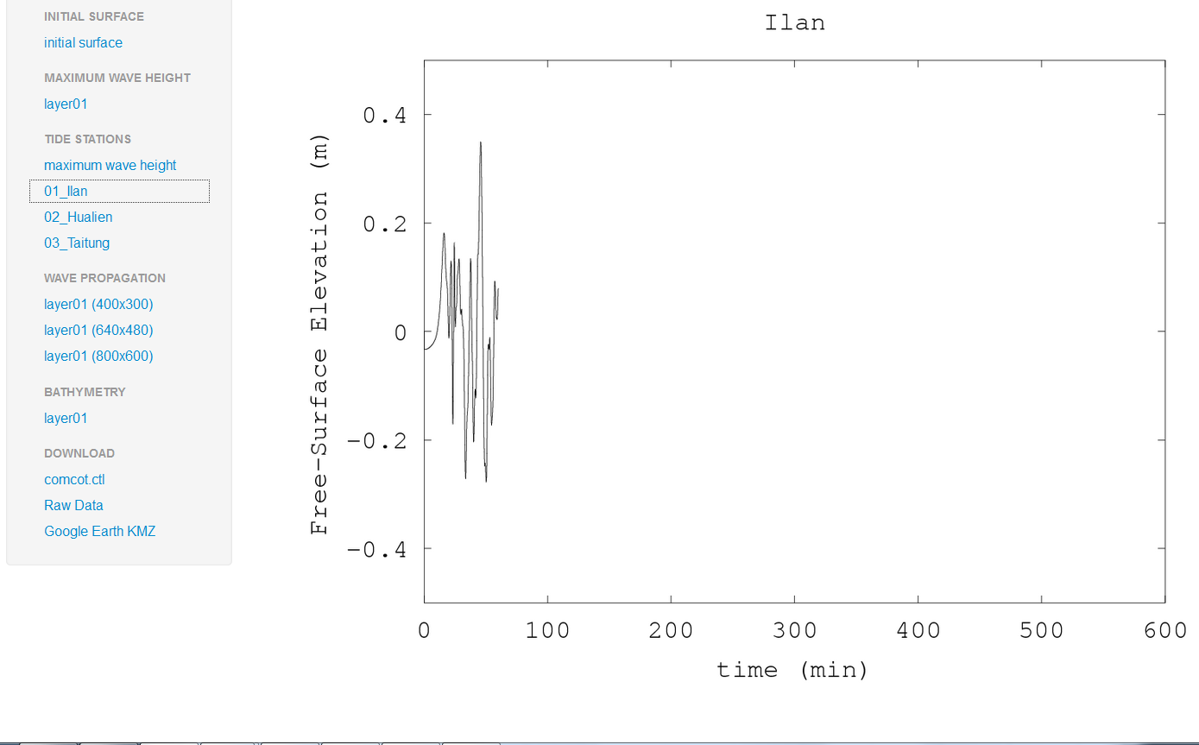
Result: Wave Height of one Tide station (Ilan)
Only 1 hour simulation in this case according to the input parameter
Time of the maximum wave height and the changes of the wave height could be observed

Slide 16
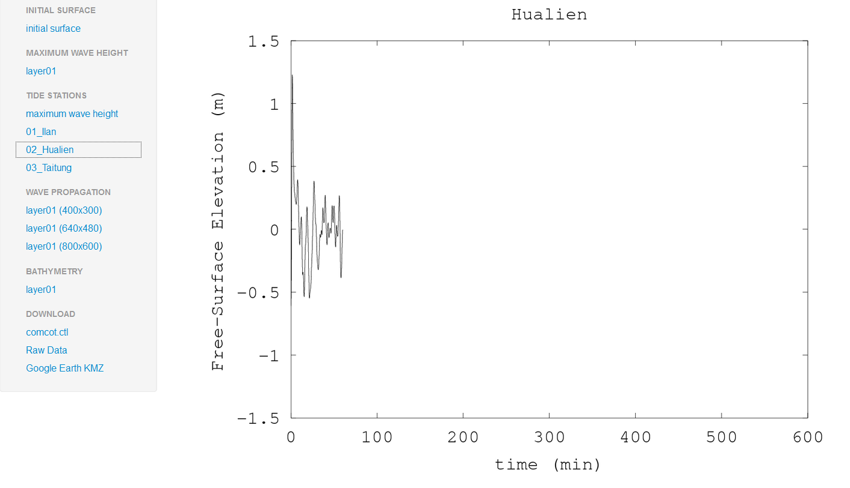
Result: Wave Height of one Tide station (Hualien)

Slide 17
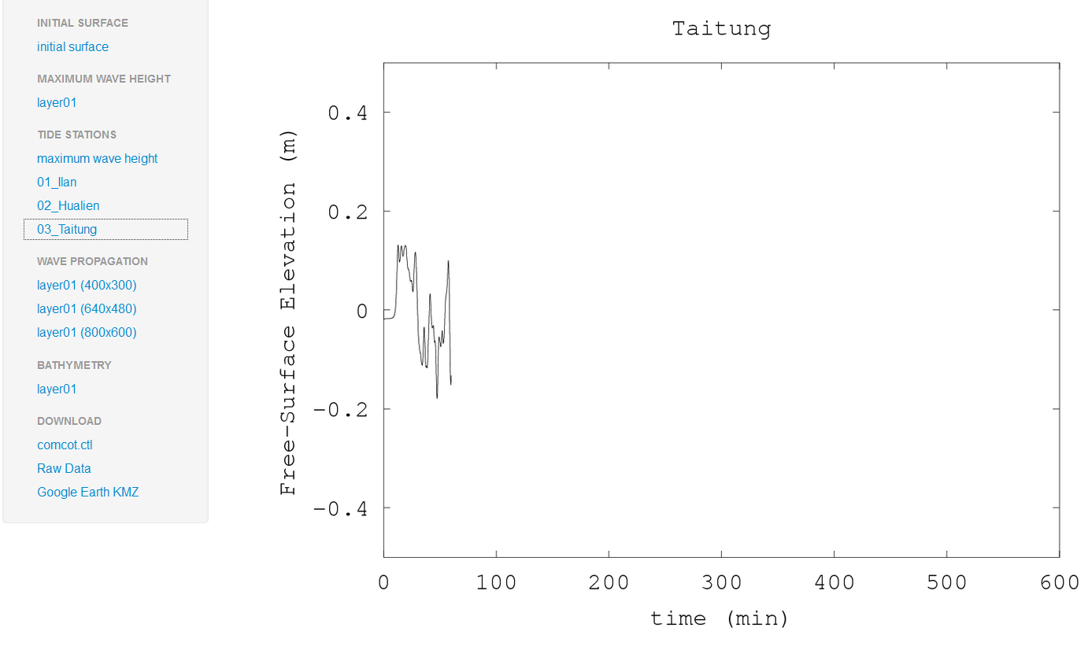
Result: Wave Height of one Tide station (Taitung)

Slide 18
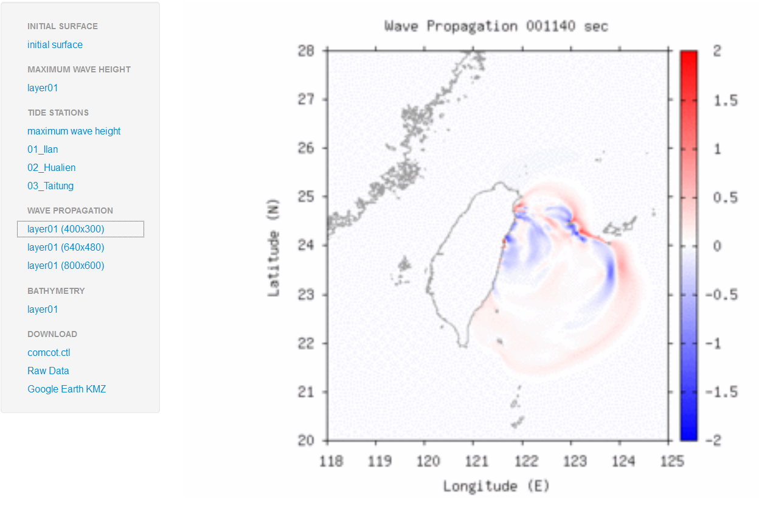
Wave propagation in Animation

