Slide 1
Disaster Mitigation Competence Centre Project Meeting
Coordinator: Simon Lin
July 28, 2015

Slide 2
Reminder
Please mute your microphone if you are not speaking
Please do not turn video on to ensure good audio quality
Should you have any material to share, please send it to everyone. Eric will put it on the Indico page

Slide 3
Agenda
Introduction (Simon Lin)
From Previous Meeting on July 7, 2015 (Eric Yen)
Progress Report (Eric Yen)
Partner Status Report
Discussion
Future Events
AOB

Slide 4
Minute of DMCC Project Meeting on July 7
1630-1730, June 23, 2015 (Taipei Time) at WebEx Virtual Room
Participants: Vicky and Eric (TW), Cerlane (DE), Rafael (PH)
Progress Report & Discussion:
Progress of identified case studies from partners: PH, TW
Training Plan at APAN40 and ISGC2016
Agenda of next DMCC F2F meeting at APAN40
Task force initiation for the regional e-Infrastructure implementation
Action Items
Case Study: workflow, training and data collection
F2F @ APAN40: bring your user(s)
Next Meeting: July 28, 2015

Slide 5
Agenda of DMCC F2F Meeting at APAN40
Date & Time: 1330-1730, Aug. 11, 2015
Tentative Agenda
Session I (13:30 – 15:30) : Chaired by Prof. Simon C. Lin
DMCC Status Report (ASGC): 20 min
Progress Report from all members : 40 min
Case study, user community engagement, requirements, etc.
Thematic Talk 1 -- Tsunami and Storm Surge Simulation (Prof. TR Wu from NCU, TW): 30 min
Thematic Talk 2 -- Weather Simulation and Analysis (Prof. CY Lin from AS, TW): 30 min
Session III (16:00 – 17:30) : Chaired by Prof. Simon C. Lin
Presentation 1 -- Telecommunication Towers Assessment System In Consideration of Earthquake Effects in Malaysia (Malaysia) : 20 min
Presentation 2 -- The Importance of Seismic Mapping for Telecommunication Towers Considering Earthquake Effects in Malaysia (Malaysia) : 20 min
Training by Demonstration of iCOMCOT: 30 min
General Discussion

Slide 6
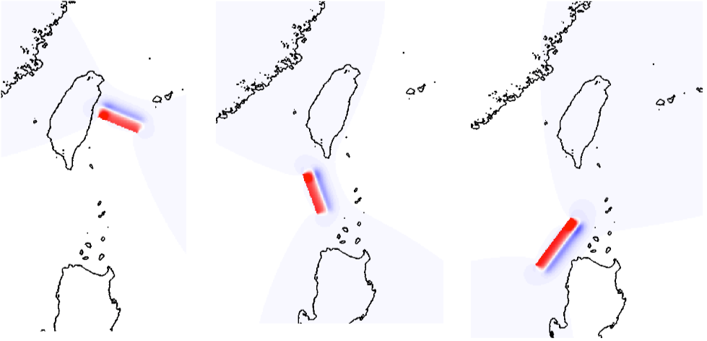
iCOMCOT for Tsunami Simulation http://icomcot.twgrid.org Please apply your account and start to work. Demonstration/Training will be arrangement in next F2F or future meetings.

Slide 7
Discussion I: Progress of Case Study
Buildup reliable modeling and simulation for future events analysis
Data Collection: observation data from tidal gauge, rainfall (hourly, daily), radar, satellite, etc., the more the better
Impact Assessments of Tsunami Hazards from Manila Trench (AS)
Tidal gauge data in PH, VN, TW, and iCOMCOT
Historical Tsunami in South China Sea (AS)
By Reverse Tracking Method for potential tsunami sources with iCOMCOT
Storm Surges Cases in PH and TW (AS)
Thailand Floods in 2011 (TH)
https://en.wikipedia.org/wiki/2011_Thailand_floods
Malaysia Floods in 2014-15 (MY)
https://en.wikipedia.org/wiki/2014–15_Malaysia_floods

Slide 8
Discussion II
Regional Infrastructure and Integration with Application Portal: simplified and flexible infrastructure, Application platform and resource access
AAI, VO, Operation, Data Management, AP development, Federated Cloud Architecture, etc.
Need a task force to review the EGI services and related EU project products, then plan for the implementation: 3 months ?
EGI CF2015
Time & Place: 10-13 Nov. 2015, Bari, Italy
contributions from DMCC
DMCC Face-to-Face Meeting: 90 min
Tsunami Simulation by iCOMCOT: Presentation

Slide 9
Next Meeting & Future Events
Aug. 10-14, APAN40, Kuala Lumpur, MY
Aug. 11, DMCC face-to-face meeting (& training)
Aug. 25, Progress Checking
Sep. 8, Progress Checking
EGI CF2015, 10-13, Nov. 2015, Bari, Italy
Environmental Computing Workshop, ISGC 2016

